Slide 1

Doing Data Science
Live Session: Unit 11
Dane Holmes

Slide 2
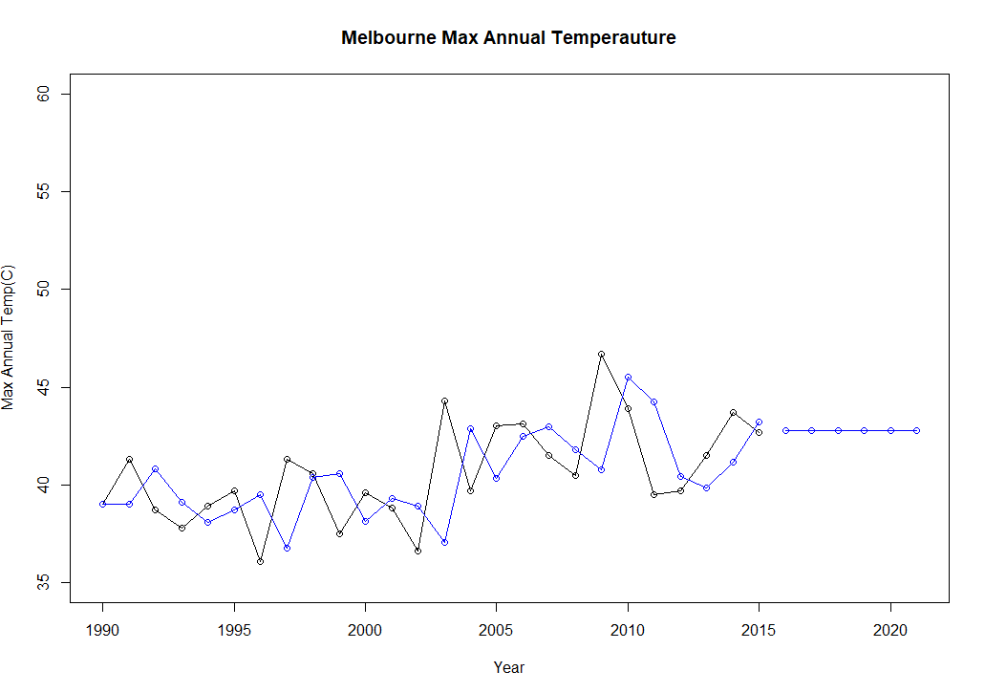
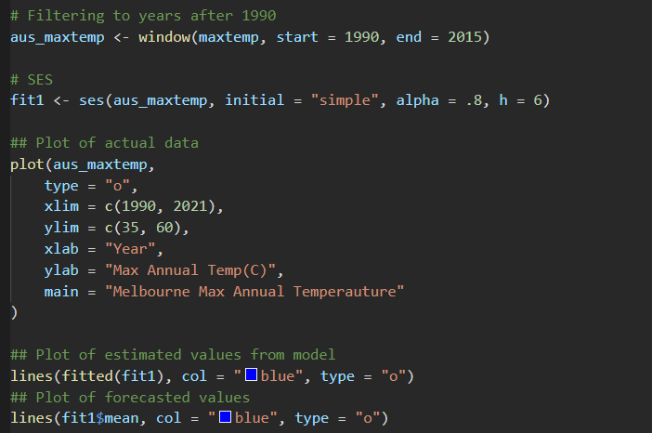
Part 1
AICc & BIC are not available for a SES model, so I used the Residual Mean instead.
MASE = 0.8829
Mean(Residuals) = 0.1826

Slide 3
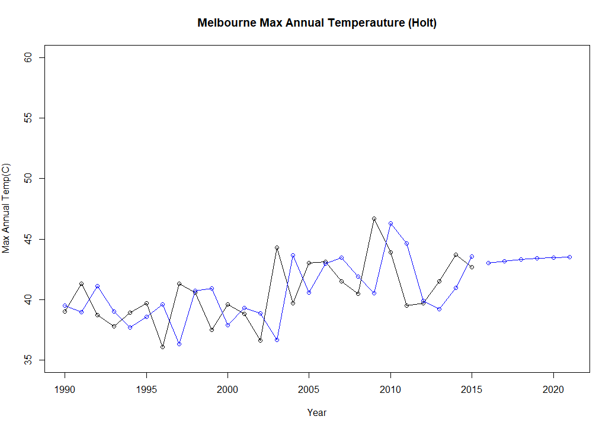
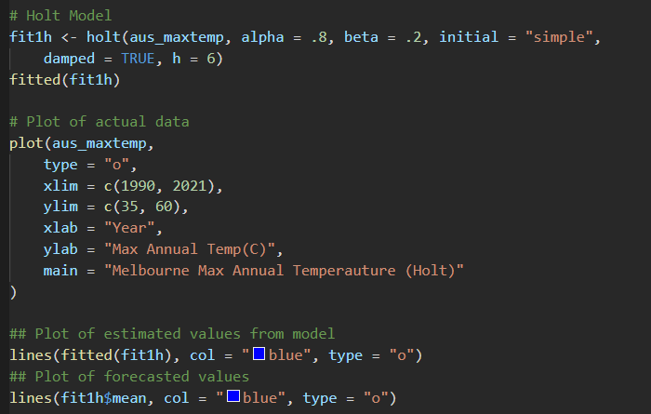
Part 2
AIC
150.67
AICc
152.78
BIC
155.70
MASE = 0.9640
Mean(Residuals) = 0.1078

Slide 4
Part 3
SES
MASE = 0.8829
Mean(Residuals) = 0.1826
Holt
MASE = 0.9640
Mean(Residuals) = 0.1078
Best Model by Metric
Mean(Residuals):
Holt
MASE:
SES Model

Slide 5
. Takeaways and/or Questions
I found the material to significantly harder to follow along with without the RMD file. I didn’t realize that the code was in the Live Session file.
I also though this lesson in general was harder to follow along with. It felt like I was already supposed to know some of the things being discussed. I believe the lessons would be well served to be longer and more detailed about the differences between additive and multiplicative modeling.
With all the formulas that were discussed, how familiar do I need to be with each of them and their structure?
I don’t feel like the connection between the R functions and the formulas was made very clear.
In general, it feels like this week needs to be redone in the format of other weeks.

