Slide 1

Doing Data Science
Live Session: Unit 1
Dane Holmes

Slide 2
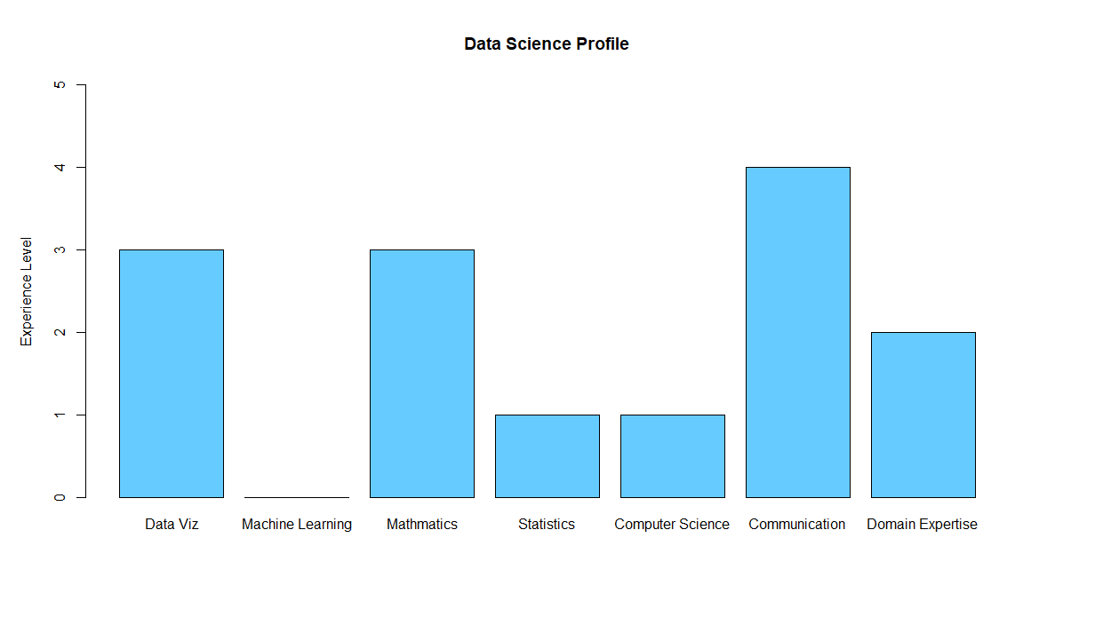
1.Data Science Profile

Slide 3
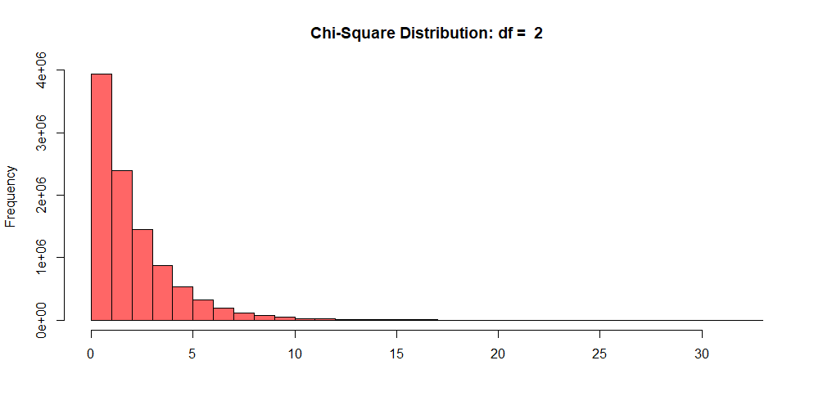

2.CLT: Chi-Square Distribution
N = 10,000,000
$$μ=2.000197$$
$$σ=2.000716$$

Slide 4
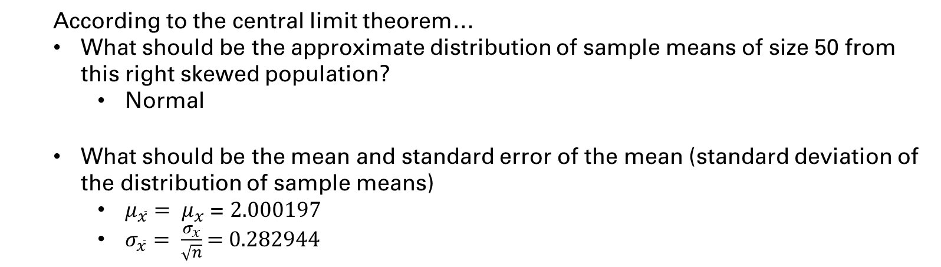
2.CLT: Chi-Square Distribution
cont.
According to the central limit theorem…
What should be the approximate distribution of sample means of size 50 from this right skewed population?
Normal
What should be the mean and standard error of the mean (standard deviation of the distribution of sample means)
$μ_{\overline{x}}= μ_{x}$ = $2.000197$
$σ_{\overline{x}}= \frac{σ_{x}}{\sqrt{n}}$ = 0.282944

Slide 5
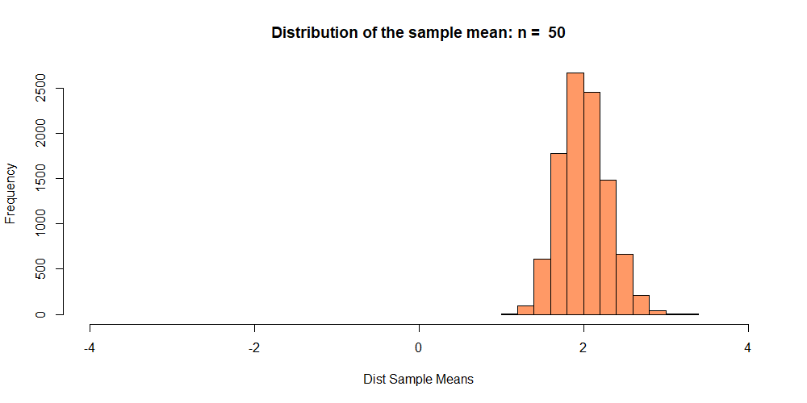
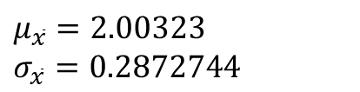
2.CLT: Chi-Square Distribution
cont.
$$μ_{\overline{x}}=2.00323$$
$$σ_{\overline{x}}=0.2872744$$

Slide 6
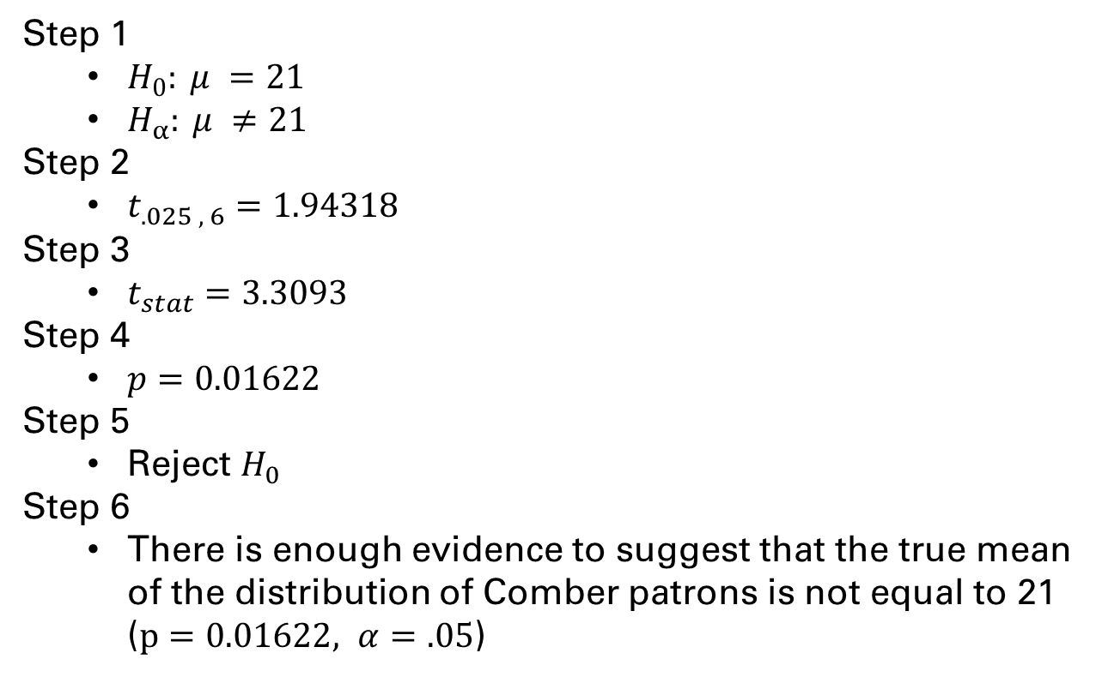
3. T-Test
Step 1
$H_{0}: μ =21$
$H_{α}: μ ≠21$
Step 2
$t_{.025 , 6}=1.94318$
Step 3
$t_{stat}=3.3093$
Step 4
$p=0.01622$
Step 5
Reject $H_{0}$
Step 6
There is enough evidence to suggest that the true mean of the distribution of Comber patrons is not equal to 21 ($p=0.01622, α=.05$)

Slide 7
4. Takeaways and/or Questions
R Markdown files create nice reports with code block, but the charts aren’t dynamic. This causes problems for pulling them into PP.
Can selected charts be pulled into the plots tab in R Markdown or is there another solution?
What is the proper way to show conclusions in R Markdown, if at all?
Is there a reason to use bash commands over the GitHub Desktop app?

