Slide 1

Doing Data Science
Live Session: Unit 5
Dane Holmes

Slide 2
1. Restaurant Data from Baltimore
5.5 Strings | Regular Expressions, Part 2
For live session, fix the problem, and reproduce the plot.

Slide 3
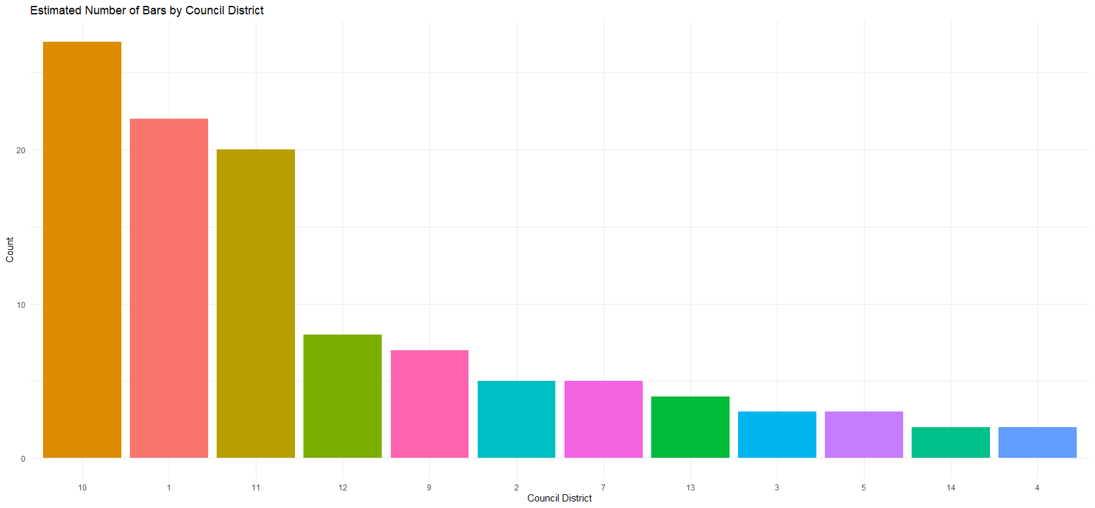
1. Restaurant Data from Baltimore
cont.

Slide 4
. Takeaways and/or Questions
For the Intrinio API, where do we find our username/password in the format of the rmd file?
I would love to explore stock prices with this API, but the lessons didn’t cover where they came from and the Intrinio API appears to be using a new method through their SDK, so the documentation doesn’t address this anymore.
APIs are extremely powerful but can be a huge headache because they are all unique in their methods/structure.

