Slide 1

Doing Data Science
Live Session: Unit 4
Dane Holmes

Slide 2
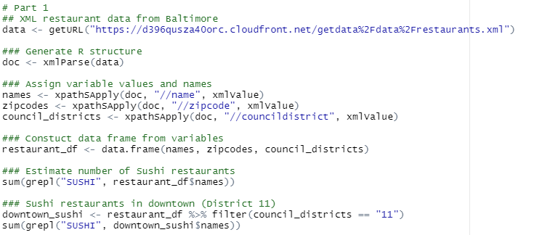
1. Restaurant Data from Baltimore
Est. Sushi Restaurants: 9
Est. Sushi Restaurants Downtown: 1

Slide 3
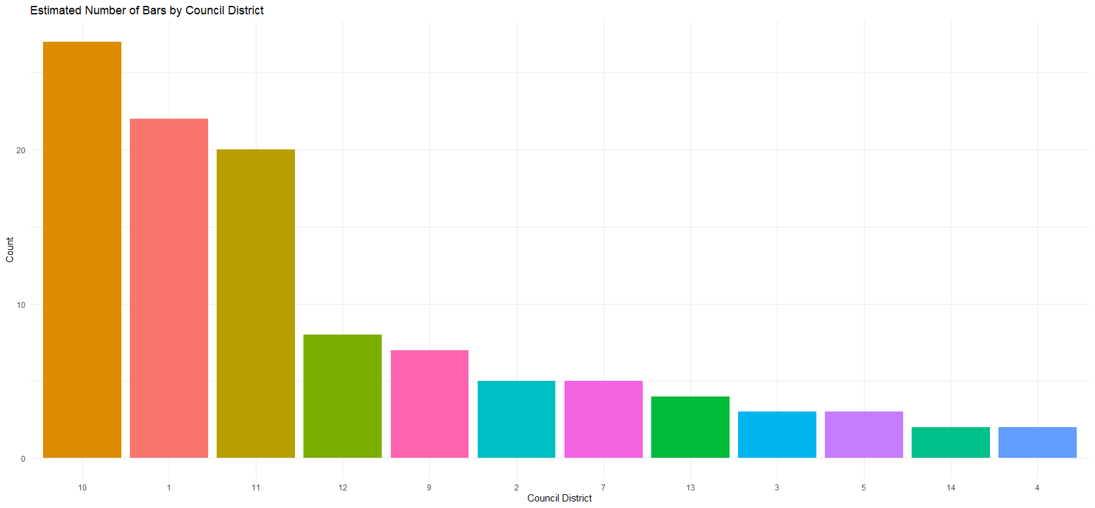
1. Restaurant Data from Baltimore
cont.

Slide 4

2. Freestyle
I chose to use data from The World Bank using their library(WDI). This package contains vast amounts of data on world metrics such as GDP, CO2 Emissions, Debt, Literacy Rate, and much more.
Process
Install package
Use the supporting xls file of identifiers from Unit 4 to explore data of interest.
I chose to focus on indicators containing water information.
This can also be found by using the WDIsearch(“water”) function to search for indicators about water.
The WDI() function allows you to define the country, indicator, and time period you want to download.
Either choose countries = “all” or explicitly choose countries.
It returns country_code, country, value, year
The value column changes based on the indicators you choose
Example

Slide 5
2. Freestyle
cont.
I chose to focus on GDP as it relates to Fresh Water Withdrawal
There are a couple indicators that shed some light on this relationship.
NY.GDP.MKTP.CD – GDP
ER.GDP.FWTL.M3.KD – Water Productivity (GDP/Total Fresh Water Withdrawal)
ER.H2O.FWTL.K3 – Annual fresh water withdrawal
ER.H2O.FWTL.ZS – Annual fresh water (% of total resources)
I used these four identifiers to explore the following,
which countries were producing the most/least water.
which countries were producing the most/least water compared to their available water.
is there a correlation between water production and GDP by region.
Did the highest producers correlate to the highest GDPs
The biggest challenge I faced when working with this data was the blending of countries with WDI created groups/regions. This made it very difficult to evaluate the entire population without filtering out country codes. I used the slice_max function to find the top 100 countries by GDP and manually select the regions instead of finding every group and excluding them.

Slide 6
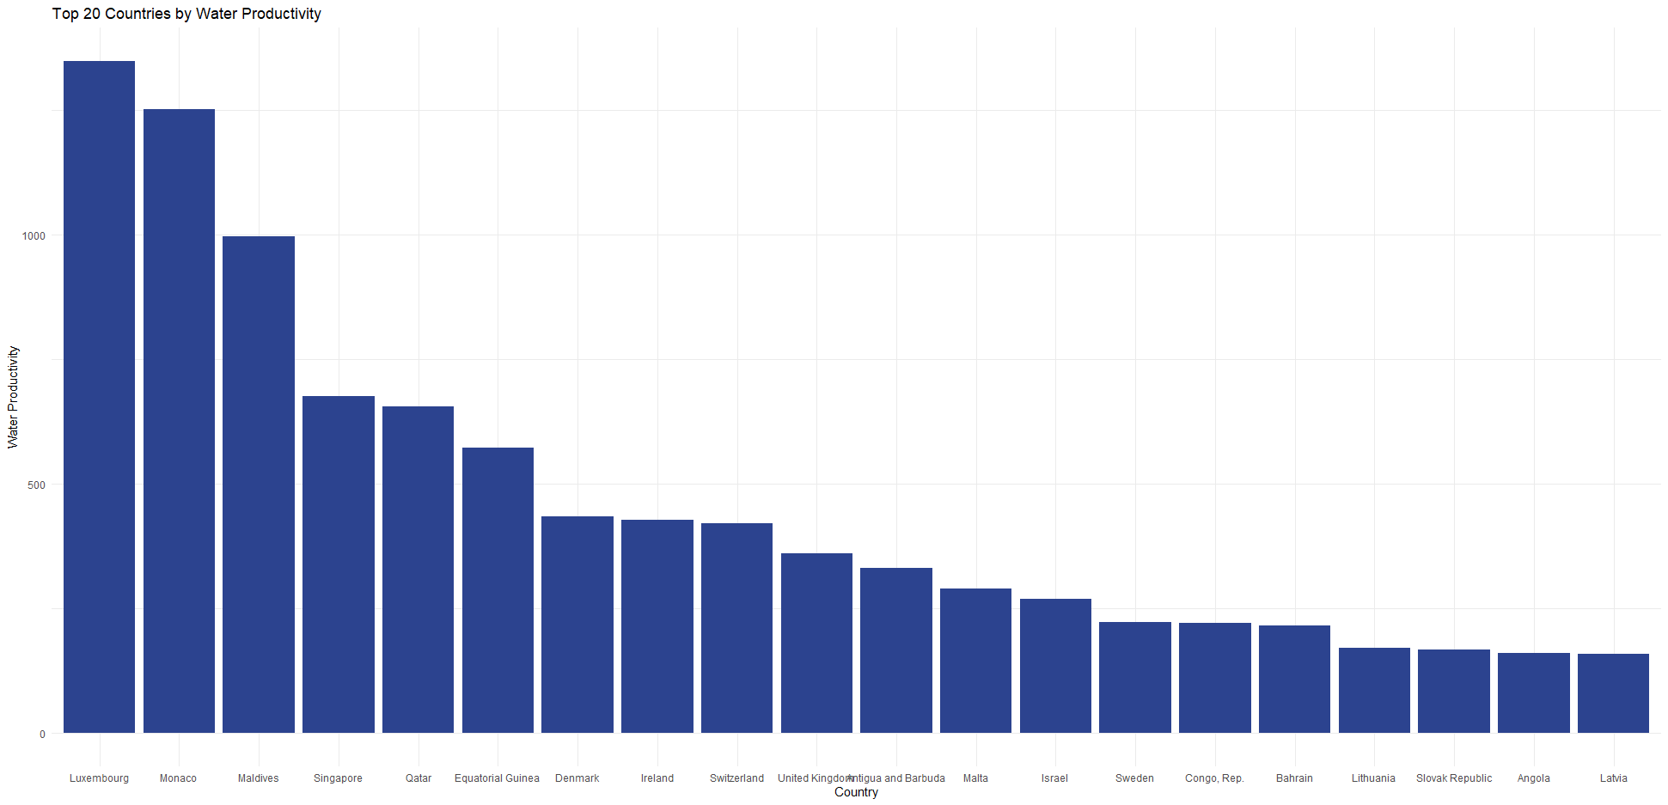
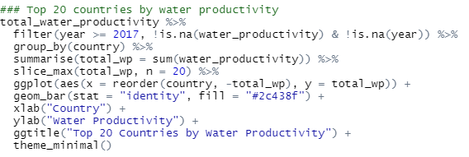
2. Freestyle
Water Productivity already takes GDP into consideration. These would be considered some of the most water rich countries.
I was surprised to see Qatar and Israel so high on the list.
cont.

Slide 7
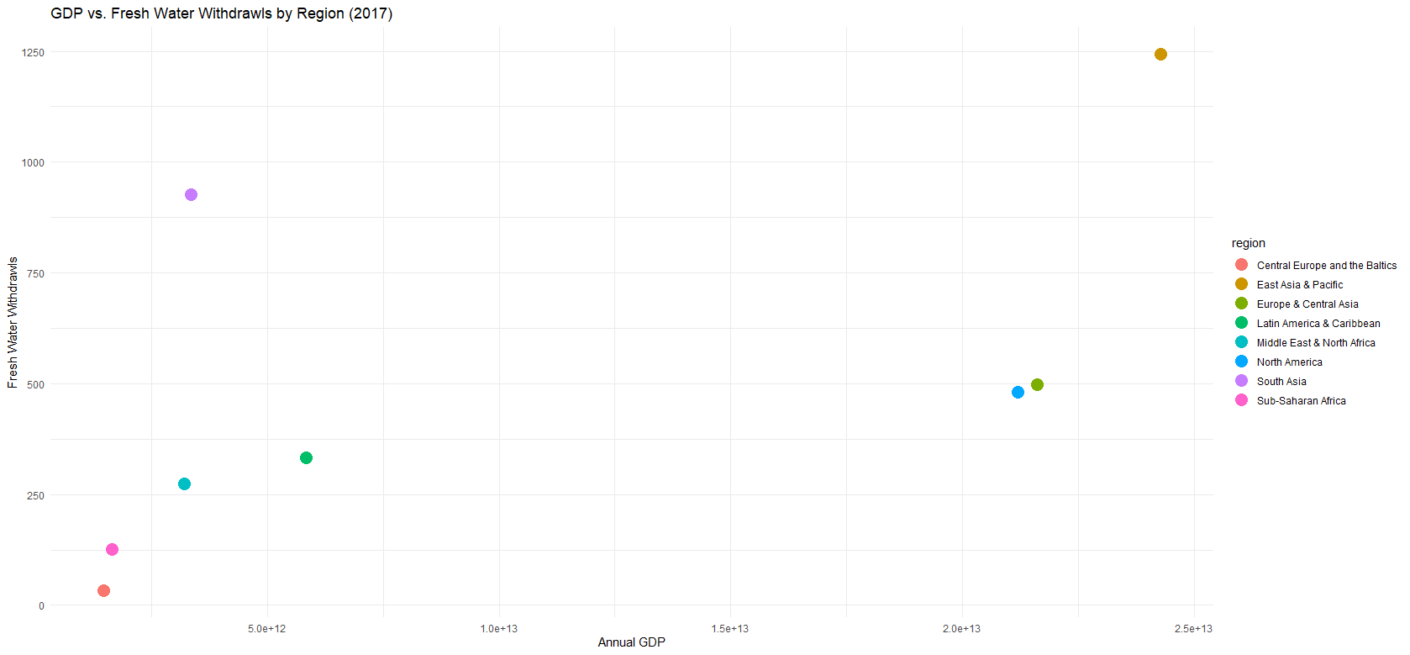
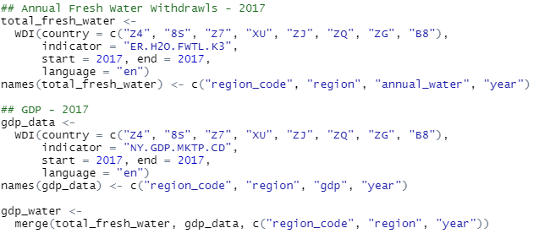
2. Freestyle
cont.
I pulled the Annual Fresh Water Withdrawals and GDP by region then merged the tables.
There appears to be a linear relationship when grouped by region between GDP and Fresh Water Withdrawals.
North America and Europe do appear to produce less than other regions in comparison to their respective GDPs.

Slide 8
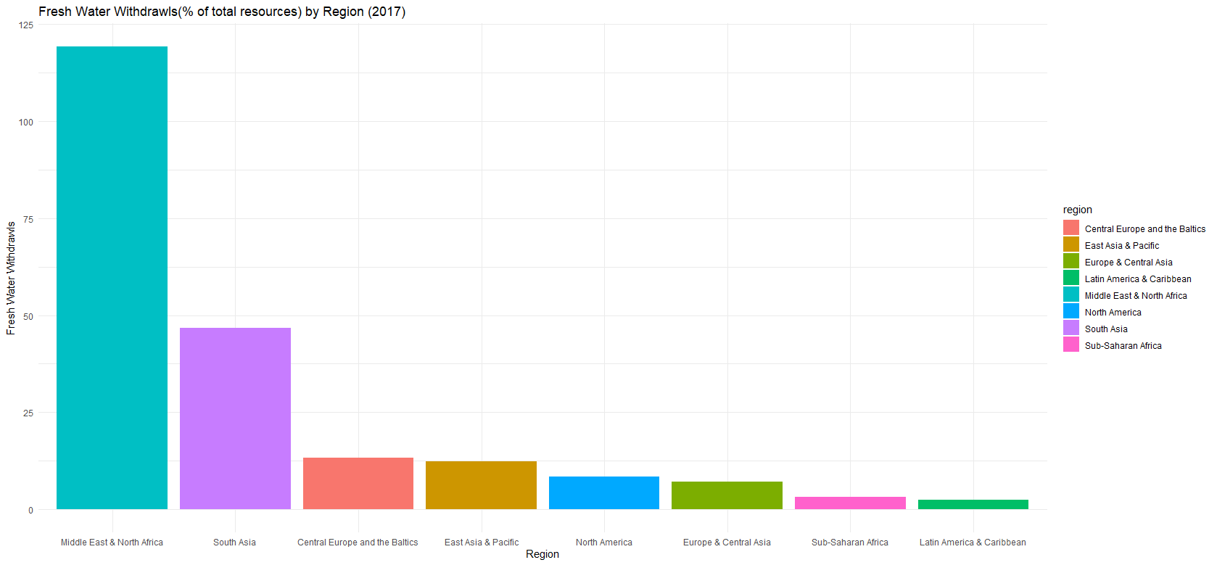
2. Freestyle
When we consider the fresh water production in comparison to available resources, the Middle East & North Africa far outpace the rest of the world.
cont.

Slide 9
. Takeaways and/or Questions
For the Intrinio API, where do we find our username/password in the format of the rmd file?
I would love to explore stock prices with this API, but the lessons didn’t cover where they came from and the Intrinio API appears to be using a new method through their SDK, so the documentation doesn’t address this anymore.
APIs are extremely powerful but can be a huge headache because they are all unique in their methods/structure.

