Slide 1

Doing Data Science
Live Session: Unit 6
Dane Holmes

Slide 2
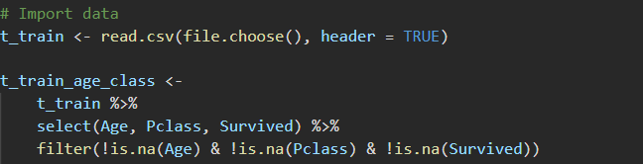

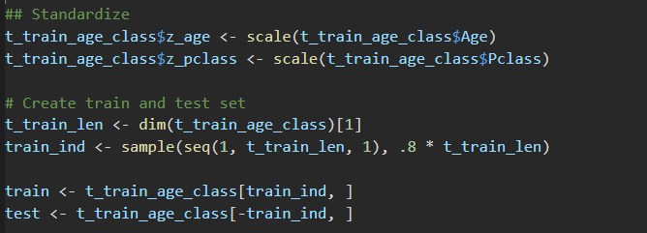
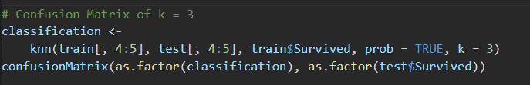

Part 1
Age | Pclass | Survival | Prob
33 | 1 | 1 | 0.714
33 | 2 | 1 | 0.5
33 | 3 | 0 | 0.875
Accuracy | 0.636
Misclassification | 0.364
Sensitivity | 0.705
Specificity | 0.554
Positive' Class: 0

Slide 3
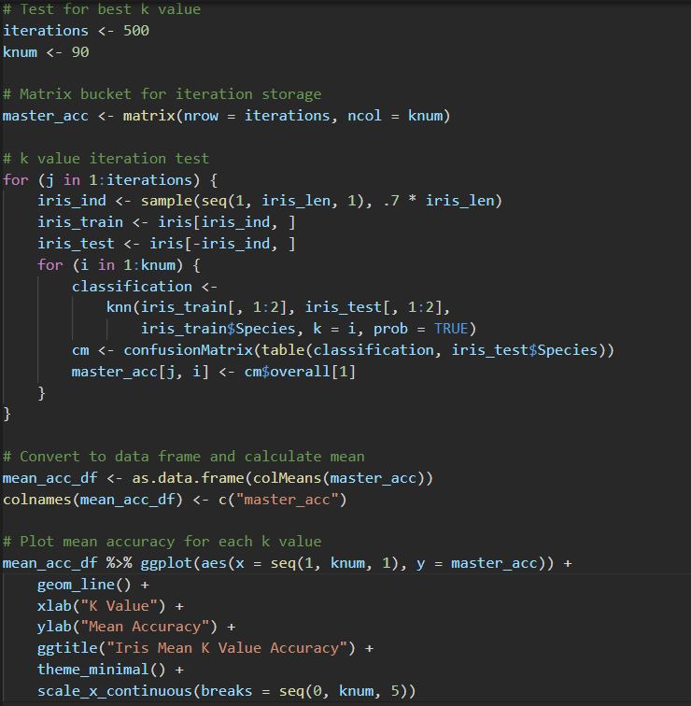
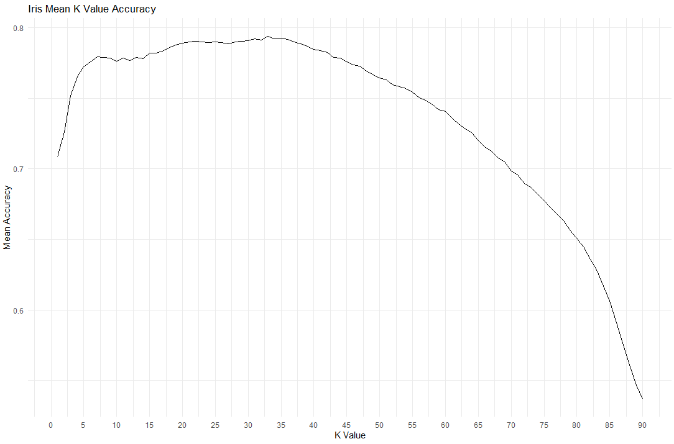
Part 2
Over 500 iterations of 1 < K < 90, the most accurate K value for predicting species with sepal length and sepal width is K = 33.

Slide 4
. Takeaways and/or Questions
How do we standardize the data when our test data and train data are already split?
Do we merge the data then standardize axes?
How do we take the results from knn() and add them as columns onto the original test data frame?

