Slide 1

Doing Data Science
Live Session: Unit 7
Dane Holmes

Slide 2
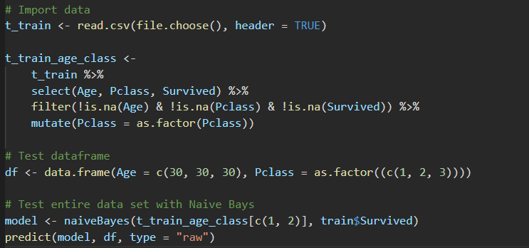
Part 1
Question 1
Naïve Bays
Age | Pclass | Survival | Prob
30 | 1 | 1 | .64
30 | 2 | 0 | .53
30 | 3 | 0 | .77

Slide 3
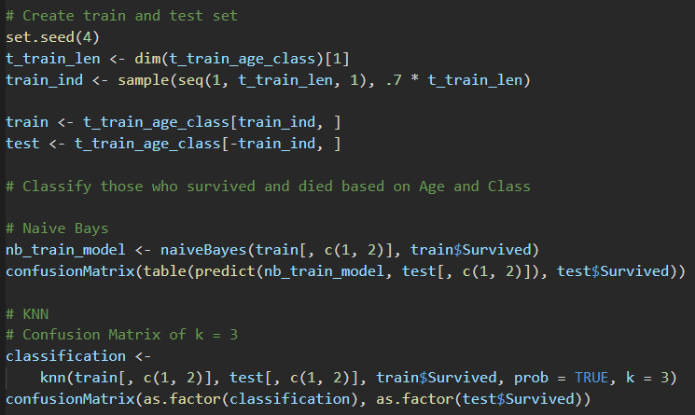
Part 1
Question 2
 | Naïve Bays | KNN = 3
Accuracy | 0.7163 | 0.7023
Sensitivity | 0.8140 | 0.7907
Specificity | 0.5698 | 0.5698

Slide 4
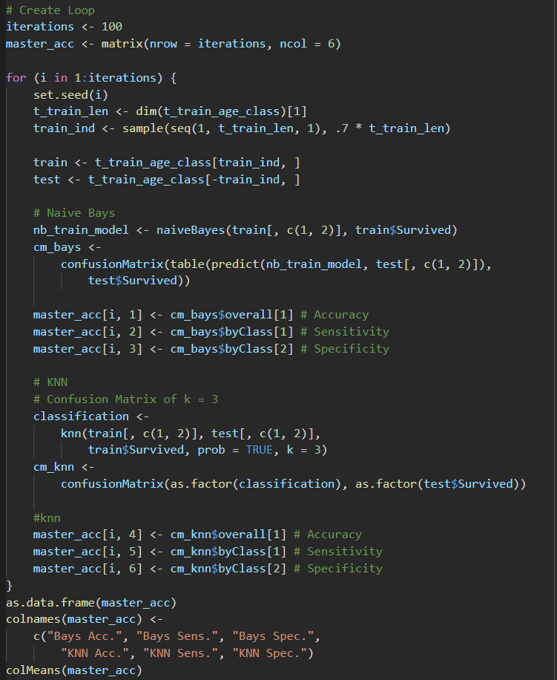
Part 1
Question 3-4
Seed 1 | Naïve Bays | KNN = 3
Accuracy | 0.693 | 0.6605
Sensitivity | 0.7833 | 0.7417
Specificity | 0.5789 | 0.5579
Seed 2 | Naïve Bays | KNN = 3
Accuracy | 0.6837 | 0.6419
Sensitivity | 0.8077 | 0.7385
Specificity | 0.4941 | 0.4941
Seed 3 | Naïve Bays | KNN = 3
Accuracy | 0.6837 | 0.707
Sensitivity | 0.8387 | 0.8145
Specificity | 0.4725 | 0.5604
Seed 4 | Naïve Bays | KNN = 3
Accuracy | 0.7163 | 0.7023
Sensitivity | 0.8140 | 0.7907
Specificity | 0.5698 | 0.5698
Seed 1-100 Average | Naïve Bays | KNN = 3
Accuracy | 0.6871 | 0.6619
Sensitivity | 0.8067 | 0.7785
Specificity | 0.5189 | 0.4967

Slide 5
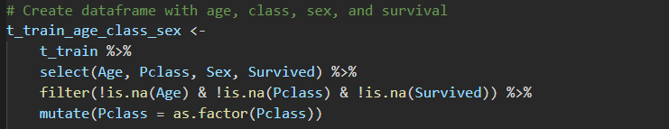

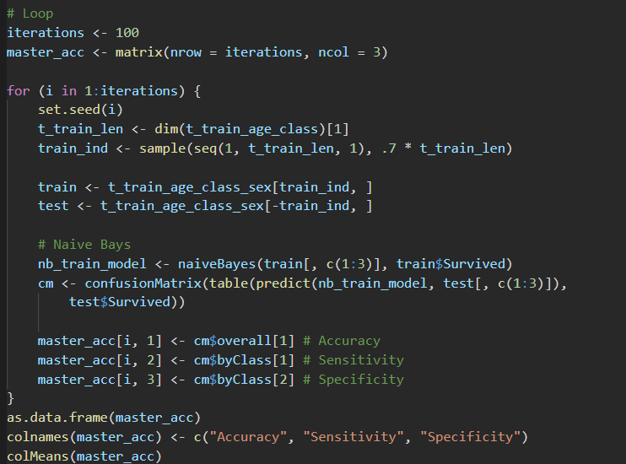
Part 1
Question 5-6
Seed 1-100 Average | Naïve Bays
Accuracy | 0.7769
Sensitivity | 0.8472
Specificity | 0.6776
Seed 4 | Naïve Bays
Accuracy | 0.7767
Sensitivity | 0.8372
Specificity | 0.6860

Slide 6
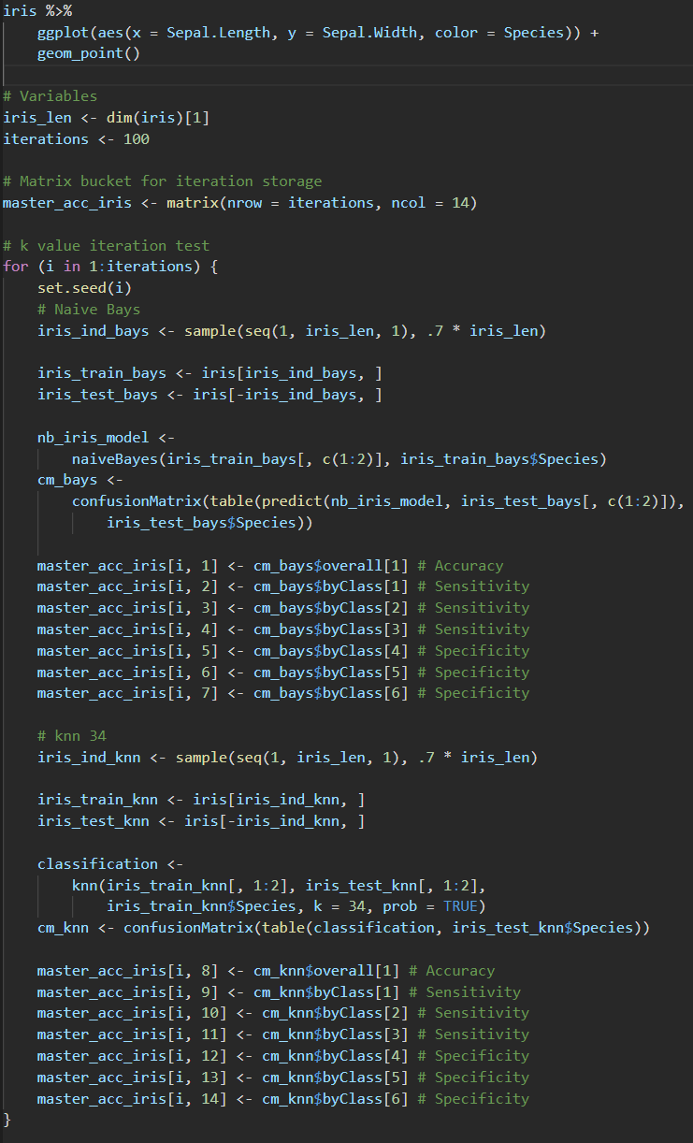
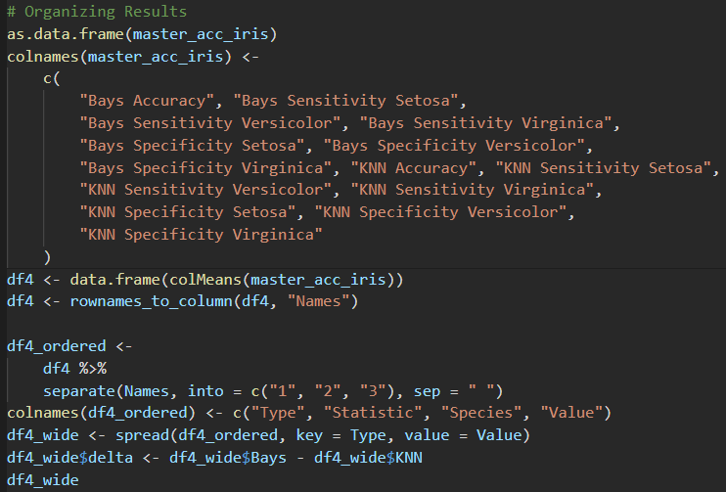
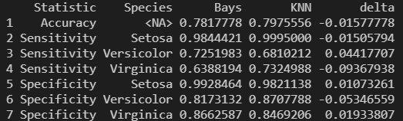
Part 2
Question 1

Slide 7
. Takeaways and/or Questions
Before using Naïve Bays, should we be testing for normality and variable independence?
If we find that these prerequisites are not met, how can we still gain insight from our findings?
Where would we see their influence in skewing the data?

