Slide 1

Doing Data Science
Live Session: Unit 5
Dane Holmes

Slide 2

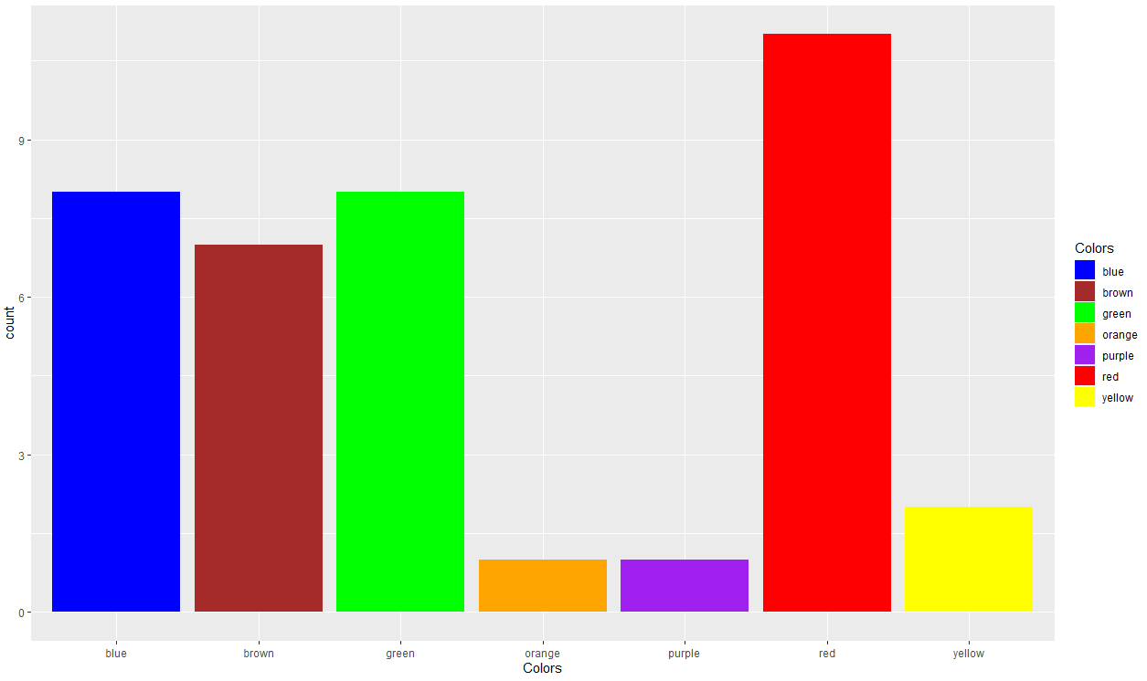
1. BBall Study
5.5 Strings | Regular Expressions, Part 2
For live session, fix the problem, and reproduce the plot.

Slide 3
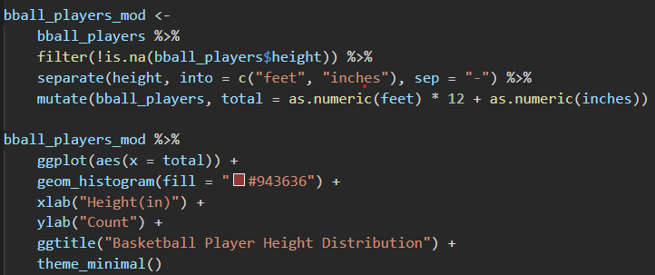
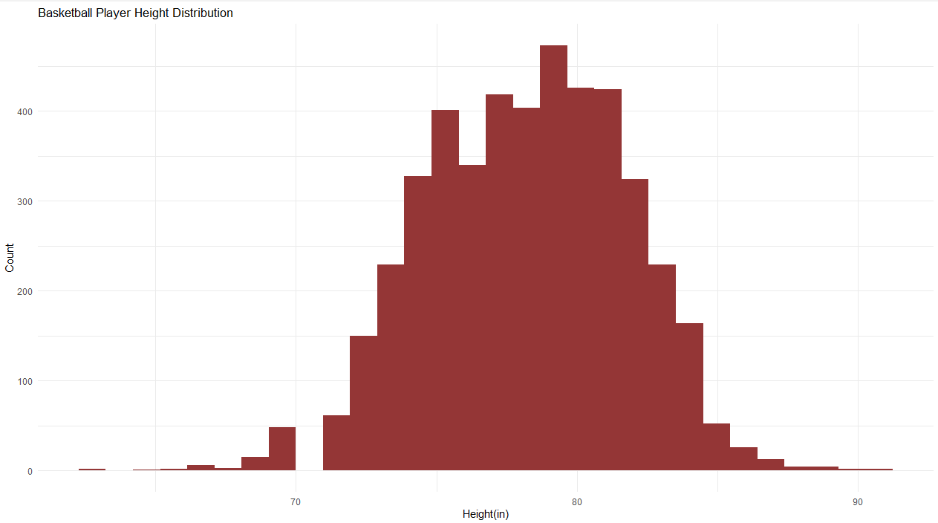
1. BBall Study

Slide 4
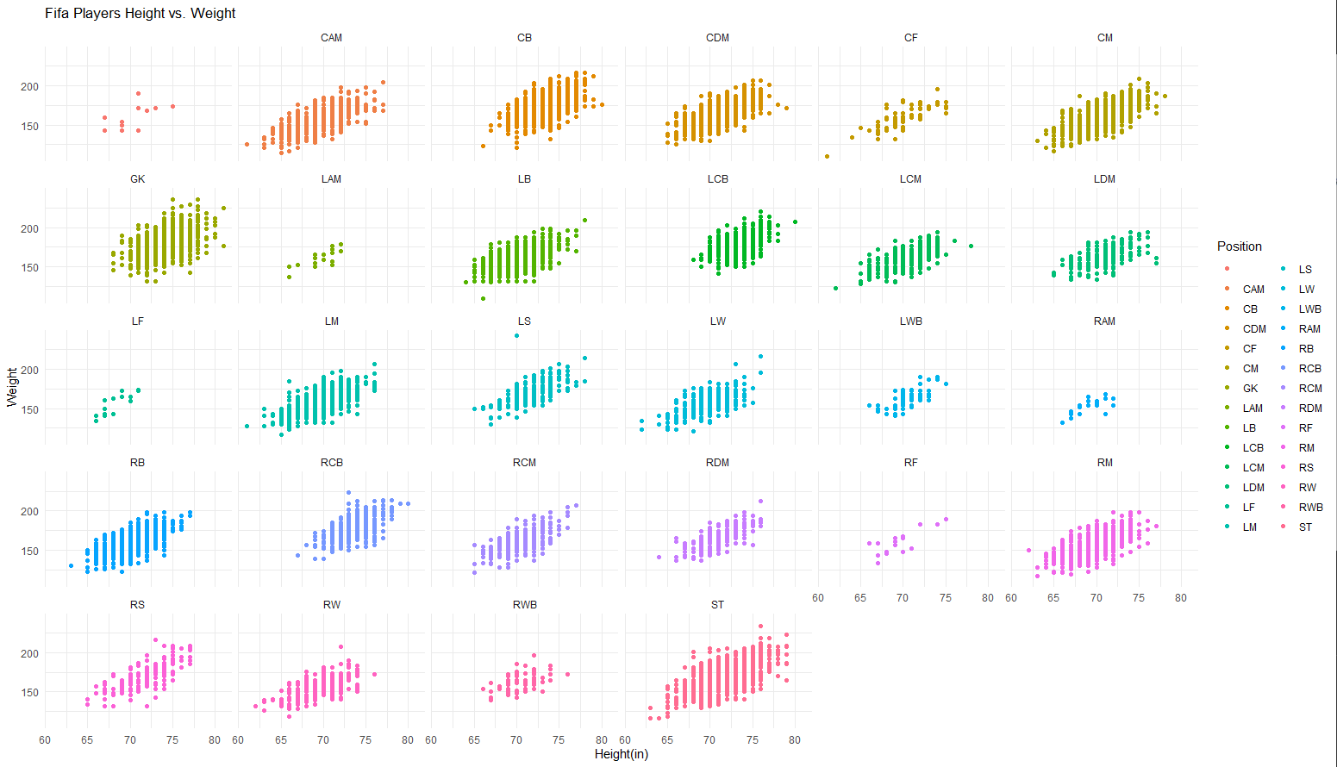
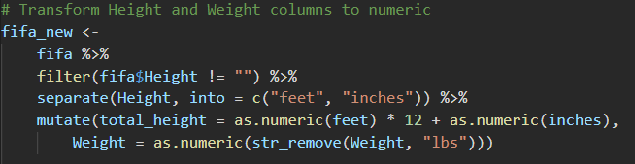
2. FIFA Study
It appears that every position has a positive linear relationship between Weight and Height.

Slide 5
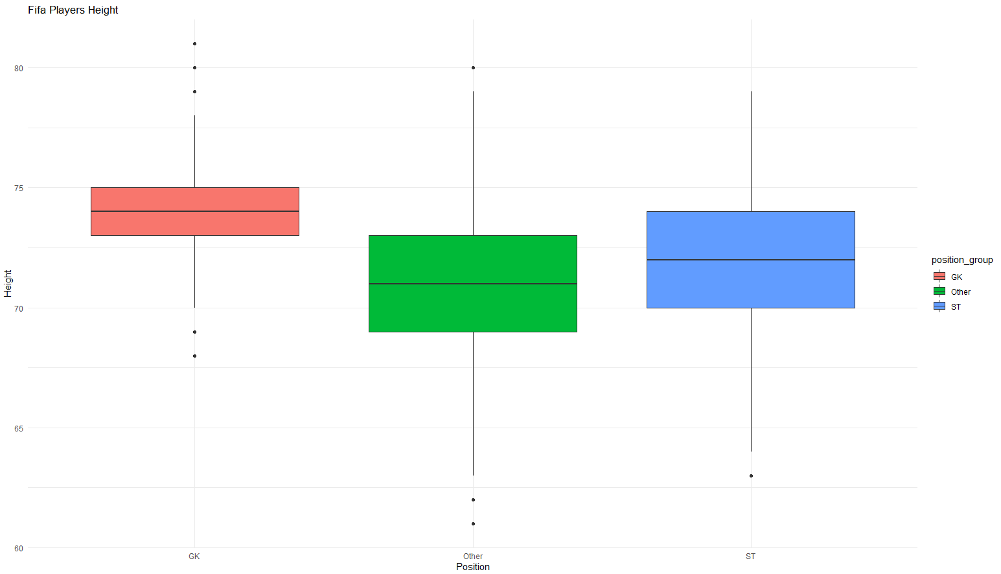
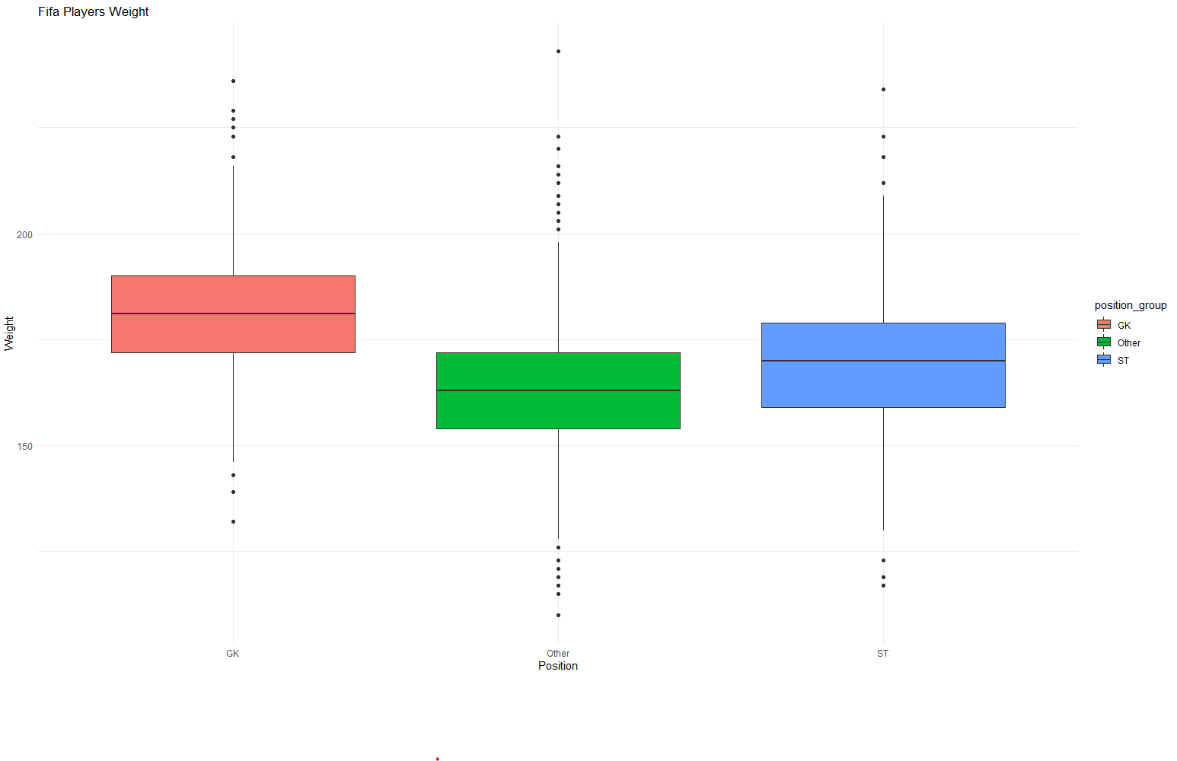
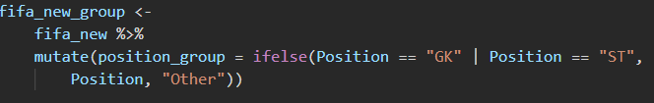
2. FIFA Study
It also appears that on average the tallest and heaviest positions are Strikers and Goal Keepers.
This is shown by grouping all other positions and comparing Height and Weight.
cont.

Slide 6
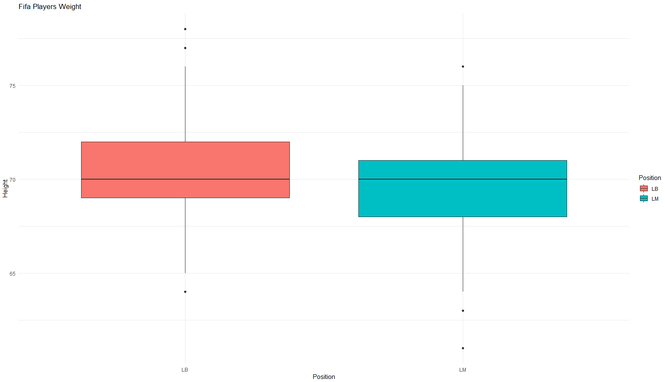
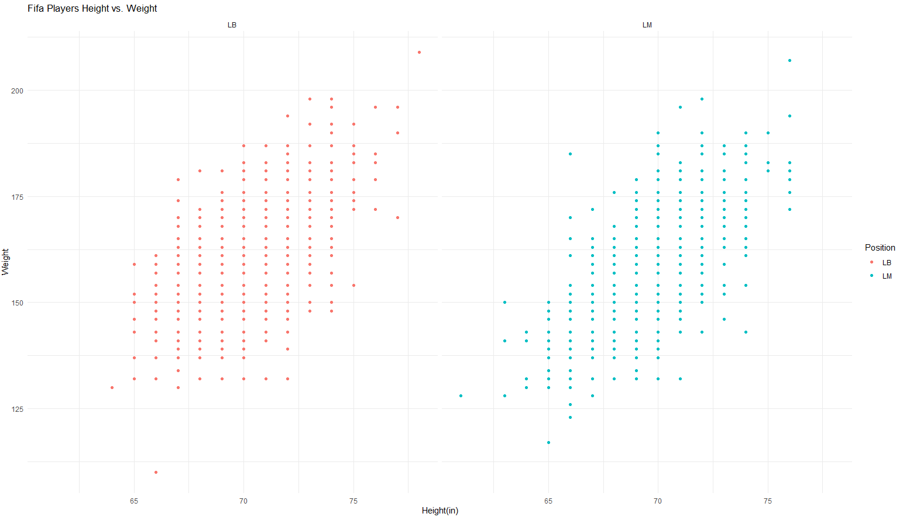
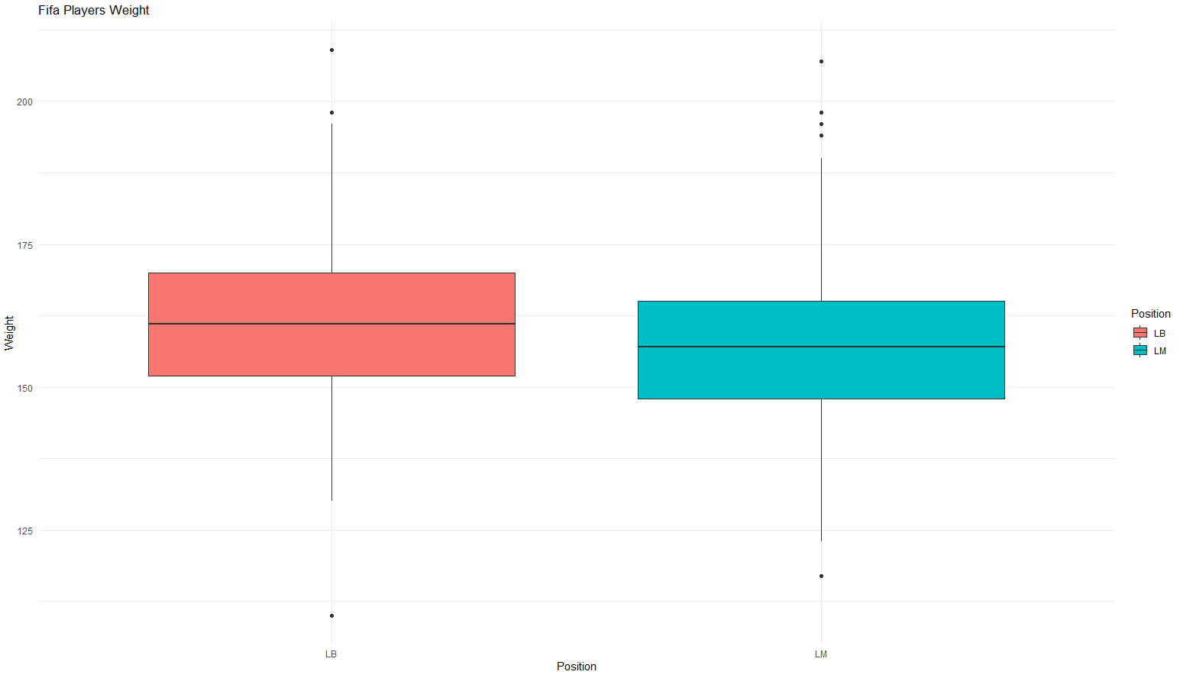
2. FIFA Study
LB vs. LM
There appears to be a very similar distribution and relationship between Height and Weight between the positions with LB edging slightly higher in both categories.

Slide 7

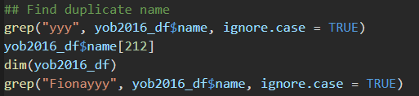

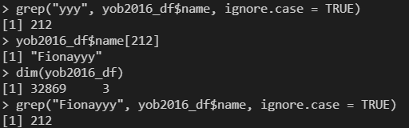

3. Baby Names

Slide 8

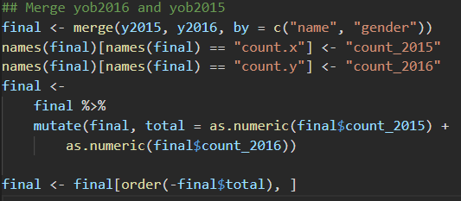
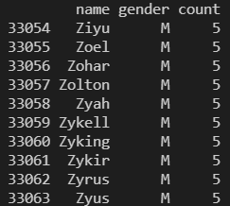

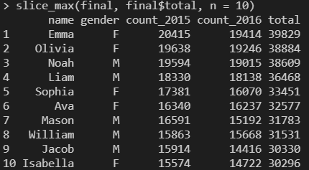
3. Baby Names
cont.
The bottom 10 names are all males, and they all have a count of 5.

Slide 9
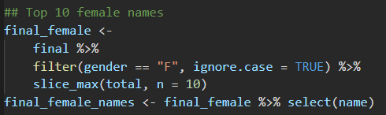
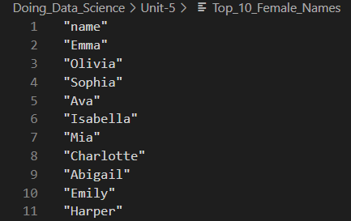
3. Baby Names
cont.

Slide 10
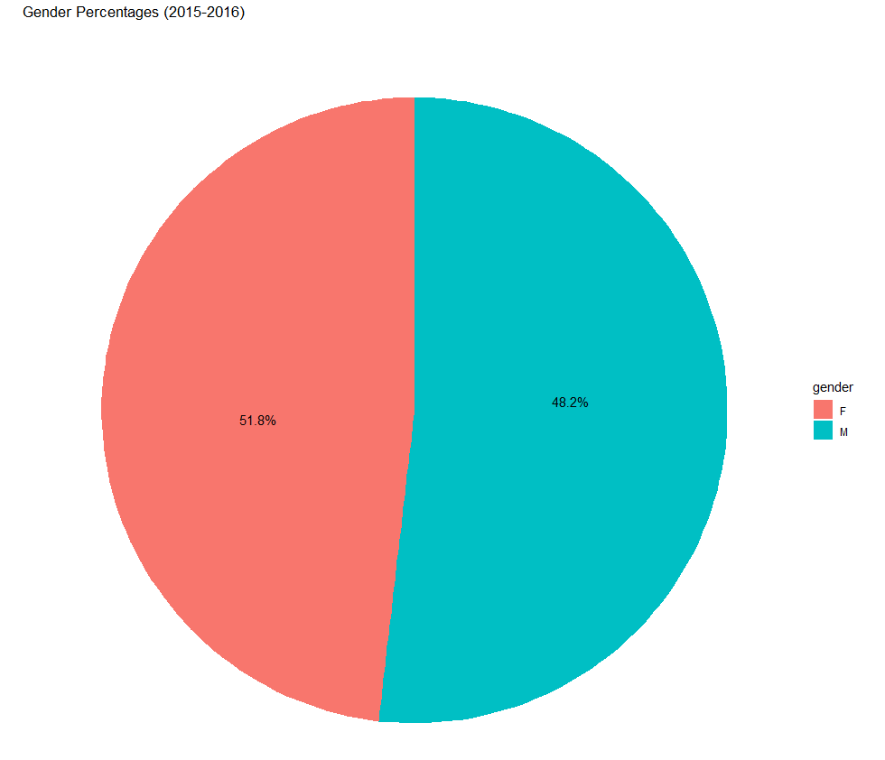
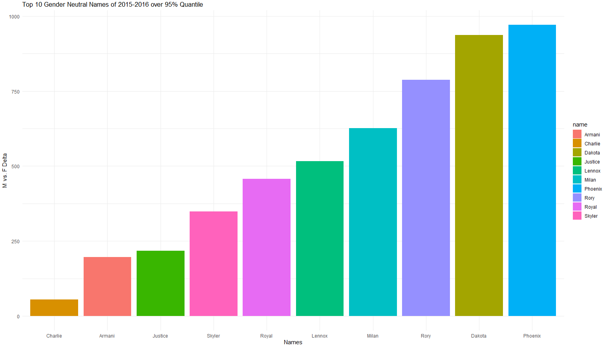
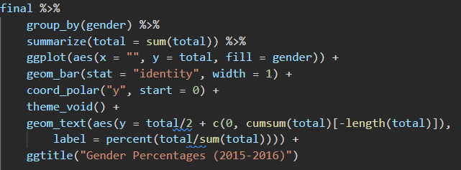
3. Baby Names
cont.
These are the top gender-neutral names defined by being in the 95% percentile for Male and Female and ranked by the absolute value total difference between occurrences.

Slide 11
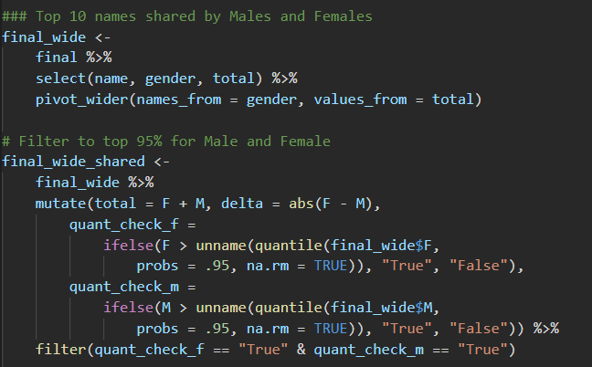
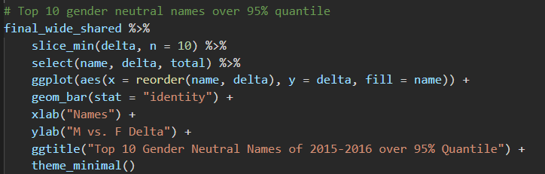
3. Baby Names
cont.

Slide 12
. Takeaways and/or Questions
I know how to do most of these transformations inside of excel, but that limits my ability to create truly automated processes and my ability to work with much larger data sets.
The items from this week and last week have felt like huge steps forward for me.
A lot of the examples were using lists of strings. I found that when I tried to use them for data frames, they didn’t always work the same.
This is more of a comment than a question.
For instance, separate() and mutate() were usually easier to use than trying to work in regex.

