Slide 1

Doing Data Science
Live Session: Unit 3
Dane Holmes

Slide 2

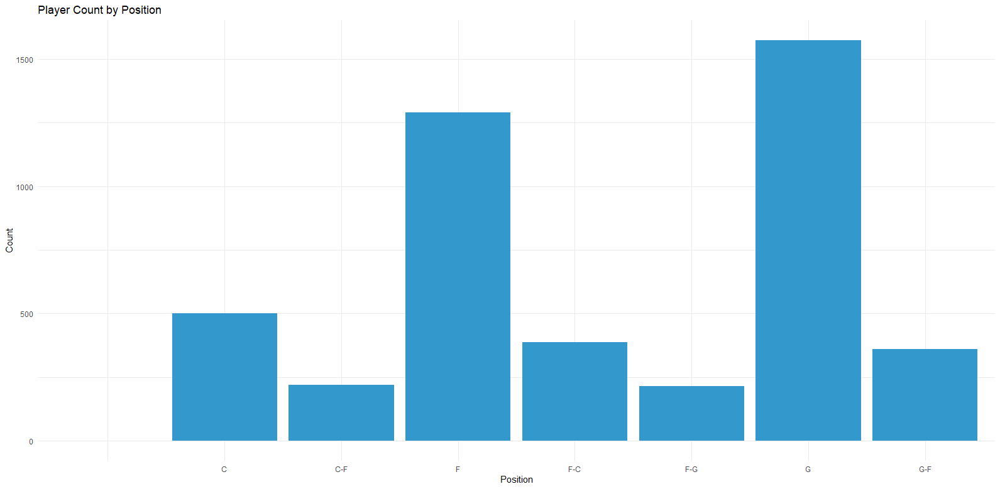
1.Basketball Players Questions

Slide 3
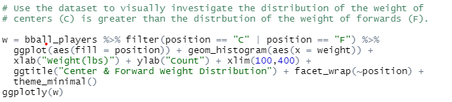
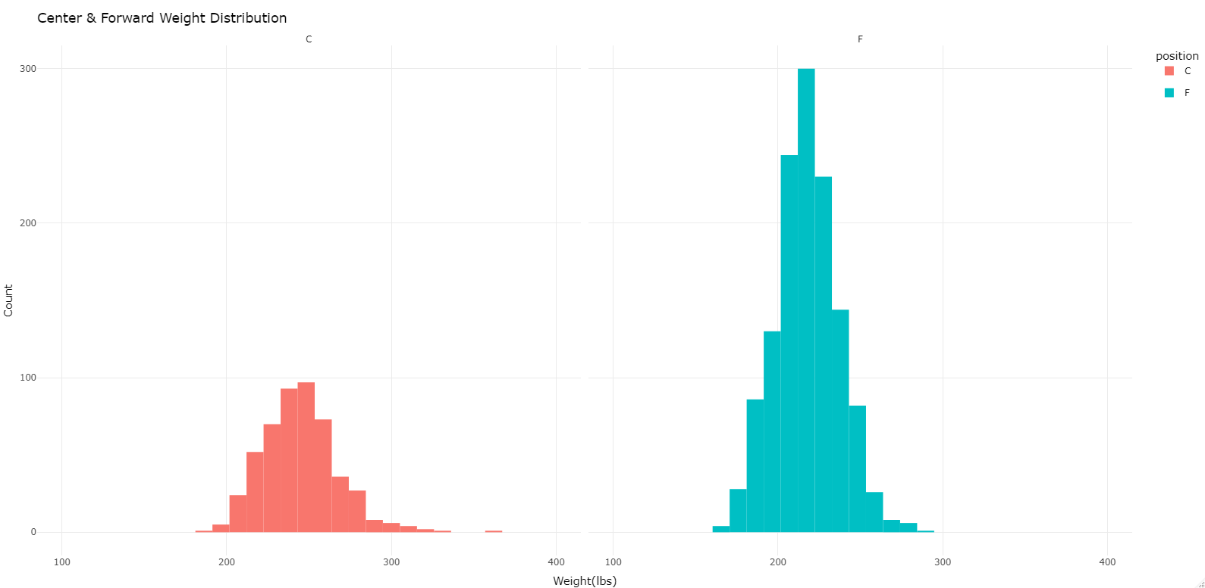
1.Basketball Players Questions
cont.
The distribution of weights of Centers appears to be greater than that of Forwards.

Slide 4
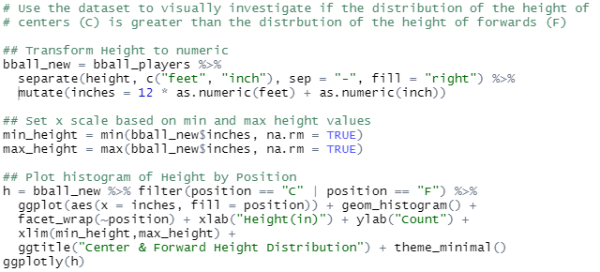
1.Basketball Players Questions
cont.
The distribution of heights of Centers appears to be greater than that of Forwards.

Slide 5
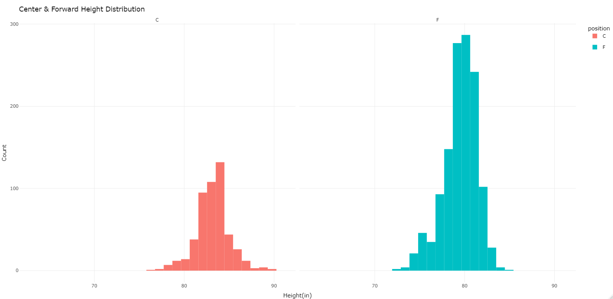
1.Basketball Players Questions
cont.

Slide 6
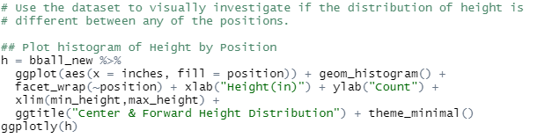
1.Basketball Players Questions
cont.
The distribution of heights appears to differ between positions.

Slide 7
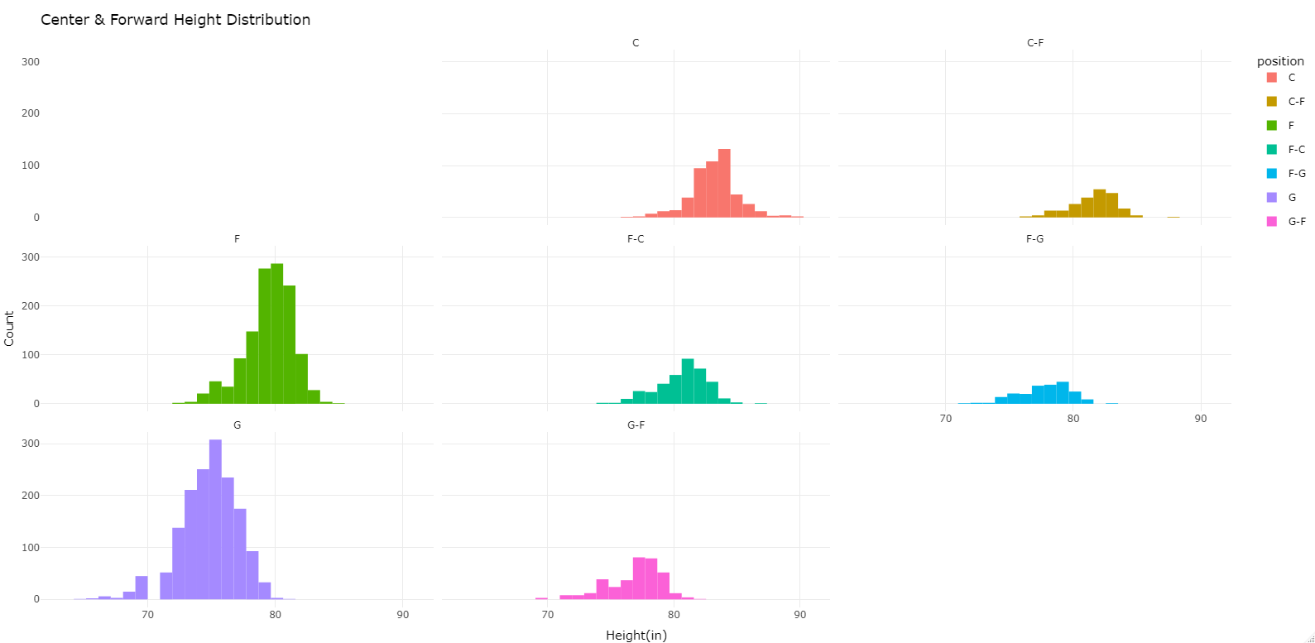
1.Basketball Players Questions
cont.

Slide 8
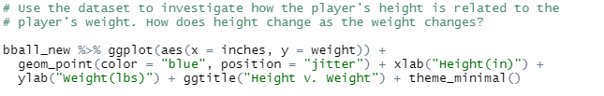
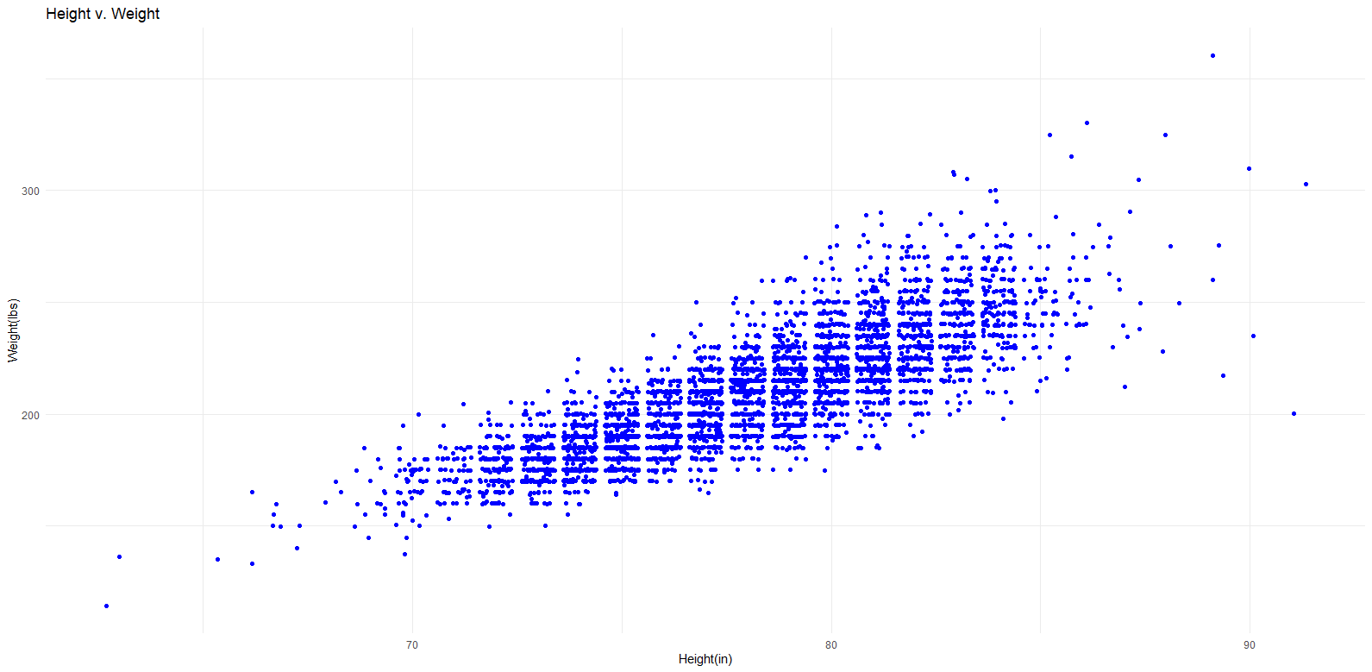
1.Basketball Players Questions
cont.
There appears to be a linear relationship between player height and weight.

Slide 9
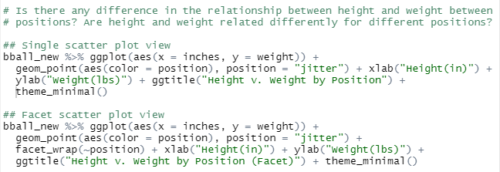
1.Basketball Players Questions
cont.
There appears to be a linear relationship between player height and weight across all positions.
The degree of linear relationship differs by position though.

Slide 10
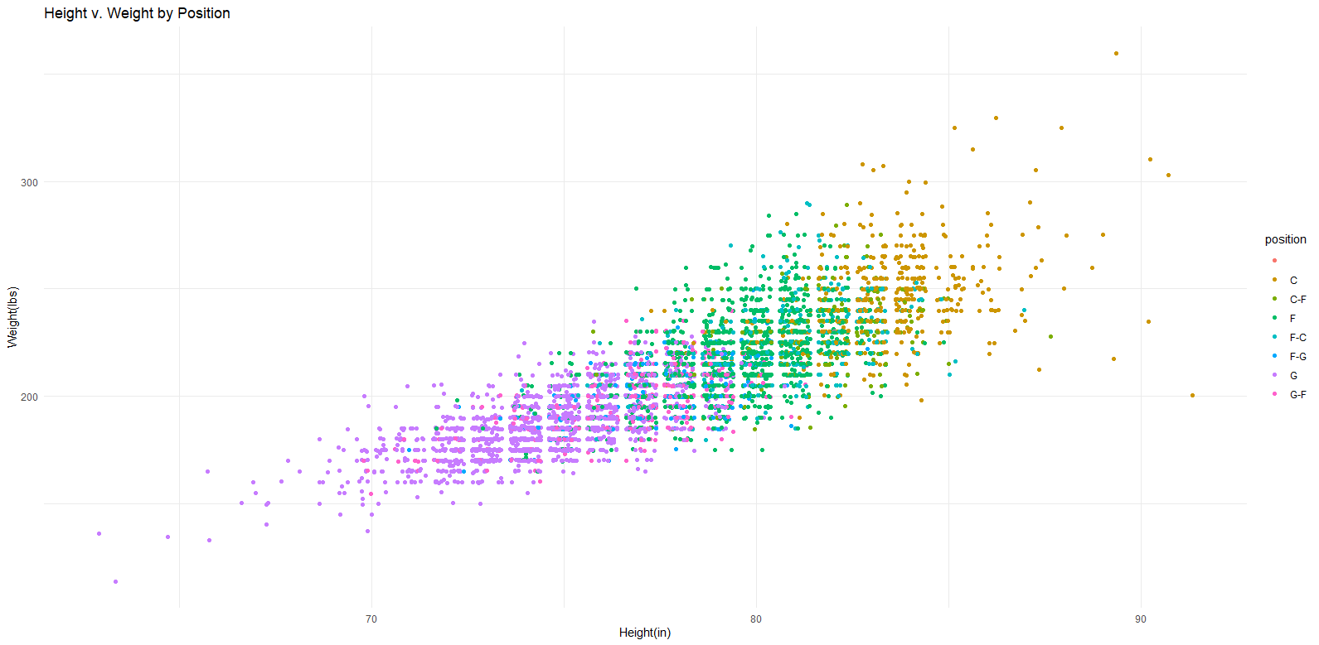
1.Basketball Players Questions
cont.

Slide 11
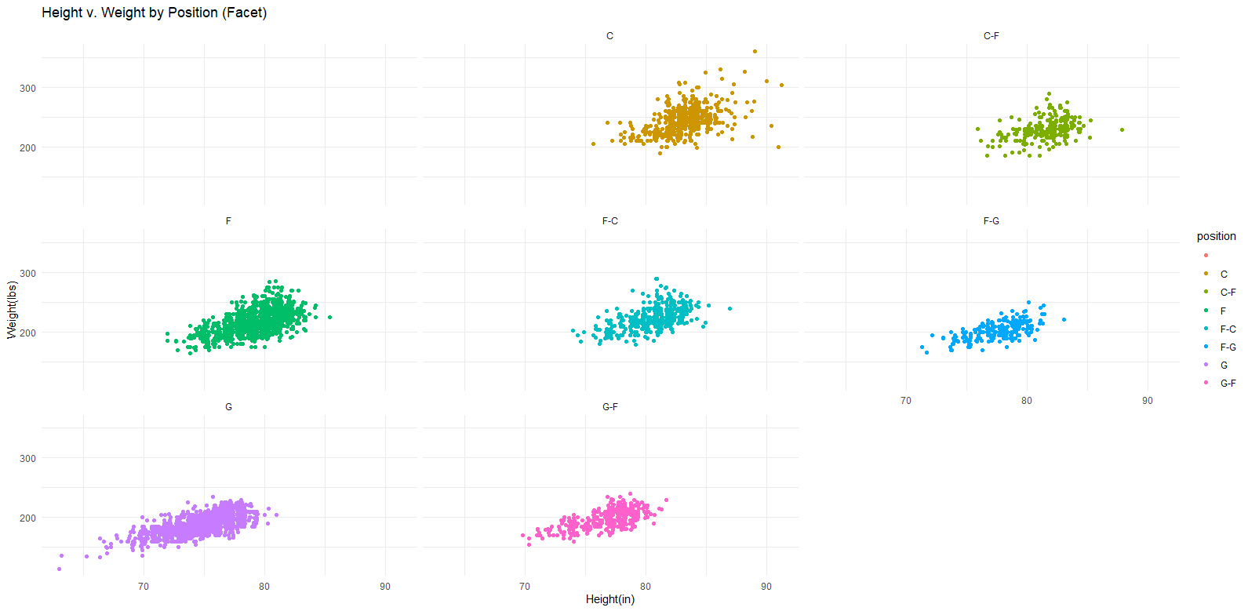
1.Basketball Players Questions
cont.

Slide 12
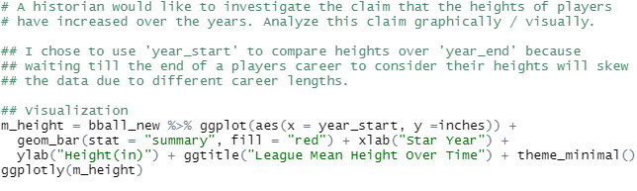
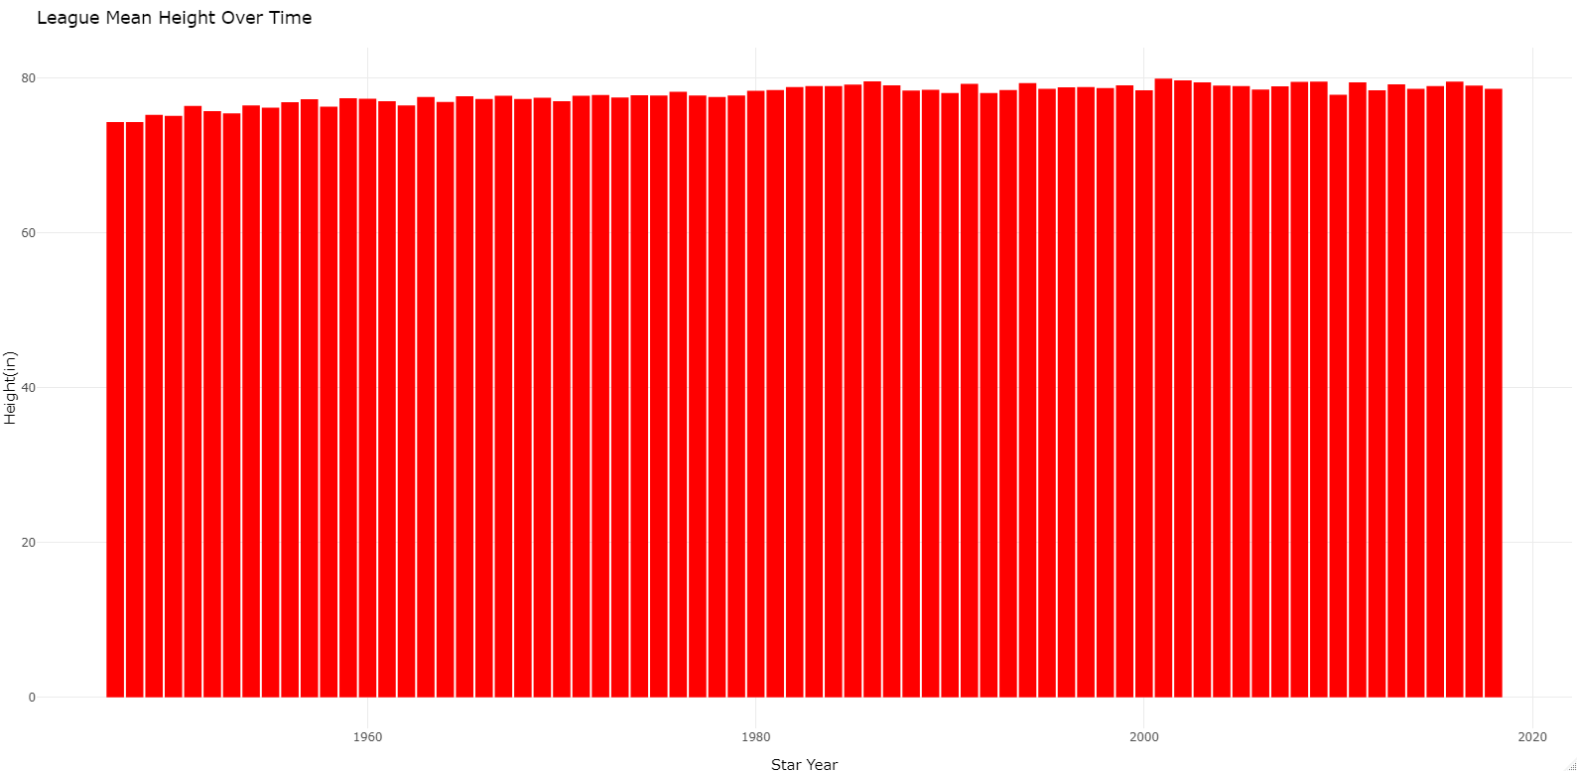
1.Basketball Players Questions
cont.
It appears that the heights of players has slightly increased over the data sets time interval.

Slide 13
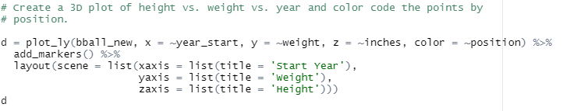
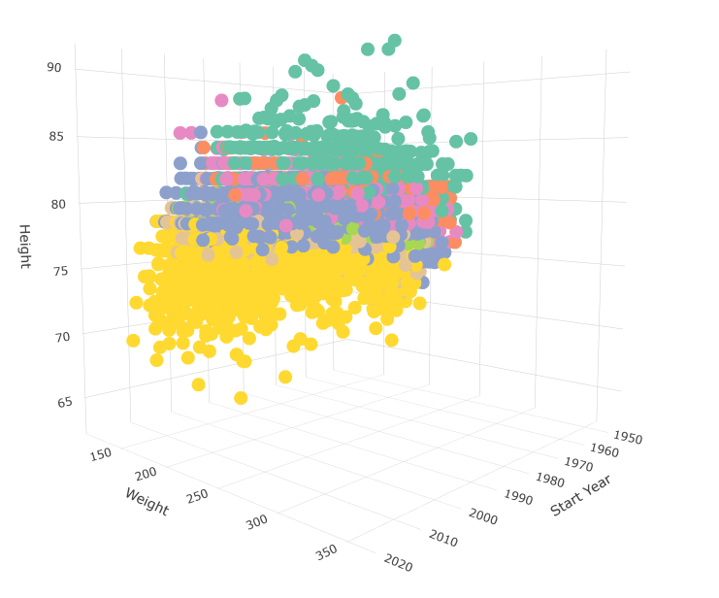
1.Basketball Players Questions
cont.

Slide 14
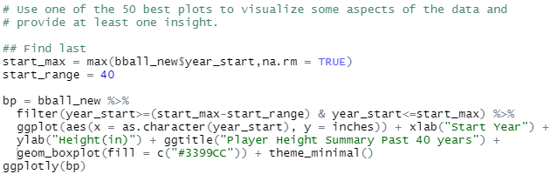
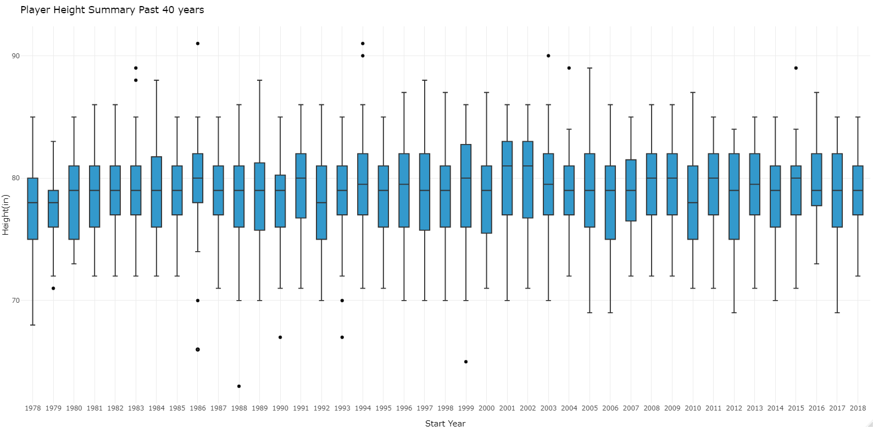
1.Basketball Players Questions
cont.
I wanted to see if the quartile data for Height in the league has significantly changed in the last 40 years.
It appears that there is not significant evidence to suggest a trend either up or down with respect to height.

Slide 15
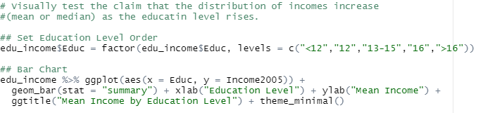
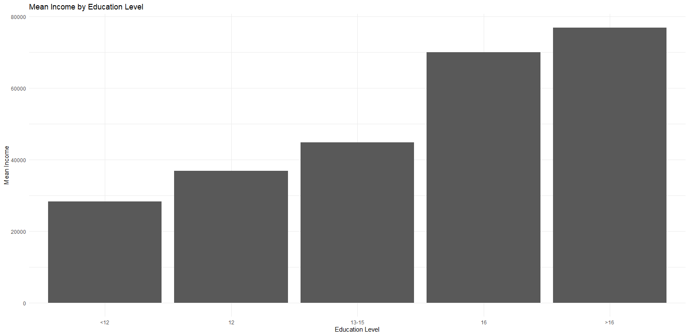
2.Education Income Questions
The mean income does increase with higher education.

Slide 16
4. Takeaways and/or Questions
ggplot2 is an exceptionally strong tool and very enjoyable to use.
Coming from Tableau/Excel, I found the customization to be very enjoyable.
I had to do some data transformation to accomplish the visualizations for height. I used a combination of google searches to discover the best way to do this. How/when do we need to site sources in this instance?

