Slide 1

Doing Data Science
Live Session: Unit 3
Dane Holmes

Slide 2

1. Filter Data Set

Slide 3
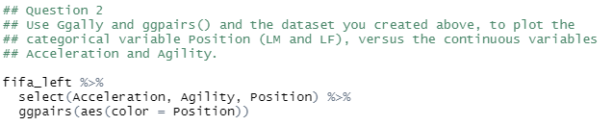

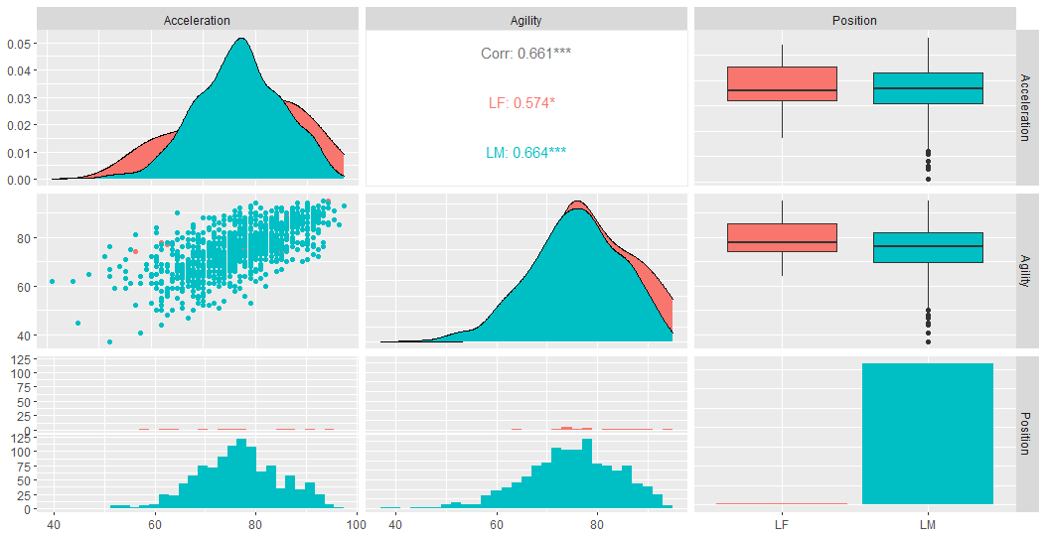
2-3. Ggpairs Dataset

Slide 4



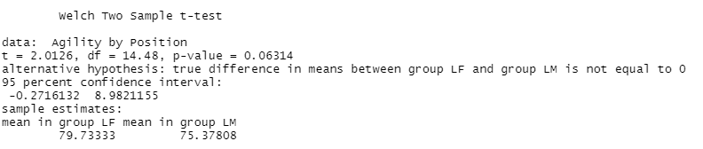

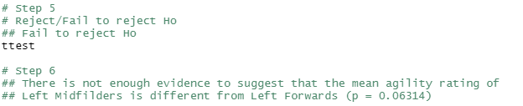



4. LM vs. LF Agility Comparison
$$Critical Value=1.962107$$
$$t_{.05,1108}=2.012613$$
$$p=0.0631375$$

Slide 5
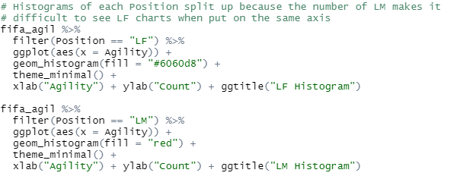
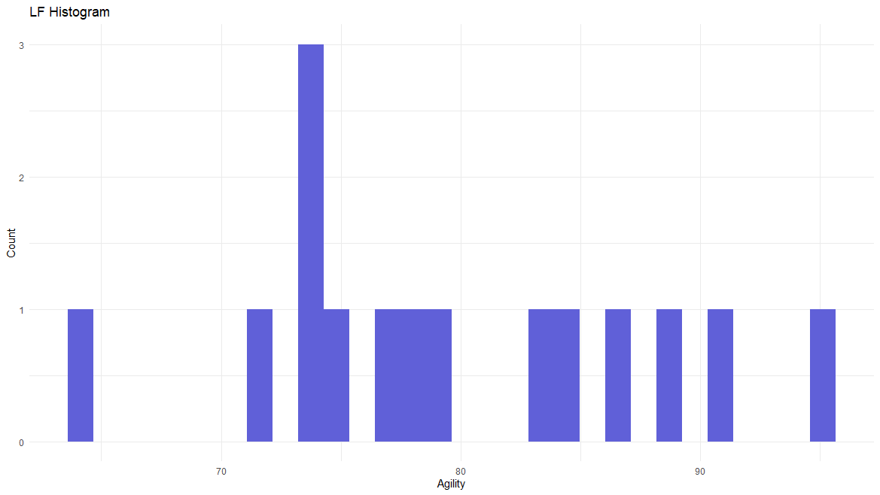
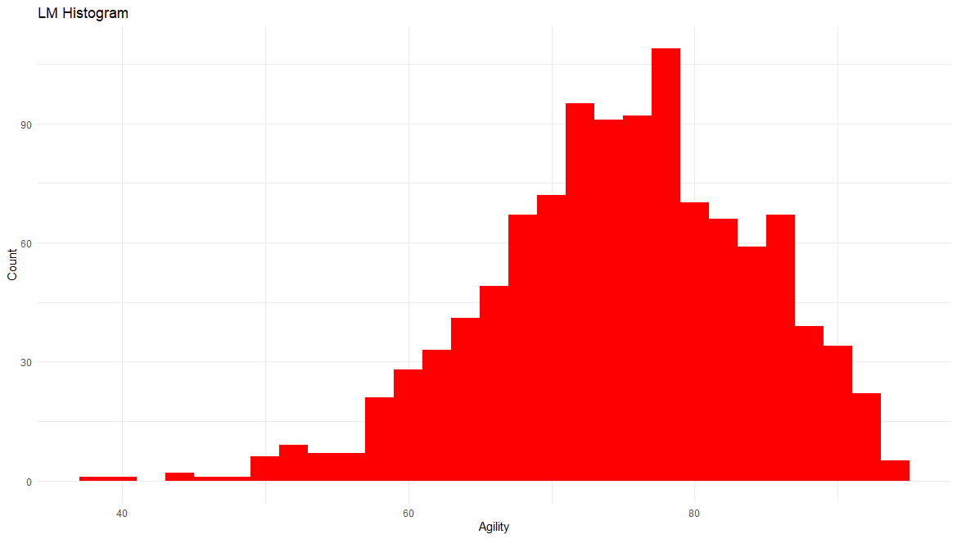
5. Assumptions of Test
The assumptions of the 6-Step t-test does not appear to be met.
The LF Histogram does not appear to have enough data to produce a reasonable normal sample mean distribution.

Slide 6
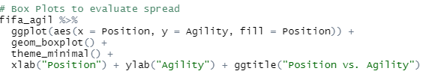
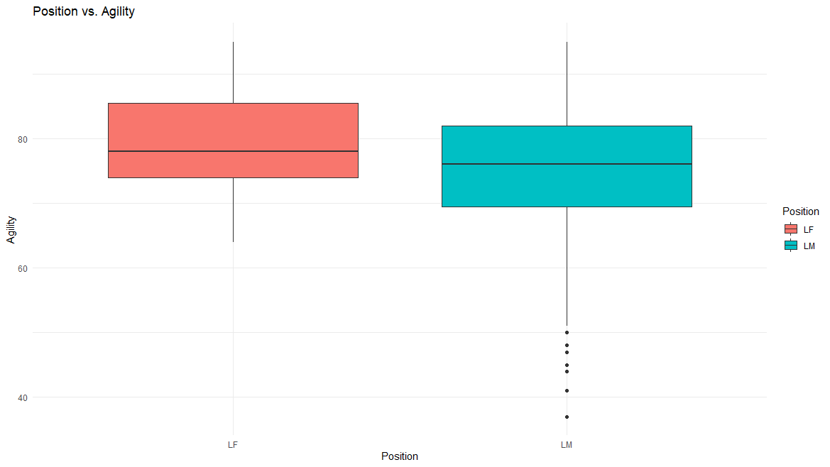
5. Assumptions of Test
cont.
There appears to be enough visible evidence to suggest that the standard deviations are different.

Slide 7
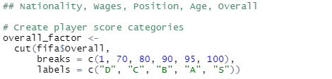
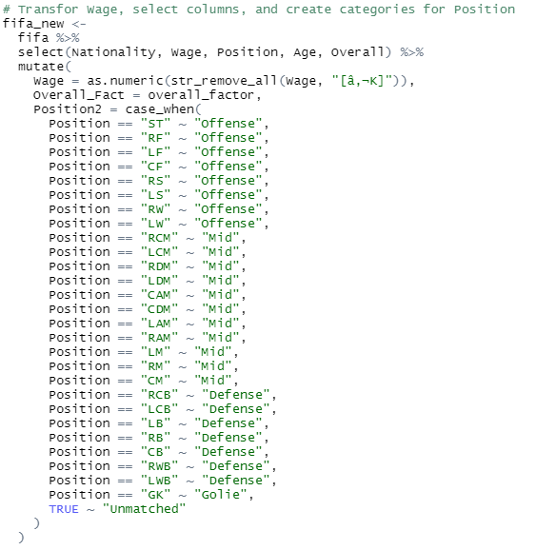
6. FIFA EDA

Slide 8
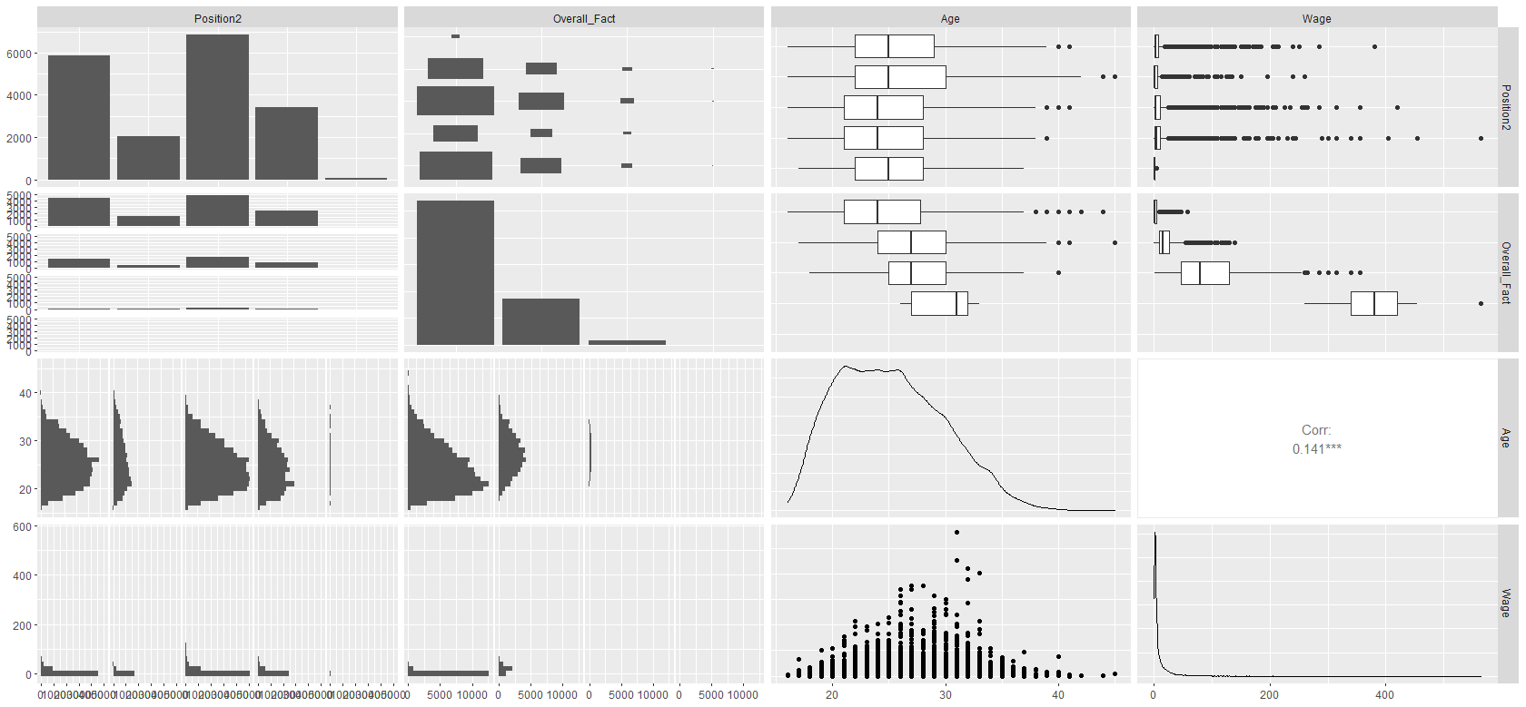
6. FIFA EDA
cont.

Slide 9
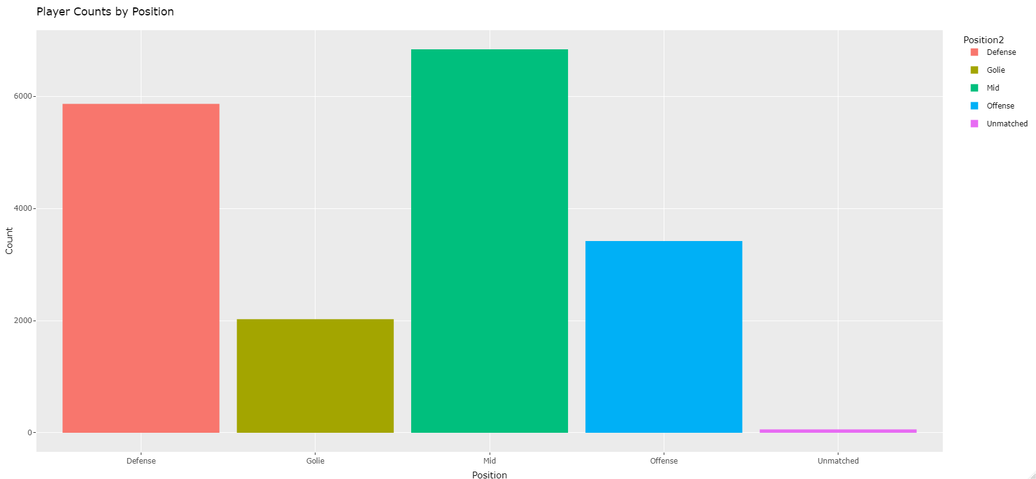
6. FIFA EDA
cont.
The unmatched player count doesn’t seem significant.

Slide 10
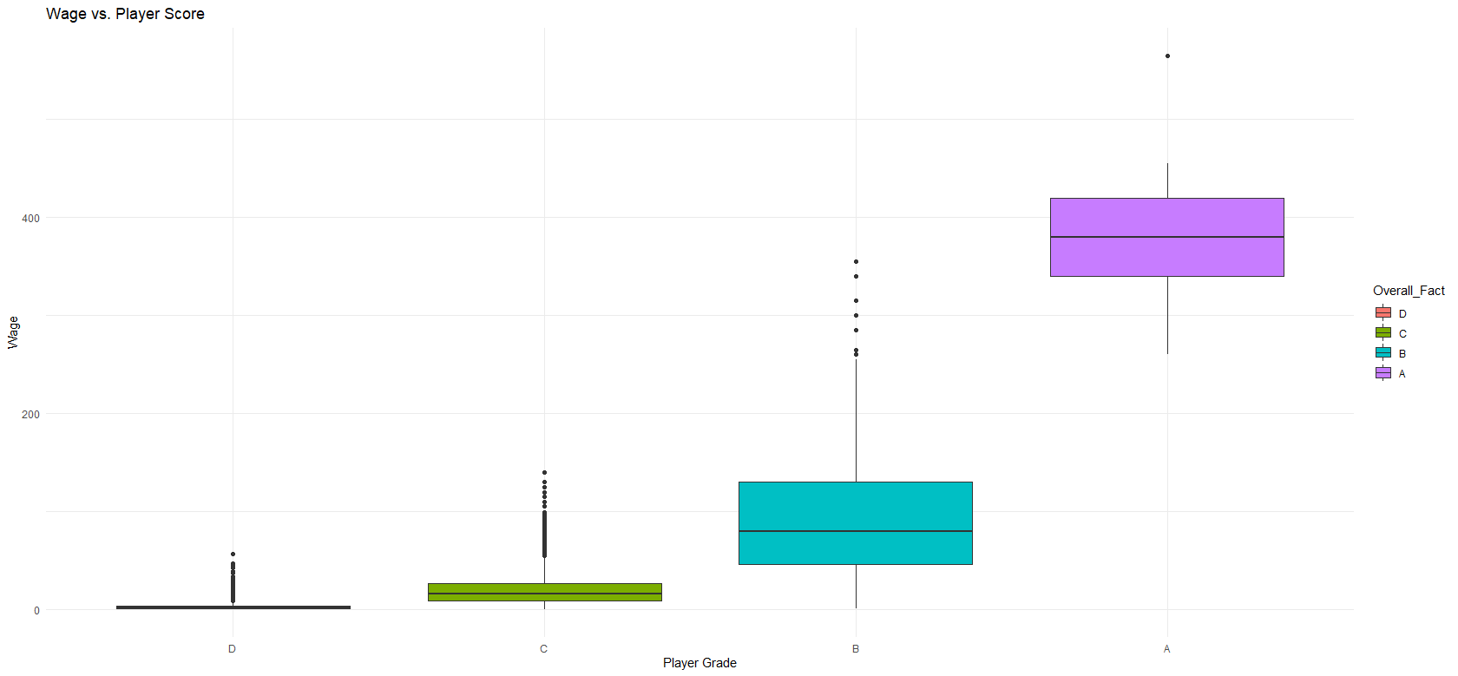
6. FIFA EDA
cont.
It appears that players with grades of A (90-95) make significantly more than those in the grades below them and the jump between grades is vastly different from B to A than any other grade.
Looking further into the relationships between Wage, Position, and Player Score

Slide 11
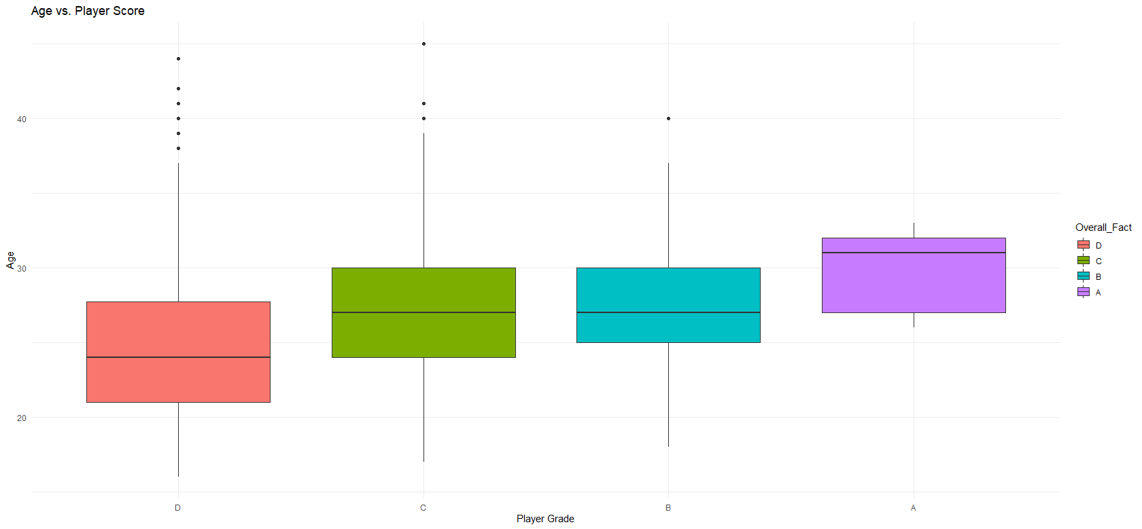
6. FIFA EDA
cont.
It appears that the older players get, the better player score they tend to have.

Slide 12
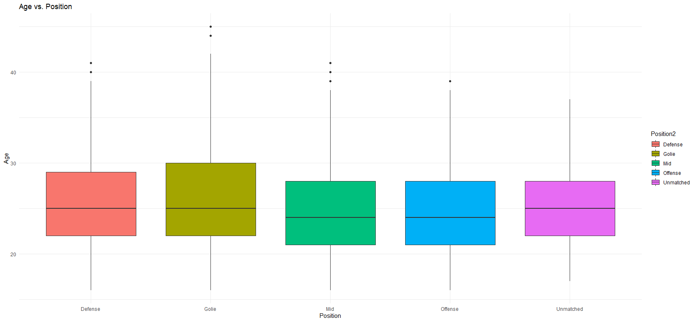
6. FIFA EDA
cont.
It appears that Offensive and Mid positions tend to be slightly younger than Defense and Goalies appear to be able to perform at older ages.

Slide 13
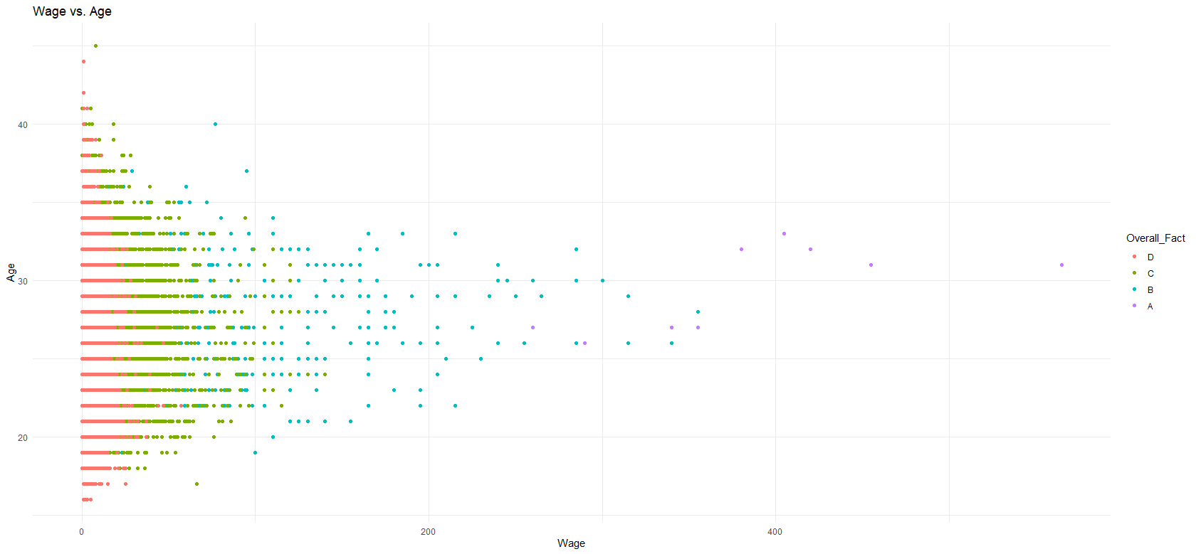
6. FIFA EDA
cont.
It appears that the players with the highest score make more than others their age, but the highest earners range from 26-33.

Slide 14
4. Takeaways and/or Questions
Performing an EDA was very helpful. It challenged me to learn how to transform data to answer the questions I had and ggpairs was again a great tool to reveal where I might want to focus my attention.
In the process of removing Euros from wages, I noticed the output was very different from what was in the csv. Why might this be?
I ended up having to replace [â‚¬] instead of €
How long does a typical EDA go and how do you know when to pull back or leave a question for a later date?
From a business standpoint, it’s not always obvious what is relevant.

