Slide 1
Inflammation & the Microbiome
Ethan Rundell, Phd

Slide 2
Outline
Intestinal inflammation
  What is inflammation?
  Causes and symptoms of acute inflammation
  Causes and symptoms of chronic inflammation
The microbiome
  Microbiome and infection
  Lessons from the mouse microbiome
  Lessons from the human microbiome

Slide 3
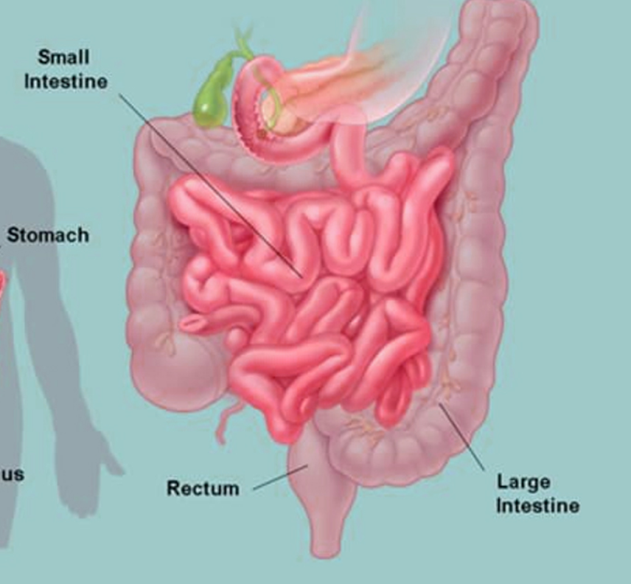
Roles of intestinal epithelium
Absorb nutrients & needed components from food
Protect body from infection and microbial exposure/waste

Slide 4
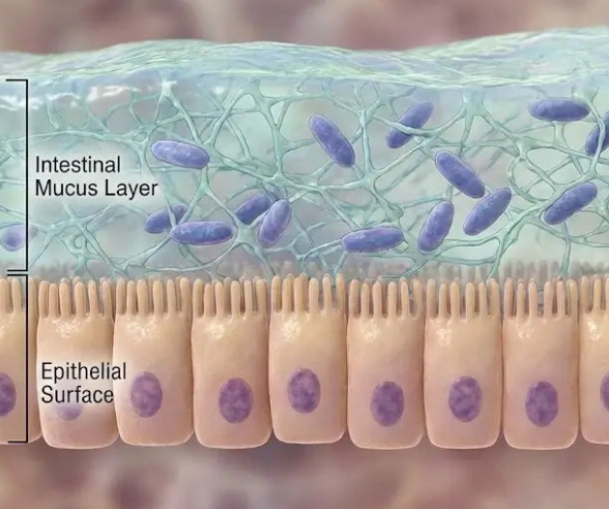
Mucus layer: review
Formed by mucins, formed from proteins released by goblet cells in intestinal epithelium
Creates protective layer shielding intestinal cells from bacteria in the gut
Mucus layer is thicker in large than small intestine
Some microbes in the microbiome can break down mucus (more on this later!)

Slide 5

Intestinal inflammation

Slide 6
What is Inflammation?
Part of the body’s immune defenses against infection and its response to injury
Characteristics of inflammation:
  Increased blood flow to affected tissue (can lead to swelling)
  Pain
  Release of cytokines (signaling molecules promoting inflammation)
  Movement of “white blood cells” to affected tissues
The suffix “-itis” is often used to describe inflammation of different tissues.
  Appendicitis = ?
  Tonsillitis = ?
  Nephritis = ?

Slide 7
Inflammation in the gastrointestinal tract
Enteritis = inflammation of the small intestine
Colitis = inflammation of the colon
“Gastroenteritis” = often used as a general term for inflammation of stomach and/or intestines
Depending on location of inflammation in GI tract, can cause abdominal pain, vomiting, diarrhea

Slide 8
Mechanisms of diarrhea
Osmotic – water drawn into the intestines from the body
  Can occur due to excess salt or levels of some sugars in the intestine
    Including after a highly salty meal!
  Can occur in cases of food intolerance (lactose for example)
  Occurs due to altered osmosis of water across intestinal epithelium

Slide 9
Mechanisms of diarrhea
Secretory – small intestinal epithelium actively secretes water and electrolytes into the intestinal space
  Can be induced by certain infections
  Movement of water by secretion rather than osmosis

Slide 10
Mechanisms of diarrhea
Motility – altered motility (movement) of food through digestive system
  If motility through the gut is too fast, absorption of nutrients can be poor and this can be associated with diarrhea

Slide 11

How is intestinal inflammation measured?

Slide 12
Outline
Intestinal inflammation
  What is inflammation?
  Causes and symptoms of acute inflammation
  Causes and symptoms of chronic inflammation
The microbiome
  Microbiome and infection
  Lessons from the mouse microbiome
  Lessons from the human microbiome

Slide 13
What is acute vs chronic inflammation?
Acute inflammation is relatively short-term
  Often associated with infection or reaction to a specific food/medication
Chronic inflammation is long-term or recurring
  Often associated with more complex diseases which may have genetic and/or environmental causes

Slide 14
What is acute vs chronic inflammation?
Acute inflammation is relatively short-term
  Often associated with infection or reaction to a specific food/medication
Chronic inflammation is a long-term or recurring case
  Often associated with more complex diseases which may have genetic and/or environmental causes

Slide 15
Example causes of acute intestinal inflammation
Can be bacterial
  For example, Escherichia coli, Shigella, Campylobacter
Can be viral
  Norovirus is a leading viral cause in adults
  Rotavirus is common in children

Slide 16
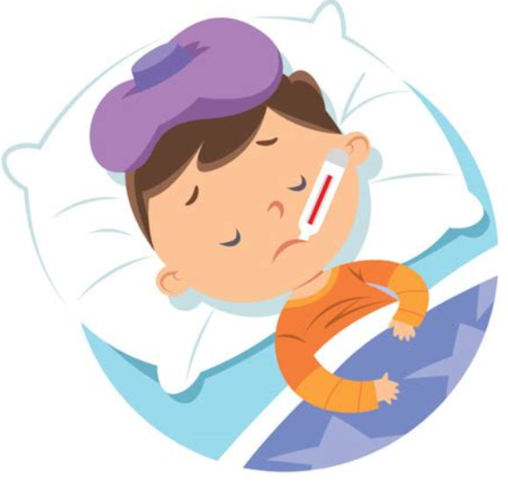
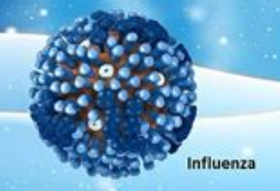
Terminology related to infection
Pathogen = an organism that causes infection
Virulence = a term for a pathogen’s ability to cause disease to a host
Virulence factor = a molecule or structure produced by a pathogen that contributes to virulence
Virulence
Pathogen

Slide 17
Symptoms can be induced directly by pathogens or related to the immune response
Example of direct induction of symptoms: toxins produced by bacteria (for instance, botulinum toxin produced by bacteria)
Example of symptoms from immune response: fever

Slide 18
What have you previously learned about differences and similarities between bacteria and viruses?

Slide 19
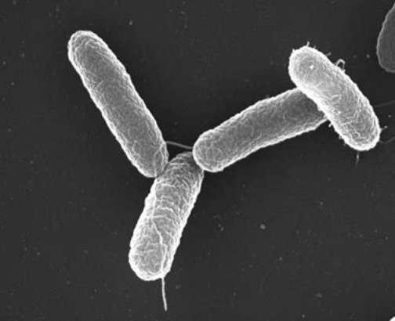
Salmonella enterica: example of a bacterial species causing diarrhea
Majority of infections come from contaminated food; often meat products
Causes gastroenteritis; can cause other forms of illness as well

Slide 20
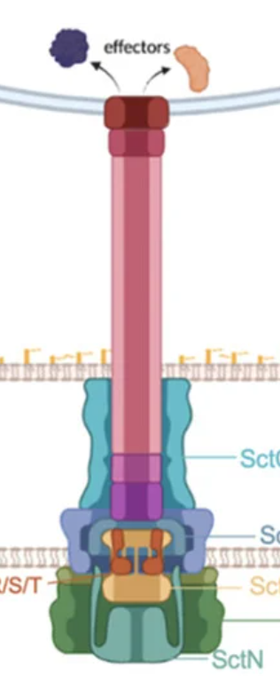
The type III secretion system: bacterial manipulation of the host
Resembles a molecular “needle” injecting proteins (“effectors”) directly into host cells
The Salmonella Type III system causes inflammation in the host
Some organisms use their T3SS to kill host immune system cells

Slide 21
Vibrio cholerae: another example of a bacterial pathogen
Ingested from contaminated water
Induces diarrhea by producing cholera toxin
Cholera toxin is not delivered by a T3SS; secreted into the surroundings of the bacterial cell
Why might inducing diarrhea be beneficial for this species?

Slide 22
Why might inducing diarrhea be favorable for Vibrio cholerae?

Slide 23
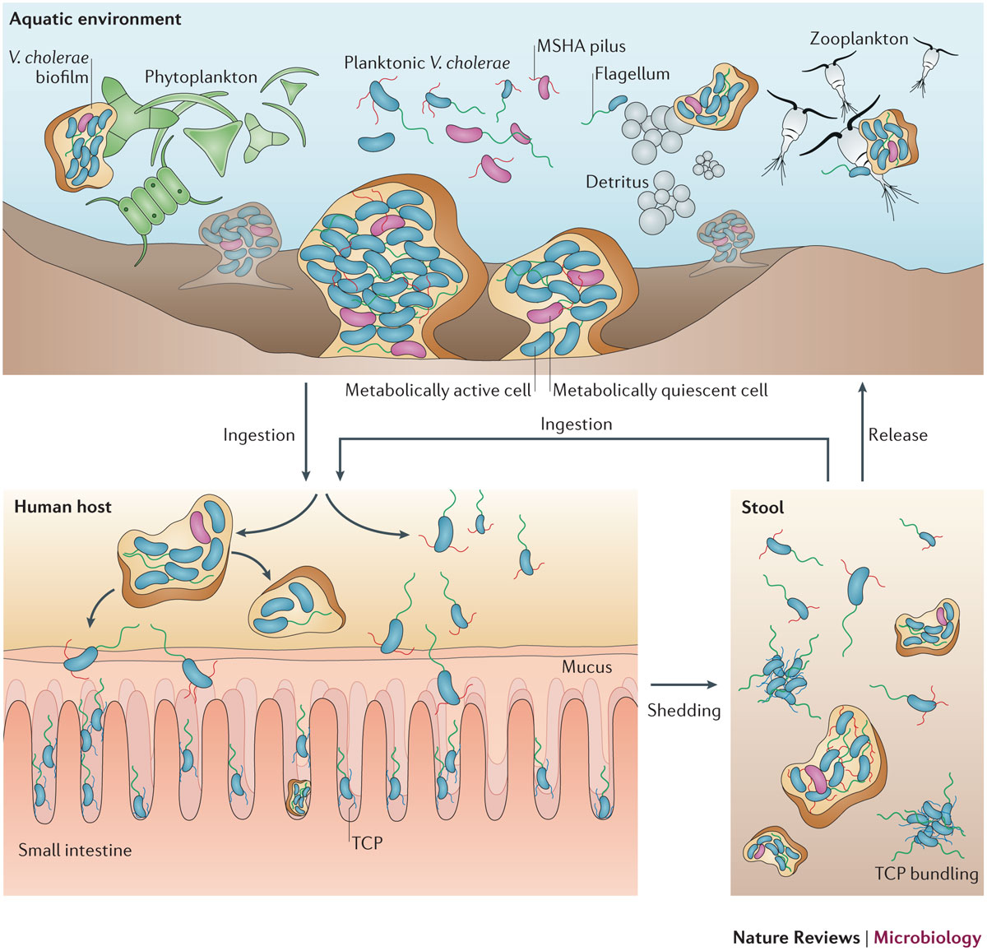
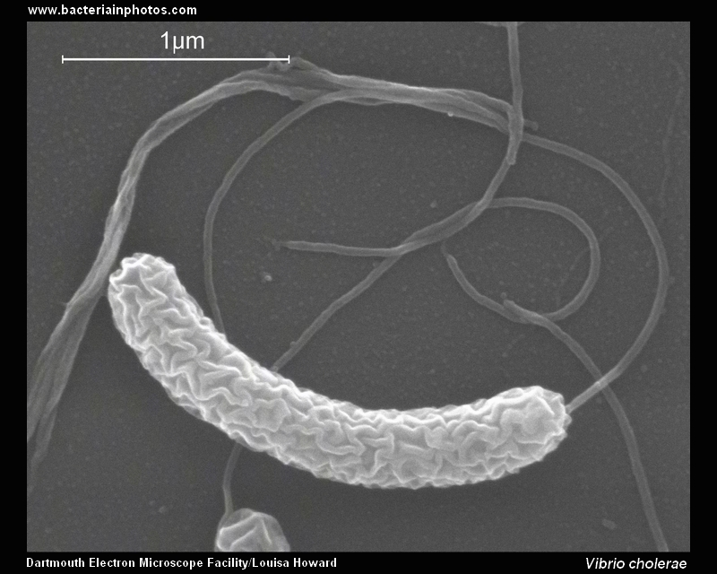
Vibrio cholerae: causative agent of Cholera
V. cholerae is an aquatic
bacterial species
Severe diarrhea, caused by cholera toxin, leads to the bacteria being shed, potentially back into water supplies.
Some strains, when ingested
by humans, can cause disease

Slide 24
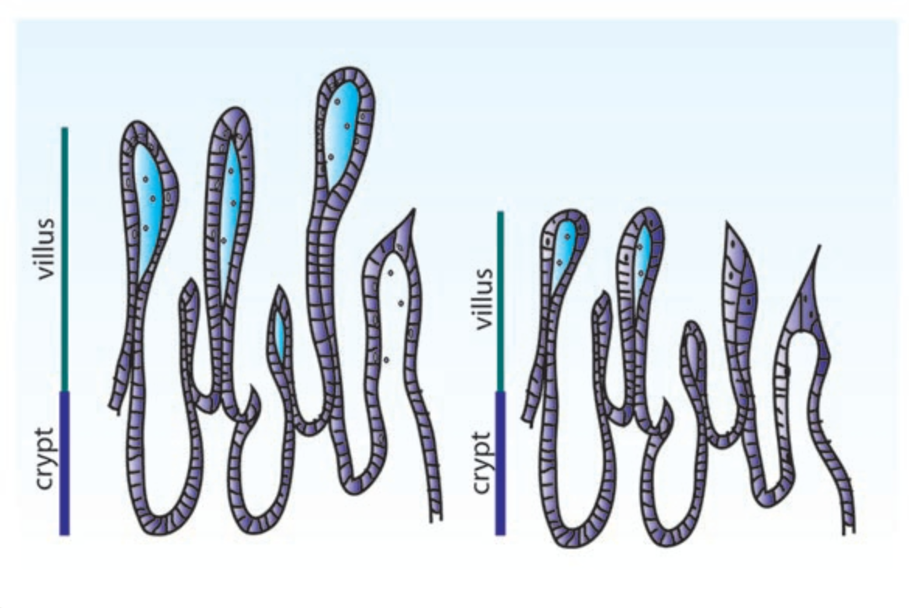
Viral example: norovirus
Common cause of viral gastroenteritis worldwide
Contagious directly between people (very contagious) or through ingesting contaminated water/food
Causes diarrhea & vomiting
Exact mechanism by which norovirus causes diarrhea is not entirely understood; evidence suggests that infection leads to villus blunting however

Slide 25
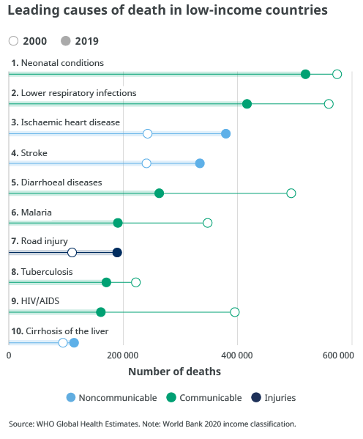
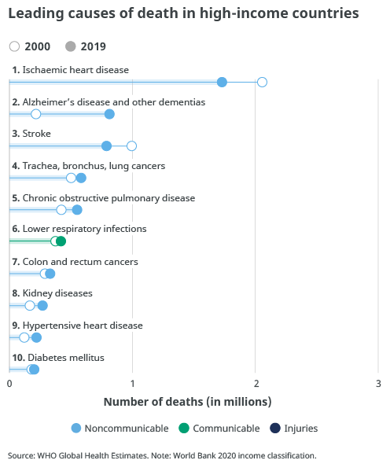
Gastrointestinal illness and global health

Slide 26
Outline
Intestinal inflammation
  What is inflammation?
  Causes and symptoms of acute inflammation
  Causes and symptoms of chronic inflammation
The microbiome
  Microbiome and infection
  Lessons from the mouse microbiome
  Lessons from the human microbiome

Slide 27
Inflammatory Bowel Disease (IBD)
“Umbrella term” referring to a group of conditions rather than one
Usually involves inflammation symptoms that come and go over time (recurring)
More common in wealthier industrialized countries
Most common forms of IBD are ulcerative colitis (UC) and Crohn’s Disease (CD)
  IBD is not the same as IBS (irritable bowel syndrome)

Slide 28
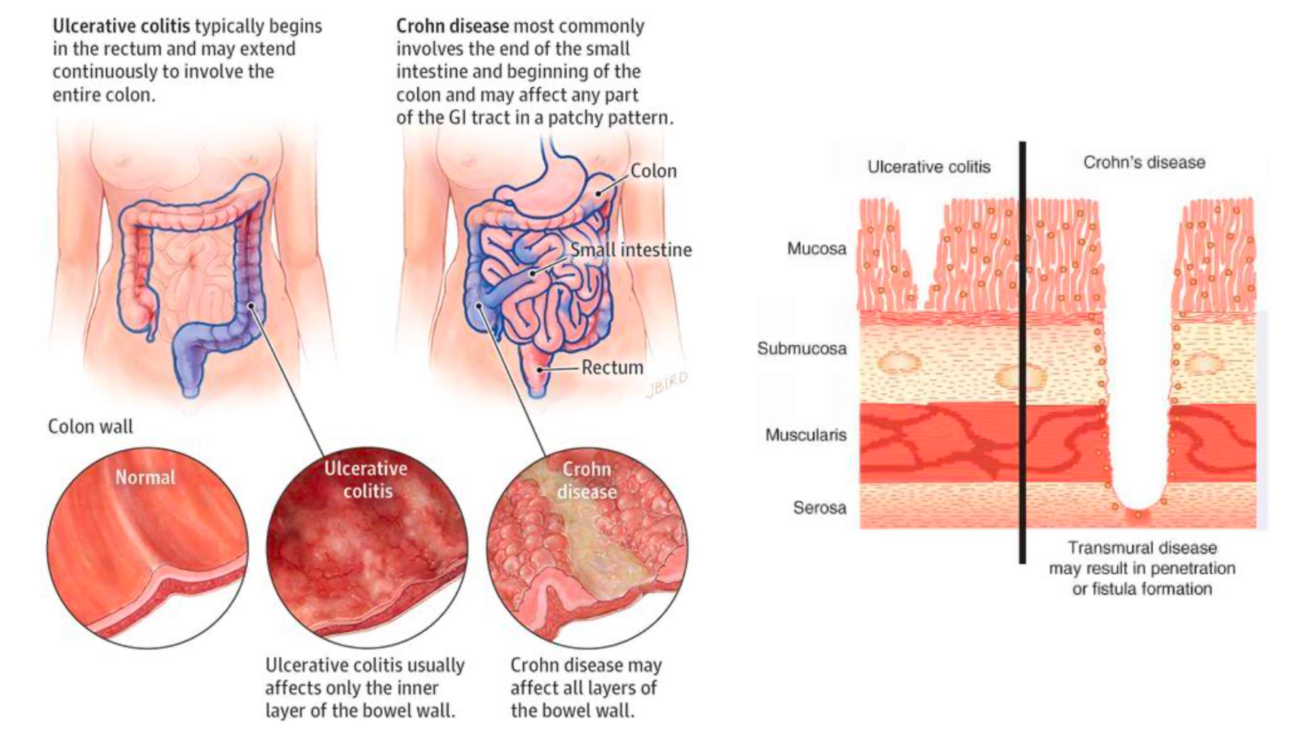

Slide 30
Compromised barrier can increase inflammation due to exposure to microbes

Slide 31
What do you remember about factors causing, or contributing to, IBD?

Slide 32
“Two hit” theory on IBD
First “hit” – genetic factor(s) impacting baseline risk of IBD
Second “hit” – dietary or lifestyle factors?

Slide 33
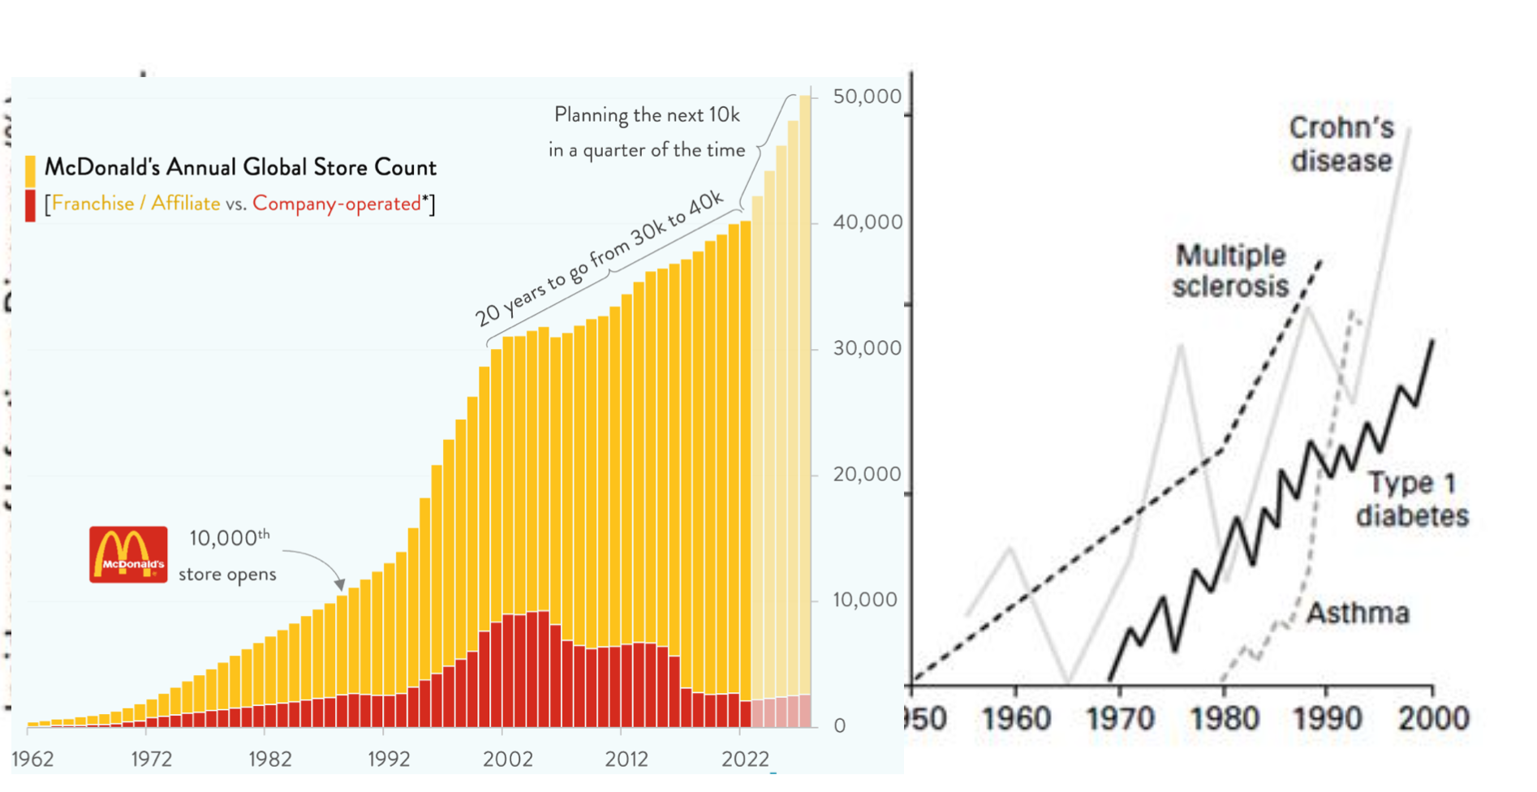

Slide 34
Vevox review questions

Slide 35
Outline
Intestinal inflammation
  What is inflammation?
  Causes and symptoms of acute inflammation
  Causes and symptoms of chronic inflammation
The microbiome
  Microbiome and infection
  Lessons from the mouse microbiome
  Lessons from the human microbiome

Slide 36
Part Two: Microbiome

Slide 37
What is the microbiome? (Vevox)

Slide 38
What factors might impact or alter microbiome composition?

Slide 39
The microbiome: some key points
Where does the microbiome come from?
  No microbiome present in fetuses
  First “inoculation” = birth!
  Altered over time with age and diet
Composition: two phyla comprise the majority
  Bacteroidetes
  Bacilotta (also called “Firmicutes”)
Benefits/roles of microbiome
  Digestion
  Production of some nutrients (vitamins for example)
  Resistance to infections
  Immune system development
  Other roles!

Slide 40
The microbiome: some key points
Where does the microbiome come from?
  No microbiome present in fetuses
  First “inoculation” = birth!
  Altered over time with age and diet
Composition: two phyla comprise the majority
  Bacteroidetes
  Bacilotta (also called “Firmicutes”)
Benefits/roles of microbiome
  Digestion
  Production of some nutrients (vitamins for example)
  Resistance to infections
  Immune system development
  Other roles!

Slide 41
How does the microbiome contribute to resisting infections?
One factor: “colonization resistance”
  Bacteria in the microbiome compete with pathogenic bacteria for resources
  This can prevent pathogenic bacteria from successfully growing in the gut

Slide 42
Some infections can arise from disrupting the microbiome
Antibiotics = antibacterial drugs used to treat infections
  Many antibiotics can also disrupt the microbiome
  Dysbiosis – harmful changes in the microbiome
Clostridioides difficile – often found in healthy digestive tract but outcompeted by other microbes
  If antibiotics disrupt the microbiome, C. difficile can grow to high numbers and cause gastrointestinal illness

Slide 43
Salmonella, inflammation, and competition with the microbiome
Salmonella induces inflammation in a manner dependent on its type III secretion system
Inflammation includes production of anti-microbial molecules
  This disrupts the microbiome, enabling Salmonella to compete more effectively against microbiome members.
Salmonella uses inflammation to compete with the microbiome.

Slide 44
Outline
Intestinal inflammation
  What is inflammation?
  Causes and symptoms of acute inflammation
  Causes and symptoms of chronic inflammation
The microbiome
  Microbiome and infection
  Lessons from the mouse microbiome
  Lessons from the human microbiome

Slide 45
How might you experimentally test the idea that the microbiome alters the immune system?

Slide 46
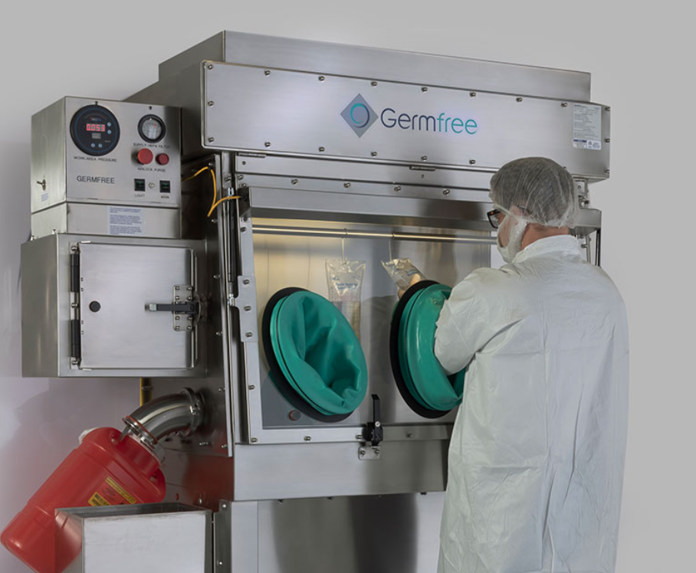
Germ-free mice: mice without microbiomes!
Mice delivered by C-section and raised in “isolator” chambers with no microbes present
Given sterilized food with no microbial contents
Experiment: how does the immune system differ between germ-free and normal mice?

Slide 47

Germ free mice
Behavior changes
Altered immune system
Altered responses to infection
Issues with digestion & nutrition

Slide 48
Germ free mice can be colonized with specific bacteria (“gnotobiotic mice”)

Slide 49
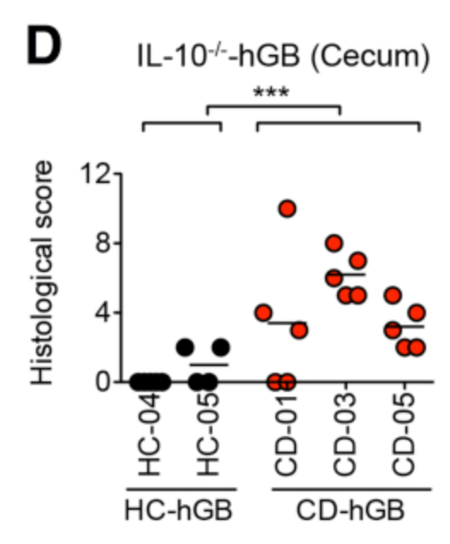
Example gnotobiotic mouse study
Healthy or Crohn’s disease microbiome administered to immunocompromised mice
Colitis was scored in these mice
Nagao-Kitamoto et al., 2016

Slide 50
What are advantages and limitations of mouse experimentation to study the microbiota?

Slide 51
Outline
Intestinal inflammation
  What is inflammation?
  Causes and symptoms of acute inflammation
  Causes and symptoms of chronic inflammation
The microbiome
  Microbiome and infection
  Lessons from the mouse microbiome
  Lessons from the human microbiome

Slide 52
What is, or is not, experimentally feasible for studying microbiome in humans rather than mice?

Slide 53
One approach that is critical: profiling the microbiome (measuring which organisms are present and in what numbers!)

Slide 54
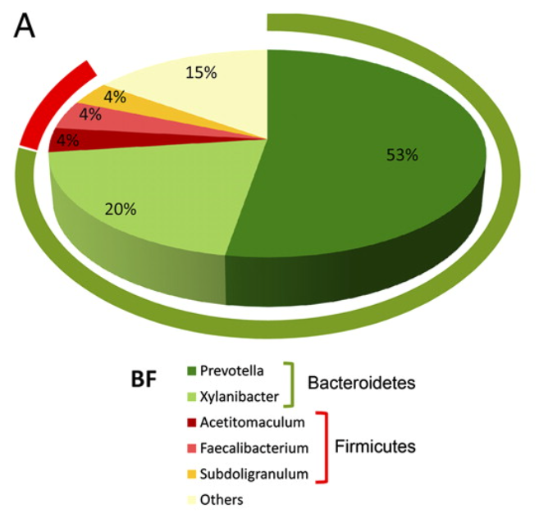
16s rRNA sequencing: a foundational tool for study of the microbiome
Goal of method: measure (1) which microbes are present and (2) what % of the community consists of each microbial taxa
Usually done using stool samples
Notes:
Image is example data

Slide 55
The 16s rRNA gene
Highly conserved in bacteria (meaning it is found in all bacteria)
Some portions of the gene are nearly identical in all bacteria
Other portions vary depending on taxonomy
Sequencing a portion of this gene allows researchers to identify which taxonomic groups are present and in what relative numbers
  Not accurate to level of species in most cases however!

Slide 56
What questions can 16s rRNA sequencing answer?
What changes in the microbiome are associated with differences in diet, disease, age, etc?
Understanding such questions requires a way to quantify and understand diversity

Slide 57
Microbiome diversity: how is “diversity” measured?

Slide 58
Concepts of microbial diversity
More variety of microbial taxa = more diversity
More diverse

Slide 59
Concepts of microbial diversity
More evenness of microbial taxa present = more diverse community
More diverse

Slide 60
Western diet is associated with reduced diversity of the human gut microbiome
“Western” diet tends to include more red meat consumption, less consumption of high-fiber foods and plants
“Western” diet also tends to include more highly processed foods

Slide 61
Potential links between diet, microbiome, and health?
Example one: short-chain fatty acids (SCFAs)
Example two: mouse microbiome study

Slide 62
Potential links between diet, microbiome, and health?
Example one: short-chain fatty acids (SCFAs)
Example two: mouse microbiome study

Slide 63
What are short-chain fatty acids?
Examples include butyrate and propionate
SCFAs are produced by members of the microbiome fermenting fiber from the diet
Fiber is higher in diets with more plant-based components

Slide 64
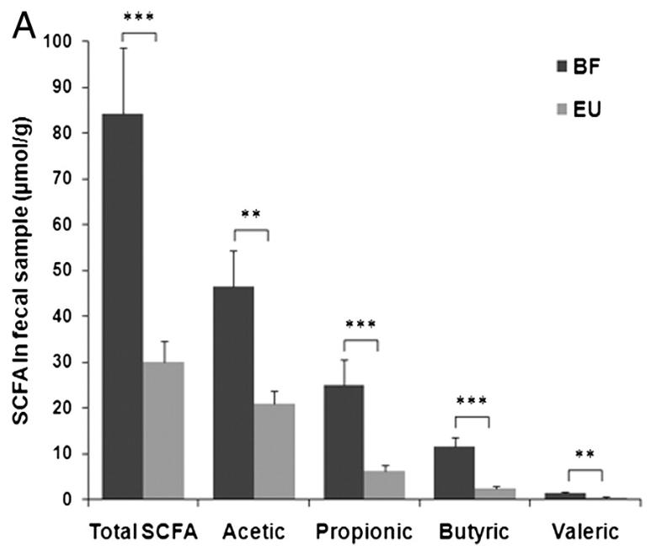
SCFAs higher in stool from children from Burkina Faso vs European Union

Slide 65
Butyrate and intestinal health
Butyrate has anti-inflammatory impacts in the gut
Favors differentiation of cells with anti-inflammatory activities
Promotes synthesis of mucin and helps strengthen gut epithelial barriers

Slide 66
Potential links between diet, microbiome, and health?
Example one: short-chain fatty acids (SCFAs)
Example two: mouse microbiome study

Slide 67
Low-fiber diet and impacts on mucosal barrier function: a primary literature example
See Cell2016_Fiber.pdf and look at abstract and Figure 4A, Figure 4B

