Slide 1

You can mock me as much as you like
Chris Hunt
Windows Platform Engineer @ Ticketmaster
@LogicalDiagram
https://github.com/cdhunt

Slide 2
Windows @ Ticketmaster
Physical Servers
GitLab CI
Docker
Xen
Prometheus
Telegraf
Terraform
AWS
Packer
DSC
PoshSpec
ELK
Kubernetes
Notes:
Background on Ticketmaster
Ticketmaster is ancient compared to most technology companies
We recently celebrated our 40th anniversary
This is a sample of some of the technologies the Windows Platform Engineering team works with regularly

Slide 3

A short story
In 1963 Ford wanted a car at Le Mans
http://pictures.topspeed.com/IMG/crop/201208/ford-gt40-gulf-mirag-4_1600x0w.jpg
Notes:
In 1963 Ford wanted a car at Le Mans
He found out Enzo Ferrari was looking to sell his company.
After a great deal of due diligence, Ford made an offer
Ferrari walked out when he found out Ford refused to let him remain in control of the racing division.
Ford was now determined to beat Ferrari and outsourced development of a race car to company from England. The result was the GT40.

Slide 4
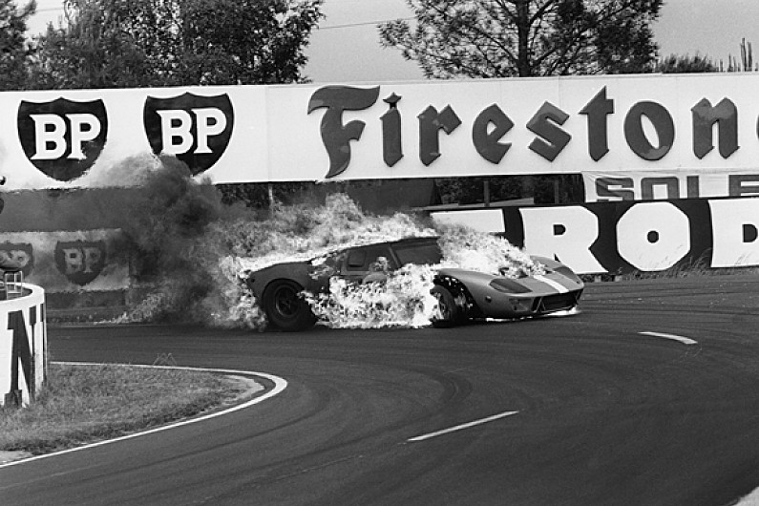
1964
Despite setting a lap, record all three GT40s failed to finish and a Ferrari won
http://www.autosport.com/news/report.php/id/122477
Notes:
In 1964, Despite setting a lap record, all three GT40s failed to finish and a Ferrari won the race.
In 1965, two GT40's were entered and both failed to finish and a Ferrari won again.

Slide 5
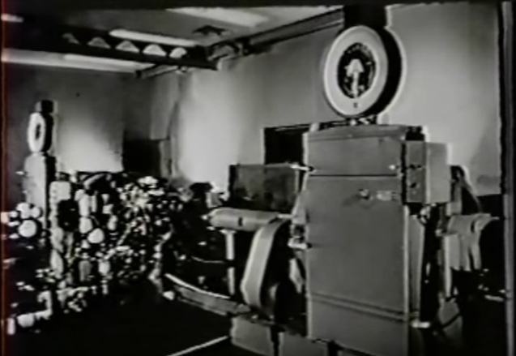
1965
Ford built a dynamometer laboratory to automate engine testing
https://youtu.be/NxP__UPj7L8
Notes:
After the 1965 season Ford built a dynamometer laboratory to automate the testing of the engines as closely to on-course conditions as possible .

Slide 6

1966
GT40's finished 1-2-3.
https://assets.hemmings.com/blog/wp-content/uploads//2015/01/1966_GT40s_LeMans_HR.jpg
Notes:
Not only did all three GT40’s finished, but they swept the podium
Automated testing leads to better, more reliable products
A significant part of automated testing is isolating your system under test and validating real-world conditions and oftentimes even conditions you don’t expect

Slide 7
Let's start with the vocabulary
Mocks - Functions pre-programmed with expectations which form a specification of the calls they are expected to receive
Stubs - Provide static response to calls made during the test
Fake Object - A working object, but takes some shortcuts. Example: Hard codes some properties instead of pulls them from an external source
Dummy Object - An object that is passed around but never used
Test Double - Any kind of pretend object used in place of a real object for testing purposes
System Under Test or rather the abbreviation SUT
Behavior Verification - Check to see if the system made the correct calls
State Verification - Determine whether the exercised method worked correctly by examining the state of the SUT and its collaborators after the method was exercised
As defined by Gerard Meszaros in xUnit Test Patterns
Notes:
I want to start with some vocabulary
The names aren’t super important. We tend to refer to everything as Mocking unless your title is QA Automation Engineer, but it’s helpful to understand the different patterns.
[go through defs]

Slide 8
[Mock] vs. Stub
function MockMe ($Path) {
return (Get-ChildItem -Path $Path)
}
Describe 'Mock' { # Behavior Verification
Mock Get-ChildItem -ParameterFilter {$Path -eq 'C:\foo'} -MockWith {$null}
Mock Get-ChildItem -ParameterFilter {$Path -eq 'C:\bar'} -MockWith {$null}
Context 'Foo' {
It 'Should only call GCI Foo' {
$output = MockMe 'C:\foo'
Assert-MockCalled Get-ChildItem -Times 1 -ParameterFilter {$Path -eq 'C:\foo'}
Assert-MockCalled Get-ChildItem -Times 0 -ParameterFilter {$Path -eq 'C:\bar'}
}
}
Context 'Bar' {
It 'Should only call GCI Bar' {
$output = MockMe 'C:\bar'
Assert-MockCalled Get-ChildItem -Times 0 -ParameterFilter {$Path -eq 'C:\foo'}
Assert-MockCalled Get-ChildItem -Times 1 -ParameterFilter {$Path -eq 'C:\bar'}
} } }
Notes:
My function MockMe just takes a parameter and calls Get-ChildItem with the given parameter
I have two Mock statements with different specifications
You see that there are no Should assertions and both Mocks just return $null. We’re verify the functionality entirely based on the calls made

Slide 9
Mock vs. [Stub]
function StubMe ($Path) {
$files = Get-ChildItem -Path $Path
return ($files | Select-Object -First 1 -ExpandProperty Name)
}
Describe 'Stub' { # State Verification
Mock Get-ChildItem -MockWith {[PSCustomObject]@{Name="test.txt"
"LastWriteTime"=(Get-Date "2000-01-01")}}
It 'Should return test.txt' {
$output = StubMe C:\Whatever
$output | Should Be 'test.txt'
}
}
Notes:
Here, my StubMe function is extracting a specific property of the output of Get-ChildItem
In this case my Mock statement has no ParameterFilter and instead returns a Fake Object
This test does use a Should Be assertion to verify the value returned by StubMe
These are both simple examples, but even as the code and tests become more complex it boils down to behavior or state verification.
Behavior Verification is good when you are testing an integration with some dependency. You want to test that you are making the correct calls, but not actually making them.
State Verification is necessary when your System Under Test is modifying state. Obviously.

Slide 10
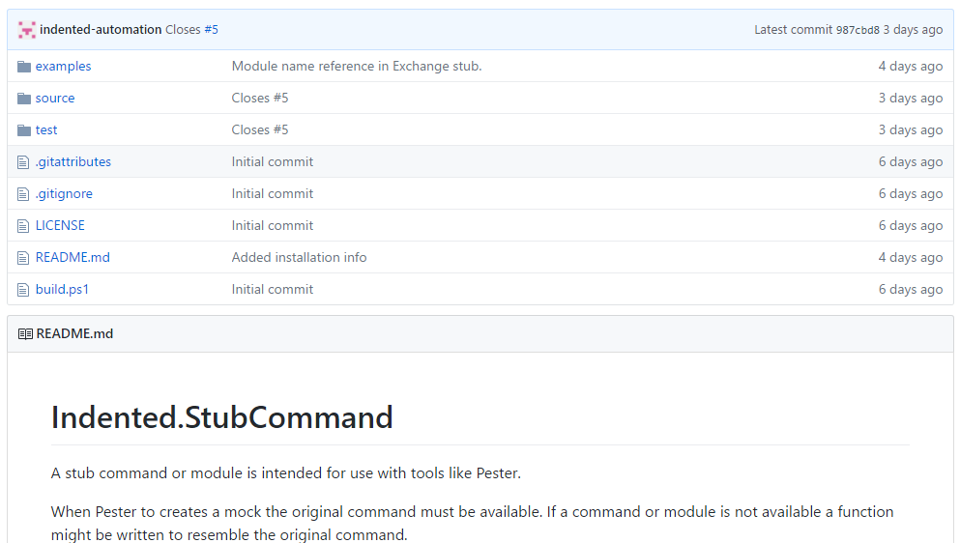
Mock vs. [Stub]
https://github.com/indented-automation/Indented.StubCommand
Notes:
Here, my StubMe function is extracting a specific property of the output of Get-ChildItem
In this case my Mock statement has no ParameterFilter and instead returns a Fake Object
This test does use a Should Be assertion to verify the value returned by StubMe
These are both simple examples, but even as the code and tests become more complex it boils down to behavior or state verification.
Behavior Verification is good when you are testing an integration with some dependency. You want to test that you are making the correct calls, but not actually making them.
State Verification is necessary when your System Under Test is modifying state. Obviously.

Slide 11
Mocking outside of the Box
Binaries
PowerShell Classes
Script Files
Script Blocks
.Net Classes
Cmdlets
Functions
Notes:
The “fun” of Mocking in PowerShell is there are so many ways to execute commands
The Mock command in Pester only works with functions
However, the very flexibility that makes testing in PowerShell a challenge makes it easy to Mock almost any call
While it’s easy to create Test Dummies in PowerShell, we lose the ability to use Assert-MockCalled for Behavior Verification

Slide 12
Script Files
Demo2a-ScriptFiles.ps1 =
Write-Output "Original File"
Describe 'Script File' {
It 'Should call Demo2a-ScriptFiles.ps1' {
${function:C:\Source\TMGit\Chris.Hunt\pssummit2017-mocking\Demo2a-ScriptFiles.ps1}`
= {Write-Output 'Testing'}
$results = C:\Source\TMGit\Chris.Hunt\pssummit2017-mocking\Demo2a-ScriptFiles.ps1
$results | Should Be 'Testing'
}
}
Describing Script File
[+] Should call Demo2a-ScriptFiles.ps1 143ms
Notes:
Say you need to invoke a stand-alone script and you want to Stub that out without actually executing the script
You can create a function with a name that is equivalent to the path of your script
This is a form of Behavior verification. Even though I’m testing the value returned, it’s a static response. If we get the “Testing” response that means we invoked the script.
Creating functions is one of the primary patterns you can use in PowerShell to fake just about any call

Slide 13
Binaries
Describe 'Binaries' {
Context 'LocalHost' {
function ping { return @'
Pinging LOCALHOST [::1] with 32 bytes of data:
Reply from ::1: time<1ms
Reply from ::1: time<1ms
Ping statistics for ::1:
Packets: Sent = 2, Received = 2, Lost = 0 (0% loss),
Approximate round trip times in milli-seconds:
Minimum = 0ms, Maximum = 0ms, Average = 0ms
'@
}
$results = ping localhost
$results | Should Match '0% loss'
}
}
Notes:
As you can see, the Function trick works well for binaries also
If you are just trying to verify the binary was called, you can return a static value

Slide 14
Binaries
Describe 'Binaries Again' {
Context 'Pseudo-Behavior Verification' {
function ping { return $args[0] }
$results = ping remotehost
$results | Should Be 'remotehost'
}
}
Notes:
But, you could take it a bit further and process arguments
By asserting the values in $arg, you define a call specification and do some basic Behavior Verification
Just don’t get carried away with logic or you’ll have to test your tests

Slide 15
Web APIs
Import-Module flancy
$url = "http://localhost:8001"
New-Flancy -url $url -webschema @(
Get '/' { "Api Mocks" }
Post '/nodes/' {
try {
$body = (New-Object System.IO.StreamReader @($Request.Body, `
[System.Text.Encoding]::UTF8)).ReadToEnd()
[PSCustomObject]@{Path=$Request.Path
Headers=$Request.Headers
Query=$Request.Query
Method=$Request.Method
Body=$body} |
ConvertTo-Json -depth 2 }
catch { $Error } }
)
Start-Sleep -Seconds 1
https://github.com/toenuff/flancy
https://github.com/Jaykul/NancyPS
Notes:
You need to test Integrating with a Web API?
In this example, we actually spin up a small web service to respond to Invoke-RestMethod
This configuration response to Get and Post commands. The Get returns a static value. The Post echoes back the contents of the Request.
Flancy and NancyPS are both wrappers around the .Net Nancy framework

Slide 16
Web APIs
Describe Nodes {
$URI = "http://localhost:8001"
Start-Job -Name ApiMocks -FilePath .\Demo4a.ps1
Context "Verify Flancy Server is running" {
It "Should respond" {
$results = Invoke-RestMethod $URI
$results | Should Be "Api Mocks"
}
}
Stop-Job -Name ApiMocks
Remove-Job -Name ApiMocks
}
Notes:
The only value this has over just mocking Invoke-RestMethod is you more closely simulate the real integration with real Request and Response objects
You can test how your code handles different Http status codes without hand crafting Response objects

Slide 17
.Net Objects
PS > New-Object -TypeName Diagnostics.Process -Property @{Name = "IMadeItUp.exe" }
New-Object : The value supplied is not valid, or the property is read-only. Change the value, and then try again. At line:1 char:7+ $ps = New-Object -TypeName Diagnostics.Process -Property @{Name = "IM ...
$ps = New-Object -TypeName Diagnostics.Process |
Add-Member ScriptProperty -Name ProcessName -Value {"IMadeItUp.exe"} -Force -PassThru |
Add-Member ScriptProperty -Name ID -Value {321} -Force -PassThru |
Add-Member ScriptMethod -Name Kill -Value {"Killed $($this.id)"} -Force -PassThru
PS > $ps
Handles NPM(K) PM(K) WS(K) CPU(s) Id SI ProcessName
------- ------ ----- ----- ------ -- -- -----------
0 0 0 321 IMadeItUp.exe
PS > $ps.kill()
Killed 321
Notes:
Speaking of hand crafting objects
You can use Add-Member to effectively override the value of any Property or Method
Note, this method of creating a fake object requires a class with a public constructor

Slide 18
ScriptBlocks
$scriptblock = [scriptblock]{
Get-Process
}
Describe 'ScriptBlock' {
Mock Get-Process {'Mocked PS'}
It 'Should Mock Get-Process' {
$results = $scriptblock.Invoke()
Assert-MockCalled Get-Process -Times 1
}
}
Describing ScriptBlock [+]
Should Mock Get-Process 83ms
Notes:
You can unit test your ScriptBlocks as well
Don’t put a lot of logic in your ScriptBlock. Build a testable module then use the ScriptBlock to install and invoke the module.

Slide 19
Review
What are you trying to verify with your test?
Behavior
Did the system call the things you think it’s supposed to call with the correct parameters?
State
Did the system return data with the structure and values you expected?
A lot of the times you have to verify State in order to verify Behavior with the tools we have available today
Take advantage of how dynamic PowerShell is and don’t fight it (Just don’t go crazy)
If you add imperative code to your tests, you could be adding bugs to your tests
Additional Resources
https://github.com/cdhunt/pssummit2017-mocking
xUnit Test Patterns: Refactoring Test Code by Gerard Meszaros

