Slide 1

You can mock me as much as you like
Chris Hunt
Windows Platform Engineer @ Ticketmaster
@LogicalDiagram
https://github.com/cdhunt

Slide 2
Windows @ Ticketmaster
Physical
GitLab CI
Docker
Private Cloud
Terraform
Public Cloud
Packer
DSC
PoshSpec

Slide 3

A short story
In 1963 Ford wanted a car at Le Mans
http://pictures.topspeed.com/IMG/crop/201208/ford-gt40-gulf-mirag-4_1600x0w.jpg
Notes:
In 1963 Ford wanted a car at Le Mans
He found out Enzo Ferrari was looking to sell his company.
After a great deal of due diligence by Ford made an offer
Ferrari walked out when he found out Ford refused to let him remain in control of the racing division.
Ford was now determined to beat Ferrari and outsourced development of a race car to company from England. The result was the GT40.

Slide 4

1964
Despite setting a lap, record all three GT40s failed to finish and Ferrari won
http://www.autosport.com/news/report.php/id/122477
Notes:
In 1964, Despite setting a lap, record all three GT40s failed to finish and a Ferrari won.
In 1965, two GT40's were entered and both failed to finish and a Ferrari won.

Slide 5
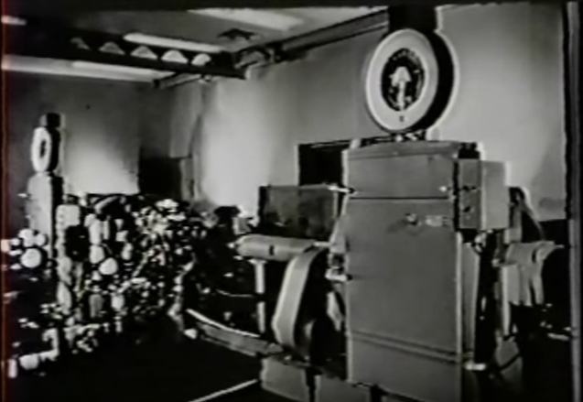
1965
Ford built a dynamometer laboratory to automate engine testing
https://youtu.be/NxP__UPj7L8
Notes:
After the 1965 season Ford built a dynamometer laboratory to automate the testing of the engines as closely as possible to on-course conditions.

Slide 6

1966
GT40's finished 1-2-3.
https://assets.hemmings.com/blog/wp-content/uploads//2015/01/1966_GT40s_LeMans_HR.jpg
Notes:
Automated testing leads to better, more reliable products
A significant part of automated testing is isolating your system under test and validating real-world conditions and oftentimes even conditions you don’t expect

Slide 7
Let's start with the vocabulary
Mocks - Functions pre-programmed with expectations which form a specification of the calls they are expected to receive
Stubs - Provide static response to calls made during the test
Fake Object - A working object, but takes some shortcuts. Example: Hard codes some properties instead of pulls them from an external source
Dummy Object - An object that is passed around but never used
Test Double - Any kind of pretend object used in place of a real object for testing purposes. All of the above
System Under Test or rather the abbreviation SUT
Behavior Verification - Check to see if the system made the correct calls
State Verification - Determine whether the exercised method worked correctly by examining the state of the SUT and its collaborators after the method was exercised
As defined by Gerard Meszaros in xUnit: Testing Patterns
Notes:
We use the term Mock we are most likely mean Test Double
It’s probably not super important that you know these by heart, but understand that you use different Test Doubles for the different types of verification
When you are verifying the state, was your state affected by a Stub?
When you are verifying behavior

Slide 8
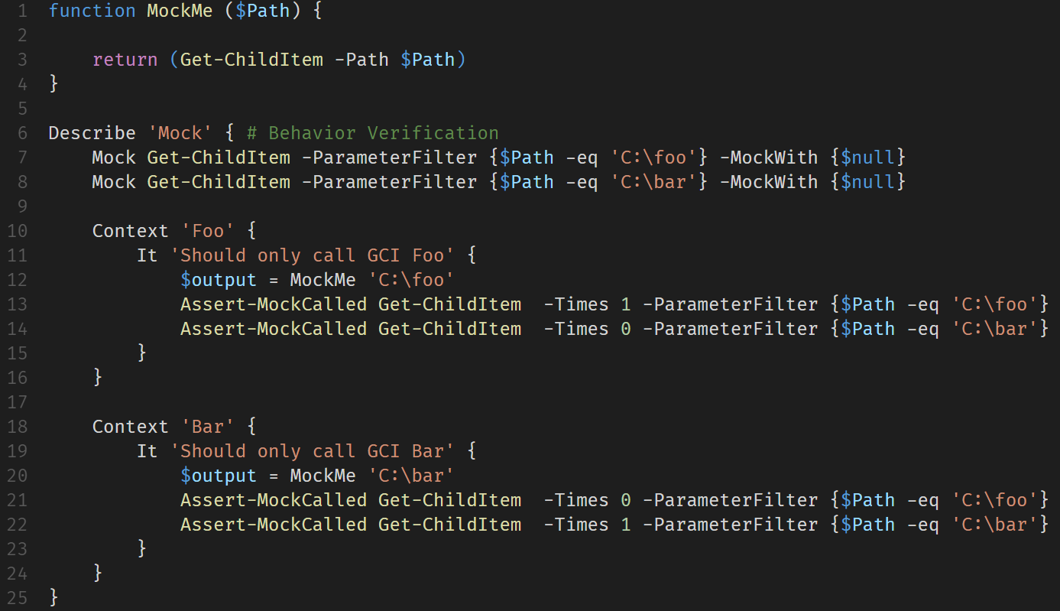
[Mock] vs. Stub
Notes:
My function MockMe just takes a parameter and calls Get-ChildItem with the given parameter
I have two Mock statements with different specifications
You see that there are no Should assertions and both Mocks just return $null. We’re verify the functionality entirely based on the calls made

Slide 9
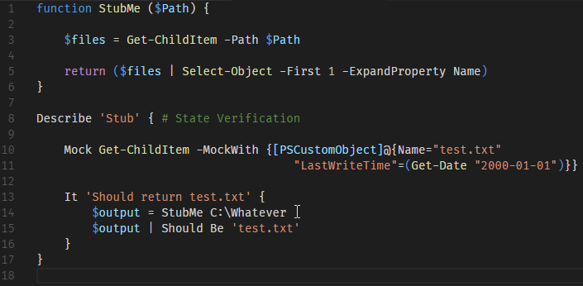
Mock vs. [Stub]
Notes:
Here, my StubMe function is extracting a specific property of the output of Get-ChildItem
In this case my Mock statement has no ParameterFilter and instead returns a Fake Object
This test does use a Should Be assertion to verify the value returned by StubMe
These are both simple examples, but even as the code and tests become more complex it boils down to behavior or state verification.
Behavior Verification is good when you are testing an integration with some dependency. You want to test that you are making the correct calls, but not actually making them.
State Verification is necessary when your System Under Test is modifying state. Obviously.

Slide 10
Mocking outside of the Box
Binaries
PowerShell Classes
Script Files
Script Blocks
.Net Classes
Cmdlets
Functions
Notes:
The “fun” of Mocking in PowerShell is there are so many ways to execute commands
The Mock command in Pester works with functions/cmdlets
The very flexibility that makes testing in PowerShell a challenge makes it easy to Mock almost any call
While it’s easy to create Test Dummies in PowerShell, we are pretty much stuck with State Verification once we abandon the Mock command of Pester

Slide 11
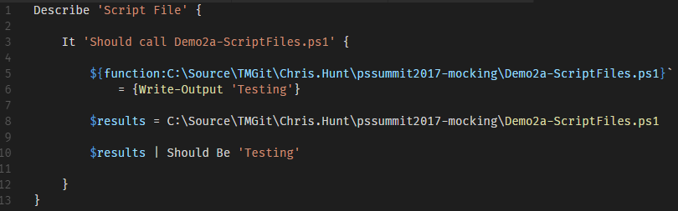
Script Files
Notes:
Say you need to invoke a stand-alone script and you want to Stub that out without actually executing the script
You can create a function with a name that is equivalent to the path of your script
This is one of the primary patterns you can use in PowerShell to fake just about any call

Slide 12
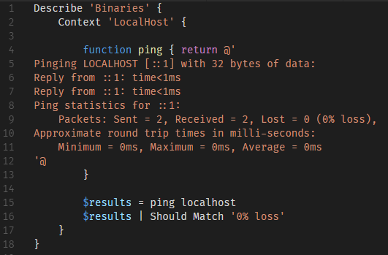
Binaries
Notes:
The Function trick works well for binaries also
If you are just trying to verify the binary was called, you can return a static value

Slide 13
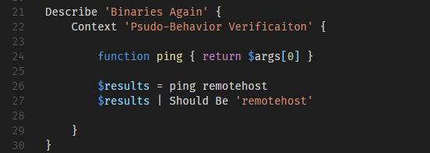
Binaries
Notes:
But, you could take it a bit further and work with $args
If you test the $arg values, you create a call specification and do some basic Behavior Verificaiton
Just don’t get carried away with logic or you’ll have to unit test your unit tests

Slide 14
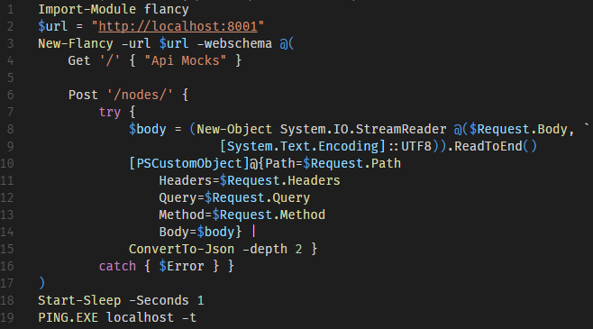
Web APIs
https://github.com/toenuff/flancy
https://github.com/Jaykul/NancyPS
Notes:
In this example, we actually spin up a small web service to respond to Invoke-RestMethod
Flancy and NancyPS are similar, but with slightly different approaches.

Slide 15
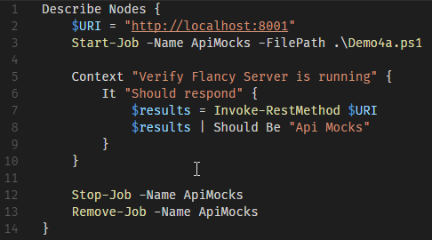
Web APIs
Notes:
The only value this has over just mocking Invoke-RestMethod is you more closely simulate the real integration with real Request and Response objects
You can test how your code handles different Http status codes without hand crafting Response objects

Slide 16
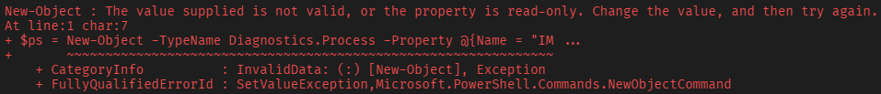


.Net Objects
New-Object -TypeName Diagnostics.Process -Property @{Name = "IMadeItUp.exe" }
PS >$ps
PS >$ps.Kill()
Notes:
Speaking of hand crafting objects

Slide 17
Digit
Recommendations
Investigation and if possible, leverage Docker containers based on Windows Server 2016
Consider alternate solutions to the IPList / static address issue: NAT/PAT, reverse proxy, etc.
Concerns
Digit is currently a single point of failure
IPList / static IP addresses are not optimal in AWS
Should send the content of the console output of Digit to a remote location
Since Digit requires each client to run it’s own instance(s), it is relatively expensive to maintain. A shared pool (that could auto-scale) would achieve significant cost savings.

Slide 18
RDS Farm
Recommendations
Docker is not possible; recommend immutable EC2 instances based on Server 2016
Use ELB (Elastic Load Balancer) for load balancing
Should be implemented as auto-scaling groups for: Gateways, connection broker and session host servers (per collection), SQL Servers
Concerns
Current licensing prevents us from scaling horizontally (we also may not be licensed correctly)
Remove dependency on Arcshare, or provision file share cluster to support
Should another team be responsible for TMWin?
IPList issues for TMWin will need to be solved
How will access to the gateways be handled (direct vs. TM router)
RDS Farm is very expensive to maintain; a web farm would be vastly less expensive

Slide 19
Other Classes
Recommendations
Leverage Docker containers based on Windows Server 2016 where possible
Use auto-scaling groups for self-healing where possible
Concerns
Deployment must be fully automated
Discovery of configuration of servers is not complete

Slide 20
Miscellaneous
TMCRM will not be in scope for AWS (in a separate data center)
Disaster Recovery plans will need to be updated
DSC / AADS and AWS / containers / immutable EC2
Hosted.Ticketmaster.com DNS zone

Slide 21
Next Steps
Investigate and finalize compute provisioning decisions
Determine application changes required for AWS
Identify solutions for potential blockers / concerns
Determine availability zone / region layout
Finalize decision on first product to move
Decision on archive / training databases in the cloud
Consider revisiting RDS licensing scheme (per-server vs. per-user)
Final decisions on client networking and responsibility for that

