Slide 1
The AC/DC Framework
Analysis Concepts & Derivation Concepts for Analysis

Slide 2
Agenda
The Problem: Why Current Approaches Don't Scale
The Recipe Analogy: A Mental Model for AC/DC
The Three Components: Template, TEs, Method
The Core Model: OUTPUT = f(INPUT)
From Template to Study: Model Layers
Same Recipe, Different Kitchens
SDMX Data Cubes: The Technical Foundation for Machine-Executable Specifications
Summary

Slide 3
The Problem
Why Current ADaM and Output Programming Doesn't Scale

Slide 4
Everything is Hardcoded
A typical ANCOVA program:
proc mixed data=adam.adqsadas;
where PARAMCD="ACTOT11" and EFFFL="Y";
model CHG = BASE SITEID TRTP;
run;
What's embedded in the code:
Dataset name: adqsadas
Variable names: CHG, BASE, TRTP, SITEID
Filter conditions: PARAMCD, EFFFL values
Different parameter? → Copy-paste, change values
Different study? → Rewrite everything

Slide 5
An automated approach – tied to specific language
YAML + R Code References
table:
name: ADSL
filter_domain:
- dm: '!is.na(AGE)' # R syntax
column_action:
AGE_GRP1:
code_id: "age_group_01.R" # code file
Domain-Specific Language (DSL)
if DM.DTHFL = 'Y'
and the latest of
([ADSL.LSTALVDT + 1 day, ADSL.DTHDTC])
is not later than 2023-07-01,
then set to the latest of
([ADSL.LSTALVDT + 1 day, ADSL.DTHDTC]),
else set to blank.
Example from PHUSE EU 2025, Paper SM04
Matthew Phelps, Nicolai Skov Johnsen, Novo Nordisk
Example from PHUSE EU 2023, Paper DH12
Kang Zhao, AstraZeneca
Common Problems:
Clever solutions, but proprietary: Each company invents its own format
Platform-specific: Tied to R ecosystem or custom interpreters
Spec ≠ Code: Logic hidden in external code-files (YAML) or requires custom parser (DSL)
Not portable: Can't be shared across companies or tools
Missing intent: Tells us HOW to compute, but not the analytical purpose
…if every organisation builds their own LEGO system with proprietary brick sizes, we've just created a hundred incompatible toy boxes. Your bricks won't fit my castle…

Slide 6
The AC/DC Solution
Separating "What" from "How" from "Where"

Slide 7
Think of Analysis Like Cooking
Every time you want to prepare a dish, you need three things:
📋
🫒
👨‍🍳
A Recipe
Ingredients
Instructions
(Template)
(Semantic Transformation Concepts)
(Method)
+
+
The pattern that describes what you're making
Abstract components — 'oil' not 'Bertolli Extra Virgin'
How to combine ingredients using named roles
= A complete, reproducible analysis specification

Slide 8
The Separation of Concerns
A vinaigrette recipe doesn't specify "Bertolli olive oil" — it just says "oil"
AC/DC separates what you need from the specific product you use:
WHAT (Abstract)
WHERE (Concrete)
"oil" → analysis_value "vinegar" → baseline_value "emulsify" → Subtraction method
→
ADaM: AVAL, BASE, CHG SAS: PROC GLM Your specific study data
This enables:
🌐
Standard-independence
⚙️
Machine-execution
♻️
Reusability
ADaM, SDTM, OMOP, FHIR
Automated code generation
Define once, execute anywhere
A good recipe works in any kitchen, with any brand of ingredients.

Slide 9
The Three Components
Recipe, Ingredients, and Cooking Instructions
📋
🫒
👨‍🍳
+
+
Recipe
Ingredients
Instructions
Let's explore each component in detail...

Slide 10
The Big Picture
The recipe doesn't care about brands — it works with abstract ingredient types. Similarly, Templates work with semantic concepts
(Semantic Transformation Concepts (STC)).
AC/DC Framework
Recipe Analogy
1.
TEMPLATE
1.
THE RECIPE
Pattern defining clinical intent and what elements are needed
Instructions defining what dish to make and what ingredients needed
2.
SEMANTIC TCs
2.
THE INGREDIENTS TYPES
Abstract data concepts (analysis_value, baseline_value)
Abstract types: "oil", "vinegar" — not specific brands
3.
METHOD
3.
THE TECHNIQUE
Operations with named roles (Subtraction, ANCOVA)
How to combine: emulsification, reduction, sautéing

Slide 11
Templates: The Recipe Card
The recipe doesn't specify "Bertolli Extra Virgin" — it just says "oil". Templates work the same way.
AC/DC Template
Recipe Card
Template: ChangeFromBaseline
Recipe: Classic Vinaigrette
Clinical Intent:
Purpose:
Calculate absolute change from baseline
Create an emulsified salad dressing
Semantic TCs needed:
Ingredients types needed:
• analysis_value (input measure) • baseline_value (input measure) • change_value (output measure)
• oil (3 parts) • vinegar (1 part) • seasoning (to taste)
Method: Subtraction
Method: Emulsification
Template captures WHAT you're doing clinically
Recipe captures WHAT dish you're making

Slide 12
Semantic TEs: The Ingredients
The same recipe works regardless of which specific oil you use — same template works across data standards.
Semantic Transformation Concepts
Ingredient Types
Abstract concepts, not physical variables
Generic categories, not specific products
analysis_value
Oil
Could be bound to:
Could be:
ADaM: AVAL | OMOP: value_as_number
Olive oil from Italy | Canola from Canada | Coconut from Thailand
baseline_value
Vinegar
Could be bound to:
Could be:
ADaM: BASE | OMOP: (derived)
Balsamic | Red wine | Apple cider | Rice
treatment_planned
Seasoning
Could be bound to:
Could be:
ADaM: TRT01P | OMOP: drug_concept_id
Salt + pepper | Dijon mustard | Herbs de Provence

Slide 13
Methods: The Cooking Technique
The technique doesn't care what specific oil or vinegar you use — it just combines "fat" and "acid" into an emulsion.
AC/DC Methods
Cooking Techniques
Derivation Method: Subtraction
Technique: Emulsification
difference := minuend - subtrahend
1. Place [acid] in bowl 2. Slowly drizzle [fat] while whisking 3. Add [seasonings] and mix
Roles: minuend (in) | subtrahend (in) | difference (out)
Roles: acid | fat | seasonings | emulsion
Analysis Method: ANCOVA
Technique: Reduction
response ~ covariate + group
Simmer [liquid] until volume reduced by [ratio]
Roles: response | covariate | group
Roles: liquid | ratio | concentrated_result
Methods define HOW using named roles
Techniques use generic roles, not specific brands

Slide 14
The Three-Layer Architecture
Both derivation and analysis follow the same pattern: Method → Template → Implementation
AC/DC Framework Layers
Recipe Parallel
METHOD LAYER
TECHNIQUE
Derivation: Subtraction, Division Analysis: t-test, ANCOVA, MMRM, Cox PH
Emulsification, reduction, sautéing
Pure operations with named roles
How to combine ingredients
TEMPLATE LAYER
RECIPE CARD
ChangeFromBaseline, PercentChange CFB_ANCOVA, TTE_CoxPH
Classic Vinaigrette: oil + vinegar
Binds STCs to method roles for clinical purpose
What dish + what ingredients needed
IMPLEMENTATION
ACTUAL PRODUCTS
ADaM / SDTM / OMOP variables R / SAS / Python code
Bertolli olive oil, Whole Foods balsamic
Physical bindings & code generation
Physical items from your pantry

Slide 15
The Core Model
Derivation and Analysis as Functions

Slide 16
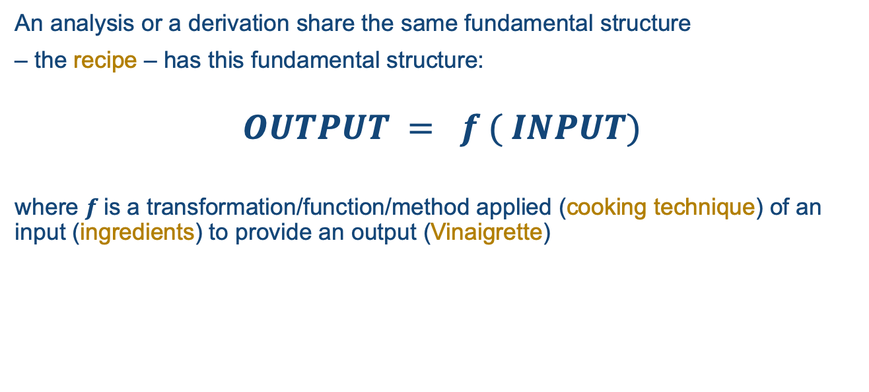
Derivation and Analysis - Functions
An analysis or a derivation share the same fundamental structure
– the recipe – has this fundamental structure:
$$OUTPUT = f ( INPUT)$$
where $f$is a transformation/function/method applied (cooking technique) of an input (ingredients) to provide an output (Vinaigrette)

Slide 17
The $f$ : The Method
In our model, $f$is the Method — a pure operation defined entirely through named roles.
It knows nothing about clinical data, variables, or standards.
Derivation Method: Subtraction
Analysis Method: ANCOVA
difference := minuend − subtrahend
response ~ covariate + group
Named Roles:
Named Roles:
minuend (input)
subtrahend (input)
difference (output)
response (input)
covariate (input)
group (input)
estimate (output)
significance (output)
🍳 Technique: Emulsification
🍳 Technique: Reduction
Methods define HOW using named roles — they are standard-independent and reusable.
#ClearDataClearImpact

Slide 18

The Input & Output: Why Concepts?
The challenge
As a standards organisation, we don't know how your ADaM model looks.
Even within a single company, multiple ADaM structures may exist across studies.
If the function references ADaM variables directly, it only works for one specific data structure.
The solution: Generic Concepts
We introduce Concepts — generic, standard-agnostic descriptions of the data elements that derivations and analyses need.
These are the ingredient types from the recipe analogy — "oil", not "Bertolli Extra Virgin".
The input and output of the function refer to these Concepts — not to physical variables.
You then link your ADaM model to these Concepts to use the function on your study.
Your ADaM Structure
CHG, AVAL, BASE, TRT01P ...
maps to →
Concepts
analysis_value, baseline_value,
change_value, treatment ...
← refers to
Method
$f$(roles)
#ClearDataClearImpact

Slide 19
Putting It Together: The Transformation
OUTPUT = f(INPUT) as a whole is the Transformation — the AC/DC template.
It orchestrates the connection between Method and Concepts through
Role Bindings.
Transformation: ChangeFromBaseline
Clinical Intent: Calculate the absolute change from baseline value
Method
Role Bindings (Concept → Method Role)
Subtraction
Concept | Method Role | Direction | dataStructure Role
analysis_value | minuend | input | measure
baseline_value | subtrahend | input | measure
change_value | difference | output | measure
subject, visit, parameter | scope | input | dimension(s)
difference := minuend − subtrahend
The Transformation captures clinical intent — not just what the operation is, but why you're doing it.
#ClearDataClearImpact

Slide 20
From Abstract to Concrete
To use a Transformation on your study, you provide Implementation Bindings and study-specific configuration — which variables, which parameter, which visit, which population.
Your Study Configuration
Resolved Transformation
Concept | Dataset | Variable
analysis_value | ADQSADAS | AVAL
baseline_value | ADQSADAS | BASE
change_value | ADQSADAS | CHG
subject | ADQSADAS | USUBJID
ChangeFromBaseline on ADQSADAS
→
ADQSADAS.CHG := ADQSADAS.AVAL − ADQSADAS.BASE
ADQSADAS.AVAL → minuend (input)
ADQSADAS.BASE → subtrahend (input)
ADQSADAS.CHG → difference (output)
by USUBJID
Study-Specific Configuration
parameter | = | ACTOT11 (ADAS-Cog 11)
visit | = | Week 24
population | = | ITT (ITTFL = 'Y')
WHERE
PARAMCD = 'ACTOT11'
AND AVISIT = 'Week 24'
AND ITTFL = 'Y'
🍳 Tonight's dinner: Caesar salad, 4 servings, for the dinner party
Same Transformation, different study?
Only the bindings and configuration change. The template, the method, and the concepts stay the same.
#ClearDataClearImpact

Slide 21
Layered Architecture
METHODS LIBRARY
Derivation Methods (Subtraction, DateDiff, Aggregation, ...)
Analysis Methods (ANCOVA, MMRM, Cox PH, ...)
TECHNIQUE
TEMPLATES
Derivation Templates (derivation role bindings)
Analysis Templates (analysis role bindings)
RECIPE CARD
CLINICAL SEMANTIC TRANSFORMATION MODEL (CSTM)
Semantic Transformation Concept (STC)
Observation-level STCs
• Value (observation, analysis, baseline, change) • Timing (visit, timepoint, period) • Treatment, Flags, Identity, TTE, Parameter
Inference-level STCs
• Estimates (point estimate, LS mean, HR) • Interval (CI, prediction interval) • Tests (p-value, test statistic)
INGREDIENT TYPES
IMPLEMENTATION BINDINGS
ACTUAL PRODUCTS
ADaM
SDTM
OMOP
FHIR
USDM
...

Slide 22
The framework model - conceptually
Analysis/derivation specification
Clinical Semantic Transformation Model
Standard/Study Implementation
AC/DC
ADaM Sponsor Variable
Dimension
Is a
Concept
Is a
ADaM Standard Variable
Input Cube
ADaM Sponsor Variable
ADaM Sponsor Dataset
ADaM Standard Variable
ADaM Sponsor Variable
Method
Measure
Concept
TECHNIQUE
Output Cube
Dimension Component
Slice
Attribute
Concept
Analysis Output Dataset
Measure Component
Attribute Component
RECIPE CARD
INGREDIENT TYPES
ACTUAL INGREDIENTS

Slide 23
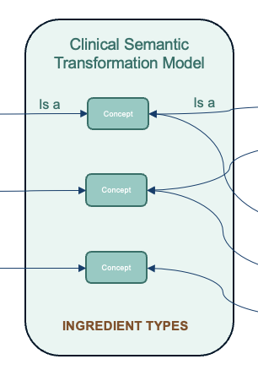
Three-Layer Architecture
Layer 1: AC/DC Instance – the derivation/analysis logic
"What am I deriving/analyzing"
template based on semantic concepts (change_value, baseline_value)
references the Clinical Semantic Transformation Model via IS_A relationships
Layer 2: Clinical Semantic Transformation Model
Definitions of analytical concepts and their relationships
study-independent
generic definition of change_value, baseline_value, treatment, LSMean, p-value...
Layer 3: Implementation/presentation layer
"Where is my data?" — Study-specific
How does my presentation layer relate to the Analytical Data Model
change_value ← CHG ← ADQSADAS.CHG
treatment ← TRT01P ← ADQSADAS.TRT01P
Same analysis, different study? Only Implementation layer changes.
“Translator”

Slide 24
The Clinical Semantic Transformation Model
The semantic vocabulary — concepts that AC/DCs reference:
Concepts (standard-agnostic):
subject, parameter, visit, treatment, site
analysis_value, baseline_value, change_value
population_flag, baseline_flag
Semantic relationships:
change_value derived_from (analysis_value, baseline_value)
baseline_value identified_by (subject, parameter, baseline_flag)

Slide 25
From Template to Study
The Three Layers of Resolution

Slide 26
Layer 1: The Recipe Card (Template)
You decide to make vinaigrette — you pull out the recipe card (Template)
Tonight's Vinaigrette Instance:
Using recipe: Classic Vinaigrette
For: Caesar salad
Serving: 4 people
The Template captures your clinical analysis intent
It references semantic concepts, not physical variables

Slide 27
Layer 2: The Pantry (Semantic TE Bindings)
Your pantry has a labeling system — the jar labeled 'OIL' holds different products
CSTM Bindings map concepts to standards:
ADaM: AVAL → analysis_value
ADaM: BASE → baseline_value
ADaM: CHG → change_value
The Semantic TC is the semantic connector
Same labels work with ADaM/SDTM, OMOP, FHIR

Slide 28
Layer 3: Actual Products (Implementation)
When you open the pantry, you grab actual physical items
Study Implementation:
AVAL → ADQSADAS.AVAL (physical column)
BASE → ADQSADAS.BASE
CHG → ADQSADAS.CHG
This is where abstract concepts meet real data
And generate executable code

Slide 29
The Magic
Same Recipe, Different Kitchens

Slide 30
Restaurant Kitchen (OMOP)
Home Kitchen (ADaM)
Template: ChangeFromBaseline
Standard: ADaM
Study: ADQSADAS
Generated Code:
CHG = AVAL - BASE
PROC GLM; CLASS TRT;
MODEL CHG = BASE TRT;
Template: ChangeFromBaseline (same!)
Standard: OMOP CDM
Study: measurement table
Generated Code:
change = value_as_number - baseline_value
The recipe didn't change.
Only the pantry labelling changed.

Slide 31
Data Cubes
The Technical Foundation for Machine-Executable Specifications

Slide 32
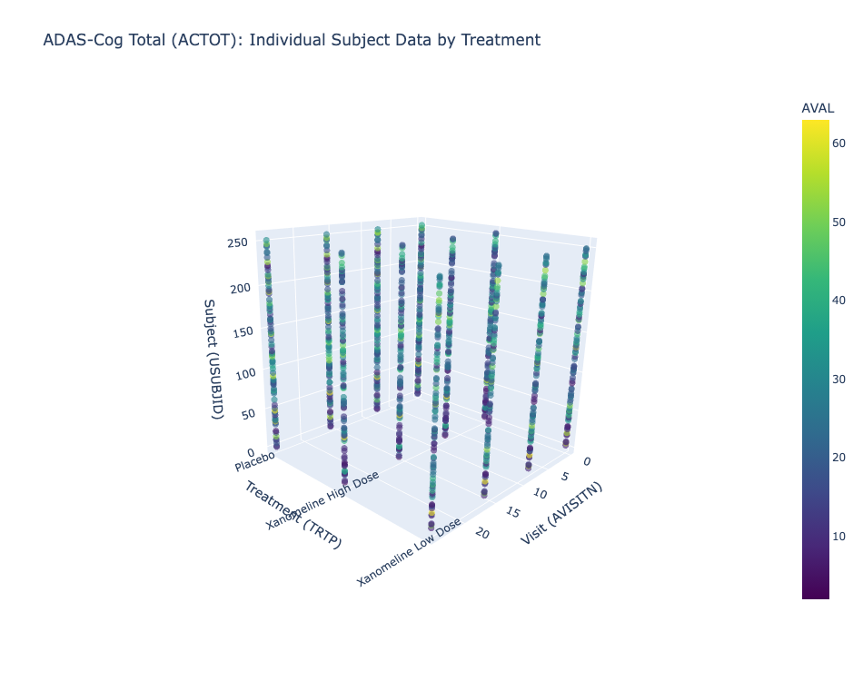
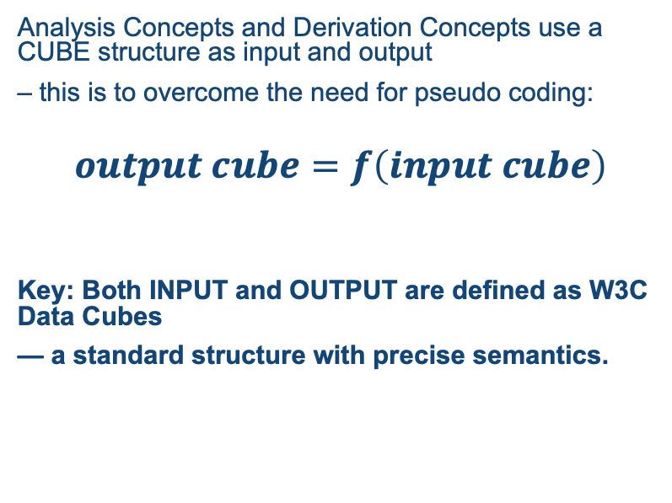
The AC/DC Model: A Function Over Data Cubes
Analysis Concepts and Derivation Concepts use a CUBE structure as input and output
– this is to overcome the need for pseudo coding:
$$output cube=f\left(input cube\right)$$
Key: Both INPUT and OUTPUT are defined as W3C Data Cubes
— a standard structure with precise semantics.

Slide 33
The SDMX Data Cube: Three Component Types
Each component has a defined role that determines how it participates in operations:
DIMENSION
Identifies the observation — the "coordinates" in the cube
Examples: subject, visit, parameter, treatment
MEASURE
The observed/computed value at that point — numeric quantities
Examples: analysis_value, baseline_value, change_value, lsmean, p_value
ATTRIBUTE
Metadata that qualifies but does not identify — context and flags
Examples: population_flag, baseline_flag, unit, reason_for_exclusion
Why CUBEs? W3C standard for statistical data exchange.
The roles are not arbitrary — they have standardized meaning across tools and platforms.

Slide 34
Slices: Subsetting the Cube
A Slice fixes certain dimensions or attributes to create a subset of the cube.
Full Cube (all data):
Dimensions: subject, visit, parameter, treatment
Measures: analysis_value, baseline_value, change_value
Attributes: population_flag, baseline_flag
Slice (analysis context):
parameter = "ADAS-Cog(11)"
visit = "Week 24"
population_flag = "Y" (efficacy population)

Slide 35
Machine-Executable: Roles Define Operations
Each CUBE role has inherent computational semantics — no pseudo-code needed:
CUBE Role → Code Generation Operation
DIMENSION → GROUP BY / BY statement / stratification axis
MEASURE (input) → Function arguments / MODEL variables
MEASURE (output) → Return values / result columns
ATTRIBUTE (slice) → WHERE clause / filter condition
Declarative, Not Procedural
You specify the structure of input/output, not the steps
Platform Independent
Same cube definition can generate SAS, R, or Python if engine is developed
Unambiguous Semantics
A generator knows exactly what to do with DIMENSION vs MEASURE
Standardized
Standard is used by statistical agencies worldwide
The cube structure IS the specification.
Roles carry meaning; a generator traverses the structure and emits code.

Slide 36
Both Directions
Derivation Concepts & Analysis Concepts

Slide 37
Modularity & Traceability: The Recipe Analogy
Recipes reference other recipes — just like AC/DC derivations and analyses
AC/DC Framework
Recipe Analogy
S_AC_001: ANCOVA Analysis
Recipe: Caesar Salad
Uses: S_DC_004 (change_value)
↑
≈
Uses: Caesar Dressing recipe
↑
S_DC_004: ChangeFromBaseline
Recipe: Caesar Dressing
Uses: S_DC_001, S_DC_003
↑
≈
Uses: Vinaigrette Base, Garlic Paste recipes
↑
S_DC_001: AVAL
S_DC_003: BASE
≈
Recipe: Vinaigrette
Recipe: Garlic Paste
Template: CopyValue
Template: Baseline
Technique: Emulsify
Technique: Mince
↓ Top-Down
↑ Bottom-Up
↓ Planning
↑ Tracing
Planning: What do I need?
Audit: Where is this used?
What recipes do I need?
Where is this recipe used?
Modularity: Recipes build on other recipes • Traceability: Follow dependencies in either direction

Slide 38
Derivation Concepts (DC): ADaM Variable Derivations
Instead of 500-line monolithic programs:
CHG = AVAL - BASE; /* buried in code */
Define atomic, composable derivations:
DC Instance: S_DC_004 (based on T_DC_ChangeFromBaseline)
Input concepts: analysis_value, baseline_value
Output concept: change_value
Formula: target = analysis_value - baseline_value
Depends on: S_DC_001 (AVAL), S_DC_003 (BASE)
Benefits:
Explicit dependency graph
Reusable across studies (same template, different implementation)
Automatic traceability

Slide 39
Analysis Concepts (AC): Complex Analyses
For statistical operations beyond simple derivations:
AC Instance: S_AC_001 (based on T_AC_ANCOVA)
Template's cube roles map to statistical operations:
Concept with role=dimension (factor) → CLASS variables
Concept with role=measure (dependent) → MODEL left side
Concept with role=measure (covariate) → MODEL right side
Concept with fixed value (slice) → WHERE clause
Output cube contains results:
lsmean, lsmean_se, ci_lower, ci_upper, p_value
Same template handles ADAS-Cog, MMSE, any efficacy endpoint — only the slice changes.

Slide 40
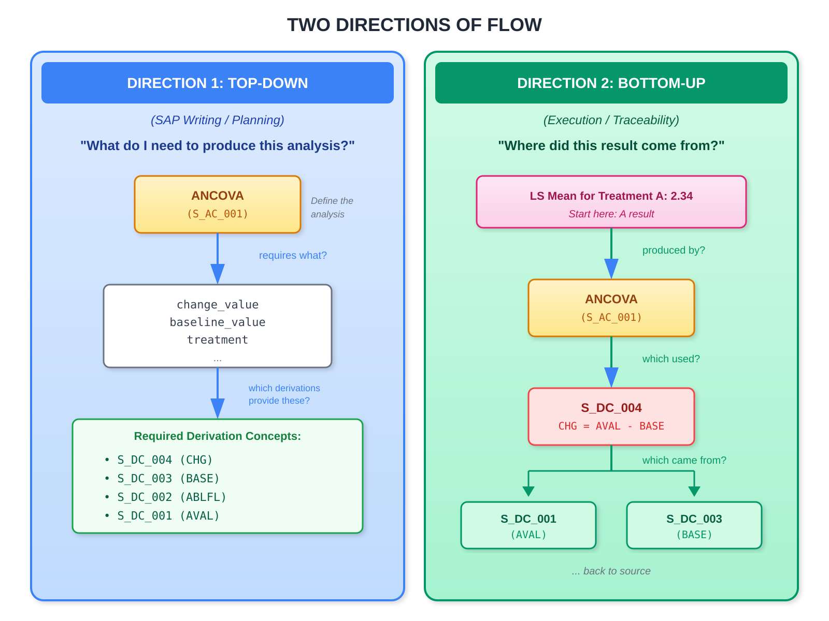
Bidirectional Traceability
At SAP Writing Time (Top-Down):
1. Author defines: "ANCOVA of change from baseline in ADAS-Cog(11)"
2. System identifies required concepts: change_value, baseline_value
3. System surfaces DC requirements: CHG needs BASE needs ABLFL
4. ADaM specs generated from the dependency graph
At Submission Time (Bottom-Up):
Reviewer: "How was the LS Mean difference of -3.2 calculated?"
System traces:
Result (-3.2) → S_AC_001 (ANCOVA)
→ Input: ADQSADAS.CHG
→ Derived by: S_DC_004 (ChangeFromBaseline)
→ Sources: AVAL, BASE
The same metadata supports both directions.

Slide 41
Summary

Slide 42
What the Framework Guarantees
STANDARDIZED
ANCOVA will be performed
Change from baseline calculated
Model structure defined
Results traceable
NOT STANDARDIZED
The choice of derivation and analysis for your study
We standardize the cookbook,
not the chef's judgment.

Slide 43
The Cookbook Guides Choices
For example, ANCOVA template prompts you for:
Required:
Response, Treatment, Baseline covariate
Optional:
Additional covariates?
Include interactions?
Parameters:
SS type, Alpha, CI level
Ensures you don't miss decisions.

Slide 44
Key Principles
Separation of Concerns
Implementation-Independence
Machine-Executable
WHAT concepts exist (CTM) vs HOW transformations work (Methods/Templates)
Core specifications work across ADaM/SDTM, OMOP, FHIR, and future standards
Metadata drives automated code generation to R, SAS, Python
🍳 Ingredients vs cooking techniques
🍳 Same recipe, any kitchen
🍳 Recipe translates to any equipment
Semantic Richness
Unified Pattern
CDISC-Maintained & Extensible
Captures clinical intent, not just computational steps
Both derivation and analysis follow Method → Template → Implementation
Standard library of Methods/Templates; organizations can extend
🍳 Why you're making vinaigrette, not just how
🍳 Consistent approach for all recipes
🍳 Master cookbook with room for house specials

Slide 45
The Key Insight
A good AC/DC Template works with any data standard, any study, as long as you have the right types of data concepts and apply the appropriate statistical method.
Just as a recipe doesn't need to know if your olive oil is organic, cold-pressed, or from a specific region — it just needs "oil" that plays the role of "fat" in the process.
That's the power of separation of concerns.
AC/DC Framework - CDISC Standards
45

