Slide 1
4th Annual Ford/ASME Design Contest
Innovation for the Edge
February 2, 2006

Slide 2
Design Contest Overview
Imagine the Following Situation
You recently hired into Ford Motor Company and are supporting an Advanced Program Team that is designing cars that will not reach production for another 3 years.
The Chief Engineer for the Ford Edge is looking for innovative ideas to include in the program that will appeal to the target customer and make your product stand out in a very competitive marketplace.
Your Task
Form teams consisting of 3 to 5 people to develop an innovative idea to be implemented on the all-new Ford Edge. Your team will develop an idea, capture the idea on a single page summary with up to 2 pages of illustrative drawings (if required), and present the idea to a panel of judges from Ford Motor Company on U of I’s campus on February 17.

Slide 3
Design Contest Judging
Scores for the team's entry will be based on the following elements:
  Feasibility of Strategy
  Originality of Ideas
  Applicability to Target Customer
  Data supporting Claims and Idea
  Student Votes
  Effectiveness of Presentation

Slide 4
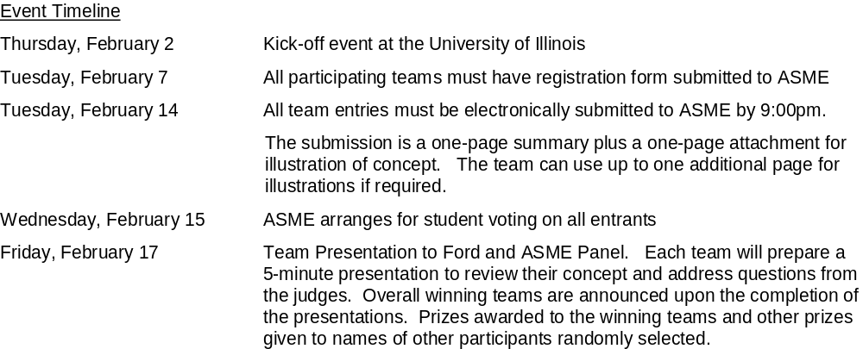
Timeline

Slide 5
The Reward
Top Prize of $500 worth of certificates and merchandise. Additional prizes 2nd and 3rd place teams and random prizes for all participants.

Slide 6
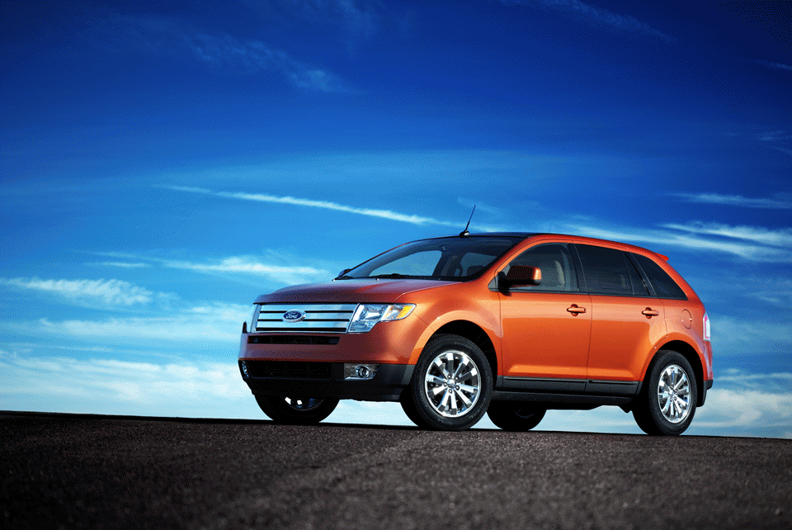
The all-new Ford Edge

Slide 7
Target Customer
Inquisitive Spirits, age 30, newly married, no kids.
This audience is in a ‘me’ focused stage of life. Their ‘no kids to tie me down yet’ lifestage affords them the ability to go and try whatever piques their interest. They are always eager to push themselves to try new experiences. Sometimes that drive is reflected in their physical activities and other times it’s a challenge they’ve never tried before.
They have an appreciation for nature and the outdoors which shows itself in their activities and their sense of style (organic, simple, and unique). They find the joys of the outdoors in both urban and rural adventures. For them, it’s just about getting out there and gathering experiences.
Emotional Benefits Sought:
To be seen as stylish .
To be seen as confident.
To reward themselves.
To feel unique.
To feel good (smart) about decisions.
Product Benefits Sought:
Unique Styling – successful, outdoor, sporty
Agile handling – confident, spirited driving.
Adaptable Interior w/o compromising style
  Comfortably seats adults
  Carries equipment for their active life
Assured Safety

Slide 8

Appealing Style
Appealing styles focus on the organic, the simple and the unique.
Organic – natural objects and settings
Simplicity – modern, clean & uncluttered lines
Unique – present something in a different way

Slide 9
Ford’s Strategy for Target Customer
Design & Package
Interior and exterior design is stylish and distinctive. Exterior: a bold chrome grill, dual chrome exhaust and sporty, muscular stance. Interior: textured aluminum and chrome accents, contrast seat stitching, two tone door panels.
17” and 18” wheels available
Available panorama roof with dual power sunshades.
Available luxury technology, including navigation system, satellite radio and rear DVD.
Uncompromised rear seat room
Reclining rear seatback, also easily folds flat, using an electronic switch and spring assist. Fold flat front passenger seat.
Compartmentalized Center Console Storage Bin
Driving Dynamics
Independent multilink suspension, based on the Fusion and Mazda 6 design, delivers responsive, sports sedan-like handling.
New "Active" AWD system available – initiates preemptive torque transfer – tuned more for traction and on-road performance than for off-road capability.
New engine-controlled traction assist and Integrated Vehicle Dynamics with Roll Stability Control.
Performance
First vehicle to use the all-new Duratec 35, 3.5L V6, with 250 hp and 240 lb-ft of torque
All-new 6-speed adaptive automatic transmission.
Targeted to be best-in-class 0-60 acceleration performance.

Slide 10
Sources of Information
http://www.fordvehicles.com/autoshow/
Select 2007MY Edge under Up & Coming
Vehicle Features Listed under ‘Build Your Edge’ toward the bottom of the page.
www.ford.com Ford Motor Company’s Web Page
www.edmunds.com Price and product guides
www.intellichoice.com Product Guide
www.kbb.com Kelley Blue Book
www.autosite.com Price and Product Guides
www.census.gov U.S. Census

