Slide 1
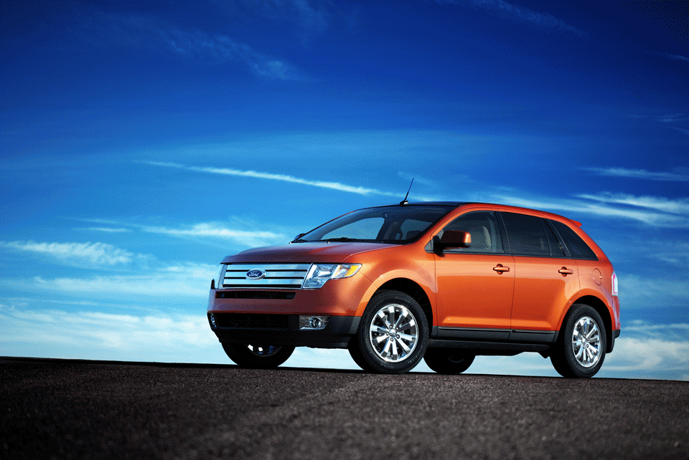

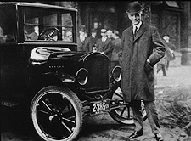
4th Annual Ford Motor Company and University of Illinois’ ASME Design Contest
Innovation for the Edge
Teams comprised of 3 to 5 students compete to win a top prize of $500 worth of certificates and merchandise by identifying new, innovative concepts for the Ford Edge. All students are welcome. Team registration due by February 7, 2006. Contact Heather Vance (hdvance1@yahoo.com) for details or to register your team.

Slide 2
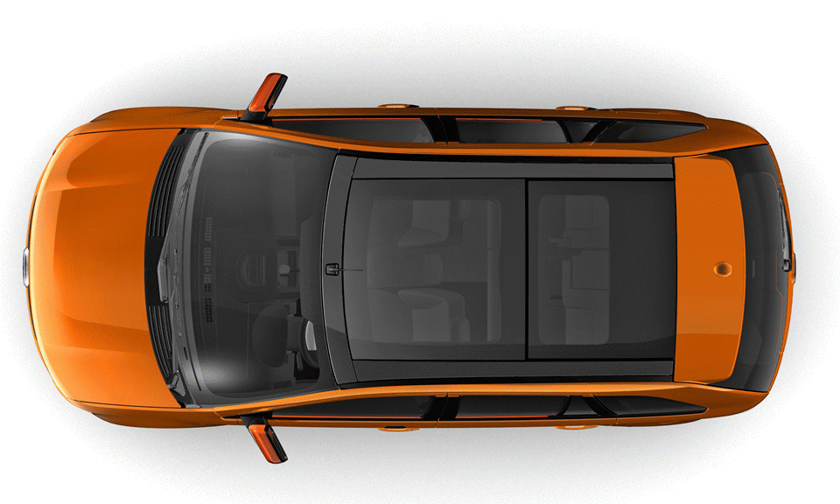
4th Annual Ford Motor Company and University of Illinois’ ASME Design Contest
Innovation for the Edge
Teams comprised of 3 to 5 students compete to win a top prize of $500 worth of certificates and merchandise by identifying new, innovative concepts for the Ford Edge. All students are welcome. Team registration due by February 7, 2006. Contact Heather Vance (hdvance1@yahoo.com) for details or to register your team.

Slide 3

4th Annual Ford Motor Company and University of Illinois’ ASME Design Contest
Innovation for the Edge
Teams comprised of 3 to 5 students compete to win a top prize of $500 worth of certificates and merchandise by identifying new, innovative concepts for the Ford Edge. All students are welcome. Team registration due by February 7, 2006. Contact Heather Vance (hdvance1@yahoo.com) for details or to register your team.

