Slide 1
Mushroom Classification
By Kelly Keith

Slide 2
The problem
In this dataset, we have the properties of different mushrooms.
We want to train a program to identify mushrooms based on only the properties.
Multiple different methods are used to try to solve this problem, in order to find the best one,

Slide 3
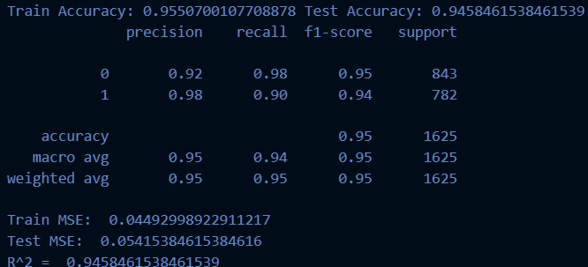
KNN

Slide 4
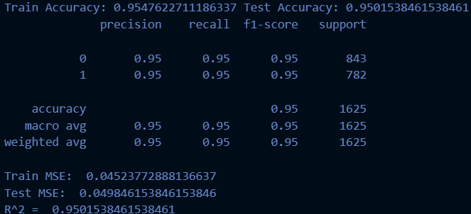
Logistic Regression

Slide 5

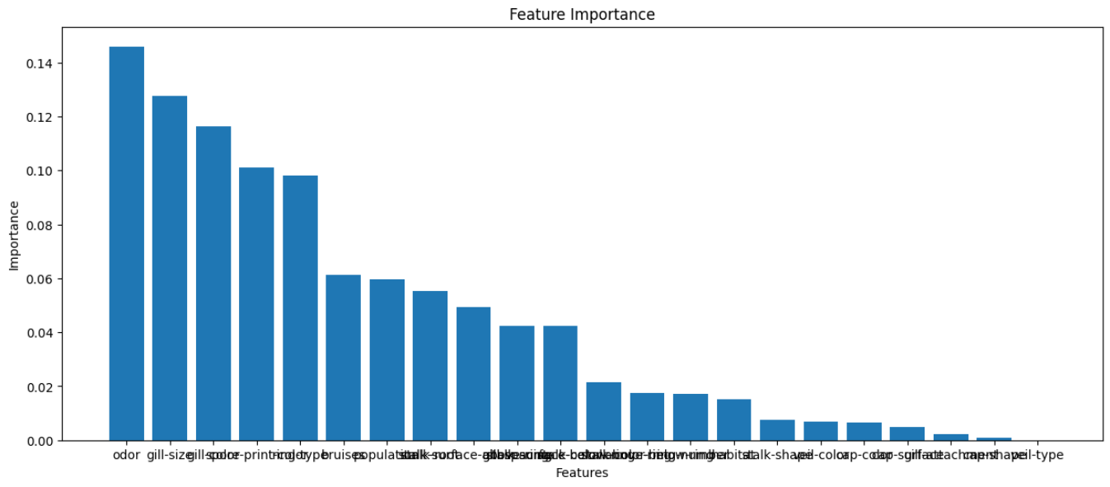
Random Forest

Slide 6


XGBoost

Slide 7

Neural Network

