Slide 1
Making maps with R
Dr. Caitie Kuempel
@cdkuempel
c.kuempel@uq.edu.au

Slide 2
Housekeeping and disclaimers
Assuming you are familiar with R and Rstudio
More tutorial and less lecture
Please speak up and comment in the chat window with comments, questions, useful tips
I’m a conservation scientist – I learned everything I know from you and twitter
I’m still learning, but always trying to improve ☺
Special thanks to Rladies Nairobi for inspiration for this tutorial

Slide 3
Getting started
If you are familiar with github you can find all of today’s materials here: https://github.com/cdkuempel/making_maps_in_R
If you are not familiar with github you can still download the zip file with everything… let’s do this now!
I’ve designed the tutorial so you can download all the data from the script
If problems, the data is also saved in the “data” folder
Some packages take awhile to load so let’s start installing packages now!

Slide 4
Overview
What we will cover today
Very brief intro of the package sf
A tutorial of different packages you can use to make maps (e.g., spatially visualize data) in R
Ggplot2
Tmap
leaflet
What we will NOT cover today
Spatial analysis in R

Slide 5
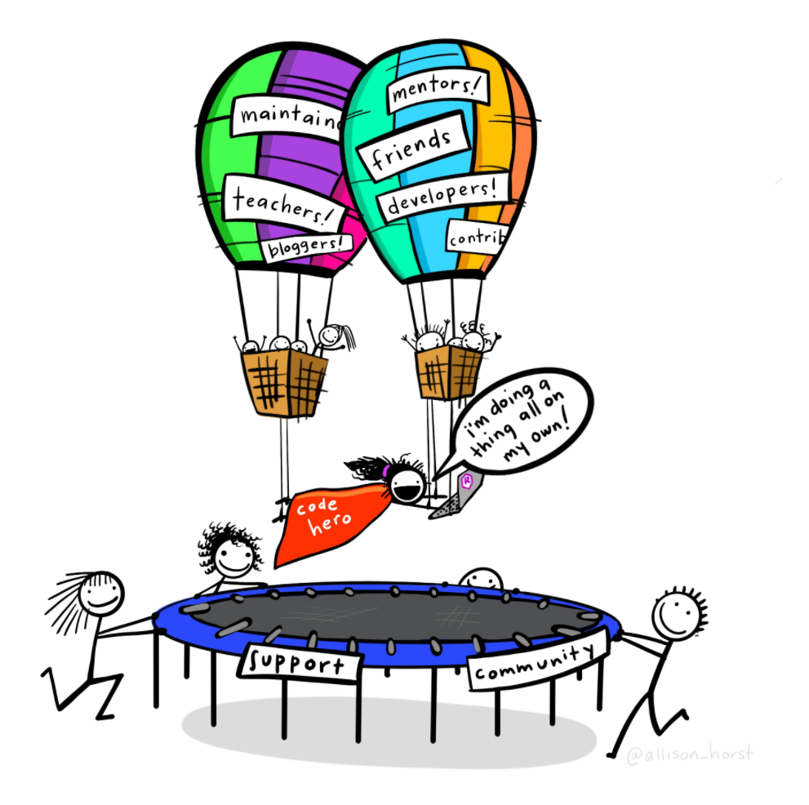
Thanks!
Follow me on twitter @cdkuempel
Get in touch if you would like to present at a future Rladies Brisbane meeting or have a topic you would like to see covered

