Slide 1
Motivating Example
This is how we can represent things in EMF

Slide 2
ism:ItemStateMachine
T=0
r1:Robot
i1:Item
pg1:processing
t1: processingFinished
pg1:processed
ism:ItemStateMachine
r1:Robot
i1:Item
pg1:processing
T=1
t1: processingFinished
pg1:processed
Notes:
This example can be represented in the following way using traditional model-driven techniques.
A metameta-model such as Ecore is used to represent concepts on the language level (i.e. the metamodel). In this case, this would be the concepts Class, State, and Transition. This metamodel can be instantiated to describe a model for a particular domain, i.e. the classes, states and transitions for our example (i.e. robot and item as classes, processing and processed as states, and processingFinished as Transition). This model can then be further instantiated for particular robots and items, who are connected to particular states, and concrete transitions which can activate or deactivate these states.

Slide 3
EClass
Class
StateMachine
State
Transition
name: String
isActive: Bool
isStart: Bool
name: String
fires: Bool
processing
Robot
Item
ItemStateMachine
processingFinished
processed
Notes:
This example can be represented in the following way using traditional model-driven techniques.
A metameta-model such as Ecore is used to represent concepts on the language level (i.e. the metamodel). In this case, this would be the concepts Class, State, and Transition. This metamodel can be instantiated to describe a model for a particular domain, i.e. the classes, states and transitions for our example (i.e. robot and item as classes, processing and processed as states, and processingFinished as Transition). This model can then be further instantiated for particular robots and items, who are connected to particular states, and concrete transitions which can activate or deactivate these states.

Slide 4
ism:ItemStateMachine
T=0
p1:3DPrinter
i1:Item
pg1:processing
t1: processingFinished
pg1:processed
ism:ItemStateMachine
r1:Robot
i1:Item
pg1:processing
T=1
t1: processingFinished
pg1:processed
Notes:
This example can be represented in the following way using traditional model-driven techniques.
A metameta-model such as Ecore is used to represent concepts on the language level (i.e. the metamodel). In this case, this would be the concepts Class, State, and Transition. This metamodel can be instantiated to describe a model for a particular domain, i.e. the classes, states and transitions for our example (i.e. robot and item as classes, processing and processed as states, and processingFinished as Transition). This model can then be further instantiated for particular robots and items, who are connected to particular states, and concrete transitions which can activate or deactivate these states.

Slide 5
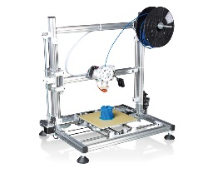
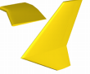
System
1..* printers
0..* items
3DPrinter
id: String [1..1]
temp : Float [1..1]
isActive : Boolean [1..1]
Item
id: String [1..1]
…
run() : void

Slide 6
Idle
startRun
Preheating
startPrinting
Printing
finishedPrinting
Undefined
Processing
Processed

Slide 7
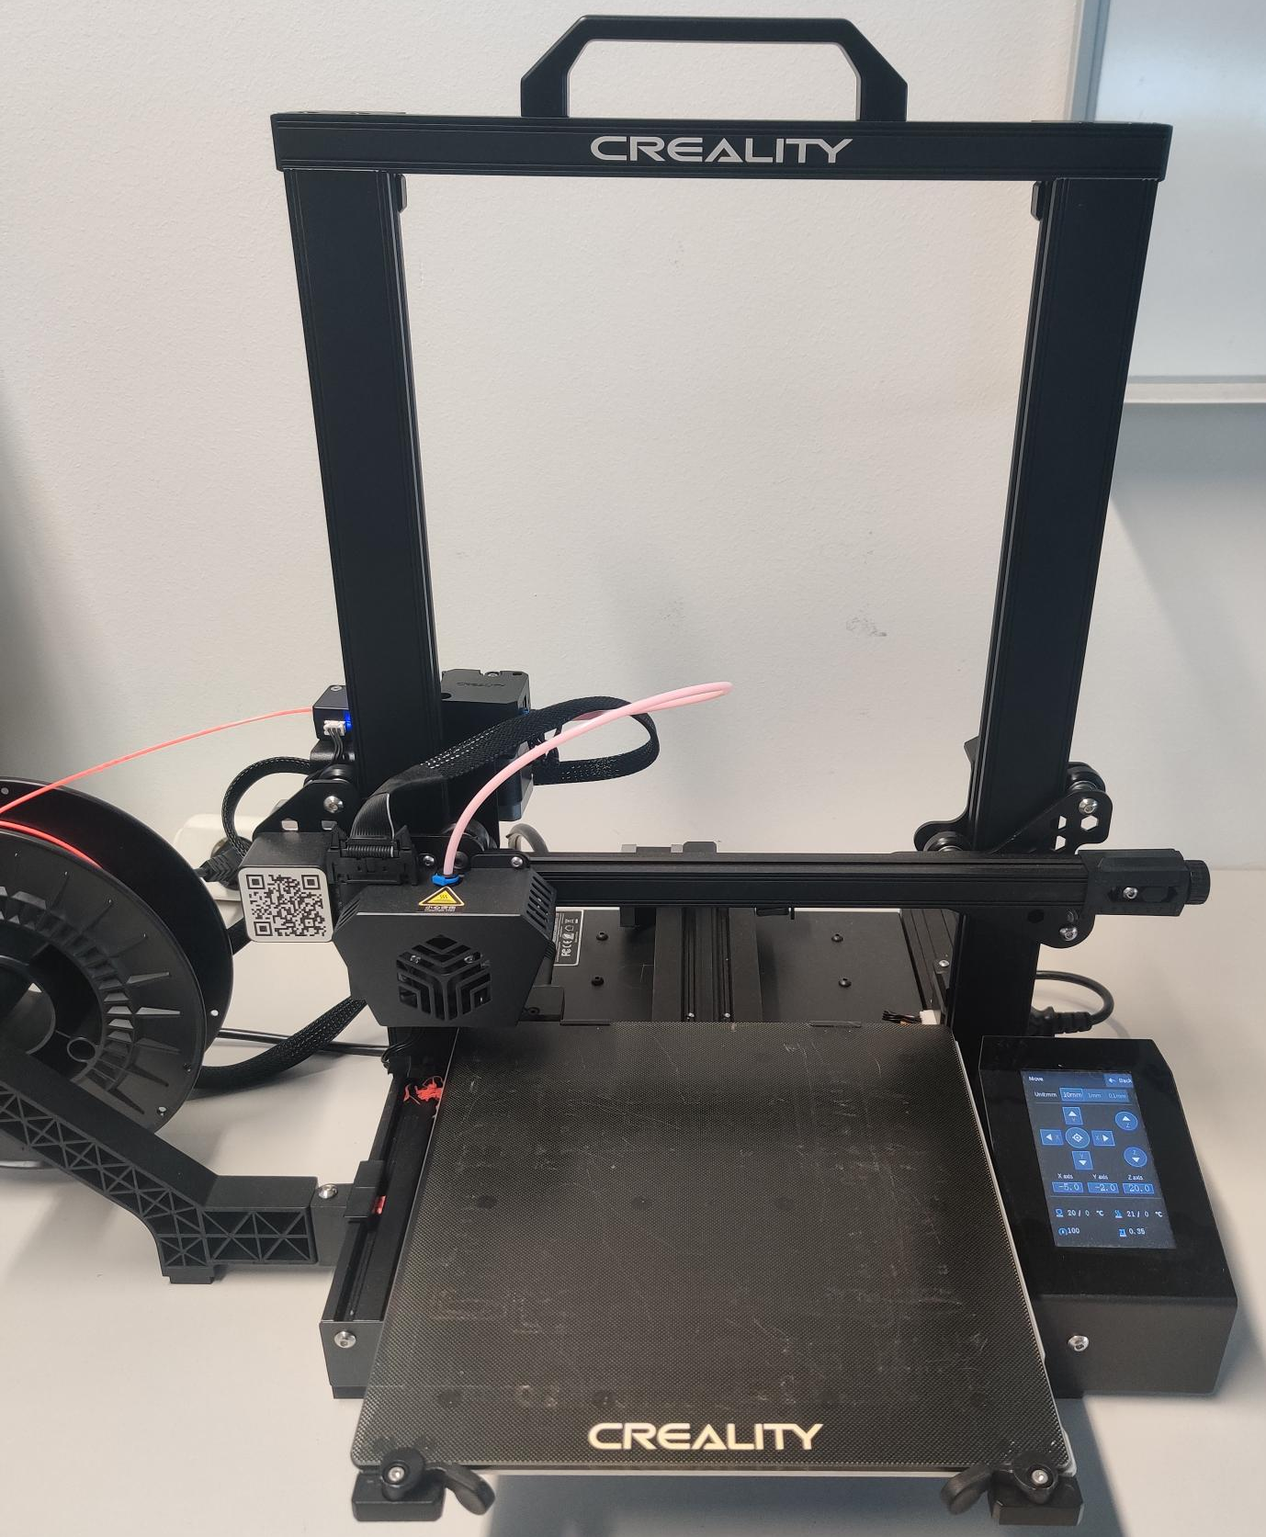
3DPrinter
id: String [1..1]
temp : Float [1..1]
x: Float[1..1]
y: Float[1..1]
z: Float[1..1]
<<inSignals>>
connect
sendCADFile
print
pause
stop
reset
<<outSignals>>
finished
error

Slide 8
t₀
t₁
t₂
t₃
p1: 3DPrinter
id: Printer1
temp : 35
x: 0
y: 0
z: 0
p1: 3DPrinter
id: Printer1
temp : 80
x: 0
y: 1
z: 0
…
print
…
operational
printing

Slide 9
finished
CancelPrinting
stop
StandBy
connect
Connected
sendCADFile
Operational
print
Printing
finished
pause
print
PausePrinting
reset
error
Error

Slide 10
Background

Slide 11
M3
Meta-
Language (ML)
MOF
Legend
MOF Meta Object Facility
SL Structural Language
BL Behavioral Language
SM Structural Model
BM Behavioral Model
ST Structural Trace
BT Behavioral Trace
M2
Language (L)
SL
BL
Domain Model (DM)
SM
BM
M1
<<instance of>>
Runtime
Trace (RT)
<<association>>
M0
ST
BT

Slide 12
<<Metamodel>>
CD+SM +
DT Profile
<<Metamodel>>
DTML
Modeling Layer
UML Model
DT Model
???
DT Platform
System
Digital Twin
Dashboard
Realization Layer
Notes:
Using existing models which conform to metamodeling-languages such as ecore, we can generate the code required to run a system, as e.g. shown by TODO.
Reusing these models for generating infrastructure to represent the current system state is possible, as shown in ETFA.
However, in order to extend these existing capabilities, we need

Slide 13
SL
BL
Modeling Layer
Legend
SL Structural Language
BL Behavioral Language
SM Structural Model
BM Behavioral Model
SM
BM
?
<<instance of>>
DT Platform
<<association>>
Realization Layer
System
Digital Twin
Data exchange
Generation
Notes:
Using existing models which conform to metamodeling-languages such as ecore, we can generate the code required to run a system, as e.g. shown by TODO.
Reusing these models for generating infrastructure to represent the current system state is possible, as shown in ETFA.
However, in order to extend these existing capabilities, we need

Slide 14
Modeling Patterns for including behavior descriptions into DT Platforms
For bridging the following restrictions of DT platform modeling capabilities
Restriction 1: no metamodeling support -> thus, the language intended to represent data structures cannot natively extended on the
Restriction 2: no dedicated modeling support for representing historical states

Slide 15
 | Closed (model) -> merge m1/m2 | Open (metamodel) -> merge m0/m1
Time Series
Snapshot-basiert

Slide 16
Meta Modeling Stack
Closed System Behavior Pattern
Open System Behavior Pattern
Meta-
Language (ML)
L/ML
MOF
L/DM
Language (L)
CDL
SML
ML+L
DTML
ML+L
DTML
CDL
SML
(DM)/RM
Domain Model (DM)
CDL
SML
aCD
aSM
L+DM
L+DM
aCD
aSM
aCD
Runtime
Model (RM)
sET
bET
RM
sET
bET
DM+RM
sET
aSM + bET
Legend
Instantiation
Association
Inheritance
Notes:
Open: skip explicit instantiation of aSM

Slide 17
Traditional
Closed
Open
Meta-
Language (ML)
L/ML
Ecore
DTML
DTML
L/DM
Language (L)
CDL
SML
CDL
SML
CDL
SML
(DM)/RM
Domain Model (DM)
aCD
aSM
aCD
aSM
aCD
Runtime
Model (RM)
OD
cOLC
OD
cOLC
OD
aSM + cOLC
Legend
Instantiation
Association
Inheritance
Notes:
Open: skip explicit instantiation of aSM

Slide 18
Snapshot-Language
Legend
Instantiation
CDL
SML
Association
Inheritance
aCD
aSM
OD
cOLC
Snapshot

Slide 19
Demonstration
Showing the applicability of the proposed patterns for the motivating example

Slide 20
StateMachine
State
Transition
Class
name: String
isActive: Bool
isStart: Bool
name: String
fires: Bool
ItemStateMachine
processing
Item
processingFinished
processed
i1:Item
i1:Item
itemStateMachine: ItemStateMachine
itemStateMachine: StateMachine
pg1:processing
pg1:State
name: processingItem1
isStart: true
isActive: true
name: processingItem1
isStart: true
isActive: true
t1: processingFinished
t1: Transition
pg1:processed
pg1:State
name: processedItem1
isStart: false
isActive: false
name: processedItem1
isStart: false
isActive: false
Notes:
A first approach to representing States and Transitions on the model level is shown in Figure X.
Here, the information which would traditionally be represented on the Metamodel level (i.e. Class, State, Transition) is represented on the model level, together with the domain elements (i.e. specific classes such as Robot and Item, as well as specific States and Transitions). All of these elements are instances of the Metamodel element Type, which is available in the examined DT Languages.

Slide 21
s1:Snapshot
s1:Snapshot
i1:Item
i1:Item
itemStateMachine: ItemStateMachine
itemStateMachine: StateMachine
pg1:processing
pg1:State
name: processingItem1
isStart: false
isActive: true
t1:processingFinished
name: processingItem1
isStart: true
isActive: true
t1:Transition
name: pFItem1
fires: false
name: pFItem1
fires: false
pg2:processed
pg1:State
name: processedItem1
isStart: false
isActive: false
name: processedItem1
isStart: false
isActive: false
s2:Snapshot
s2:Snapshot
i1:Item
i1:Item
itemStateMachine: ItemStateMachine
itemStateMachine: StateMachine
pg1:processing
pg1:State
name: processingItem1
isStart: true
isActive: false
t1:processingFinished
name: processingItem1
isStart: true
isActive: false
t1:Transition
name: pFItem1
fires: true
name: pFItem1
fires: true
pg1:processed
pg1:State
name: processedItem1
isStart: false
isActive: true
name: processedItem1
isStart: false
isActive: true
Notes:
A first approach to representing States and Transitions on the model level is shown in Figure X.
Here, the information which would traditionally be represented on the Metamodel level (i.e. Class, State, Transition) is represented on the model level, together with the domain elements (i.e. specific classes such as Robot and Item, as well as specific States and Transitions). All of these elements are instances of the Metamodel element Type, which is available in the examined DT Languages.

Slide 22
BACKUP

Slide 23
pg1:processing
t1: processingFinished
S1: Snapshot
i1:Item
isActive: true
r1:Robot
pg2:processing
i2:Item
isActive: false
pg1:processing
t1: processingFinished
i1:Item
S2: Snapshot
isActive: false
r1:Robot
pg2:processing
i2:Item
isActive: true
Notes:
A first approach to representing States and Transitions on the model level is shown in Figure X.
Here, the information which would traditionally be represented on the Metamodel level (i.e. Class, State, Transition) is represented on the model level, together with the domain elements (i.e. specific classes such as Robot and Item, as well as specific States and Transitions). All of these elements are instances of the Metamodel element Type, which is available in the examined DT Languages.

Slide 24
processing
Model
Robot
Item
processingFinished
processed
Instance
pg1:processing
t1: processingFinished
i1:Item
T=0: isActive: true
T=1: isActive: false
r1:Robot
i2:Item
pg2:processing
T=0: isActive: false
T=1: isActive: true
Notes:
An alternative pattern for representing the history of states in the DT platform is. Therefore, the platform needs to provide time-series support, e.g. through time-series databases.

Slide 25
Problem
This cannot be represented in current platforms

Slide 26
tnow
Tnow,T<now
DTML
DTML
Temp | snapshot
aCD
CDL
???
OD
Framework Approach
aCD
Notes:
However, we found that these traditional modeling levels are not available in modern DT platforms. In ECMFA we showed that the modeling capabilities of these platforms focus on describing structural information, i.e. provide languages do describe class diagrams.
However, Digital Twins are often also thought to incapsulate behavior. As the modeling capabilities of the platforms do not offer a metameta-level to extend language components, we need patterns to extend these capabilities to incorporate behavioral models, such as the state machines described in the previous figure.
Verhaltensmodelle
Restriction 1: no metamodeling support -> thus, the language intended to represent data structures cannot natively extended on the
Restriction 2: Abbildung von Traces (historie von Verhaltensmodellen) -> no dedicated modeling support for representing historical states
In the following, we provide patterns for overcoming these restrictions using the modeling concepts which are natively available in DT platforms.

Slide 27
CD + SM + DT Profile
UML Model
Dashboard
JS-based?
Test
System
Digital Twin
Cloud-based
Java Proto
Contribution:
Combination of Process Mining (offline) + Value-based Digital Twins (online)
UML-based Generation Approach (Extension of current code generators)
Notes:
Using existing models which conform to metamodeling-languages such as ecore, we can generate the code required to run a system, as e.g. shown by TODO.
Reusing these models for generating infrastructure to represent the current system state is possible, as shown in ETFA.
However, in order to extend these existing capabilities, we need

Slide 28
Open
Traditional
Closed
L/ML
DTML
Meta-Language (ML)
M3
Ecore
DTML
L/ML
CDL
Language (L)
M2
CDL
SML
L/DM
aCD
DM/L
SML
CDL
SML
aCD
aSM
aCD
aSM
(DM)/RM
Design Model (DM)
M1
OD
cOLC
OD
cOLC
OD
aSM1 + cOLC
RM
Runtime Model (RM)
M0
Legend
instanceOf
Association

Slide 29
OPEN
Meta-Language (ML)
M3
Ecore
DTML
L/ML
Language (L)
M2
CDL
SML
aCD
L/DM
CDL
SML
Design Model (DM)
M1
aCD
aSM
(DM)/RM
OD
aSM1 + cOLC
OD
cOLC
Runtime Model (RM)
M0
Legend
instanceOf
Association

Slide 30
DTML
DTML
Language
Temporal Pattern – Assumption DTML allows to model temporal elements
aCD
aCD
Design Model
Meta-Language (ML)
M3
Ecore
OD
OD
Runtime Model
Language (L)
M2
CDL
SML
DTML
L/ML
Structure
CDL
SML
Design Model (DM)
M1
aCD
aSM
DM/L
aCD
aSM
OD
cOLC
OD
cOLC
RM
Runtime Model (RM)
M0
Legend
instanceOf
inheritsFrom
Association

Slide 31
Traditional
Closed
Meta-Language (ML)
M3
Ecore
DTML
L/ML
Language (L)
M2
CDL
SML
SnapshotElements
SnapshotL
CDL
SML
aCD
aSM
aCD
aSM
DM/L
Design Model (DM)
M1
OD
cOLC
Snapshots
RM
OD
cOLC
Runtime Model (RM)
M0
Legend
instanceOf
Association

Slide 32
Example
Class
State
Transition
processing
Robot
Item
processingFinished
processed
pg1:processing
t1: processingFinished
i1:Item
r1:Robot
pg2:processing
i2:Item

Slide 33
Class
Language
Entity
Snapshot
State
Schema
State
S1
EClass
Transition
S2
SM
T1
Robot
Instance
Snapshot 1
sc1:S1
active : true
sc2:S2
r1
tc1:T1
Notes:
In this pattern,

Slide 34
Architecture
Ecore
DTDL
Problem Statement
CD
SM
SD
Schema
Schema
Generic Transformation Possible??
Code Generator
Value
View
Behaviour View
System
DS Platform
Level-flattening
Transformation
Contribution
Notes:
Using existing models which conform to metamodeling-languages such as ecore, we can generate the code required to run a system, as e.g. shown by TODO.
Reusing these models for generating the

Slide 35
Pattern 1: Snapshot-based
Class
Metametamodel
EClass
Language
Entity
Snapshot
Class
Schema
State
Transition
Metamodel
active²
State
fire()²
State
S1
entry()²
EClass
Model
S2
Transition
Robot
S1
SM
T1
T1
S2
Robot
Instance
Snapshot 1
Trace / Snapshot-based
sc1:S1
active : true
r1:Robot
sc1:S1
sc2:S2
sc2:S2
active:=True
active:=false
r1
tc1:T1

Slide 36
Pattern 1: Temporal-based
Class
Metametamodel
EClass
Language
Entity
Class
Schema
State
Transition
Metamodel
active²
State
fire()²
State
S1
entry()²
EClass
Model
S2
Transition
Robot
S1
SM
T1
T1
S2
Robot
Instance
Trace / Snapshot-based
sc1:S1
active : true + history {….}
r1:Robot
sc1:S1
sc2:S2
sc2:S2
active:=True
active:=false
r1
tc1:T1

Slide 37
Example
Class
Metametamodel
EClass
Language
Entity
Class
Schema
State
Transition
Metamodel
active²
State
fire()²
State
entry()²
EClass
active:Temporal
Model
Transition
Robot
S1
SM
T1
S2
Robot
Instance
Trace / Snapshot-based
S1
active:=True {history…}
sm1
S2
active:=false {history}
r1:Robot
sc1:S1
sc2:S2
active:=false
r1
active:=True
T1

