Slide 1
3DPrinter
id: String [1..1]
temp: Float [1..1]
x: Float[1..1]
y: Float[1..1]
z: Float[1..1]
<<inSignals>>
connect
sendCADFile
print
pause
stop
reset
<<outSignals>>
finished
error

Slide 2
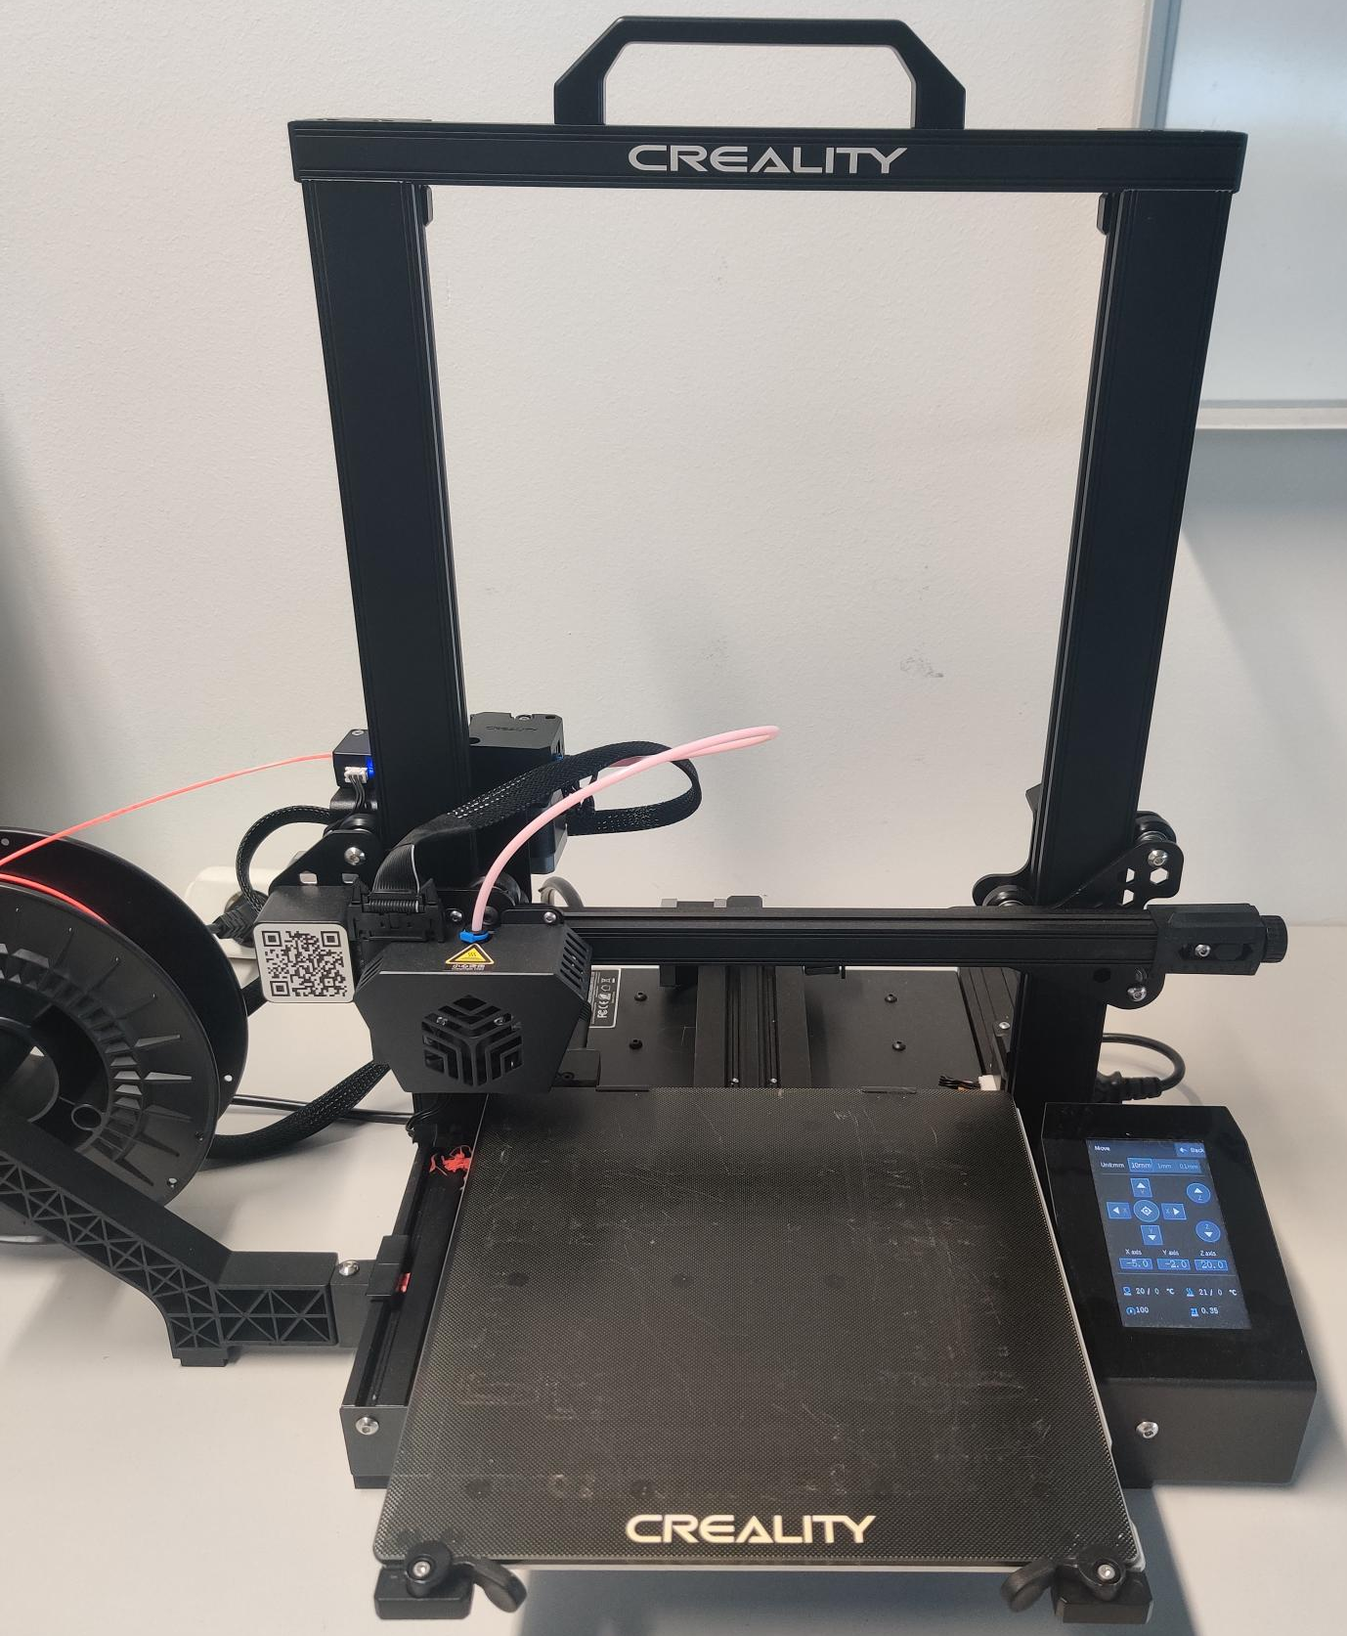
t₀
t₁
t₂
t₃
p1: 3DPrinter
id: Printer1
temp: 35
x: 0
y: 0
z: 0
p1: 3DPrinter
id: Printer1
temp: 80
x: 0
y: 1
z: 0
…
print
…
operational
printing

Slide 3
finished
StandBy
connect
Connected
sendCADFile
Operational
print
CancelPrinting
stop
Printing
finished
print
pause
PausePrinting
reset
error
Error

Slide 4
M3
Meta-
Language (ML)
MOF
Legend
MOF Meta Object Facility
SL Structural Language
BL Behavioral Language
SM Structural Model
BM Behavioral Model
ST Structural Trace
BT Behavioral Trace
M2
Language (L)
SL
BL
Domain Model (DM)
SM
BM
M1
<<instance of>>
Runtime
Trace (RT)
<<association>>
M0
ST
BT

Slide 5
SL
BL
Modeling Layer
Legend
SL Structural Language
BL Behavioral Language
SM Structural Model
BM Behavioral Model
SM
BM
?
<<instance of>>
System
DT Platform
<<association>>
Realization Layer
Digital Twin
Data exchange
Generation
Notes:
Using existing models which conform to metamodeling-languages such as ecore, we can generate the code required to run a system, as e.g. shown by TODO.
Reusing these models for generating infrastructure to represent the current system state is possible, as shown in ETFA.
However, in order to extend these existing capabilities, we need

Slide 6
pkg_SL
pkg_BL
Class
0..1
StateMachine
0..*
0..*
0..*
0..*
Property
Signal
State
source
outgoing
Transition
0..1
0..*
<<enumeration>>
Signal_enum
name : String
type : signal_enum
name : String
isInitial : Boolean
isFinal : Boolean
isActive : Boolean
trigger : String
fire() : void
target
incoming
inSignal outSignal
0..1
0..*

Slide 7
M2
DTML
Legend
DTML Digital Twin Modeling Language
SL Structural Language
BL Behavioral Language
SM Structural Model
BM Behavioral Model
ST Structural Trace
BT Behavioral Trace
SL
BL
M1
<<instance of>>
SM
BM
<<association>>
<<inherit>>
Closed behavior model pattern
M0
ST
BT
BM+BT
Open behavior model pattern
Shared pattern elements

Slide 8
Legend
DTML Digital Twin Modeling Language
MT_{t=0} Model Trace at time = 0
S Snapshot
S_{t=0} Snapshot Instance at time = 0
M2
DTML
M1
Model
S
MT_{t=0}
S_{t=0}
<<instance of>>
M0
<<association>>
MT_{t=1}
S_{t=1}
Snapshot-based history pattern

Slide 9
M2
DTML
(incl. TA concept)
Legend
DTML Digital Twin Modeling Language
TA Temporal Annotation
cT current Model Trace
hT historical ModelTrace
M1
Model
(incl. TA)
T
<<instance of>>
M0
cT
<<association>>
Temp. Annot. history pattern
hT

Slide 10
Entity
M2
<<abstract>>
Structure
<<abstract>>
Behavior
M1
DomainStructure
DomainBehavior
M0
StructuralTrace1
DomainBehavior4StructuralTrace1
Legend
<<instance of>>
<<association>>
<<inherit>>

Slide 11
M2
Entity
{abstract}
Structure
Behavior
M1
DomainStructure
M0
StructuralTrace1
Behavior4StructuralTrace1
Legend
<<instance of>>
<<association>>
<<inherit>>

Slide 12
Entity
M2
{abstract}
Structure
{abstract}
Behavior
pred.
M1
succ.
Snapshot
DomainStructure
DomainBehavior
Snapshot_{t=0}
StructuralTrace1_{t=0}
pred.
DomainBehavior4StructuralTrace1_{t=0}
succ.
M0
Snapshot_{t=1}
StructuralTrace1_{t=1}
DomainBehavior4StructuralTrace1_{t=1}
Legend
<<instance of>>
<<association>>
<<inherit>>

Slide 13
Entity
attributes
temporalAttributes
M2
{abstract}
Structure
{abstract}
Behavior
attribute1: Type <<temporal> attribute2: Type
DomainStructure
DomainBehavior
M1
attribute1: Type
<<temporal>> attribute2: Type
attribute1: Type <<temporal> attribute2: Type
StructuralTrace1
DomainBehavior4StructuralTrace1
attribute1: Value
attribute1: Value
M0
attribute2
attribute2
Timestamp: Value
Timestamp: Value
…
Timestamp: Value
Timestamp: Value
…
Legend
<<instance of>>
<<association>>
<<inherit>>

Slide 14
{abstract}
Class
StateMachine
State
1..1
Transition
3DPrinter
id: String [1..1]
temp: Float [1..1]
x: Float[1..1]
y: Float[1..1]
z: Float[1..1]
name: String
isStart: bool
isActive: bool
1..1
name: String
fires: bool
M1
Printer1
id: 1
temp: 45
x: 0
y: 1
z: 0
StateMachine4Printer1
M0
Operational4Printer1
Print4Printer1
Printing4Printer1
name: Operational
isStart: false
isActive: false
name: Print
fires: true
name: Printing
isStart: false
isActive: false
Legend
<<instance of>>
<<association>>
<<inherit>>

Slide 15
{abstract}
Class
{abstract}
StateMachine
{abstract}
State
{unsettable}
{abstract}
Transition
1..1
{unsettable}
name: String
isStart: bool
isActive: bool
1..1
name: String
fires: bool
M1
{unsettable}
{unsettable}
3DPrinter
id: String [1..1]
temp: Float [1..1]
x: Float[1..1]
y: Float[1..1]
z: Float[1..1]
1..1
PrinterStateMachine
1..1
1..1
1..1
1..1
Printing
Operational
1..1
Print
isStart: bool = false {final}
isActive: bool
isStart: bool = false {final}
isActive: bool
fires: bool
Printer1
id: 1
temp: 45
x: 0
y: 1
z: 0
StateMachine4Printer1
Operational4Printer1
Printing4Printer1
isStart: false
isActive: false
Print4Printer1
M0
isStart: false
isActive: false
fires: true
Legend
<<instance of>>
<<association>>
<<inherit>>
Text Meta-Information

