Slide 1
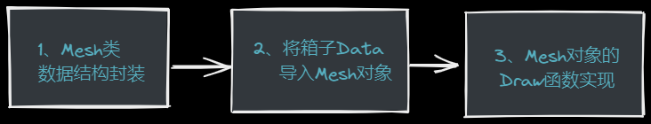
告诉OpenGL如何渲染Mesh
一个网格应该至少需要：:
顶点数据：至少包含一个位置向量、一个法向量和一个纹理坐标向量
材质数据（漫反射/镜面光贴图）
索引数据
struct Vertex {
QVector3D Position;
QVector3D Normal;
QVector2D TexCoords;
};
struct Texture {
unsigned int id;
string type;
string path;
};
#include <QOpenGLShaderProgram>
#include <QOpenGLFunctions_3_3_Core> #include <string>
#include <vector>
using namespace std;
class Mesh {
public:
// mesh data
vector<Vertex> vertices;
vector<unsigned int> indices;
vector<Texture> textures;
void Draw(QOpenGLShaderProgram &shader);
Mesh(QOpenGLFunctions_3_3_Core *glFuns,
vector<Vertex> vertices, vector<unsigned int> indices, vector<Texture> textures);
private:
// render data
unsigned int VAO, VBO, EBO;
void setupMesh();
private: QOpenGLFunctions_3_3_Core *m_glFuns;
};
调用方（ initializeGL() ） 执行完initializeOpenGLFunctions()之后可以通过
QOpenGLContext::currentContext()->versionFunctions<QOpenGLFunctions_3_3_Core>()
获取，并传入Mesh对象

Slide 2
构造函数与初始化
Mesh::Mesh(QOpenGLFunctions_3_3_Core *glFuns,
vector<Vertex> vertices, vector<unsigned int> indices, vector<Texture> textures)
:m_glFuns(glFuns)
{
this->vertices = vertices;
this->indices = indices;
this->textures = textures;
setupMesh();
}
数据结构填充好之后就可以初始化了
void Mesh::setupMesh() {
//创建VBO和VAO对象，并赋予ID
m_glFuns->glGenVertexArrays(1, &VAO);
m_glFuns->glGenBuffers(1, &VBO);
m_glFuns->glGenBuffers(1,&EBO);
//绑定VBO和VAO对象
m_glFuns->glBindVertexArray(VAO);
m_glFuns->glBindBuffer(GL_ARRAY_BUFFER, VBO);
//为当前绑定到target的缓冲区对象创建一个新的数据存储。
//如果data不是NULL，则使用来自此指针的数据初始化数据存储
m_glFuns->glBufferData(GL_ARRAY_BUFFER, vertices.size()*sizeof(Vertex),
&vertices[0], GL_STATIC_DRAW); m_glFuns->glBindBuffer(GL_ELEMENT_ARRAY_BUFFER, EBO);
m_glFuns->glBufferData(GL_ELEMENT_ARRAY_BUFFER,
indices.size() * sizeof(unsigned int),&indices[0], GL_STATIC_DRAW); //告知显卡如何解析缓冲里的属性值
m_glFuns->glVertexAttribPointer(0, 3, GL_FLOAT, GL_FALSE, 8 * sizeof(float), (void*)0);
m_glFuns->glEnableVertexAttribArray(0);
m_glFuns->glVertexAttribPointer(1, 3, GL_FLOAT, GL_FALSE, sizeof(Vertex),
(void*)offsetof(Vertex, Normal));
m_glFuns->glEnableVertexAttribArray(1);
m_glFuns->glVertexAttribPointer(2, 2, GL_FLOAT, GL_FALSE, sizeof(Vertex),
(void*)offsetof(Vertex, TexCoords));
m_glFuns->glEnableVertexAttribArray(2); }
Initialization
offsetof(TYPE, MEMBER)

Slide 3
将Data导入Mesh对象
Mesh* AXBOpemglWidget::processMesh() { vector<Vertex> _vertices(36);
vector<unsigned int> _indices;
vector<Texture> _textures;
// _vertices.reserve(36);
// _vertices.resize(36);
memcpy(&_vertices[0],vertices,sizeof(vertices));
for(int i=0;i<36;i++){
// Vertex vert;
// vert.Position[0]=vertices[i*8+0];
// vert.Position[1]=vertices[i*8+1];
// vert.Position[2]=vertices[i*8+2];
// vert.Normal[0]=vertices[i*8+3];
// vert.Normal[1]=vertices[i*8+4];
// vert.Normal[2]=vertices[i*8+5];
// vert.TexCoords[0]=vertices[i*8+6];
// vert.TexCoords[1]=vertices[i*8+7];
// _vertices.push_back(vert);
_indices.push_back(i);
} Texture tex;
tex.id=m_diffuseTex->textureId();
tex.type="texture_diffuse";
_textures.push_back(tex);
tex.id=m_specularTex->textureId();
tex.type="texture_specular";
_textures.push_back(tex); return new Mesh(
QOpenGLContext::currentContext()->versionFunctions<QOpenGLFunctions_3_3_Core>()
,_vertices,_indices,_textures);
}
processMesh必须发生在纹理创建成功之后执行

Slide 4
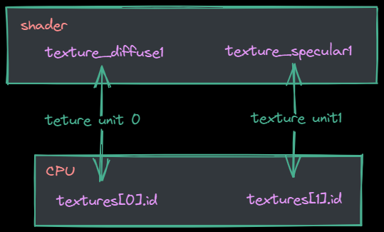
渲染
#version 330 core
struct Material {
sampler2D texture_diffuse1;
sampler2D texture_specular1;
float shininess;
};
片段着色器
void Mesh::Draw(QOpenGLShaderProgram &shader) {
unsigned int diffuseNr = 1;
unsigned int specularNr = 1; for(unsigned int i = 0; i < textures.size(); i++) {
m_glFuns->glActiveTexture(GL_TEXTURE0 + i);
string number;
string name = textures[i].type;
if(name == "texture_diffuse")
number = std::to_string(diffuseNr++);
else if(name == "texture_specular")
number = std::to_string(specularNr++);
shader.setUniformValue(("material." + name + number).c_str(), i);
m_glFuns->glBindTexture(GL_TEXTURE_2D, textures[i].id);
} m_glFuns->glBindVertexArray(VAO);
m_glFuns->glDrawElements(GL_TRIANGLES, indices.size(), GL_UNSIGNED_INT, 0);
//m_glFuns->glDrawArrays(GL_TRIANGLES, 0, vertices.size());
m_glFuns->glBindVertexArray(0);
}
可以通过QOpenGLTexture对象的textureId()函数获取

