Slide 1
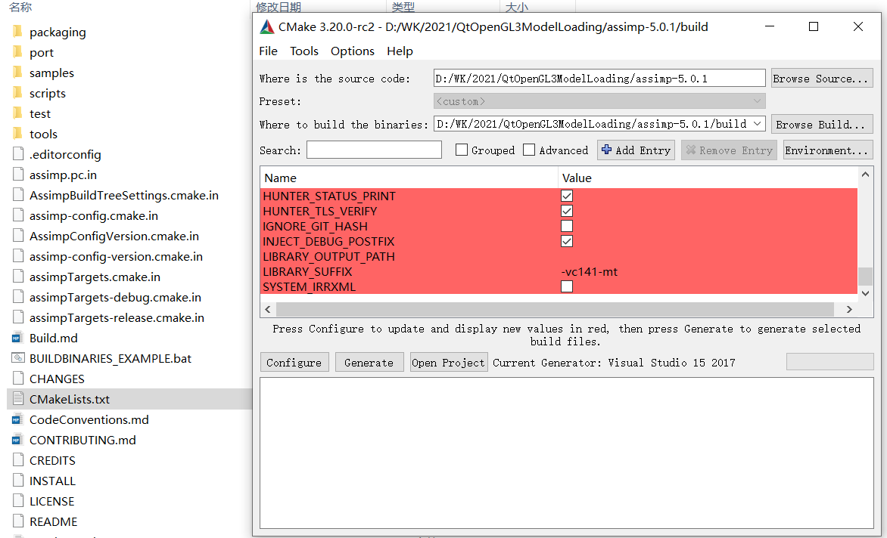
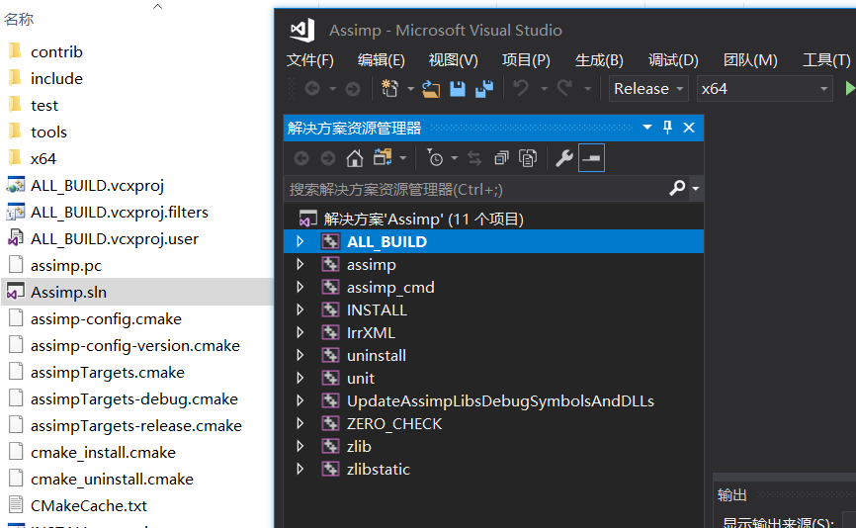
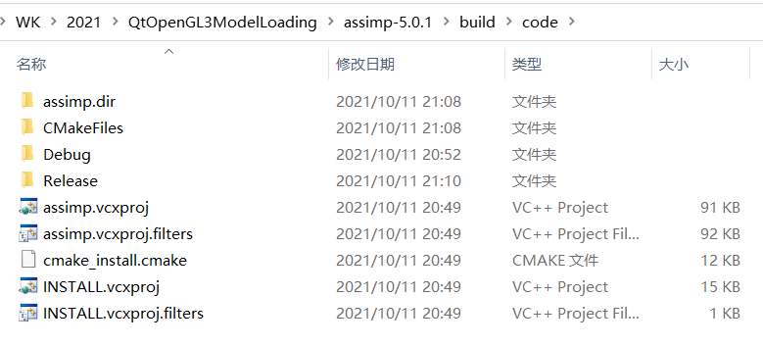
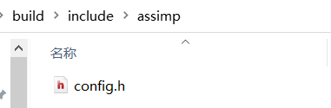
编译Assimp
Assimp 下载地址：Downloads (assimp.org)
CMake 下载地址：Download | CMake
如果按照过程一致遇到下面的问题，可能是没有按照DirectX SDK，下载地址：DirectX Software
Could not locate DirectX CMake Error at cmake-modules/FindPkgMacros.cmake:110 (message): Required library DirectX not found! Install the library (including dev packages) and try again. If the library is already installed, set the missing variables manually in cmake.
需要将编译生成的config.h头文件加入到include目录

