Slide 1
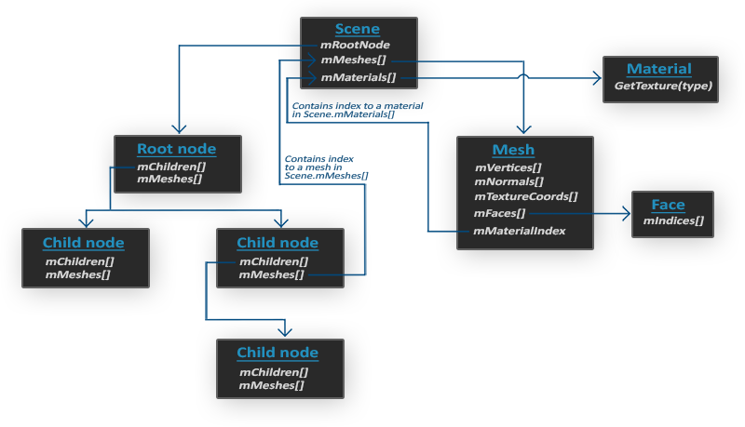
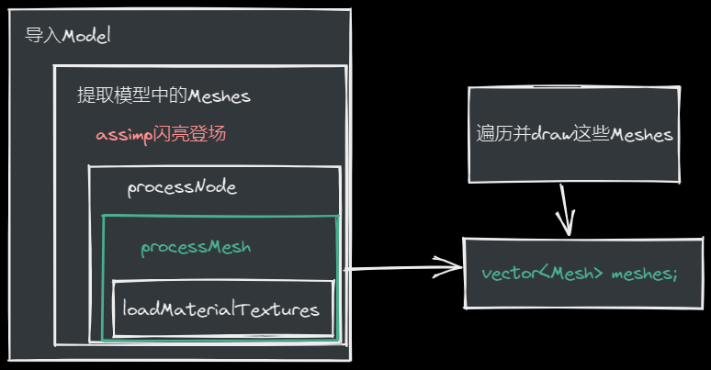
Model
#include <assimp/Importer.hpp>
#include <assimp/scene.h>
#include <assimp/postprocess.h>
编译器版本需要与Assimp编译的版本一致
class Model {
public:
vector<Texture> textures_loaded;
Model(QOpenGLFunctions_3_3_Core *glfuns,const char *path):m_glFuns(glfuns) {
loadModel(path);
}
void Draw(Shader &shader) {
for(unsigned int i = 0; i < meshes.size(); i++) meshes[i].Draw(shader);
}
private:
QOpenGLFunctions_3_3_Core *m_glFuns;
// model data
vector<Mesh> meshes;
string directory;
void loadModel(string path);
void processNode(aiNode *node, const aiScene *scene);
Mesh processMesh(aiMesh *mesh, const aiScene *scene);
vector<Texture> loadMaterialTextures(aiMaterial *mat, aiTextureType type, string typeName);
};
我们将通过Assimp加载模型，并将其转换为多个网格（Mesh）对象
void loadModel(string path) {
Assimp::Importer import;
const aiScene *scene = import.ReadFile(path, aiProcess_Triangulate | aiProcess_FlipUVs);
if(!scene || scene->mFlags & AI_SCENE_FLAGS_INCOMPLETE || !scene->mRootNode) {
qDebug() << "ERROR::ASSIMP::" << import.GetErrorString() ;
return;
}
directory = path.substr(0, path.find_last_of('/'));
processNode(scene->mRootNode, scene);
}
Once we have the scene object, we can access all the data we need from the loaded model
aiProcess_Triangulate : tell Assimp that if the model does not (entirely) consist of triangles, it should transform all the model's primitive shapes to triangles first
返回从0位置开始，到最后一个’/’
（从path里去除了文件名）

Slide 2

Assimp里的结构：每个节点包含一组网格索引，每个索引指向场景对象中的特定网格
void processNode(aiNode *node, const aiScene *scene) {
// process all the node's meshes (if any)
for(unsigned int i = 0; i < node->mNumMeshes; i++) {
aiMesh *mesh = scene->mMeshes[node->mMeshes[i]];
meshes.push_back(processMesh(mesh, scene));
}
// then do the same for each of its children
for(unsigned int i = 0; i < node->mNumChildren; i++) {
processNode(node->mChildren[i], scene);
}
}
将Assimp的数据解析到上一节中创建的Mesh类中：
Mesh processMesh(aiMesh *mesh, const aiScene *scene) {
vector<Vertex> vertices;
vector<unsigned int> indices;
vector<Texture> textures;
for(unsigned int i = 0; i < mesh->mNumVertices; i++) {
Vertex vertex;
// 处理顶点位置、法线和纹理坐标
[...]
vertices.push_back(vertex);
}
// 处理索引
[...]
// 处理材质
if(mesh->mMaterialIndex >= 0) {
[...]
}
return Mesh(vertices, indices, textures);
}
QVector3D vector;
vector.vector.setX(mesh->mVertices[i].x);
vector.vector.setY(mVertices[i].y);
vector.vector.setZ(mVertices[i].z);
vertex.Position = vector;
vector.vector.setX(mesh->mNormals[i].x);
vector.vector.setY(mesh->mNormals[i].y);
vector.vector.setZ(mesh->mNormals[i].z);
vertex.Normal = vector;
if(mesh->mTextureCoords[0]) // 有纹理坐标？
{
QVector2D vec;
vec.vector.setX(mesh->mTextureCoords[0][i].x);
vec.vector.setY(mesh->mTextureCoords[0][i].y); vertex.TexCoords = vec;
} else
vertex.TexCoords = QVector2D(0.0f, 0.0f);

Slide 3
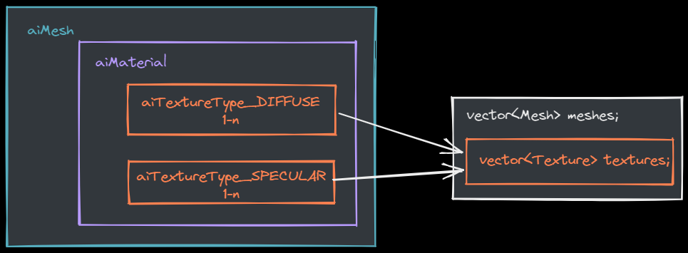
for(unsigned int i = 0; i < mesh->mNumFaces; i++) {
aiFace face = mesh->mFaces[i];
for(unsigned int j = 0; j < face.mNumIndices; j++)
indices.push_back(face.mIndices[j]);
}
索引
材质纹理
if(mesh->mMaterialIndex >= 0) {
aiMaterial *material = scene->mMaterials[mesh->mMaterialIndex];
vector<Texture> diffuseMaps =
loadMaterialTextures(material, aiTextureType_DIFFUSE, "texture_diffuse");
textures.insert(textures.end(), diffuseMaps.begin(), diffuseMaps.end());
vector<Texture> specularMaps =
loadMaterialTextures(material, aiTextureType_SPECULAR, "texture_specular");
textures.insert(textures.end(), specularMaps.begin(), specularMaps.end());
}
vector<Texture> loadMaterialTextures(aiMaterial *mat, aiTextureType type, string typeName) {
vector<Texture> textures;
for(unsigned int i = 0; i < mat->GetTextureCount(type); i++) {
aiString str;
mat->GetTexture(type, i, &str);
Texture texture;
texture.id = TextureFromFile(str.C_Str(), directory);
texture.type = typeName;
texture.path = str..C_Str();
textures.push_back(texture);
}
return textures;
}
unsigned int Model::TextureFromFile(const char *path, const string &directory){
string filename = string(path);
filename = directory + '/' + filename;
QOpenGLTexture * texture=new QOpenGLTexture(QImage(filename.c_str()).mirrored());
if(texture==NULL) qDebug()<<"texture is NULL";
else qDebug()<<filename.c_str()<<"loaded";
return texture->textureId();
}

Slide 4
重大优化
大多数场景都会在多个网格中重用部分纹理
struct Texture {
unsigned int id;
string type;
string path;
// we store the path of the texture to compare with other textures
};
vector<Texture> textures_loaded;
vector<Texture> loadMaterialTextures(aiMaterial *mat, aiTextureType type, string typeName) {
vector<Texture> textures;
for(unsigned int i = 0; i < mat->GetTextureCount(type); i++) {
aiString str;
mat->GetTexture(type, i, &str);
bool skip = false;
for(unsigned int j = 0; j < textures_loaded.size(); j++) {
if(std::strcmp(textures_loaded[j].path.data(), str.C_Str()) == 0) {
textures.push_back(textures_loaded[j]);
skip = true;
break;
}
}
if(!skip) {
// if texture hasn't been loaded already, load it
Texture texture;
texture.id = TextureFromFile(str.C_Str(), directory);
texture.type = typeName;
texture.path = str.C_Str();
textures.push_back(texture);
textures_loaded.push_back(texture); // add to loaded textures
}
}
return textures;
}

Slide 5
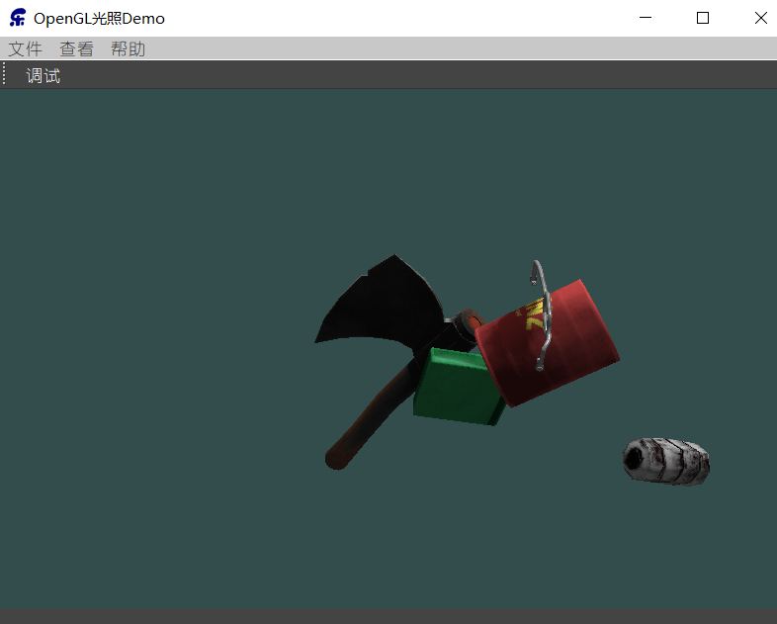
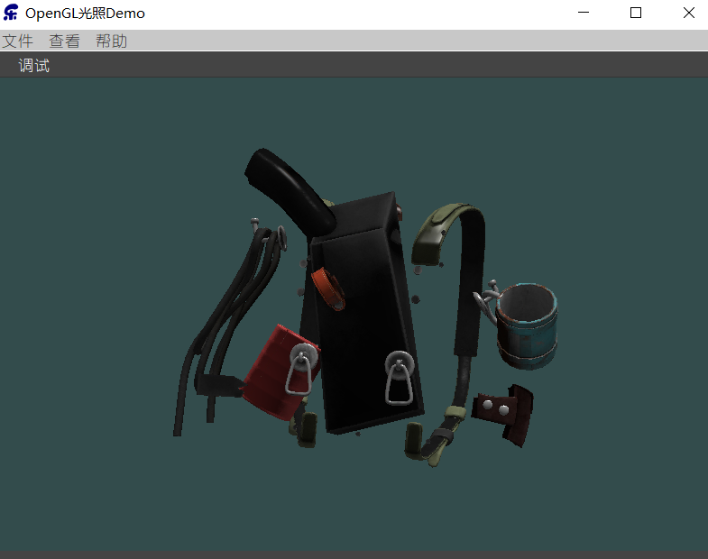
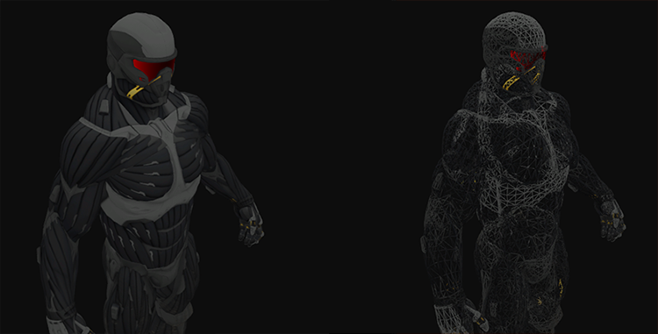
void Draw(QOpenGLShaderProgram &shader) {
for(unsigned int i = 20; i < 30; i++)
meshes[i].Draw(shader);
}
void Draw(QOpenGLShaderProgram &shader) {
for(unsigned int i =30; i < meshes.size(); i++)
meshes[i].Draw(shader);
}

Slide 6
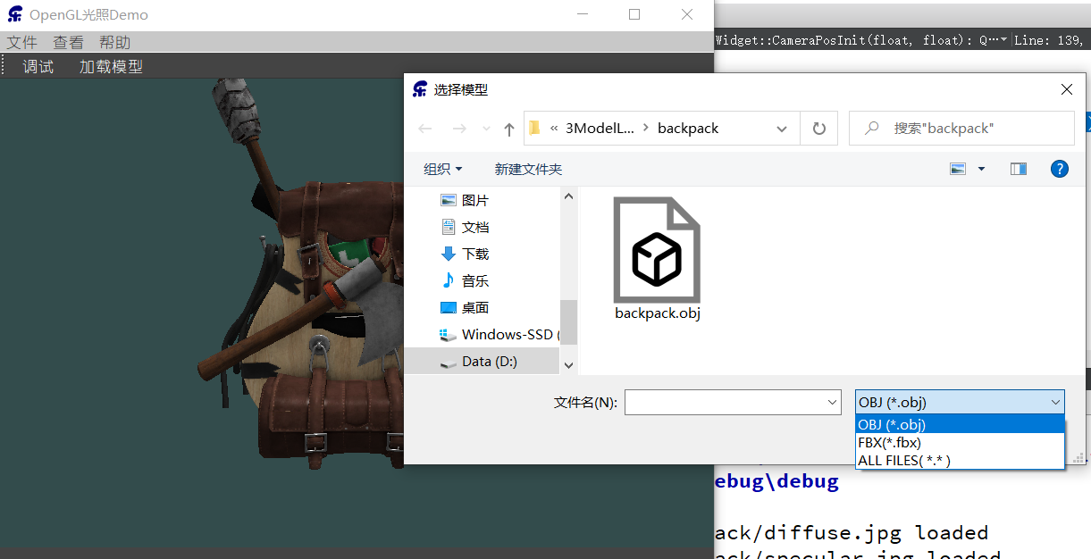
Qt UI加载模型
通过Qt UI，选择模型文件并加载模型
根据模型大小调整Camera位置
加载模型时获取模型大小
调整空格键，回到原位功能
#include <QFileDialog>
void MainWindow::on_actModelLoading_triggered() {
QString str=QFileDialog::getOpenFileName(this,"选择模型","",
"OBJ (*.obj);;FBX(*.fbx);;ALL FILES( *.* ) ");
ui->openGLWidget->loadModel(str.toStdString());
}
void AXBOpemglWidget::loadModel(string path) {
if(m_model !=NULL)
delete m_model; m_model=NULL;
makeCurrent(); m_model=new Model(
QOpenGLContext::currentContext()>versionFunctions<QOpenGLFunctions_3_3_Core>()
,path.c_str());
doneCurrent();
}
case Qt::Key_Space: m_camera.Position=CameraPosInit(m_model->m_maxY, m_model->m_minY);
QVector3D AXBOpemglWidget::CameraPosInit(float modelMaxY,float modelMinY) {
QVector3D temp = viewInitPos;
float _hight=modelMaxY-modelMinY; temp.setZ( 1.5*_hight);
if(modelMinY>=0)
temp.setY(_hight/2);
return temp;
}

