Slide 1
Github Tutorial

Slide 2
Github Rules
Yeah it’s pretty great
Do not add files > 100 MB to your repos
Create .gitignore file in root directory of repo
Push regularly
If collaborating, checkout a branch and push to that branch, then merge to master when you’ve talked to your colleague

Slide 3
Initialize repo from existing directory
To initialize from existing directory:
Cd to the root of what you want your repo to be
‘git init’
Create your gitignore to prevent large files and PHI from being uploaded (touch .gitignore; vi .gitignore, edit)
‘git add --all’
‘git commit –m “initial commit”’
Go to github.com/StanfordCosyne, click green button, follow prompts to create a repo. This will create an online version of the repo and you can clone it into your local directory. Click the green button in this new repo and copy the URL that appears (URL).
‘git remote add origin URL’
‘git pull origin master’
‘git push origin master’

Slide 4
Initialize brand new repo
To initialize a new repo:
Go to github.com/StanfordCosyne, click green button, follow prompts to create a repo. This will create an online version of the repo and you can clone it into your local directory. Click the green button in this new repo and copy the URL that appears (URL).
Go to the directory where you want your repo directory to be
‘git clone URL’
‘git add --all’
‘git commit –m “initial commit”’
‘git push’

Slide 5
Pulling and Pushing
So you’ve made changes to your files or directories in a repo… Push!
Add the directories you’ve changed (‘git add scripts’/), or if you’ve changed a lot (‘git add --all’)
Add a commit message to say what you’ve changed (‘git commit –m “Changed preprocessing configs”)
Push your changes (‘git push origin master’)

Slide 6
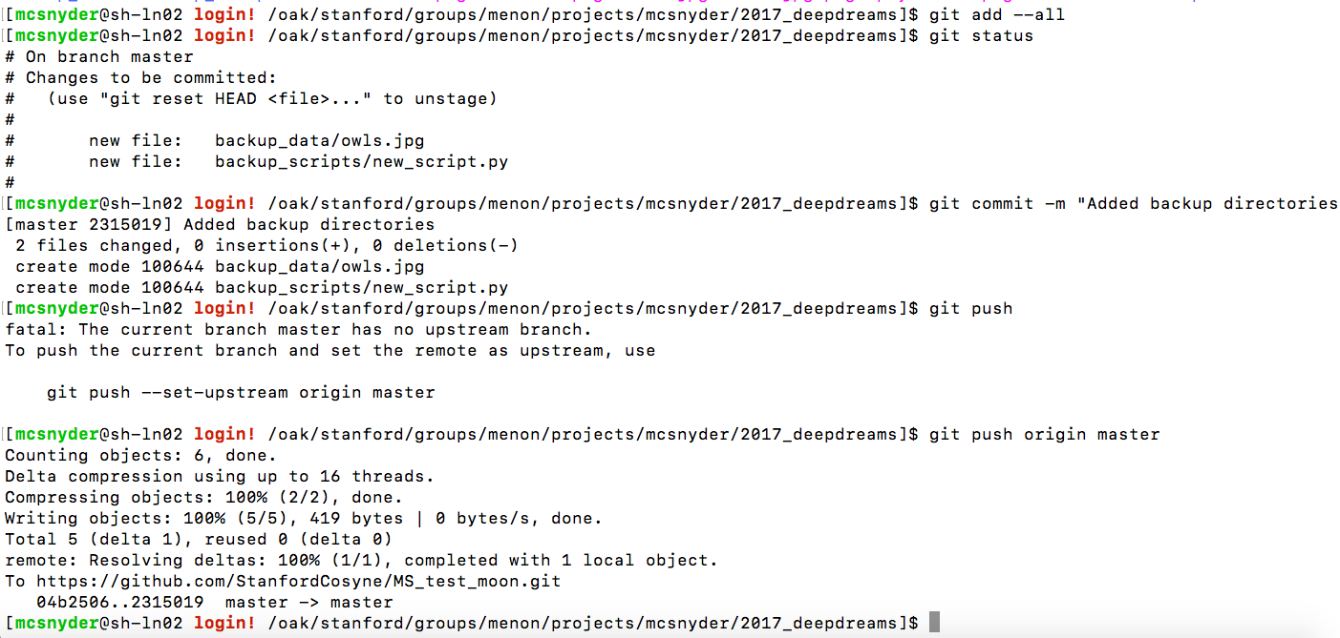

Slide 7
Sample .gitignore
# Compiled #
##########
*.com
*.class
*.dll
*.exe
*.o
*.so
*.nii
*.img
*.hdr
# Packages #
############
# it's better to unpack these files and commit the raw source
# git has its own built in compression methods
*.7z
*.dmg
*.gz
*.iso
*.jar
*.rar
*.tar
*.zip
# Logs and databases #
######################
*.log
*.sql
*.sqlite
# OS generated files #
######################
.DS_Store
.DS_Store?
._*
.Spotlight-V100
.Trashes
ehthumbs.db
Thumbs.db

