Slide 1
5003: Big Data Computing Group 14 Statistical Factor Analysis

Slide 2
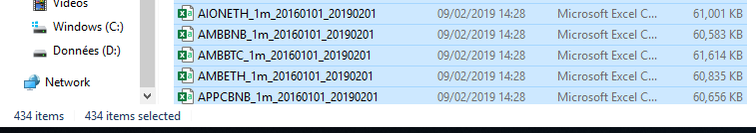
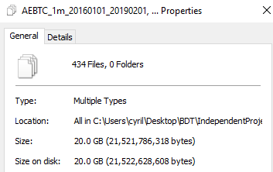
Big Data Problem

Slide 3
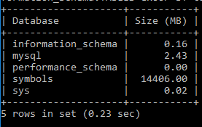
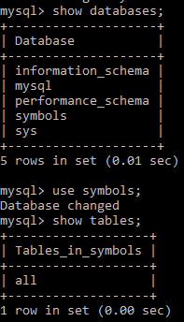
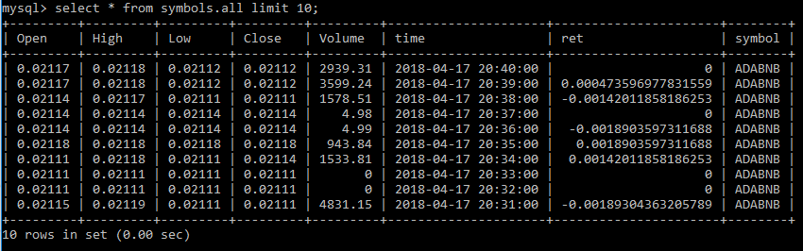
SQL: Table symbols
Storing 20Gb of raw data shrunk
to 14.5Gb after conversion

Slide 4


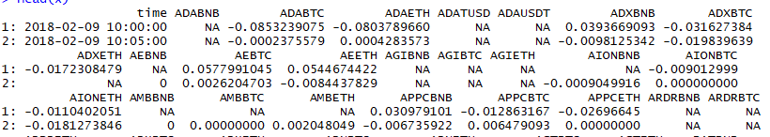
Data Transformation: SparklyR
Connection to the database
Why R and not python? →Built-in function
Output

Slide 5
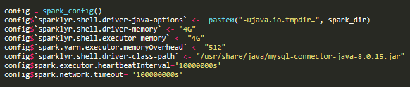
Issues we encountered
Driver options
Domain knowledge
→ Aggregation of 1min bar to 1hour bar due to low factor contribution

Slide 6
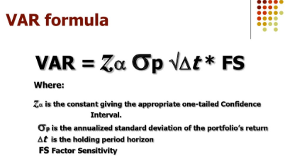
High Frequency Financial Risk Management
Recent package development in R (factorAnalytics) implemented in Pyspark
Regress each cryptocurrency return times series against PCA factors of every stock in the universe
Our function can yield which cryptocurrency can minimize your value at risk defined as:

Slide 7
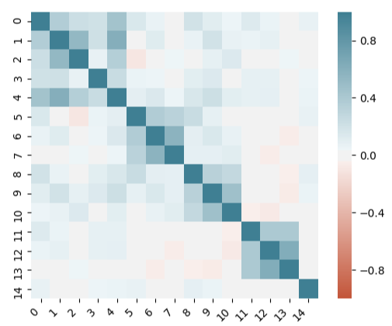
Crypto returns correlation Matrix

Slide 8
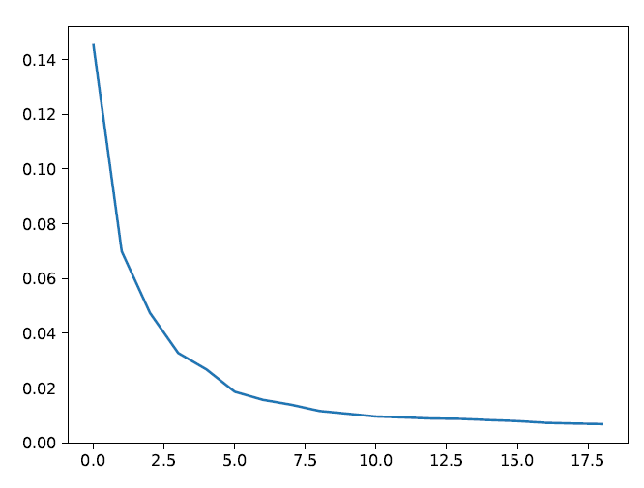
Scree Plot

Slide 9
Optimal number of components ?
Fama French
Market + Industries (BARRA model, now MSCI)
Momentum based
Since there are no consensus, we will consider 5 in our analysis
Interpretation from academia
1st = Cryptocurrency Market (Index)
2nd = Momentum based strategy

Slide 10
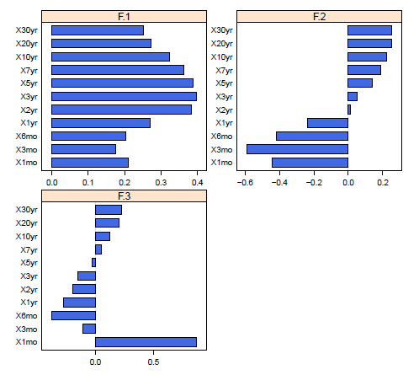
Value at Risk Decomposition

Slide 11
Enhancement
Spark streaming
Sliding window directly from Binance API
Aggregation of tick data on minute bar with Spark
Risk management:
Standard deviation decomposition
Expected Shortfall decomposition

Slide 12
References
https://economics.yale.edu/sites/default/files/files/Faculty/Tsyvinski/cryptoreturns%208-7-2018.pdf

