Slide 1



ZeroShotCeres: Zero-Shot Relation Extraction from Semi-Structured Webpages
Colin Lockard (UW, Amazon), Prashant Shiralkar (Amazon),
Xin Luna Dong (Amazon), Hannaneh Hajishirzi (UW, AI2)

Slide 2
Overview
Semi-structured websites are a rich source of data for KB population
Previous extraction methods required learning a new model for each website targeted for extraction
We introduce a method for learning a single model that can extract from arbitrary semi-structured websites
Build rich representation of textual, visual, layout features of a webpage with GNN
Pre-training task to help generalization
OpenIE extractions from never-before-seen websites in never-before-seen subject domains

Slide 3
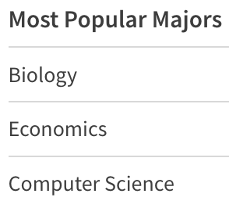
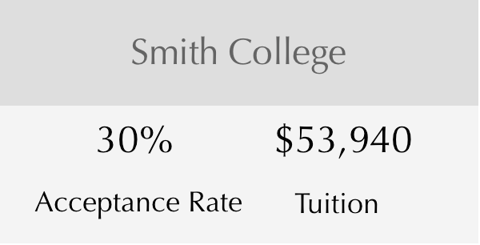
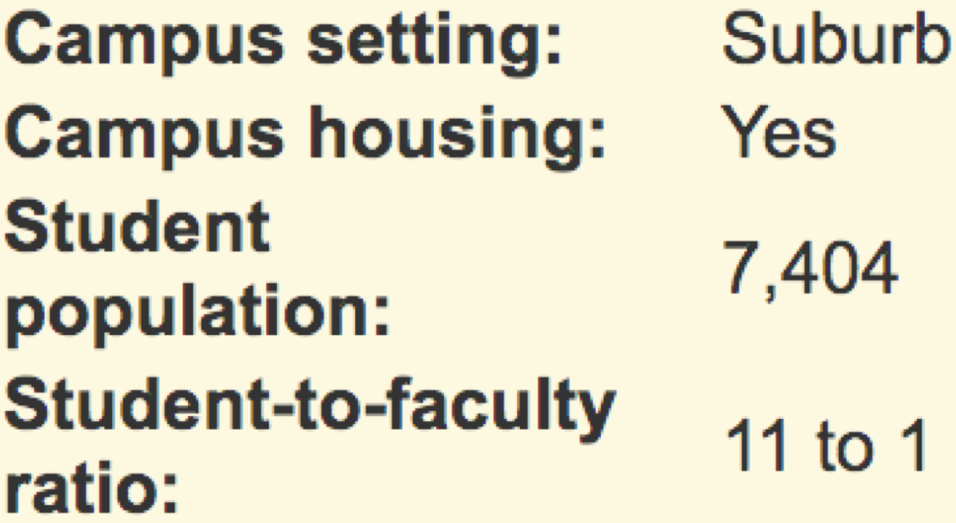
Train on University Websites

Slide 4
Graph Attention Network
Smith College
30%
Visual features,
textual features,
layout graph
$53,940
Acceptance Rate
Tuition
Train on University Websites

Slide 5
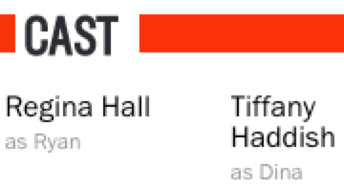
Cast
Relation: Cast
Object: Tiffany Haddish
Extract from Movie Website
Graph Attention Network
Smith College
30%
Visual features,
textual features,
layout graph
$53,940
Acceptance Rate
Tuition
Train on University Websites

Slide 6
Why should we care about semi-structured websites?

Slide 7
Overview
Semi-structured websites are a rich source of data for KB population
Previous extraction methods required learning a new model for each website targeted for extraction
We introduce a method for learning a single model that can extract from arbitrary semi-structured websites
Build rich representation of textual, visual, layout features of a webpage with GNN
Pre-training task to help generalization
OpenIE extractions from never-before-seen websites in never-before-seen subject domains

Slide 8
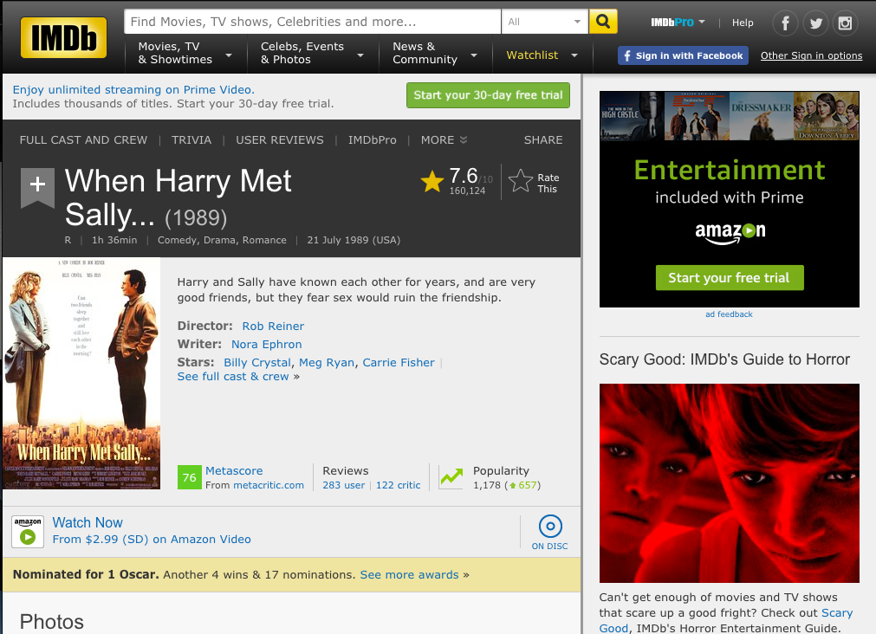

Slide 9
Semi-structured:
Rich layout features
Each page provides info about an entity
Data represented as key-value pairs and lists
Text fields consisting of just entity/attribute name

Slide 10
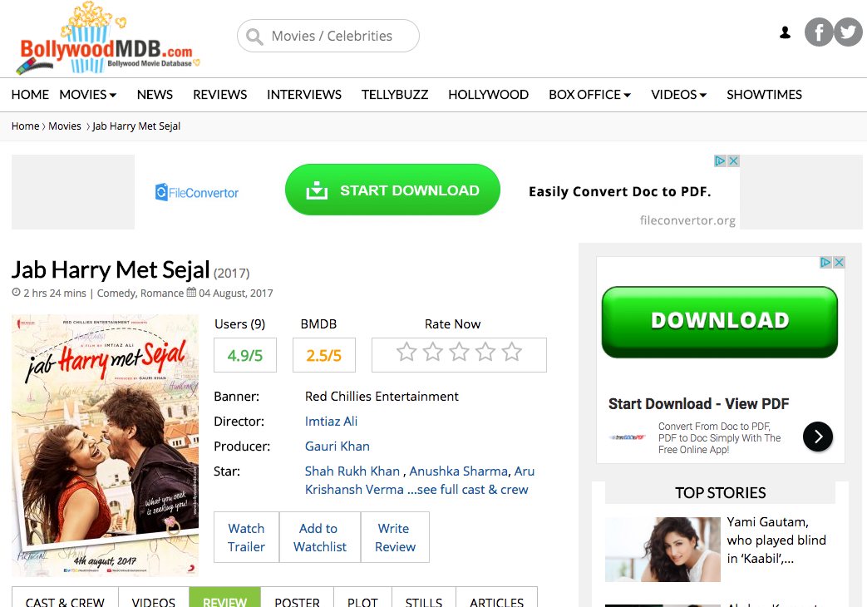
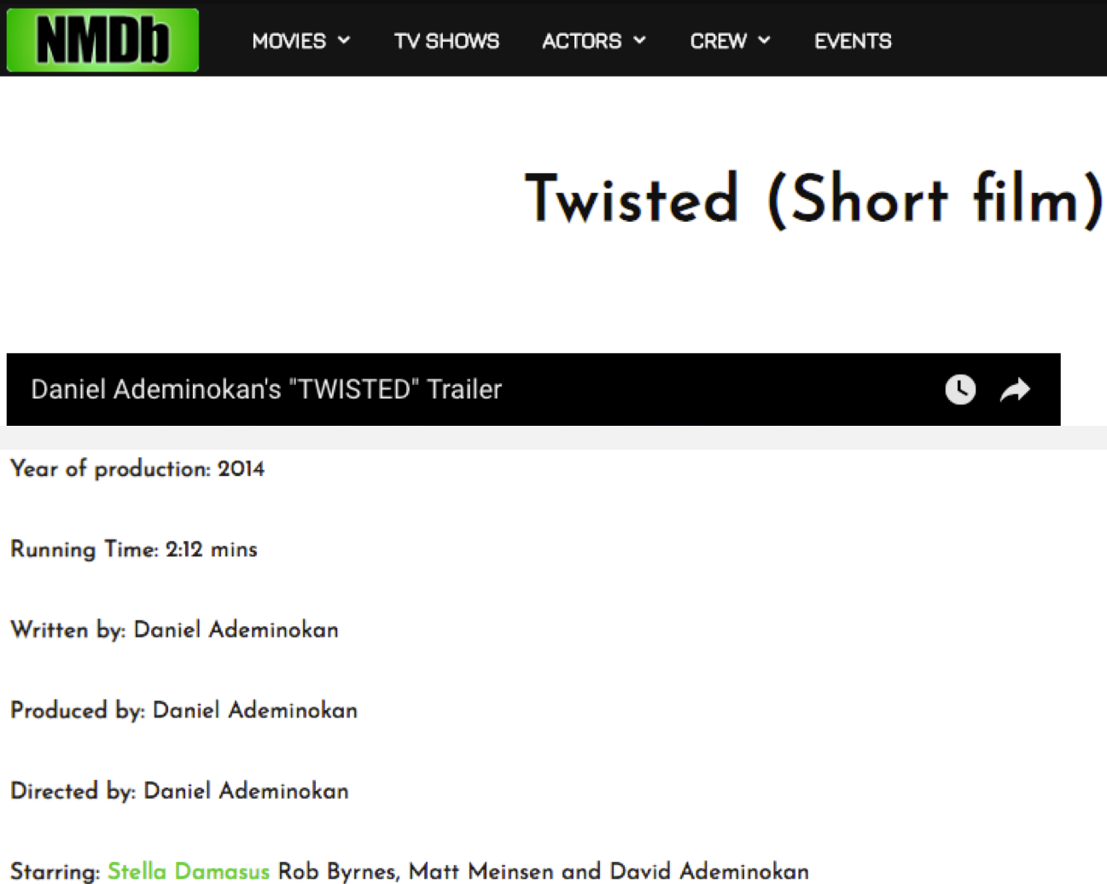
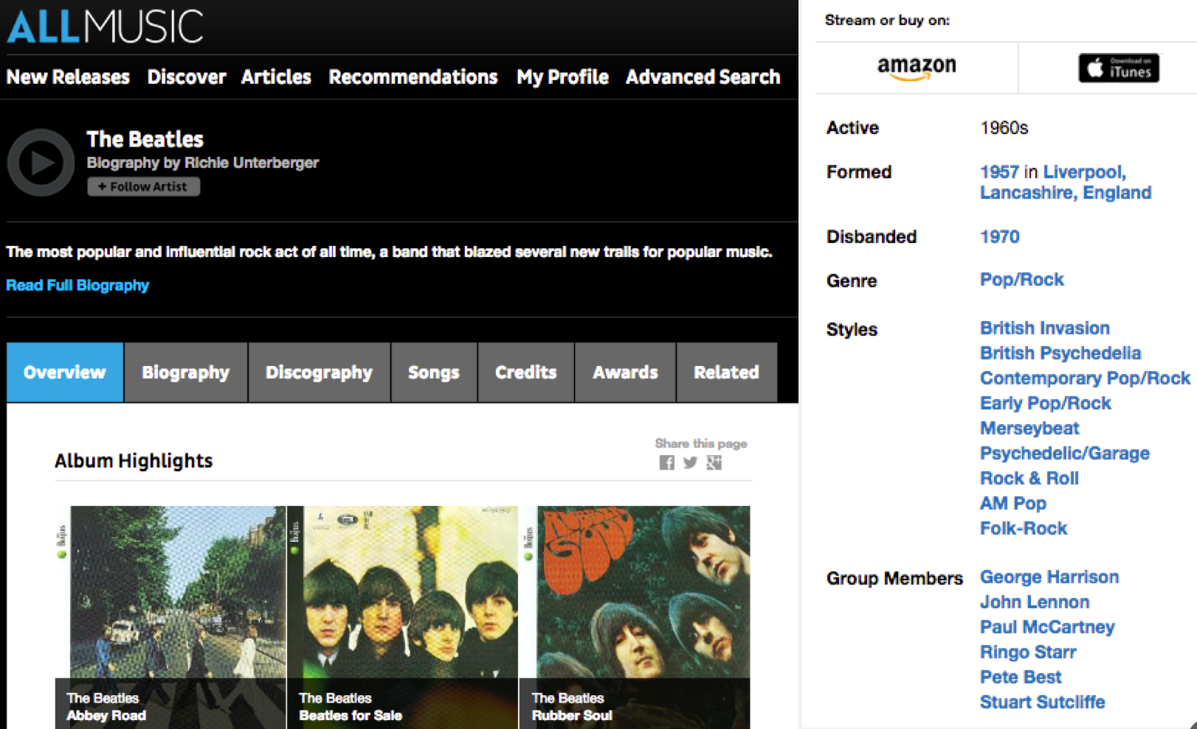
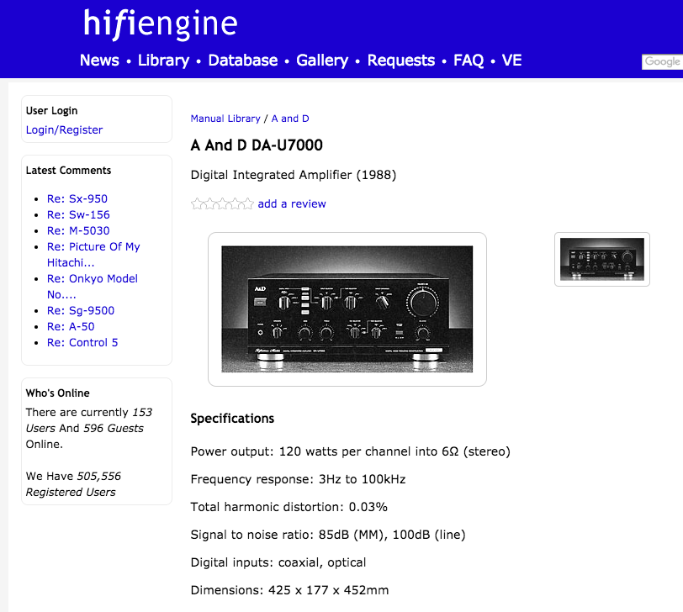
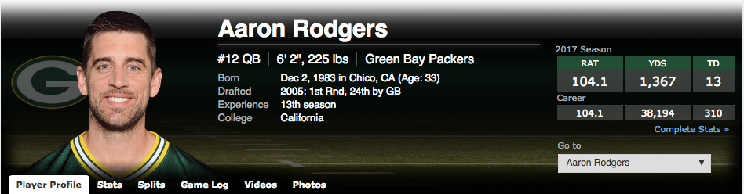
There are lots of semi-structured websites

Slide 11
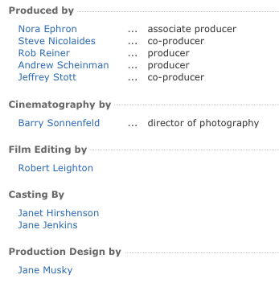
And they have a lot of information
Knowledge Vault @ Google found 4x more facts from semi-structured than unstructured text
[Dong et al., KDD’14][Dong et al., VLDB’14]

Slide 12
On10 semi-structured movie websites, the IMDb ontology covered only 7% of relations.
OpenIE allows us to extract these new relations

Slide 13
Traditional Extraction
TOPIC ENTITY
“When Harry Met Sally”
Relation types defined in ontology
(film.written_by, “Nora Ephron”)
(film.actor, “Meg Ryan”)
Notes:
Semi-structured detail page

Slide 14
Problem Definition
Input:
Pages from a semi-structured website
Seed KB (and ontology)
Output:
A set of triples (s, r, o), where
s is a string corresponding to the subject (page topic entity),
o is a string corresponding to the object
r is a string indicating the relation/predicate (OpenIE) or a relation defined in our ontology (ClosedIE)

Slide 15
Overview
Semi-structured websites are a rich source of data for KB population
Previous extraction methods required learning a new model for each website targeted for extraction
We introduce a method for learning a single model that can extract from arbitrary semi-structured websites
Build rich representation of textual, visual, layout features of a webpage with GNN
Pre-training task to help generalization
OpenIE extractions from never-before-seen websites in never-before-seen subject domains

Slide 16
Prior Work
Wrapper Induction (Kushmerick et al, 1997)
Rule mining based on labeled data from a website
Requires training data for each target website
Distantly supervised approaches (Lockard et al, 2018 Lockard et al, 2019)
Use KB to automatically create training data for a website
Requires KB with knowledge overlap for each target website
Prior models rely on site-specific features
Nicholas Kushmerick, Daniel S. Weld, and Robert B. Doorenbos. 1997. Wrapper induction for information extraction. In IJCAI.
Colin Lockard, Arash Einolghozati, Prashant Shiralkar, and Xin Luna Dong. 2018. Ceres: distantly supervised relation extraction from the semi-structured web. VLDB, 11(10):1084– 1096.
Colin Lockard, Prashant Shiralkar, and Xin Luna Dong. 2019. OpenCeres: When open information extraction meets the semi-structured web. In NAACL-HLT, pages 3047–3056.

Slide 17
Can we learn a single general model to extract from never-before-seen websites?

Slide 18
Zero-shot Extraction
Unseen-Website Zero-shot Extraction: Given website W in vertical V, learn a model for W without any training pages from W (but with pages from other websites in V)
Unseen-Vertical Zero-shot Extraction: Given website W in vertical V, learn a model for W without any training pages from W or any other website from vertical V

Slide 19
Intuition
Websites have textual, layout, and visual semantics that are consistent from site to site
Horizontal alignment
Vertical alignment
Section headers are larger, bolder
We need to build a representation that captures and combines these different feature modalities

Slide 20
Overview
Semi-structured websites are a rich source of data for KB population
Previous extraction methods required learning a new model for each website targeted for extraction
We introduce a method for learning a single model that can extract from arbitrary semi-structured websites
Build rich representation of textual, visual, layout features of a webpage with GNN
Pre-training task to help generalization
OpenIE extractions from never-before-seen websites in never-before-seen subject domains

Slide 21
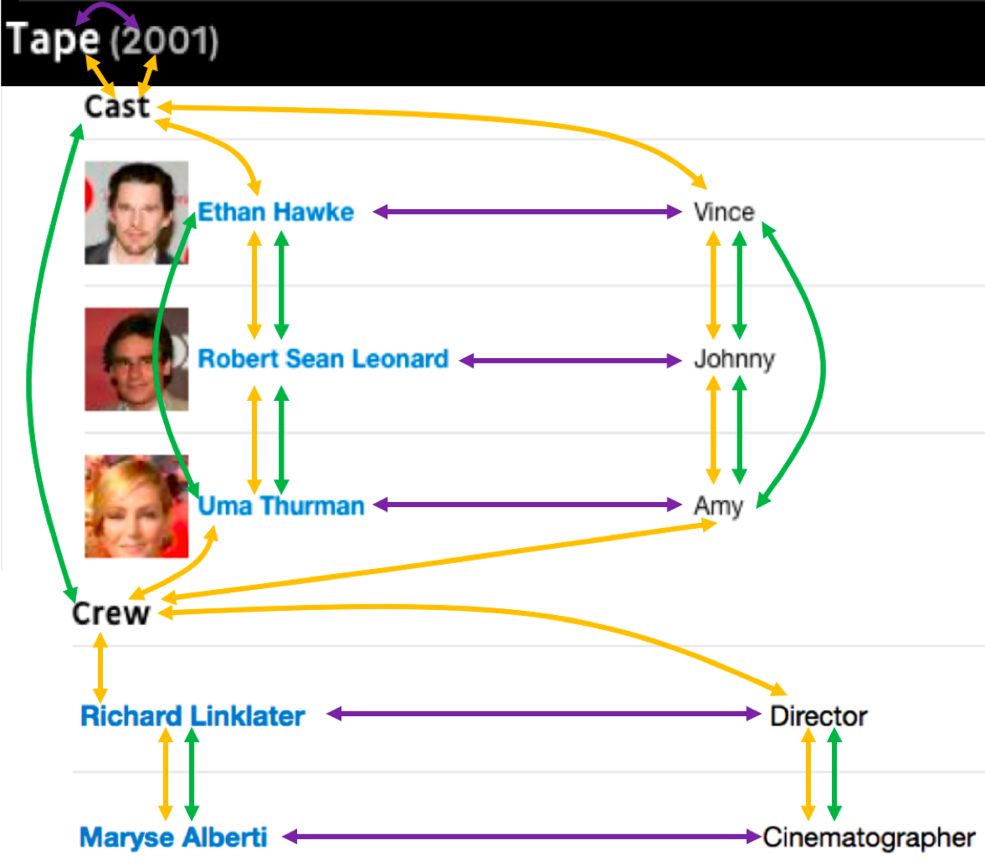
Page Layout Graph
Horizontal edges
Vertical edges
DOM edges connect nodes that are siblings/cousins in DOM tree

Slide 22
Text Field Features
Textual
BERT embedding (ClosedIE only)
IDF across website
Text length
Visual
Font size
Bold, underlined, italic
Font Color
Text field dimensions
…

Slide 23
Model
2-layer Graph Attention Network
Propagates information about neighboring text fields
Builds new contextual representation of each text field based on broader page context

Slide 25
Visual
Textual
t₁
t₂
…
t_{n}
“Smith College”
“30%”
“Tuition”
Text field features
Web Page Encoder

Slide 26
Smith College
30%
$53,940
Acceptance Rate
Tuition
Page layout graph
Visual
Textual
t₁
t₂
…
t_{n}
“Smith College”
“30%”
“Tuition”
Text field features
Web Page Encoder

Slide 27
Smith College
30%
$53,940
Acceptance Rate
Tuition
Graph Attention Network
Page layout graph
Visual
Textual
t₁
t₂
…
t_{n}
“Smith College”
“30%”
“Tuition”
Text field features
Web Page Encoder

Slide 28
Smith College
30%
$53,940
Acceptance Rate
Tuition
Graph Attention Network
Page layout graph
Contextual
features
Visual
Textual
t₁
t₂
…
t_{n}
“Smith College”
“30%”
“Tuition”
Text field features
Web Page Encoder

Slide 29
Smith College
30%
$53,940
Acceptance Rate
Tuition
Graph Attention Network
Page layout graph
Contextual
features
Visual
Textual
t₁
t₂
…
t_{n}
“$53,940”
ClosedIE
“Smith College”
“30%”
“Tuition”
Multi-class Classifier
Predicted Relation
Text field features
Web Page Encoder

Slide 30
OpenIE
Smith College
Candidate relation
30%
$53,940
“Tuition”
Acceptance Rate
Tuition
Graph Attention Network
Page layout graph
“$53,940”
Contextual
features
Candidate object
Visual
Textual
t₁
t₂
…
t_{n}
“$53,940”
ClosedIE
“Smith College”
“30%”
“Tuition”
Multi-class Classifier
Predicted Relation
Text field features
Web Page Encoder

Slide 31
OpenIE
Smith College
Candidate relation
30%
$53,940
“Tuition”
Acceptance Rate
Tuition
Pairwise features
Graph Attention Network
Page layout graph
“$53,940”
Contextual
features
Candidate object
Visual
Textual
t₁
t₂
…
t_{n}
“$53,940”
ClosedIE
“Smith College”
“30%”
“Tuition”
Multi-class Classifier
Predicted Relation
Text field features
Web Page Encoder

Slide 32
OpenIE
Smith College
Candidate relation
30%
$53,940
“Tuition”
Yes/No Relation Prediction
Pairwise features
Binary Classifier
Acceptance Rate
Tuition
Graph Attention Network
Page layout graph
“$53,940”
Contextual
features
Candidate object
Visual
Textual
t₁
t₂
…
t_{n}
“$53,940”
ClosedIE
“Smith College”
“30%”
“Tuition”
Multi-class Classifier
Predicted Relation
Text field features
Web Page Encoder

Slide 33
Overview
Semi-structured websites are a rich source of data for KB population
Previous extraction methods required learning a new model for each website targeted for extraction
We introduce a method for learning a single model that can extract from arbitrary semi-structured websites
Build rich representation of textual, visual, layout features of a webpage with GNN
Pre-training task to help generalization
OpenIE extractions from never-before-seen websites in never-before-seen subject domains

Slide 34
Training
Labeled dataset is relatively small (7-20 websites)
Pre-training task
3-way classification (relation string, object string, other)
Freeze GAT weights after pre-training
Train final classification layers on IE task

Slide 35
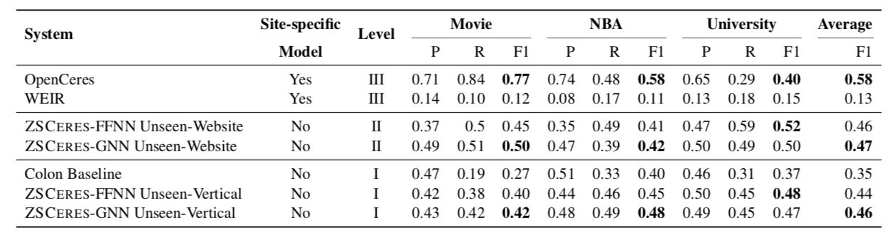
OpenIE training on 2 subject domains
Extract from 3rd (unseen) domain

Slide 36
With zero prior knowledge of University domain, more accurate than baselines with domain-specific knowledge

Slide 37
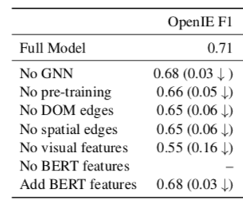
Pre-training contributes 5 pts of F1

Slide 38
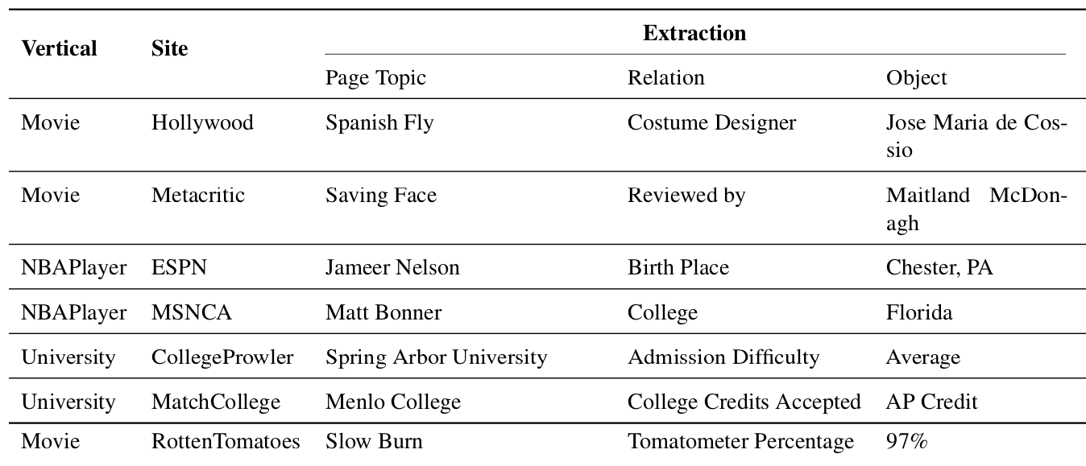

Slide 39
Conclusion
Our graph neural network model combines visual, textual, and layout features of a website
Pre-training on a simplified IE task produces better generalization
Our method can extract OpenIE triples from never-before-seen websites and subject domains

