Slide 1
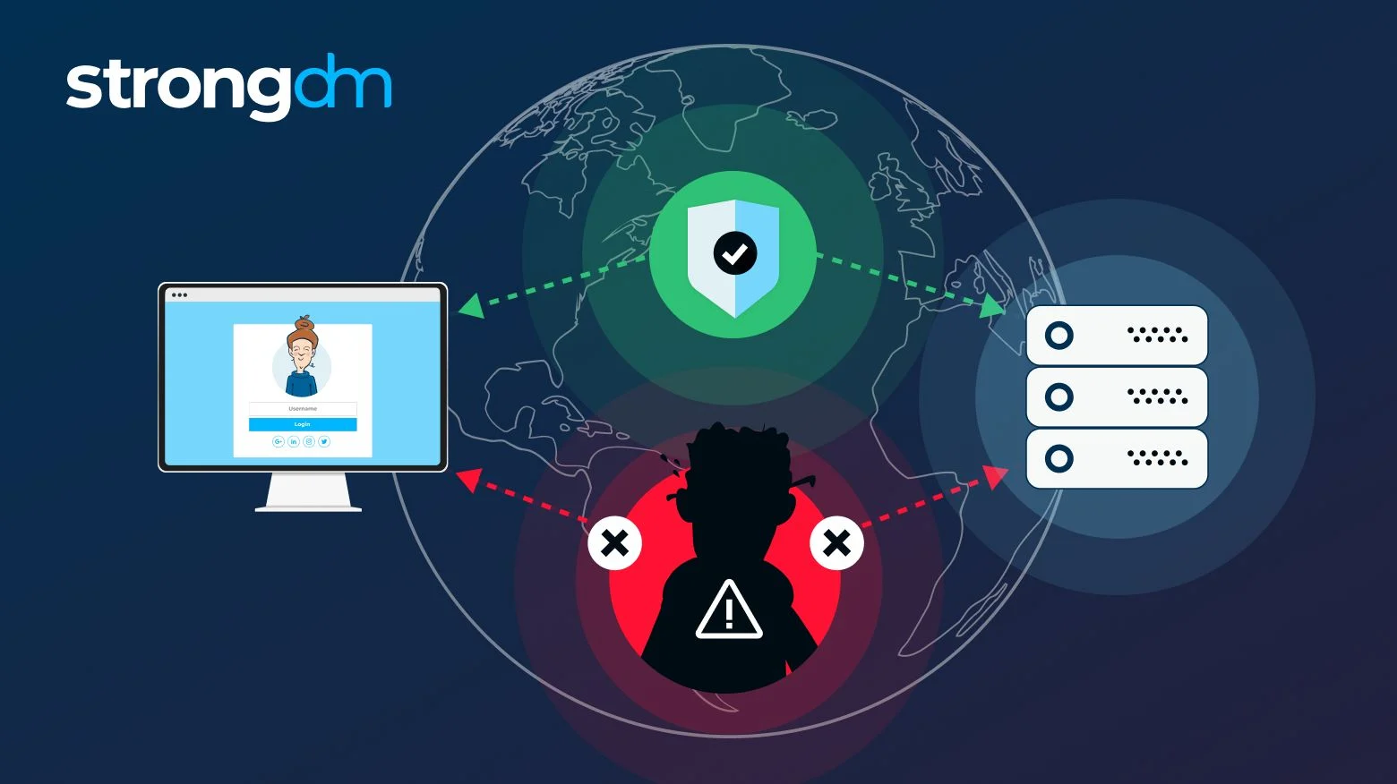
What is a Man-in-the-Middle (MITM) Attack?
A man-in-the-middle (MITM) attack is a cyber attack in which a threat actor puts themselves in the middle of two parties, typically a user and an application, to intercept their communications and data exchanges and use them for malicious purposes like making unauthorized purchases or hacking.

Slide 2
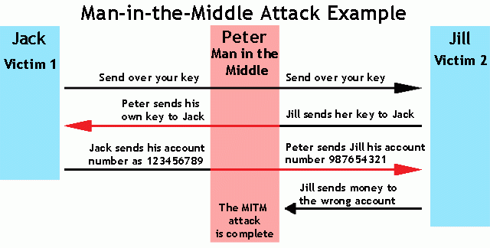

Slide 3
Example Suppose Alice wishes to communicate with Bob. Meanwhile, Mallory wishes to intercept the conversation to eavesdrop (breaking confidentiality) with the option to deliver a false message to Bob under the guise of Alice (breaking non-repudiation). Mallory would perform a man-in-the-middle attack as described in the following sequence of even
Alice sends a message to Bob, which is intercepted by Mallory:s
Alice "Hi Bob, it's Alice. Give me your key." → Mallory Bob
Mallory relays this message to Bob; Bob cannot tell it is not really from Alice:
Alice Mallory "Hi Bob, it's Alice. Give me your key." → Bob
Bob responds with his encryption key:
Alice Mallory ← [Bob's key] Bob
Mallory replaces Bob's key with her own, and relays this to Alice, claiming that it is Bob's key:
Alice ← [Mallory's key] Mallory Bob
Alice encrypts a message with what she believes to be Bob's key, thinking that only Bob can read it:
Alice "Meet me at the bus stop!" [encrypted with Mallory's key] → Mallory Bob
However, because it was actually encrypted with Mallory's key, Mallory can decrypt it, read it, modify it (if desired), re-encrypt with Bob's key, and forward it to Bob:
Alice Mallory "Meet me at the park!" [encrypted with Bob's key] → Bob

Slide 4
Types of Man-in-the-Middle Attacks
IP Spoofing: A cybercriminal alters the Internet Protocol (IP) address of a website, email address, or device and spoofs the entity—making the user think they're interacting with a trusted source when they're really passing information to a malicious actor.
DNS Spoofing: For Domain Name System (DNS) spoofing, a spammer creates and operates a fake website that the user is familiar with and routes them to it to acquire user credentials or other information.
HTTPS Spoofing: A user assumes a website has the HyperText Transfer Protocol Secure (HTTPS), meaning they have their computer data encrypted to the website host. However, they were secretly redirected to a non-secure HTTP website, allowing criminals to track interactions and steal information.
Email Hijacking: Attackers secretly gain access to a banking or credit card company's email accounts to monitor transactions and steal information. They might also use the email account or a spoofed email address slightly different from the actual one to provide false instructions to the customers, such as wiring money into a new checking account.

Slide 5
Wi-Fi Eavesdropping: Spammers create public Wi-Fi networks or hotspots that appear to be a nearby business or other trusted source. Users who connect then have all their activity and sensitive data intercepted.
SSL Hijacking: An extension of HTTPS spoofing, hijacking the Secure Sockets Layers (SSL) is when a hacker takes this protocol responsible for encrypting HTTPS connections and intercepts user data traveling between them and the server they're connecting to.
Session Hijacking: Commonly known as browser cookie theft, an attacker will steal information stored on web browser cookies, such as saved passwords.

Slide 6
How Does a Man-in-the-Middle Attack Work? The man-in-the-middle attack process has a two-stage approach: interception and decryption
Interception
During the interception step, the cybercriminal attempts to put themselves between the client and server—typically a user and web application. Depending on the type of man-in-the-middle attack, there are a few ways the attacker could approach this:

Slide 7
How Does a Man-in-the-Middle Attack Work?
Creating a non-secure Wi-Fi network or hotspot in a crowded area for people to connect and view their information.
Accessing a Wi-Fi network, typically by taking advantage of a weak password or by installing a packet sniffer to analyze traffic and scan for vulnerabilities, points of entry, and ideal targets.
Creating a fake website with spoofed DNS and routing the user through phishing or redirecting them from the intended HTTPS site.
Manipulating IP protocols to persuade users to change passwords or log in to an app.

Slide 8
How Does a Man-in-the-Middle Attack Work? The man-in-the-middle attack process has a two-stage approach: interception and decryption
Decryption
After targets are determined and fall for the bait, cybercriminals use data capture tools to transmit any login information and web activity back to them and decrypt it into readable text. During the decryption phase, the intercepted data becomes usable to the criminal.
For example, the cybercriminal will take login credentials captured from the fake website and use them on the actual one. From there, they could change the user's password, steal vital financial information, or use the credentials for longer-term initiatives such as a company network or a more severe attack.

Slide 9
How to Detect Man-in-the-Middle Attacks
Connecting to unsecured WiFi or websites: Without realizing it, a user may find themselves connected to a WiFi network tagged as "unsecure"—a possible MITM attack to lure devices. They also could intend to go to a particular website they know uses HTTPS but be rerouted to a non-secure, HTTP site.

Slide 10
How to Prevent Man-in-the-Middle Attacks
Avoid unsecure/public WiFi: Though it may seem convenient, public WiFi could be a trap used to target users that don't have solid cyber awareness.

