Slide 1
Deep Learning Framework from Scratch
Mo Zhou
April. 2018
Copyright (C) 2017-2018 Mo Zhou, CC-BY-SA 4.0 License; Code under MIT License

Slide 2

Review the Task
Loss Function
Input data
..............
......
Multilayer Perceptron
Input Label
(1) Neural Net as A Mapping; (2) Parameter estimation into Optimization problem;
(3) Non-Convex hence GD. (4) Gradient-based Optimization hence Back-Prop. (diff-able)

Slide 3
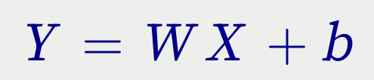
Closer View to the Linear Layer
Matrix Equation
......
W
b
X
Y

Slide 4
Interpreting the Linear Layer
With (Atomic) Math Operators, into Computation Graph.
W
Wx
GEMM
x
Y
+
b

Slide 5
Linear Layer As Building Block
Y
W
Linear
Layer
PyTorch:
Fc1 = torch.nn.Linear(4096, 512)

Slide 6
Similar to Activation Function
X
Activation
Layer
Y
PyTorch:
Relu1 = torch.nn.ReLU()

Slide 7
The Original MLP
Forward-Pass
y^
X
Linear
Act
Linear
..................
Input data
y
Loss
Input Label

Slide 8
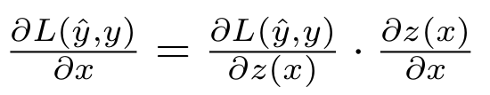
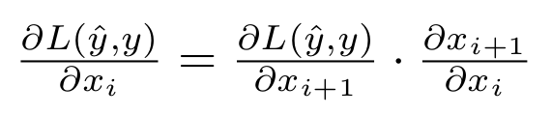
Backward Pass
Automatic Differentiation / Reverse Mode, e.g. Back-propagation Algorithm
A Neural Network Can Be Implemented in a Modularized Manner.
y^
Xi
Xi+1
Fully-Connected
Layer
Loss

Slide 9
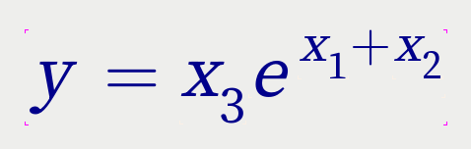
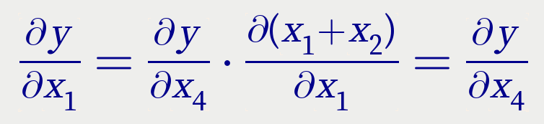
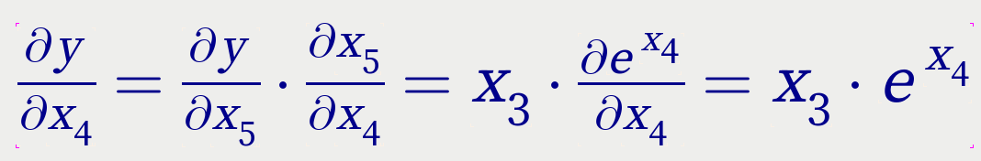
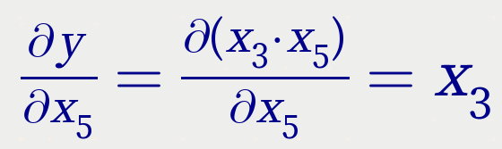
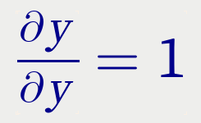
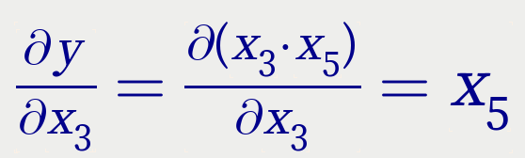
Example of Automatic Differentiation in Reserse Mode
x1
+
x2
x4
exp
x5
*
y
x3

Slide 10
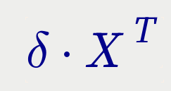

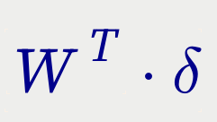
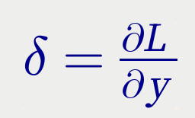
Backward Pass of Linear Layer
W
Wx
GEMM
x
Y
+
b
δ

Slide 11
Backward Pass of Activation Layer
Element-wise Activation Function, e.g. Sigmod, Tanh, ReLU
X
Activation
Layer
Y
J·δ
δ
J is the Jacobian Matrix of y w.r.t x
The Jacobian matrix is a diagonal matrix. That being said, the actual implementation involves no matrix multiplication for sake of memory efficiency.

Slide 12
Back-Pass of the Whole Network
y^
X
Linear
Act
Linear
..................
Input data
δ[n]
δ[1]
δ[n+2]
δ[n+1]
y
Loss
Input Label
Backward Pass

Slide 13

Optimization
First-Order Methods, e.g. SGD, SGDM, Adagrad, RMSProp, Adam.
e.g. saturation
grad
Second-Order Methods requires Hessian Matrix which would cost an insane amount of memory. Algorithms for approximated Hessian matrices are available but currently the first-order methods are most widely used and have demonstrated its effectiveness.
1
2
3

Slide 14
Main Procedure of Neural Network Training
for epoch in range(maxepoch):
for xbatch, ybatch in trainingset:
yhat = forward(xbatch)
loss(yhat, ybatch)
backward()
update()
for xbatch, ybatch in valset:
yhat = forward(xbatch)
performance(yhat, ybatch)

Slide 15
State-of-the-Art Implementations
Caffe (C++, Fast, Module, Static Graph, not Flexible)
LuaTorch (C/Lua, Fast, Module, Imperative, Flexible)
PyTorch (Py/C/C++, Fast, Dynamic Graph, UltraFlexible)
Theano (Py/?, Static Symbolic Graph, EOL)
TensorFlow/early (Py/C++, Static Graph)
Keras (TF Abstraction)
MXNet, CNTK, Chainer, NEON, …….
...

Slide 16
My Naive, but Simple Approach
Tensor Class, Abstraction of Vectors, Matrices, ...
Blob Class, Combination of 2 Tensors : (Value, Gradient)
Layer Class, Forward/Backward with Blobs
Graph Class, Put things above into a Computation Graph
Reference: source of Caffe and (Lua)Torch

Slide 17
Overview of My DL Framework
Abstractions
* Tensor (Scalar, Vector, Matrix, n-D Array, ...)
* Atomic Operations (GEMM, +, -, *, /, exp, ...)
* Layers (Linear, ReLU, Conv2d, SoftMax, ...)
* Loss Functions (NLLLoss, MSELoss, Triplet, ...)
Steps of Network Training
* Forward Pass
* Backward Pass
* Parameter Update

Slide 18
Example: Classification on MNIST
Image
Batch
o1
yhat
Linear
Layer
Softmax
Layer
Label
Batch
Class NLL Loss

Slide 19
cout << ">> Initialize Network" << endl;
Graph<double> net (784, 1, 100);
net.name = "test net";
net.addLayer("fc1", "Linear", "entryDataBlob", "fc1", 10);
net.addLayer("sm1", "Softmax", "fc1", "sm1");
net.addLayer("cls1", "ClassNLLLoss", "sm1", "cls1", "entryLabelBlob");
net.addLayer("acc1", "ClassAccuracy", "sm1", "acc1", "entryLabelBlob");
net.dump();
Name: fc1
Type: Linear
input: entryDataBlob
output: fc1
output_dim: 10
Name: sm1
Type: Softmax
input: fc1
output: sm1
Name: cls1
Type: ClassNLLLoss
input: sm1
output: cls1
input_label: entryLabelBlob
Name: acc1
Type: ClassAccuracy
input: sm1
output: acc1
input_label: entryLabelBlob

Slide 20
cout << ">> Start training" << endl;
for (int iteration = 0; iteration < maxiter; iteration++) {
leicht_bar_train(iteration);
// -- get batch
Tensor<double>* batchIm = new Tensor<double> (100, 784);
batchIm->copy(trainImages.data + (iteration%iepoch)*batchsize*784, batchsize*784);
batchIm->transpose_();
batchIm->scal_(1./255.);
net.getBlob("entryDataBlob", true)->value.copy(batchIm->data, 784*batchsize);
net.getBlob("entryLabelBlob", true)->value.copy(
trainLabels.data + (iteration%iepoch)*batchsize*1, batchsize*1);
delete batchIm;
// -- forward
net.forward();
// -- zerograd
net.zeroGrad();
// -- backward
net.backward();
// -- report
net.report();
// -- update
net.update(1e-3, "Adam");

Slide 21
// -- test every
if ((iteration+1)%testevery==0) {
leicht_bar_val(iteration);
vector<double> accuracy;
vector<double> l;
for (int t = 0; t < 42; t++) {
// -- get batch
Tensor<double>* tbatchIm = new Tensor<double> (100, 784);
tbatchIm->copy(valImages.data + t*batchsize*784, batchsize*784);
tbatchIm->transpose_();
tbatchIm->scal_(1./255.);
net.getBlob("entryDataBlob", true)->value.copy(tbatchIm->data, 784*batchsize);
net.getBlob("entryLabelBlob", true)→value.copy(
valLabels.data + t*batchsize*1, batchsize*1);
delete tbatchIm;
net.forward(); net.report();
}
}

Slide 22
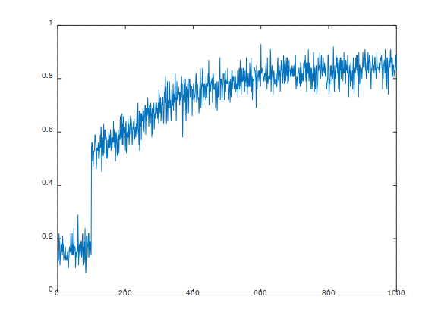
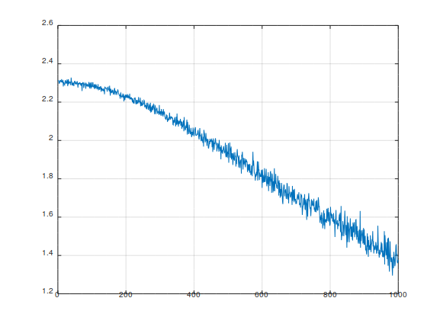
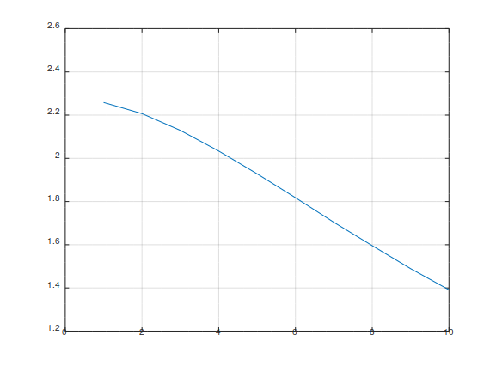
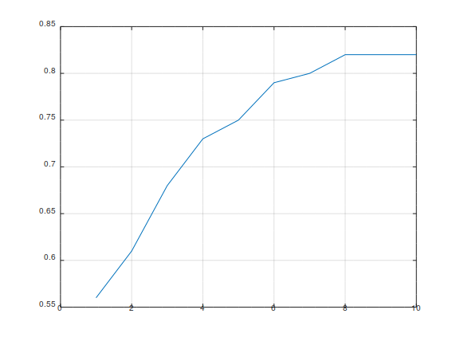
Training/Validation Curves
Training Loss
Training Accuracy
Validation Loss
Validation Accuracy

Slide 23
Time Cost & Compiler Black Magic
I5-2520M: 2.1 Sec. (OpenMP, -O2, -march=native)
I7-6900K: 1.0 Sec. (OpenMP, -O2, -march=native)
500 Iterations, Clang slightly faster than GCC
I5-2520M: 32.3 Sec. (no OpenMP, -O0)
I5-2520M: 17.4 Sec. (OpenMP, -O0)
I5-2520M: 2.4 Sec. (no OpenMP, -O2)
cuDNN: faster ...

Slide 24
Another Example: LeNet on MNIST for Classification
int
main(void)
{
leicht_threads(2);
cout << ">> Reading MNIST training dataset" << endl;
Tensor<double> trainImages(37800, 784); trainImages.setName("trainImages");
leicht_hdf5_read("mnist.th.h5", "/train/images", 0, 0, 37800, 784, trainImages.data);
Tensor<double> trainLabels(37800, 1); trainLabels.setName("trainLabels");
leicht_hdf5_read("mnist.th.h5", "/train/labels", 0, 0, 37800, 1, trainLabels.data);
cout << ">> Reading MNIST validation dataset" << endl;
Tensor<double> valImages(4200, 784); valImages.setName("valImages");
leicht_hdf5_read("mnist.th.h5", "/val/images", 0, 0, 4200, 784, valImages.data);
Tensor<double> valLabels(4200, 1); valLabels.setName("valLabels");
leicht_hdf5_read("mnist.th.h5", "/val/labels", 0, 0, 4200, 1, valLabels.data);

Slide 25
cout << ">> Initialize Network" << endl;
// reference: caffe/examples/mnist/lenet
Blob<double> label (1, batchsize, "label", false);
Blob<double> X (batchsize, 784, "X", false);
Blob<double> image (batchsize, 1, 28, 28, "image", false);
Blob<double> conv1 (batchsize, 20, 24, 24); conv1.setName("conv1");
Blob<double> pool1 (batchsize, 20, 12, 12); pool1.setName("pool1");
Blob<double> conv2 (batchsize, 50, 8, 8); conv2.setName("conv2");
Blob<double> pool2 (batchsize, 50, 4, 4); pool2.setName("pool2");
Blob<double> pool2f (batchsize, 800); pool2f.setName("pool2f");
Blob<double> pool2fT (800, batchsize); pool2fT.setName("pool2fT");
Blob<double> ip1 (500, batchsize); ip1.setName("ip1");
Blob<double> ip2 (10, batchsize); ip2.setName("ip2");
Blob<double> sm1 (10, batchsize); sm1.setName("sm1");
Blob<double> loss (1); loss.setName("loss");
Blob<double> acc (1); acc.setName("acc");

Slide 26
Layer<double> lid1; // X->image bs,784->bs,1,28,28
Conv2dLayer<double> lconv1 (batchsize, 1, 28, 28, 20, 5); // image->conv1 bs,1,28,28->bs,20,24,24
MaxpoolLayer<double> lpool1 (batchsize, 20, 24, 24, 2, 2); // conv1->pool1 bs,20,24,24->bs,20,12,12
Conv2dLayer<double> lconv2 (batchsize, 20, 12, 12, 50, 5); // pool1->conv2 bs,20,12,12->bs,50,8,8
MaxpoolLayer<double> lpool2 (batchsize, 50, 8, 8, 2, 2); // conv2->pool2 bs,50,8,8->bs,50,4,4
Layer<double> lid2; // pool2->pool2f(lattened) bs,50,4,4->bs,800
TransposeLayer<double>lt1; // pool2f->pool2fT bs,800->800,bs
LinearLayer<double> lfc1 (500, 800); // pool2fT->ip1 800,bs->500,bs
ReluLayer<double> lrelu1; // ip1->ip1
LinearLayer<double> lfc2 (10, 500); // ip1->ip2 500,bs->10,bs
SoftmaxLayer<double> lsm1; // ip2->sm1
ClassNLLLoss<double> lloss; // sm1->loss
ClassAccuracy<double> lacc; // sm1->acc

Slide 27
cout << ">> Start training" << endl;
for (int iteration = 0; iteration < maxiter; iteration++) {
tic();
leicht_bar_train(iteration);
// -- get batch
X.value.copy(
//trainImages.data + (iteration%overfit)*batchsize*784, batchsize*784);
trainImages.data + (iteration%iepoch)*batchsize*784, batchsize*784);
label.value.copy(
//trainLabels.data + (iteration%overfit)*batchsize*1, batchsize*1);
trainLabels.data + (iteration%iepoch)*batchsize*1, batchsize*1);
X.value.scal_(1./255.);

Slide 28
// -- forward : unfold with vim: BEIGN,ENDs/; /;\r/g
lid1.forward(X, image); //X.dump(true, false); image.dump(true, false);
lconv1.forward(image, conv1); //conv1.dump(true, false);
lpool1.forward(conv1, pool1); //pool1.dump(true, false);
lconv2.forward(pool1, conv2); //conv2.dump(true, false);
lpool2.forward(conv2, pool2); //pool2.dump(true, false);
lid2.forward(pool2, pool2f); //pool2f.dump(true, false);
lt1.forward(pool2f, pool2fT); //pool2fT.dump(true, false);
//auto p2T = pool2f.value.transpose();
//pool2fT.value.copy(p2T->data, p2T->getSize());
//delete p2T;
lfc1.forward(pool2fT, ip1); //ip1.dump(true, false);
lrelu1.forward(ip1, ip1); //ip1.dump(true, false);
lfc2.forward(ip1, ip2); //ip2.dump(true, false);
lsm1.forward(ip2, sm1); //sm1.dump(true, false);
lloss.forward(sm1, loss, label); //loss.dump(true, false);
lacc.forward(sm1, loss, label); //acc.dump(true, false);

Slide 29
// -- zerograd
label.zeroGrad(); X.zeroGrad(); image.zeroGrad();
conv1.zeroGrad(); pool1.zeroGrad(); conv2.zeroGrad();
pool2.zeroGrad(); pool2f.zeroGrad(); pool2fT.zeroGrad();
ip1.zeroGrad(); ip2.zeroGrad(); sm1.zeroGrad();
loss.zeroGrad(); acc.zeroGrad();
lid1.zeroGrad(); lconv1.zeroGrad(); lpool1.zeroGrad();
lconv2.zeroGrad(); lpool2.zeroGrad(); lid2.zeroGrad();
lfc1.zeroGrad(); lrelu1.zeroGrad(); lfc2.zeroGrad();
lsm1.zeroGrad(); lloss.zeroGrad(); lacc.zeroGrad();

Slide 30
// -- backward : unfold with vim: BEIGN,ENDs/; /;\r/g
lloss.backward(sm1, loss, label); //sm1.dump();
lsm1.backward(ip2, sm1); //ip2.dump();
lfc2.backward(ip1, ip2); //ip1.dump();
lrelu1.backward(ip1, ip1); //ip1.dump();
lfc1.backward(pool2fT, ip1); //pool2fT.dump();
lt1.backward(pool2f, pool2fT); //pool2f.dump();
//auto p2fT = pool2fT.gradient.transpose();
//pool2f.gradient.copy(p2fT->data, p2fT->getSize());
// delete p2fT;
lid2.backward(pool2, pool2f); //pool2.dump();
lpool2.backward(conv2, pool2); //conv2.dump();
lconv2.backward(pool1, conv2); //pool1.dump();
lpool1.backward(conv1, pool1); //conv1.dump();
lconv1.backward(image, conv1); //image.dump();
// regularize
lconv1.regularization(); lconv2.regularization();
lfc1.regularization(); lfc2.regularization();
// -- report
lloss.report(); lacc.report(true);
label.dump(true, false);
lconv1.dumpstat(); lconv2.dumpstat();
lfc1.dumpstat(); lfc2.dumpstat();
//pool1.dump(true, false);
cv_train_loss.append(iteration, lloss.lossval);
cv_train_acc.append(iteration, lacc.accuracy);

Slide 31
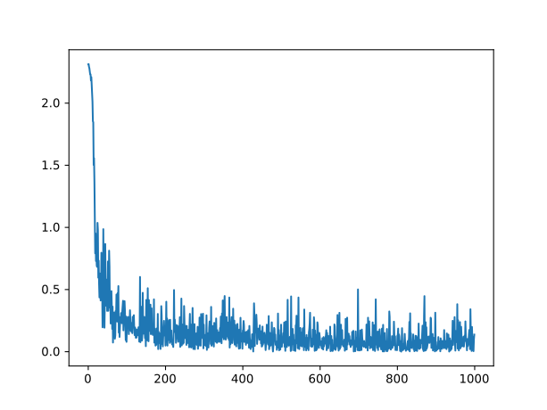
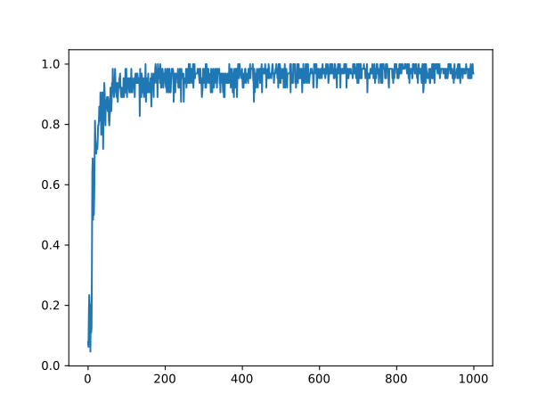
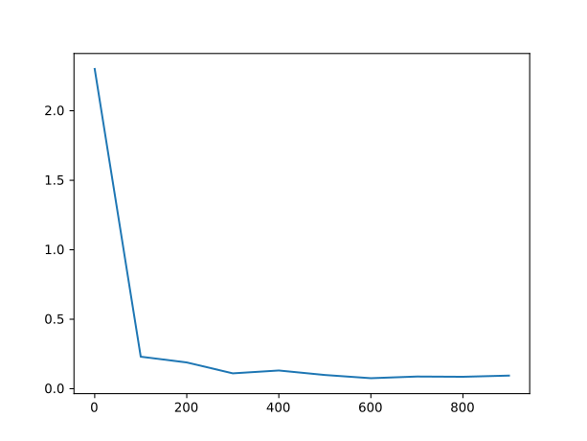
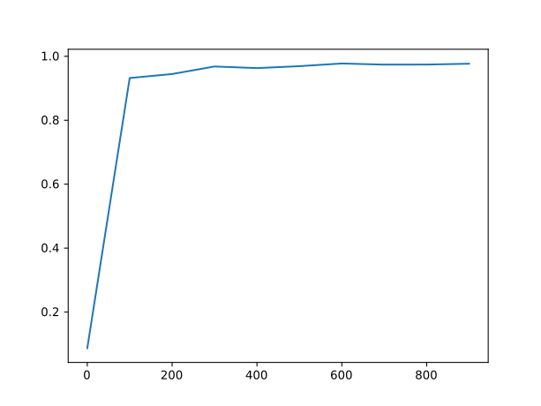
Training/Validation Curves
Training Loss
Training Accuracy
Final Accuracy
0.96
Validation Loss
Validation Accuracy

Slide 32
Implementation Detail
Five Core Modules:
1. BLAS and some extra subroutines
2. Tensor Class
3. Blob Class
4. Layer Class
5. (Static) Graph Class
Aux1. Data loading routines
Aux2. Plotting helper
Aux3. Unit test helper
Aux4. Benchmarker
Language: C++, Python
Styling: mixture of (Lua)Torch and Caffe
Lines of Code: 4106

Slide 33
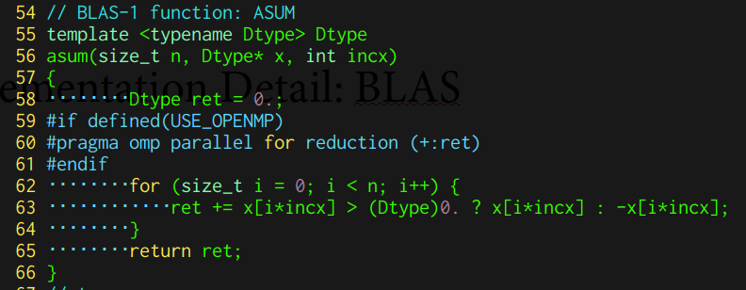
Implementation Detail: BLAS
3 Levels
Level 1 BLAS:
asum, axpy, copy, dot, nrm2, scal
Level 2 BLAS:
gemv (skipped)
Level 3 BLAS:
gemm
Extra:
Conv2d

Slide 34
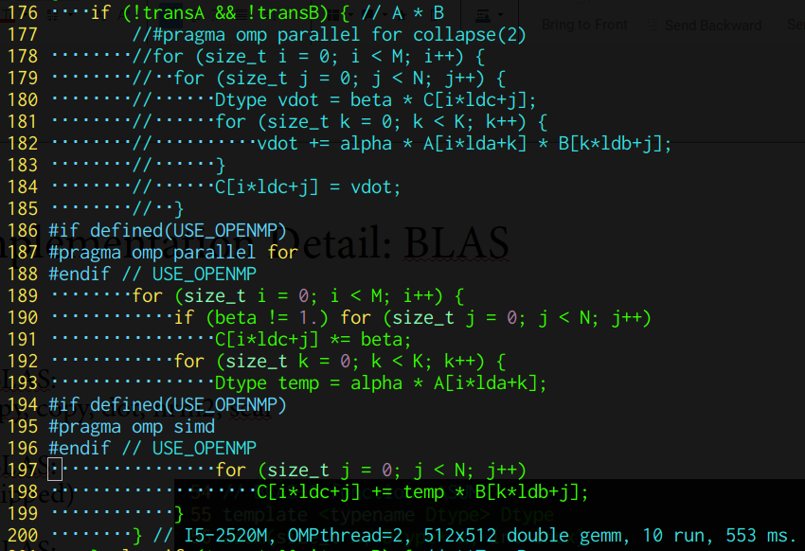
Implementation Detail: BLAS
3 Levels
Level 1 BLAS:
asum, axpy, copy, dot, nrm2, scal
Level 2 BLAS:
gemv (skipped)
Level 3 BLAS:
gemm
Extra:
Conv2d

Slide 35
Implementation Detail: Tensor Class
Core Data:
std::vector<size_t> shape;
Dtype *data = nullptr;
Core Methods:
Constructor
Locator,
Copier,
dump,
resize,
expand,
unexpand,
fill_,
+ - * /,
rand,
rot180,
clone,
sign,
transpose_,
save,
load,
overloaded operators,
BLAS wrapper

Slide 36
Implementation Detail: Blob Class
Core Methods:
Constructor
resizer,
transpose,
clone,
zerograd,
dump
Core Data:
Tensor<Dtype> value;
Tensor<Dtype> gradient;
bool requires_grad = true;

Slide 37
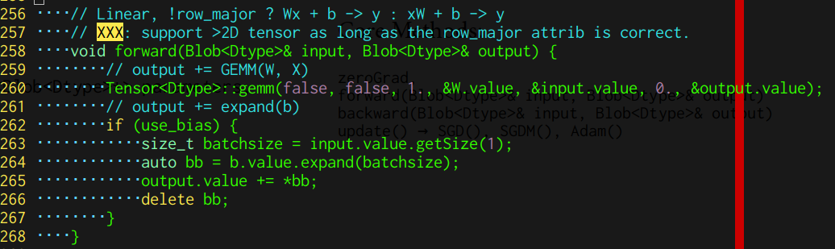
Implementation Detail: Layer Class
Core Methods:
zeroGrad,
forward(Blob<Dtype>& input, Blob<Dtype>& output)
backward(Blob<Dtype>& input, Blob<Dtype>& output)
update() → SGD(), SGDM(), Adam()
Core Data:
std::vector<Blob<Dtype>*> parameters;

Slide 38
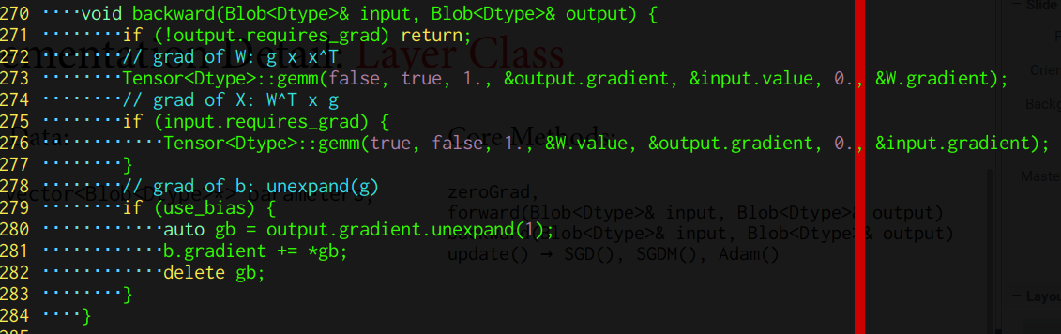
Implementation Detail: Layer Class
Core Methods:
zeroGrad,
forward(Blob<Dtype>& input, Blob<Dtype>& output)
backward(Blob<Dtype>& input, Blob<Dtype>& output)
update() → SGD(), SGDM(), Adam()
Core Data:
std::vector<Blob<Dtype>*> parameters;

Slide 39
Implementation Detail: Graph Class
Core Methods:
zerograd,
addLayer,
forward,
backward,
update
Core Data:
std::vector<Blob<Dtype>*> nodes;
std::vector<Layer<Dtype>*> edges;

Slide 40
Trouble You May Encounter
Reliability (API change, Unit Tests)
Gradient Error (Check derivative & implementation)
Memory Leak (C/C++: GDB, Valgrind)
Training Error (e.g. Numerical Precision Problems)
Performance (BLAS/GEMM: SIMD, OpenMP, CUDA)
Compilation (Compiler Flags)
Don’t write your own BLAS unless what you are doing

Slide 41
Thanks
Neural Network:
1. Pattern Recognition and Machine Learning (PRML)
2. Deep Learning (Ian Goodfellow)
3. Stanford CS231n (Feifei Li)
4. Efficient Backprop (Yann LeCun)
Automatic Differentiation:
1. Wikipedia
2. CS231n
Implementation Reference:
1. (Lua)Torch
2. Caffe
3. PyTorch
C++/Coding Reference:
1. C++ Primer Plus
2. OpenMP Guide
BLAS Reference:
1. Netlib BLAS/LAPACK

