Slide 1
How to Write a Deep Learning Framework from Scratch
Hakase. Hana
Nov 2017
Copyright (C) 2017 Mo Zhou, CC-BY-SA 4.0 License

Slide 2

Review the Task
Loss Function
Input data
..............
......
Multilayer Perceptron
Input Label

Slide 3
Closer View to the Linear Layer
Linear Equation
Y = WX + b
......
W
b
X
Y

Slide 4
Interpreting the Linear Layer
With Atomic Math Operators, into Computation Graph.
W
Wx
GEMM
x
Y
+
b

Slide 5
Linear Layer As Building Block
Y
W
Linear
Layer

Slide 6
Similar to Activation Function
X
Activation
Layer
Y

Slide 7
The Original MLP
Forward-Pass
y^
X
Linear
Act
Linear
..................
Input data
y
Loss
Input Label

Slide 8
Backward Pass
Automatic Differentiation, e.g. Back-propagation Algorithm
∂ Loss(y^,y)
∂ Loss(y^,y)
∂ y^(x)
=
∂ x
∂ y^(x)
∂ x
A Neural Network Can Be Implemented in a Modularized Manner.
y = f(x)
Loss = ...(y)
∂ Loss
∂ f(x)
=
δ
∂ Loss
∂ x
∂ x
=
δ
∂ y

Slide 9
Backward Pass of Linear Layer
W
T
δ·X
Wx
GEMM
x
δ
Y
+
T
W·δ
b
δ
δ

Slide 10
Backward Pass of Activation Layer
Element-wise Activation Function, e.g. Sigmod, Tanh, ReLU
X
Activation
Layer
Y
J·δ
δ
J is the Jacobian Matrix of y w.r.t x

Slide 11
Back-Pass of the Whole Network
y^
X
Linear
Act
Linear
..................
Input data
δ[n]
δ[1]
δ[n+2]
δ[n+1]
y
Loss
Input Label
Backward Pass

Slide 12
Optimization
First-Order Methods, e.g. SGD, SGDM, Adagrad, RMSProp, Adam.
W <- W - η·ΔW

Slide 13
Overview
Abstractions
* Tensor (Scalar, Vector, Matrix, n-D Array, ...)
* Atomic Operations (GEMM, +, -, *, /, exp, ...)
* Layers (Linear, ReLU, Conv2d, SoftMax, ...)
* Loss Functions (NLLLoss, MSELoss, Triplet, ...)
Steps of Network Training
* Forward Pass
* Backward Pass
* Parameter Update

Slide 14
State-of-the-Art Implementations
Caffe
Torch
PyTorch
Theano
TensorFlow & their abstractions e.g. Keras
MXNet
...

Slide 15
A Naive, but Simple Approach
Tensor Class, Abstraction of Vectors, Matrices, ...
Blob Class, Combination of 2 Tensors : (Value, Gradient)
Layer Class, Forward/Backward with Blobs
(Graph Class), Put things above into a Computation Graph
Reference: Caffe, (Lua)Torch

Slide 16
Example: Classification on MNIST
Image
Batch
o1
yhat
Linear
Layer
Softmax
Layer
Label
Batch
Class NLL Loss

Slide 17
Example : Classification on MNIST
int
main(void)
{
cout << ">> Reading MNIST dataset" << endl;
Tensor<double> trainImages (37800, 784);
trainImages.setName("trainImages");
lite_hdf5_read("mnist.th.h5", "/train/images", 0, 0, 37800, 784, trainImages.data);
Tensor<double> trainLabels (37800, 1);
trainLabels.setName("trainLabels");
lite_hdf5_read("mnist.th.h5", "/train/labels", 0, 0, 37800, 1, trainLabels.data);

Slide 18
cout << ">> Initialize Network" << endl;
Blob<double> imageT (784, 100, false);
imageT.setName("imageT");
Blob<double> label (1, 100, false);
label.setName("label");
Blob<double> o1 (10, 100);
o1.setName("o1");
Blob<double> yhat (10, 100);
yhat.setName("yhat");
Blob<double> loss (1);
loss.setName("loss");
Blob<double> acc (1);
acc.setName("accuracy");
LinearLayer<double> fc1 (10, 784);
SoftmaxLayer<double> sm1;
ClassNLLLoss<double> loss1;
ClassAccuracy<double> acc1;

Slide 19
cout << ">> Start training" << endl;
for (int iteration = 0; iteration < 500; iteration++) {
cout << ">> Iteration " << iteration << "::" << endl;
// -- get batch
Tensor<double>* batchIm = trainImages.sliceRows(100*(iteration%377), 100*(iteration%377+1));
Tensor<double>* batchLb = trainLabels.sliceRows(100*(iteration%377), 100*(iteration%377+1));
Tensor<double>* batchImT = batchIm->transpose();
batchImT->scal_(1./255.);
imageT.value.copy(batchImT->data, 784*100);
label.value.copy(batchLb->data, 100);
// -- forward
fc1.forward(imageT, o1);
sm1.forward(o1, yhat);
acc1.forward(yhat, loss, label);
loss1.forward(yhat, loss, label);

Slide 20
// -- zerograd
fc1.zeroGrad();
o1.zeroGrad();
yhat.zeroGrad();
loss.zeroGrad();
// -- backward
loss1.backward(yhat, loss, label);
sm1.backward(o1, yhat);
fc1.backward(imageT, o1);
// -- report
loss1.report();
acc1.report();
fc1.dumpstat();
//label.dump(true, false);
//yhat.dump(true, false);
// update
double lr = 1e-3;
fc1.update(lr);

Slide 21
// cleanup
delete batchIm;
delete batchLb;
delete batchImT;
}
return 0;
}

Slide 22
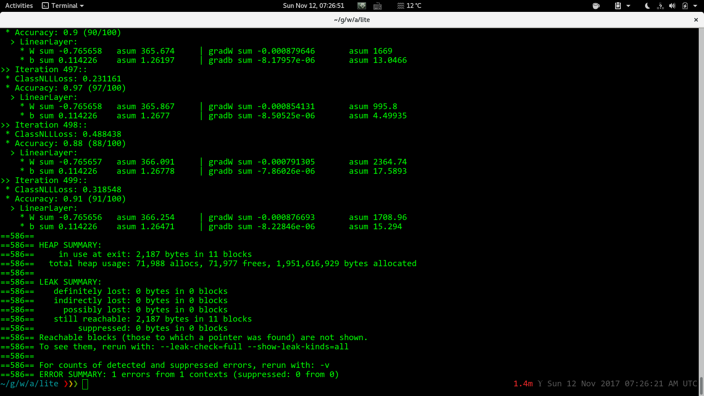

Slide 23
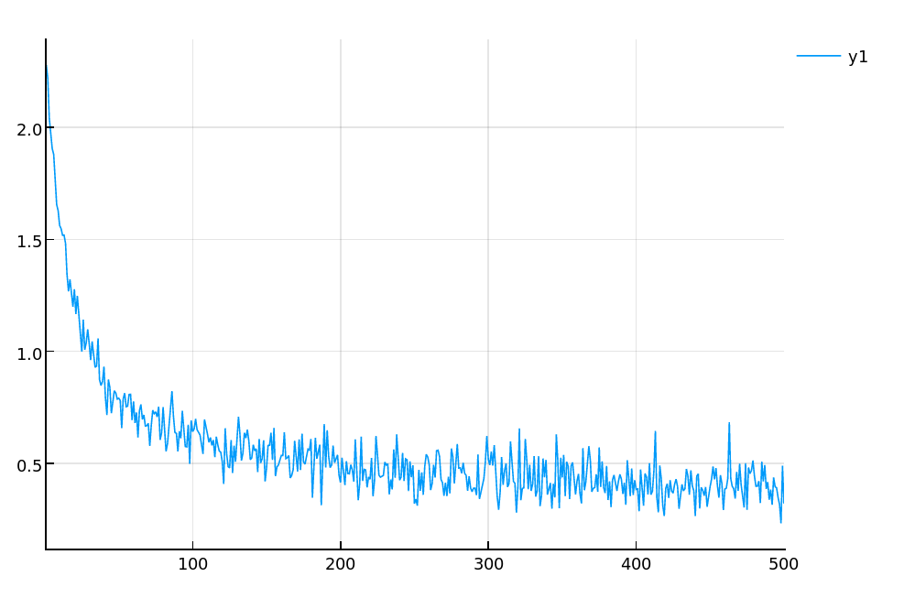
Loss Curve, x: Iteration, y: Loss

Slide 24
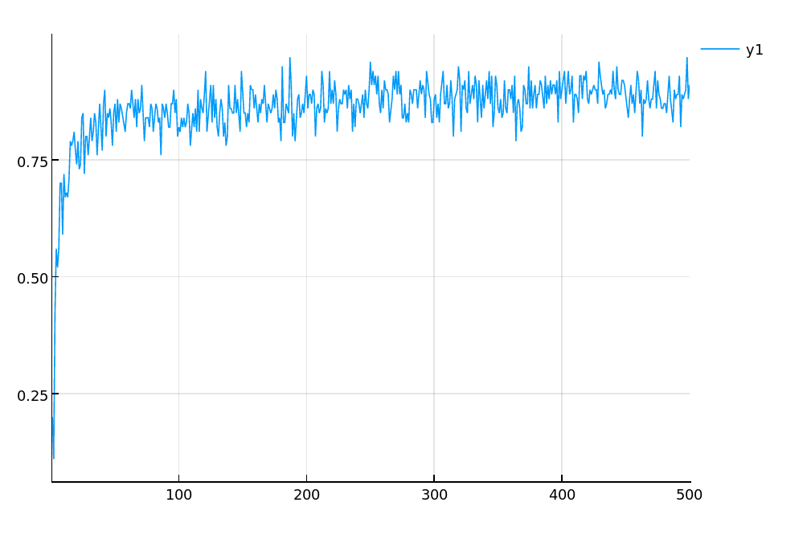
Accuracy, x: Iteration, y: Accuracy

Slide 25
Time Cost & Compiler Black Magic
I5-2520M: 2.1 Sec. (OpenMP, -O2, -march=native)
I7-6900K: 1.0 Sec. (OpenMP, -O2, -march=native)
500 Iterations, Clang slightly faster than GCC
I5-2520M: 32.3 Sec. (no OpenMP, -O0)
I5-2520M: 17.4 Sec. (OpenMP, -O0)
I5-2520M: 2.4 Sec. (no OpenMP, -O2)
cuDNN: faster ...

Slide 26
Trouble You May Encounter
Reliability (API change, Unit Tests)
Gradient Error (Check derivative & implementation)
Memory Leak (C/C++: GDB, Valgrind)
Training Error (e.g. Numerical Precision Problems)
Performance (BLAS/GEMM: SIMD, OpenMP, CUDA)
Compilation (Compiler Flags)

Slide 27
Thanks
Reference
1. Caffe Code -- github.com/bvlc/caffe
2. Torch Code -- github.com/torch/torch7
3. Deep Learning Book -- Ian Goodfellow
4. Stanford CS231n -- Feifei Li
5. Efficient Backprop -- Yann LeCun
6. GCC Manual -- gcc.gnu.org

