Slide 1



Practical Relative Order Attack in Deep Ranking
Mo Zhou, Le Wang, Zhenxing Niu, Qilin Zhang,
Yinghui Xu, Nanning Zheng, Gang Hua
<number>

Slide 2
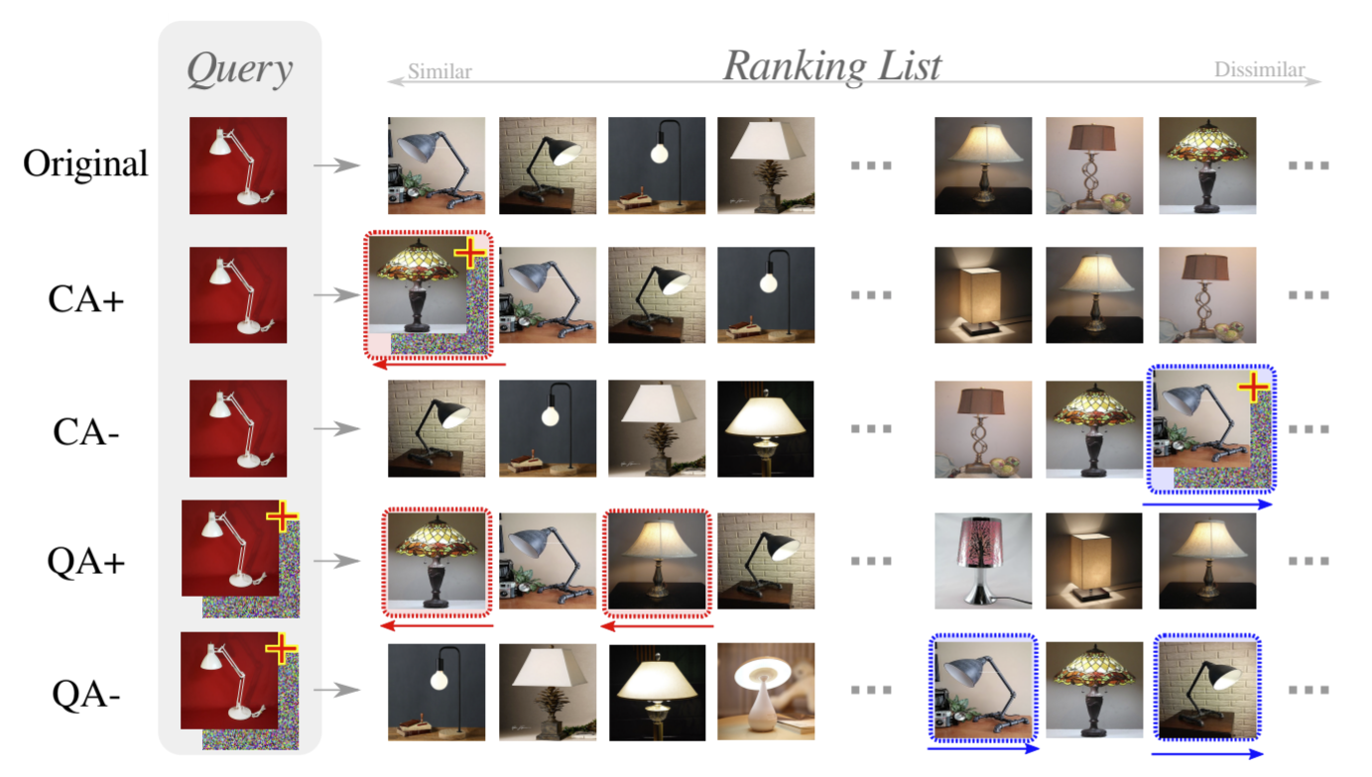
Background
Deep ranking (deep metric learning) models are vulnerable to adversarial attacks (the ranking result can be dramatically changed).
[1] Zhou, et al., Adversarial Ranking Attack and Defense, ECCV 2020.
<number>

