Slide 1



Practical Relative Order Attack in Deep Ranking
Mo Zhou, Le Wang, Zhenxing Niu, Qilin Zhang,
Yinghui Xu, Nanning Zheng, Gang Hua

Slide 2
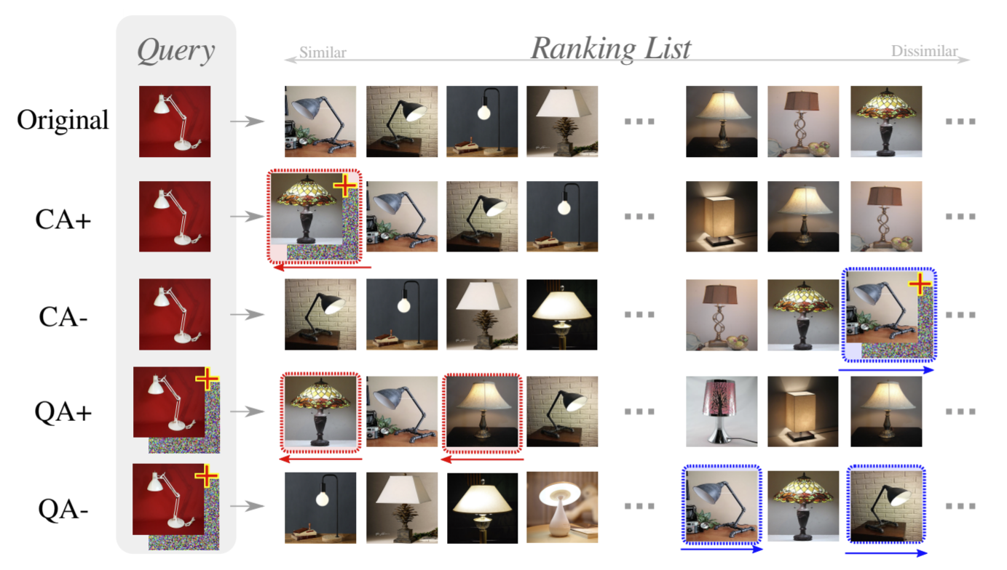
Background
Deep ranking (deep metric learning) models are vulnerable to adversarial attacks (the ranking result can be dramatically changed).
* Zhou, et al., Adversarial Ranking Attack and Defense, ECCV 2020.

Slide 3
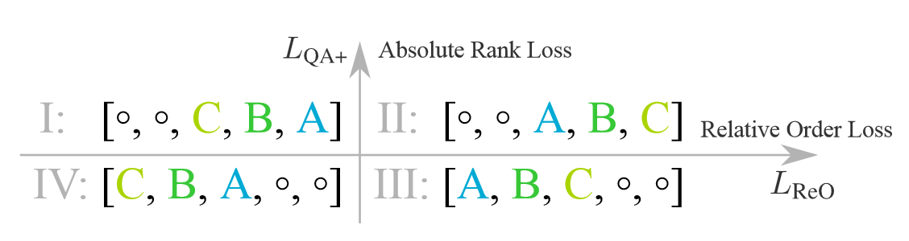
Insight
Previous attacks focus on absolute rank
Attack on relative order remains under-explored
Absolute rank: the absolute positions of selected candidates
Relative order: the relative positions among selected candidates

Slide 4
Contributions
Order Attack (OA), which alters the relative order among selected candidates through adversarial attack.
White-Box OA: a triplet-style implementation
Black-Box OA: a Short-range Ranking Correlation (SRC) metric as a surrogate objective approximating the triplet-style formulation.
Real-world attack demo: including a major online retailing e-commerce platform and a major search-by-image platform.

Slide 5
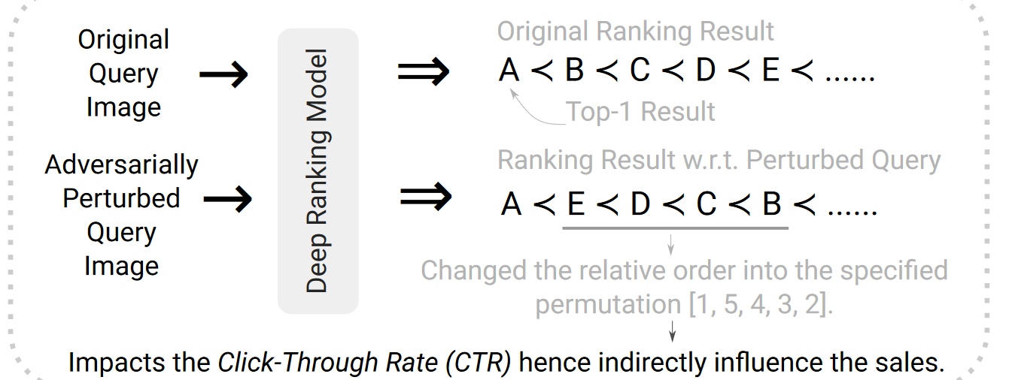
Order Attack (OA)

Slide 6
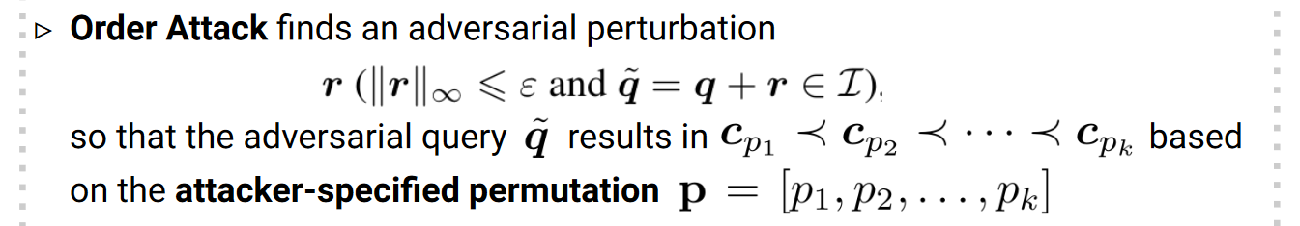
White-Box OA
Formulation

Slide 7
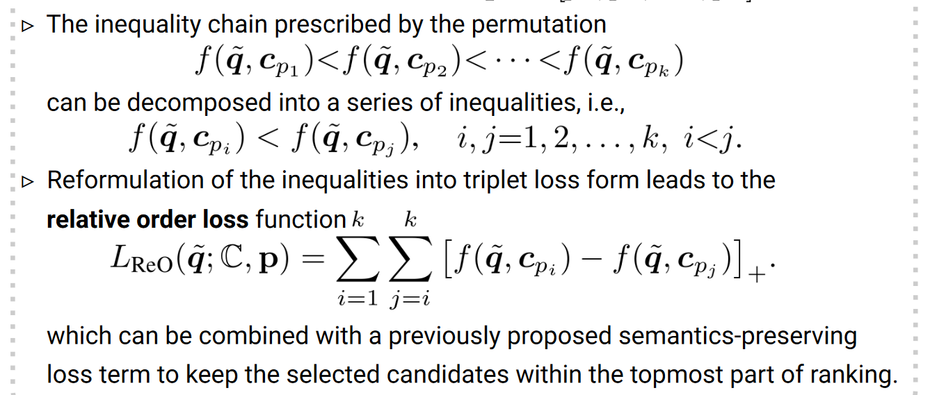
White-Box OA
Implementation

Slide 8
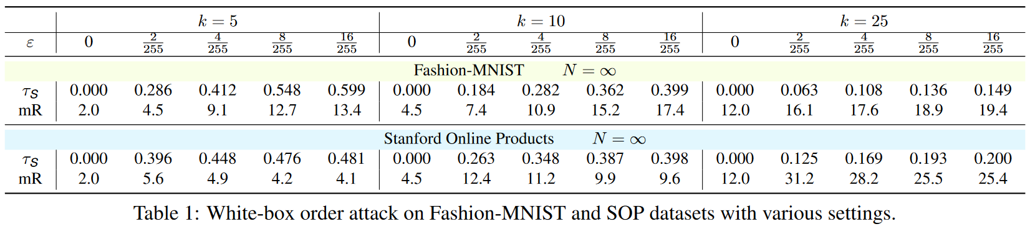
White-Box Experiments
k: number of selected candidates ε: perturbation budget
τS: Kendal’s ranking correlation mR: mean rank of selected candidates
* τS is equivalent to Kendall’s ranking correlation in white-box scenario.

Slide 9
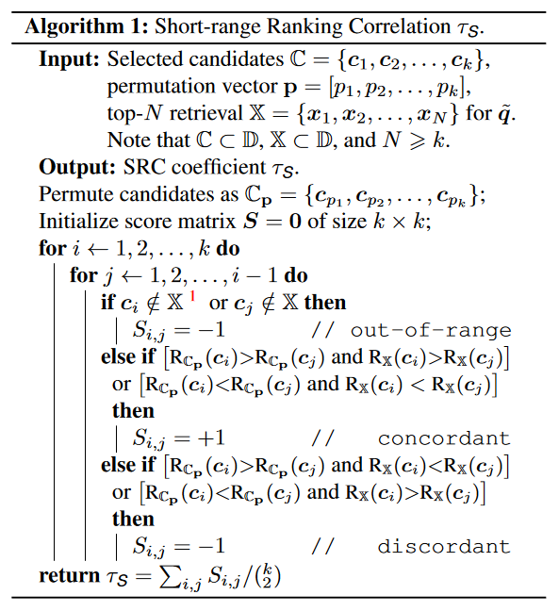
Black-Box OA
Short-range Ranking
Correlation (SRC) as a
surrogate objective.
Measures the alignment
between the specified
permutation and the actual
ranking result.
Inspired by Kendall’s tau.

Slide 10
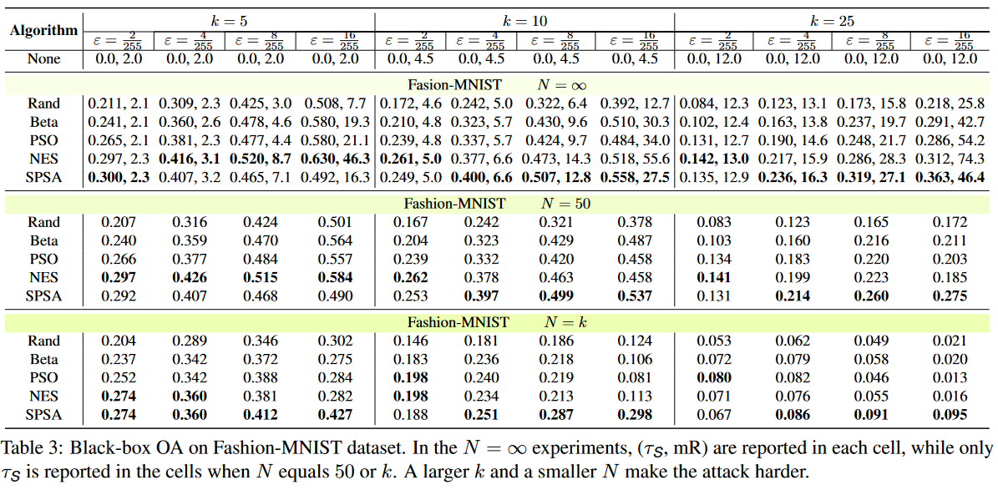
Black-Box Experiments
Fashion-MNIST Dataset

Slide 11
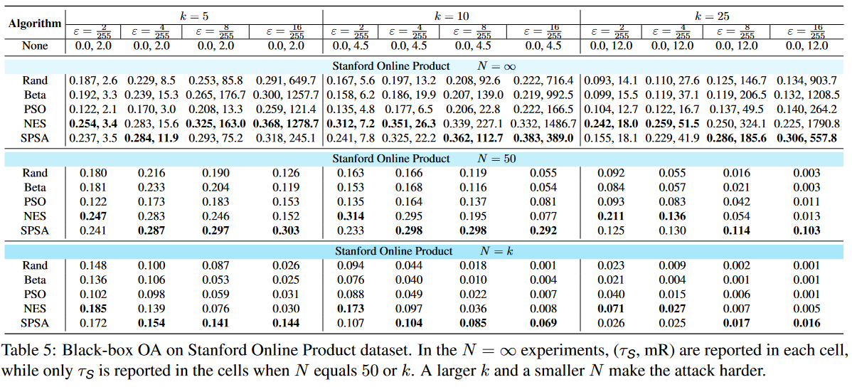
Black-Box Experiments
Stanford Online Products Dataset

Slide 12
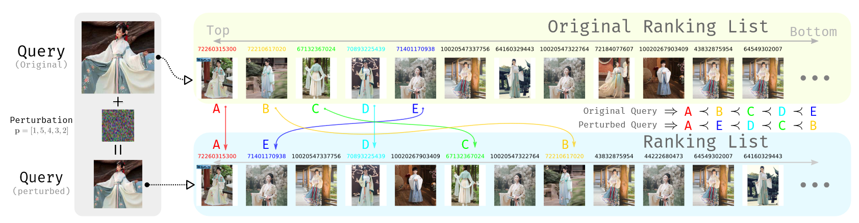
Practical OA Demo
A major e-commerce platform: JD Snapshop

Slide 13
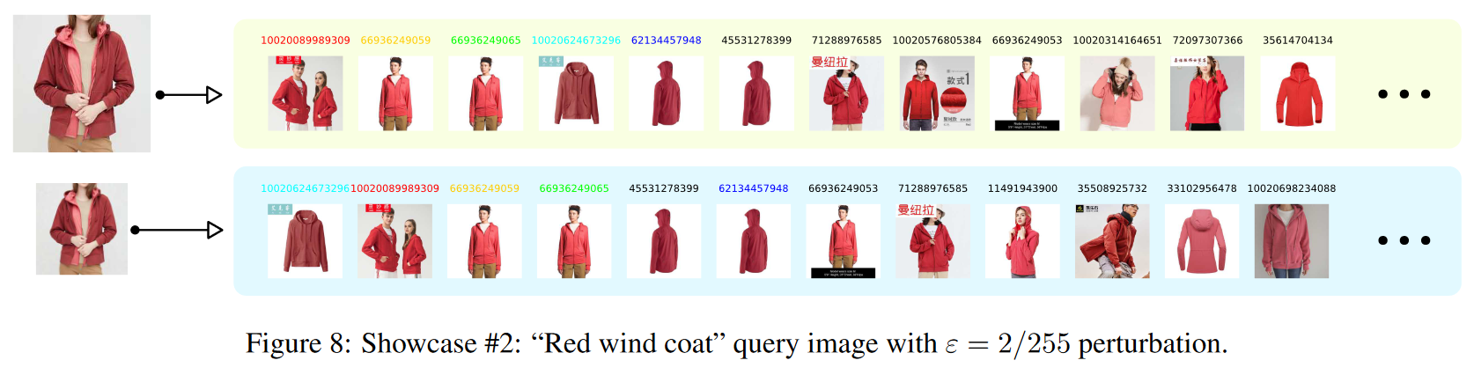
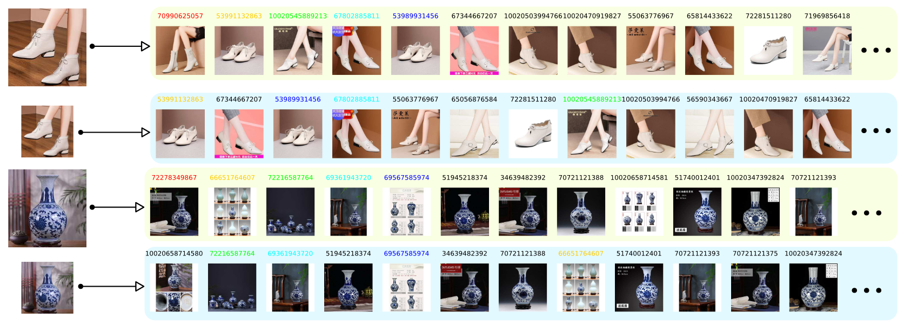
Practical OA Demo

Slide 14
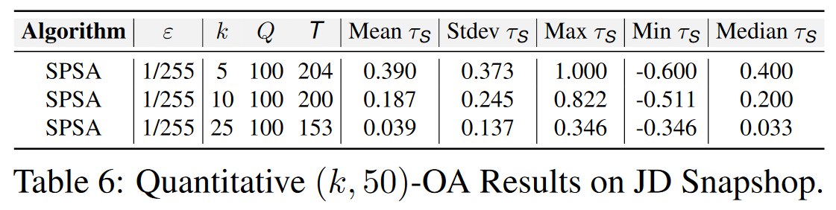
Practical OA Demo
Quantitative Results on JD Snapshop

Slide 15
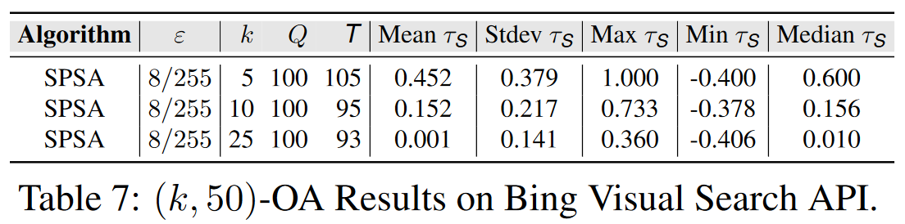
Practical OA Demo
Quantitative Results on Bing Visual Search API

Slide 16
Thanks!

