Slide 1

Deep Learning & Accelerated Calculation with Debian
M. Zhou <lumin@debian.org>
Aug 2020
Debian Deep Learning Team
CC-BY-SA 4.0 License

Slide 2
Deep Learning
Trend of Artificial Intelligence
AlphaGo, Automobile, etc.
Deep Learning is a key part
of the state-of-the-art AI.
Artificial Intelligence
Deep Learning

Slide 3
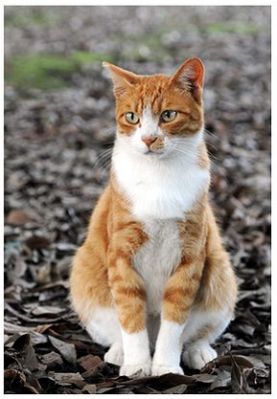
Neural Networks
Deep Learning is basically about (Deep) Neural Networks
The most typical application is classification.
Dog ?
Cat ?
Liquid ?
......
Input Image
Deep Neural Network
* The cat image comes from wikipedia, CC-licensed.

Slide 4
Closer look to Neural Net
Convolution Layer
Linear Layer
Activation Layer
Pooling Layer
etc
Deep Neural Network
INPUT
......
Label
Convolution
Pooling
ReLU
Linear
Softmax

Slide 5
Thanks!

