Slide 1


Deep Learning & Accelerated Calculation with Debian
M. Zhou <lumin@debian.org>
Aug 2020
Debian Deep Learning Team
CC-BY-SA 4.0 License

Slide 2
Deep Learning
Trend of Artificial Intelligence
AlphaGo, Automobile, etc.
Deep Learning is a key part
of the state-of-the-art AI.
Artificial Intelligence
Deep Learning

Slide 3
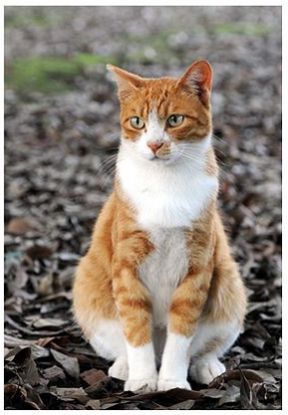
Neural Networks
Deep Learning is basically about (Deep) Neural Networks
The most typical application is classification.
Dog ?
Cat ?
Liquid ?
......
Input Image
Deep Neural Network
* The cat image comes from wikipedia, CC-licensed.

Slide 4
Closer look to Neural Net
Convolution Layer
Linear Layer
Activation Layer
Pooling Layer
etc
Deep Neural Network
INPUT
......
Label
Convolution
Pooling
ReLU
Linear
Softmax

Slide 5
Performance Bottleneck
Matrix Multiplication
(GEMM)
Linear Layer
Convolution Layer
(Linear Operation)
SIMD (CPU), e.g. AVX2
OpenCL (GPU)
Nvidia/CUDA (GPU)
AMD/ROCm (GPU)
Intel/SYCL (GPU)
FPGA, etc.
Parallelization
Optimizing Cache Access
Hardware Acceleration
Acceleration?

Slide 6
Hardware Acceleration
SIMD (CPU), e.g. AVX2 ...... FLOPS upper bound
OpenCL (GPU) ...... Programming?, Support?
Nvidia/CUDA (GPU) ...... Mature but PROPRIETARY
AMD/ROCm (GPU) ...... Open Source, developing
Intel/SYCL (GPU) ...... Open Source, developing
FPGA, etc. ...... Oops, unfamiliar :-(

Slide 7
Packages in Debian
Performance Libraries
e.g. math libraries incl. BLAS/LAPACK. (SIMD)
Deep Learning Frameworks
e.g. TensorFlow, PyTorch, Caffe
AMD ROCm (AMD GPUs)
FOSS counterpart to Nvidia/CUDA
Intel SYCL (Intel GPUs)
OpenCL, LLVM
Status
Summary

Slide 8
BLAS/LAPACK
Numerical Linear Algebra / Fundamental Math libs
libblas.so.3 + liblapack.so.3
update-alternatives Mechanism
OpenBLAS
BLIS
Atlas
Netlib
Intel-MKL
(non-free)
Fast
LibFlame*
OpenBLAS
Netlib
Fast
Reverse Depends:
(1) GNU Octave
(2) Numpy, Scipy
(3) ...
* WIP

Slide 9
Thanks!
https://people.debian.org/~lumin/debian-dl.html

