Slide 1

Enhancing Adversarial Robustness for Deep Metric Learning
Mo Zhou
<mzhou32@jhu.edu>
Johns Hopkins University
Nov. 2021
* For MLSP Course presentation only. Do not distribute.

Slide 2
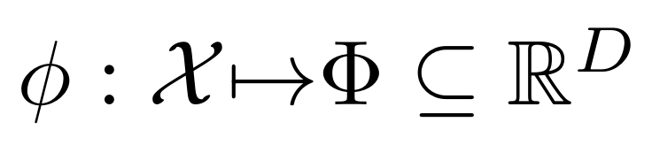
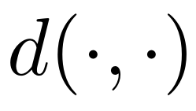

Deep Metric Learning (DML)
Goal: to learn a mapping function
How Similar are
the two images?
...
Various
Images
Embedding
Space
Distance Function
e.g. Euclidean
Appliations: image retrieval, face recognition, cross-modal retrieval, self-supervised learning.
[1] Karsten et al., Revisiting training strategies and generalization performance in deep metric Learning, ICML 2020.

Slide 3
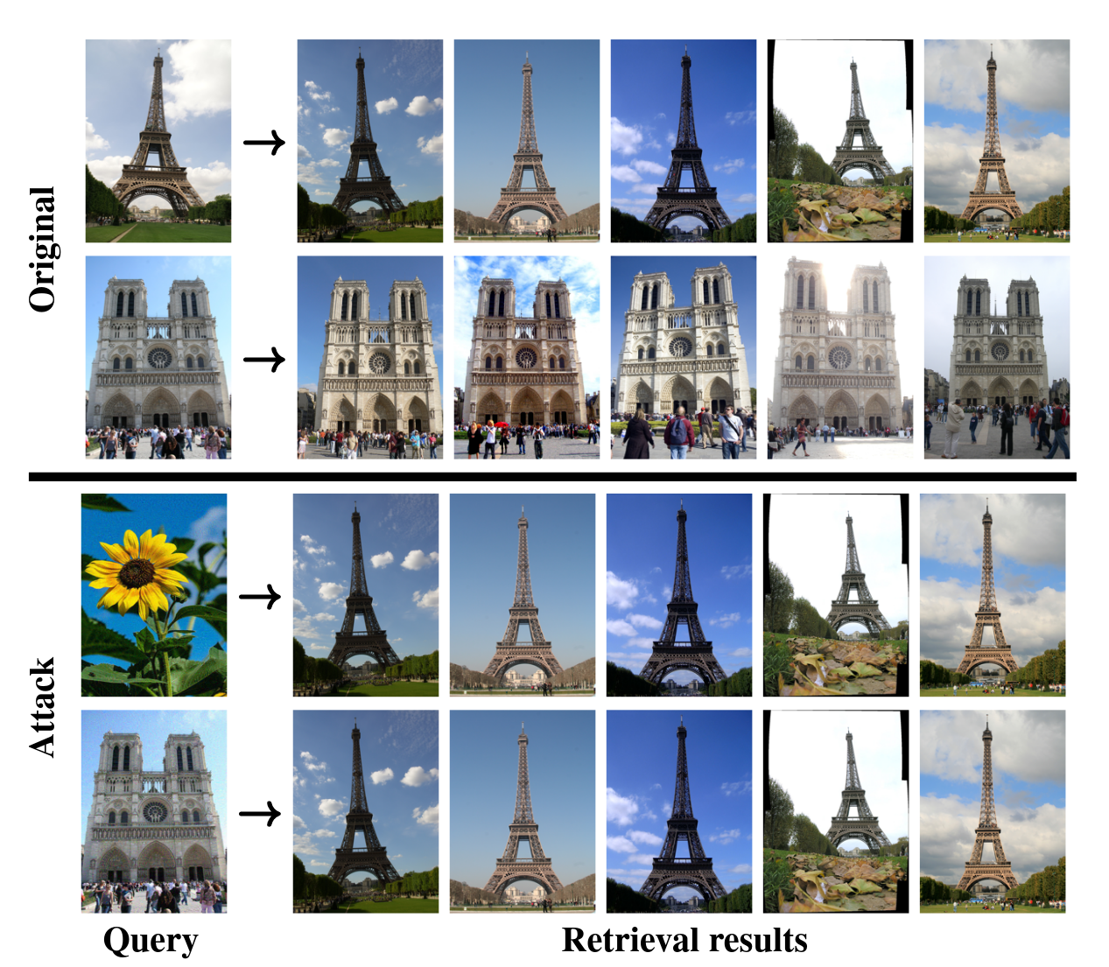
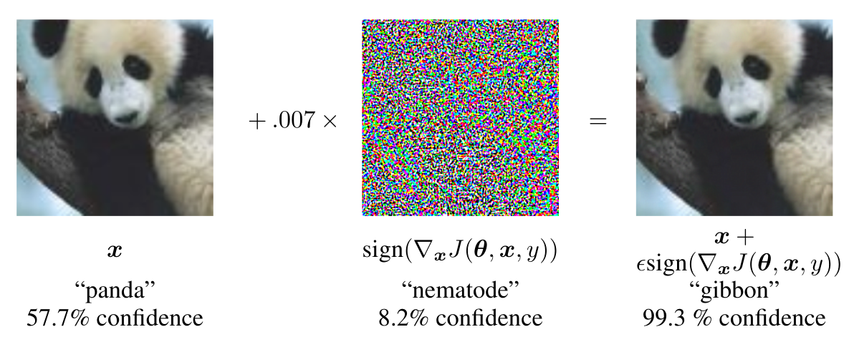
Adversarial Attack
Attack against DNN Classifier [2]
Attack against Image Retrieval (DML) model [3]
[2] Explaining and Harnessing Adversarial Examples, ICLR 2015
[3] Giorgos et al., Targeted Mismatch Adversarial Attack: Query with a Flower to Retrieve the Tower, ICCV 2019

Slide 4
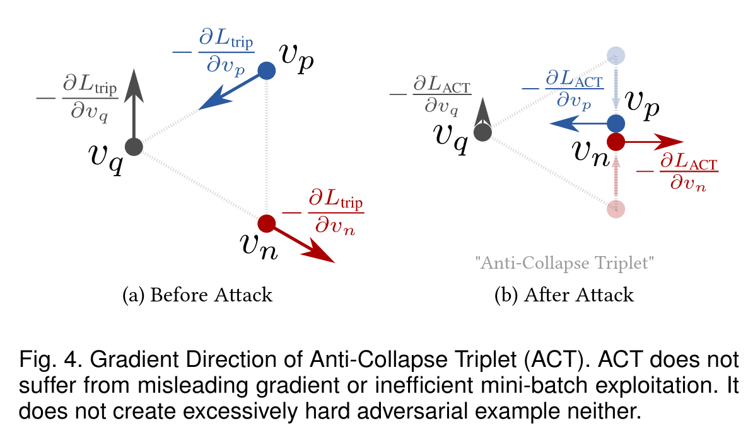
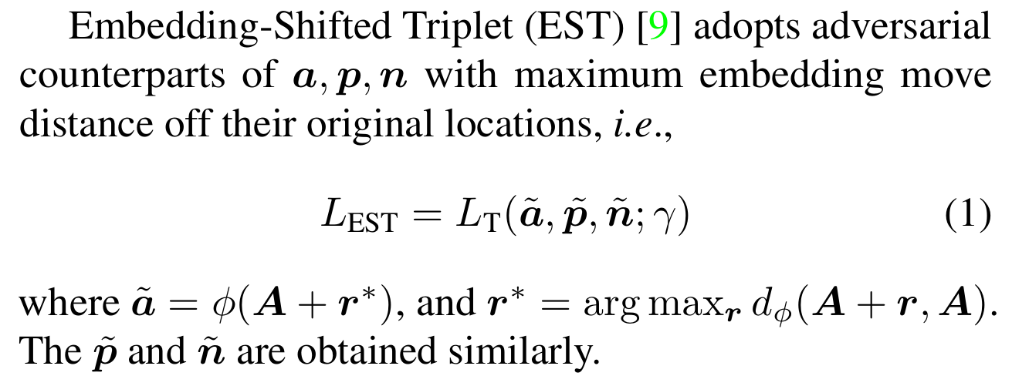
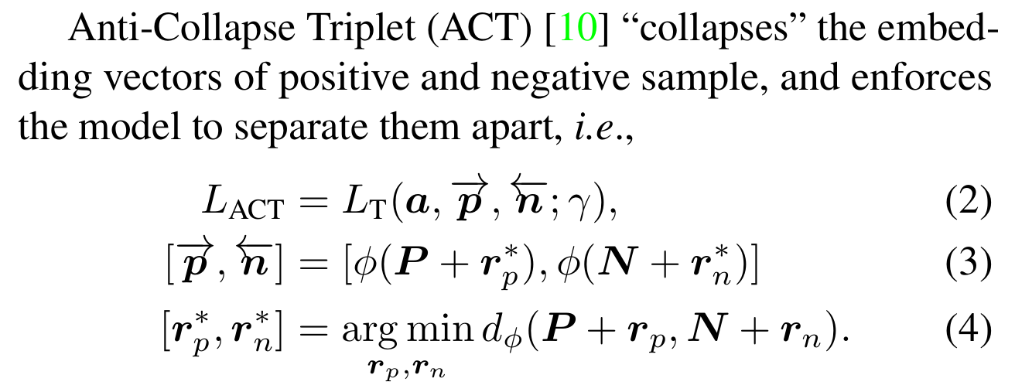
Adversarial Defense & Robustness for DML
Important, but Insufficiently Explored
(1) EST Defense
(2) ACT Defense
Common problems: high training cost (low efficiency), performance drop, etc.
[4] M. Zhou, et al., Adversarial Ranking Attack and Defense, ECCV 2020
[5] M. Zhou, et al., Adversarial Attack and Defense in Deep Ranking, ArXiv 2021

Slide 5
Rethink on DML Defense -- “Interpolation”
Strengths of adversarial examples used for adversarial training as a defense:
Attack
Strength
(Weaker)
(Stronger)
No attack: Regular DML training
& negligible robustness
Strongest attack strength: Direct adoption of Madry defense [6]
& model collapse, infeasible
Insight: an “intermediate” (flexible) attack strength that does not lead to model collapse?
[6] Aleksander et al., Towards deep learning models resistant to adversarial attacks, ICLR 2018

Slide 6




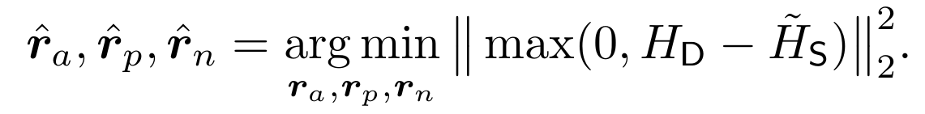
Hardness Manipulation (HM)
“Hardness” H: Internal component of triplet loss [7]
FYI:
(triplet loss)
Hardness Manipulation: flexible tool for creating adversarial examples
(1) hardness of adversarial triplet
(2) projected gradient descent
(create adv examples)
(3) optimize model parameters
(adversarial training)
[7] Florian et al., Facenet: A unified embedding for face recognition and clustering. CVPR 2015

Slide 7
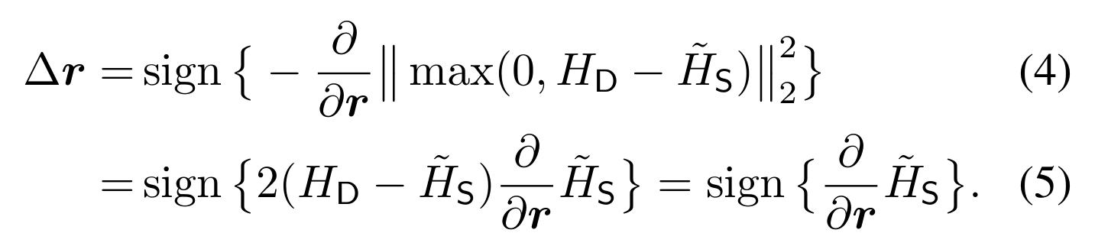

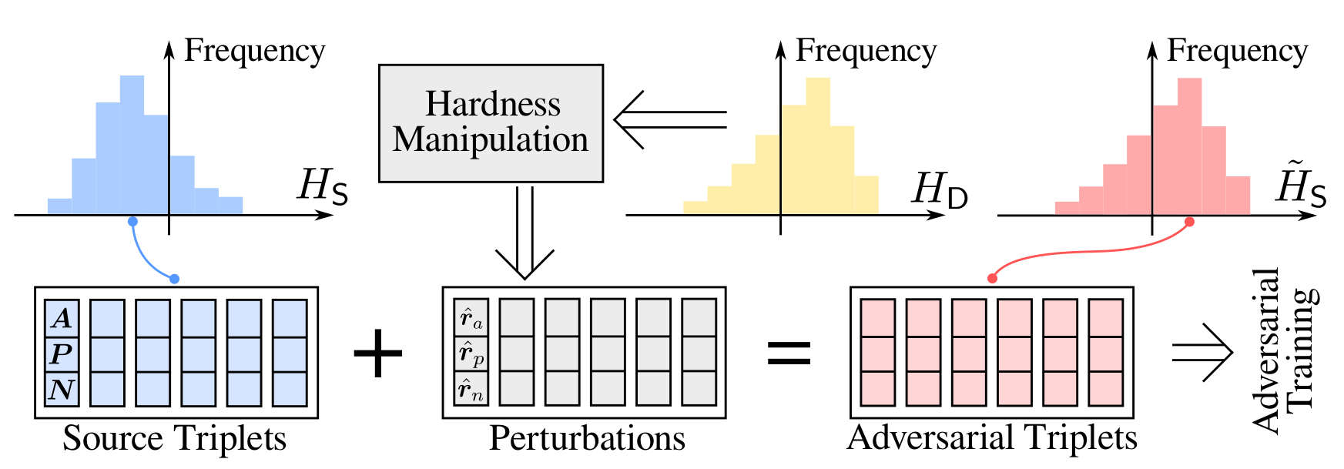
HM: Characteristics
Direct & Efficient in reaching the “intermediate” point.
The same sign of gradient as that for directly maximizing the hardness (Madry case).
Interpretation: direct maximization process of the hardness which stops “halfway”
at the specified destination hardness, instead of pushing it towards
theoretical upper bound.

Slide 8
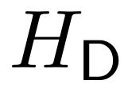
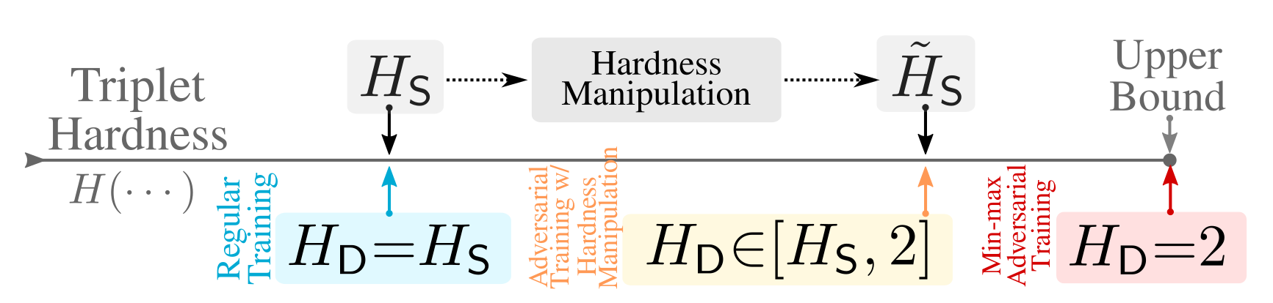
HM: Destination Hardness
Constant (not flexible)
Hardness of another benign triplet (unbalanced)
Pseudo-hardness function (requires prior-knowledge)

Slide 9
Experiment: Selection of Hardness

Slide 10
Gradual Adversary

Slide 11
Experiment: Linear Gradual Adversary

Slide 12
Intra-Class Structure (ICS) Loss

Slide 13
Experiment: ICS Loss

Slide 14
Comparison with SoTA

Slide 15
Conclusions
Defense is important.
HM: flexible and efficient tool.
LGA: balancing training objectives.
ICS: further improve robustness.
Outperforms SoTA by a margin.

Slide 16
Thanks!

