Slide 1


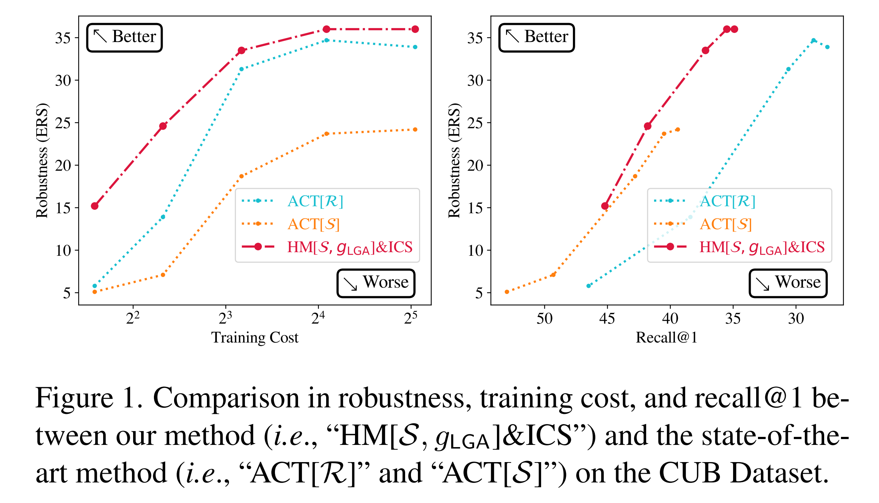
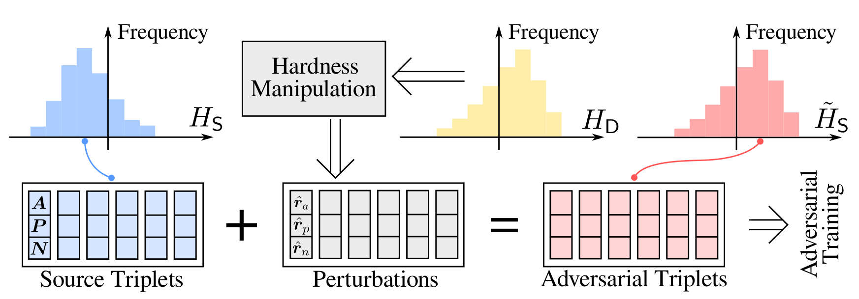
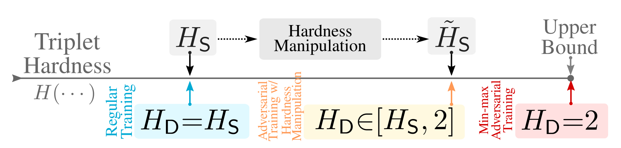


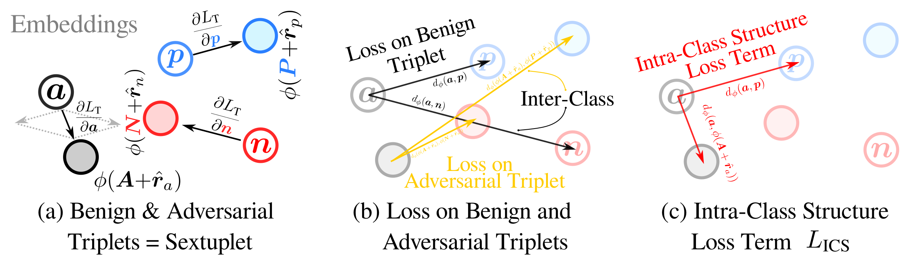
Enhancing Adversarial Robustness for Deep Metric Learning
Mo Zhou Vishal M. Patel
Johns Hopkins University
* Deep Metric Learning is vulnerable to adversarial attacks.
* Existing defense methods learn from weak adversary in
Order to avoid model collapse, which is inefficient.
* We propose Hardness Manipulation (HM), an flexible and
Efficient tool for creating adversarial example triplets.
* We propose Linear Gradual Adversary (LGA) as a
Pseudo-hardness function for HM to balance training
Objectives during adversarial training.
* We propose Intra-Class Structure (ICS) loss term to further
Improve model robustness and adversarial training efficiency.
* The proposed method overwhelmingly outperforms
SoTA by a large margin.
arXiv
Github
This material is released under the CC-BY-NC-SA-4.0 License.

