Slide 1
Coll 400 Project CSCI 434
Connor MacKinnon and Thomas Eby
Department of Computer Science
College of William & Mary

Slide 2






Objective
Utilize the Wireshark software to collect network traffic data from a set of popular websites
Utilize skills from previous courses to:
Process the data
Build a machine learning model to take in a stream of network data classify which website was the source

Slide 3
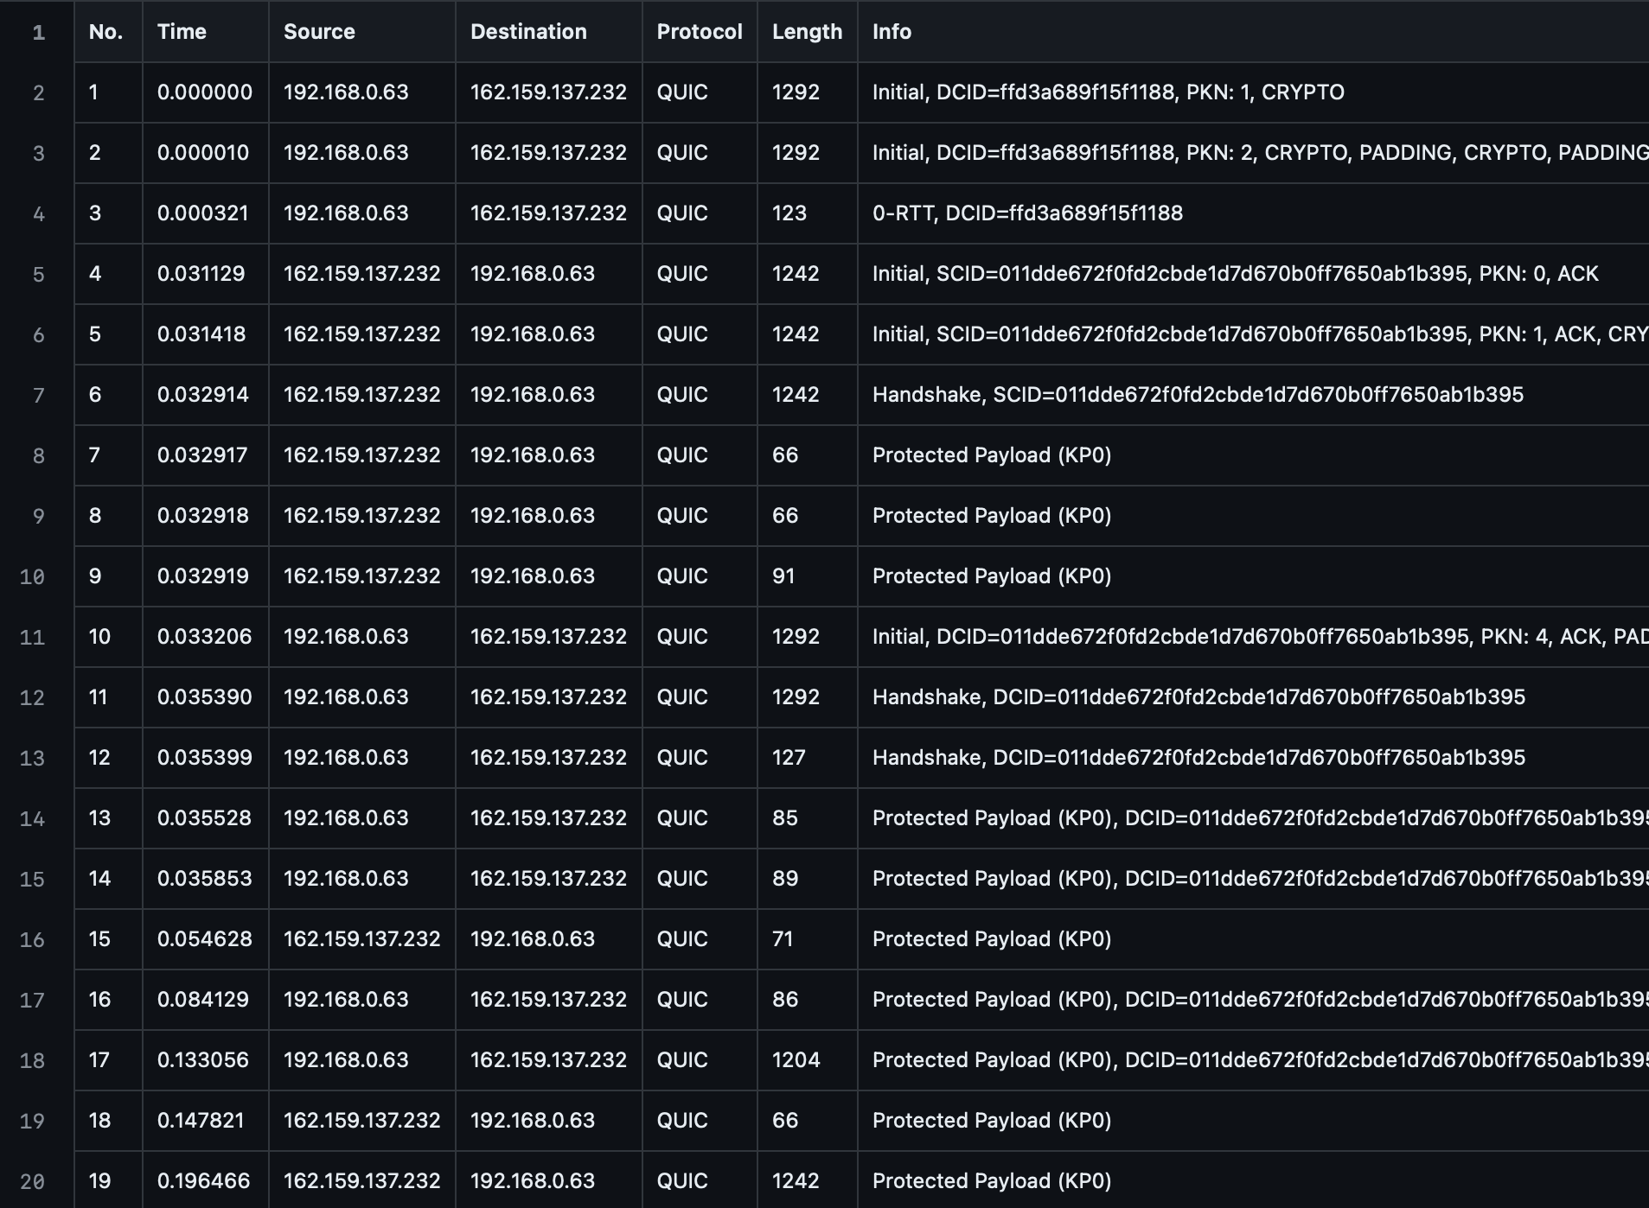
Data Collection & Preprocessing
Features:
packet_mean_timing
packet_median_timing
packet_std_timing
packet_mode_length
packet_mean_length
packet_median_length
packet_std_length
average_packets_per_second
average_bytes_per_second
TCP_percentage
TLS_percentage
UDP_percentage
QUIC_percentage
Target:
Website

Slide 4
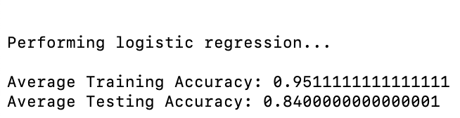
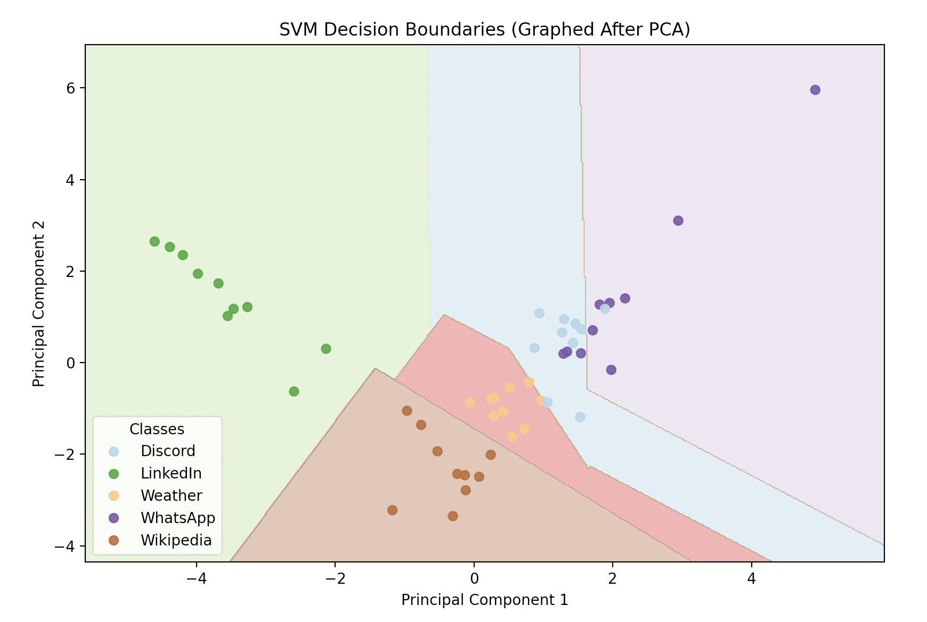
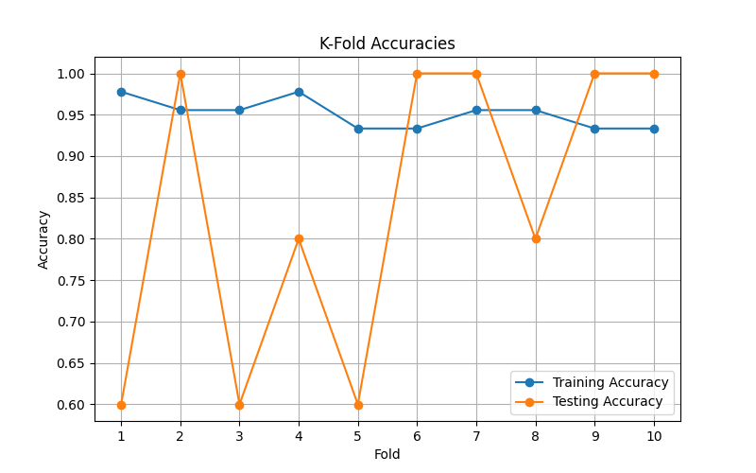
Models

Slide 5
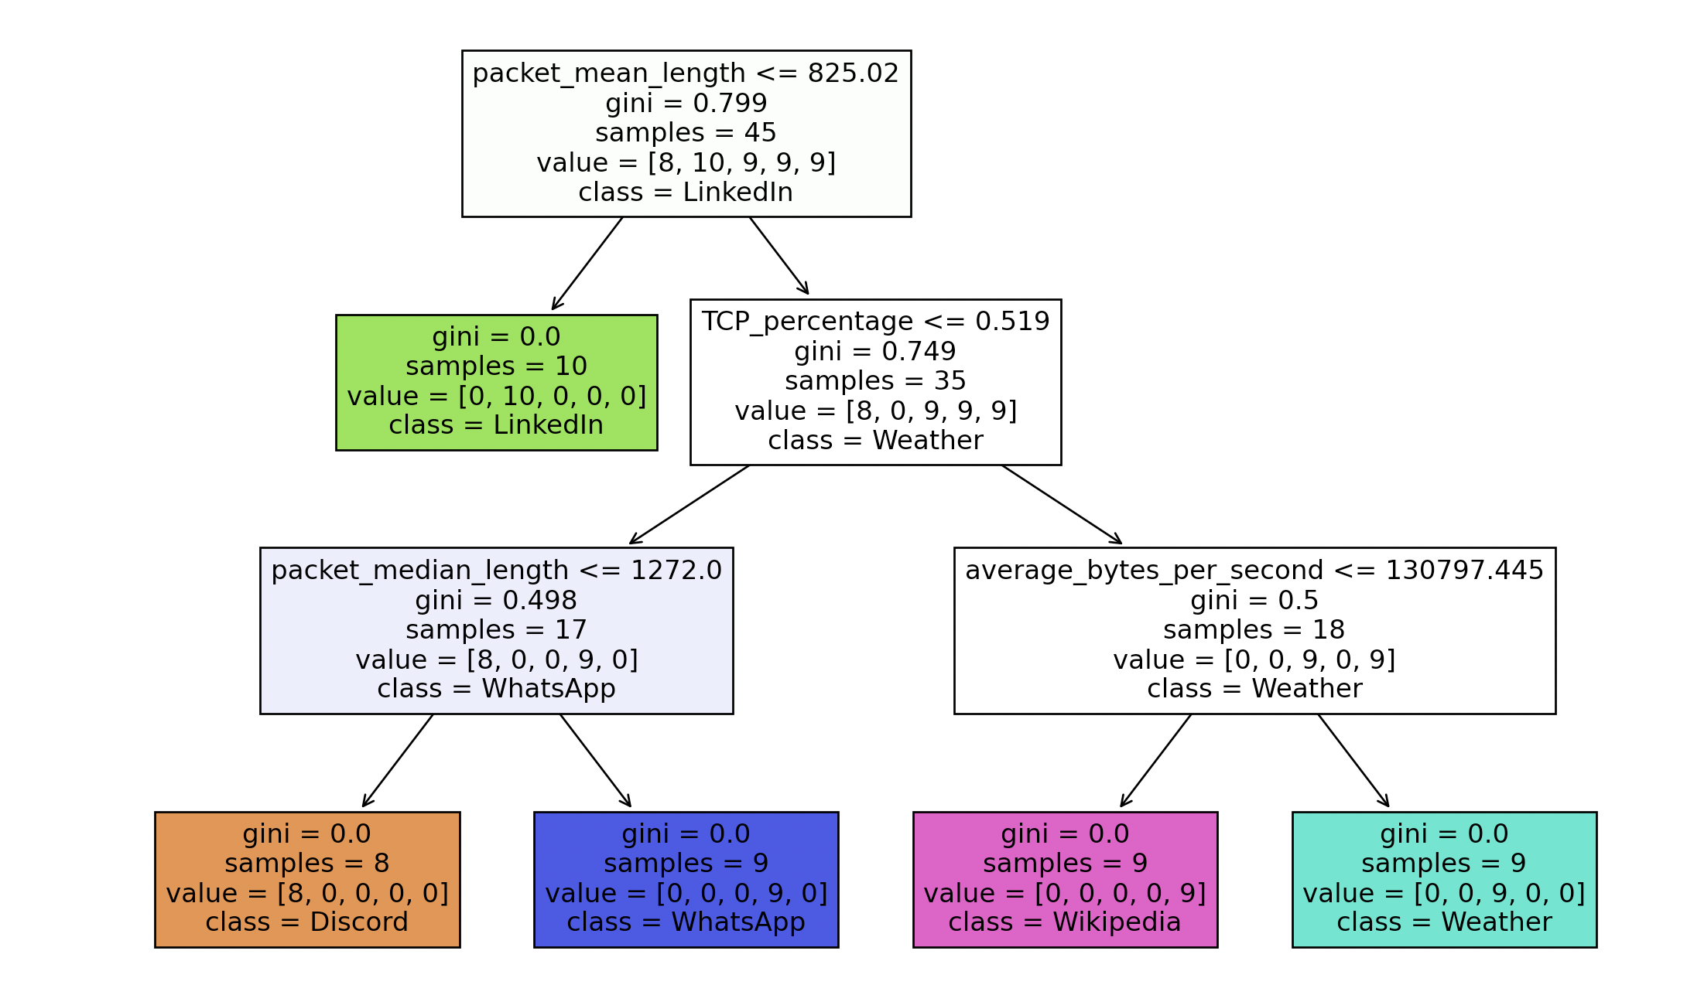
Results
We built 50 decision trees using leave-one-out k-fold cross-validation and received an average accuracy of 95%
A random forest may yield more consistent results that are less overfit, but with a starting accuracy of 95% that seemed unnecessary
A Train Test Split (10%) Sample Decision Tree

