Slide 1


Engineering Lab Reports and Technical Writing
Dr. Chris Andrews

Slide 2
Objectives
Accreditation Board for Engineering and Technology (ABET) Student Learning Outcomes:
An ability to communicate effectively with a range of audiences.
Goals for this workshop:
to invite you to begin to change the ways you think about writing, especially writing as a professional.
to help you recognize strategies that will improve the writing you are doing or will do, to make it more effective for your readers.

Slide 3
ABET says when you graduate from this program, you should have
An ability to communicate effectively with a range of audiences.
?
Why does effective communication matter?
When/why do you think engineers use writing?
Notes:
Effective communication is how work happens. It comes before work, supports work during the process, and sustains work after a project is completed.
Mechanical engineers utilize writing daily to propose projects and justify design ideas, create manufacturing instructions, record and report test results, verify progress on a project, collaborate on user manuals, disseminate information to help people make decisions, and even persuade or recommend based on the engineer's expert opinion (That's one of the reasons your accreditation by ABET matters!). The audiences that these documents communicate to are varied. Engineers must be able to effectively communicate complex topics and ideas to other engineers, technical and nontechnical personnel, business personnel, marketing people, and the public.

Slide 4
Engineers write. A lot.
% of Engineers’ workday spent writing
Source: Silyn-Roberts (1998). JPIEE 124.1.
Engineers spend between 20% and 40% of their workday writing; this figure increases as they move up the career ladder.
Source: Leydens, (2008). IEEE Transactions 51.3
First few years on the job | 〜30%
Middle management | 〜50%–70%
Senior management | 〜70%–95%

Slide 5
Writing is a Tool for Doing
Think of Writing as part of your tool collection.
Instead of considering yourself as just "writing something," consider that you are "using writing" to do.

Slide 6
Writing is a Tool for Doing
When we think of writing as using tool(s) to do . . .
What are we "doing" with a lab report or project proposal or a progress report or _____?
How will others use what we produce?
How does that affect our choices and uses of the tools we use to produce?
Notes:
Explaining a complex system in such a way that others can understand.

Slide 7
Writing for grades vs. Writing in the workplace
Achieve college goals Show your professor you did the work correctly or mastered subject matter Get a good grade Single reader: the professor | Achieve workplace goals Communicate information to audiences who need to use it Document, explain, or justify your work for other professionals Variety of readers: professionals and stakeholders

Slide 8
Technical writing
Technical writing uses simple, direct language and document design features to convey information to audiences.
Write to your audience(s). What do they need? What do they know? What do they not know?
Get to the point.
Put information where your readers expect it to be.
Label everything. (Sections, Figures, Tables, Equations, Lists)
Explain visuals or data before you show them.
Notes:
This presentation offers a few examples of each principle in action. These examples aren’t perfect, but they highlight some areas you might be struggling with as a writer.
Really all of these emphasize the idea of being direct about what happened, why it happened, and why it matters.

Slide 9
Write to your audience
What are you doing with a lab report? What do different parts of a report do?
How is a lab report analogous to communicating you would do on the job?
Who might use a lab report? For what purposes?
Notes:
A lab report is a detailed account of an experiment, its methods, results, and conclusions—all which answer a question.
What is the question your lab report answers?
Audiences:
Engineers (peers) who are interested in similar work and base their experiment on yours
Supervisors who want to know about the work you have done
Your professor or grader is also part of the audience—their job is to dramatize the presence of these other two audiences—people who don’t know what you know.
(Thus it’s your job to explain to them what you’re doing and why)
Purposes:
Inform: People want to know what you have done.
Persuade: Raw data is not convincing by itself. You must convince your audience it is correct and justify your results.

Slide 10
Abstract | Summarize what you did and what you concluded. Core results and essentials to help other understand what you did and why.
Introduction | Explain the problem you solved or the question you answered; also explain why the problem needs solving (rationale).
Theory / Background | Explain your assumptions, terminology, and major equations; why the problem should be solved this way, or what you expect to happen.
Equipment / Procedure | Describe or illustrate the equipment you used. Explain each step of how you conducted the procedure, including variables, so that someone could replicate and verify your process.
Data / Calculations Results | Present and explain what you found using graphs or tables with short explanations.
Discussion / Analysis | Explain your results; compare your results with expected or calculated results
Conclusions | Interpret or judge your results. Restate the problem and results, justify decisions, explain anomalies/errors/uncertainties, and discuss problems and how those might be corrected in the future.
Notes:
What do major sections do? (That is, what information do they provide for different kinds of audiences?)

Slide 11
Get to the point: Abstract 1
This lab report will break down into details the procedure taken to develop the plate and shaft two part assembly. Explanations and figures will aid in the rendition of the report. This experiment improved the understanding of machining, tolerances, and the expectations of co-working machinists in future work. The purpose of this experiment was to create a two part aluminum plate and shaft made from Aluminum 6061 - T6511 that can withstand a 10 ft.-lb_{f} torque applied to the end of the shaft without inducing relative motion. To complete this objective, and interference fit between the shaft and plate with precise tolerances would have to be met so that the two part system would complete the task.
Notes:
What’s an abstract’s purpose? Who is an abstract for? What do readers expect about the abstract? Where do the writers spend time on things that are irrelevant to the abstract? What other questions does this raise?
This abstract only sets out the problem; it does not summarize the contents of the report (i.e. summarize the experiment)

Slide 12

Get to the point: Abstract 2
The objective of the lab was to build an assembly that was able to withstand a 10-ft-lb_{f} torque applied at the end of the shaft without turning. Two pieces of 6061-T6 Aluminum were used for this project. It was necessary to follow the guideline dimensions, which are provided in the theory section. Also, it was necessary to consider the tolerances and use three important manufacturing processes: cutting, milling, and drilling. A band saw, a milling machine, and a lathe were employed to accomplish this. In optimal conditions, the contact pressure wouldn’t exceed the yield strength of the material we used. Though the assembly passed the text, it sustained more contact pressure than anticipated. Further investigation may need to be done into the implications of this.
Notes:
While this example suffers a bit from a lack of precision (a few pieces of data about contact pressure would be acceptable), it overviews the scope of the project, providing about a sentence-worth of summary for each major section of the report.
Get to the point: Things like starting each section with clear statements of the main idea, assumption, result, or recommendation. Stick to the one-idea, one-sentence model of technical writing, and use relatively bite-size paragraph chunks.

Slide 13
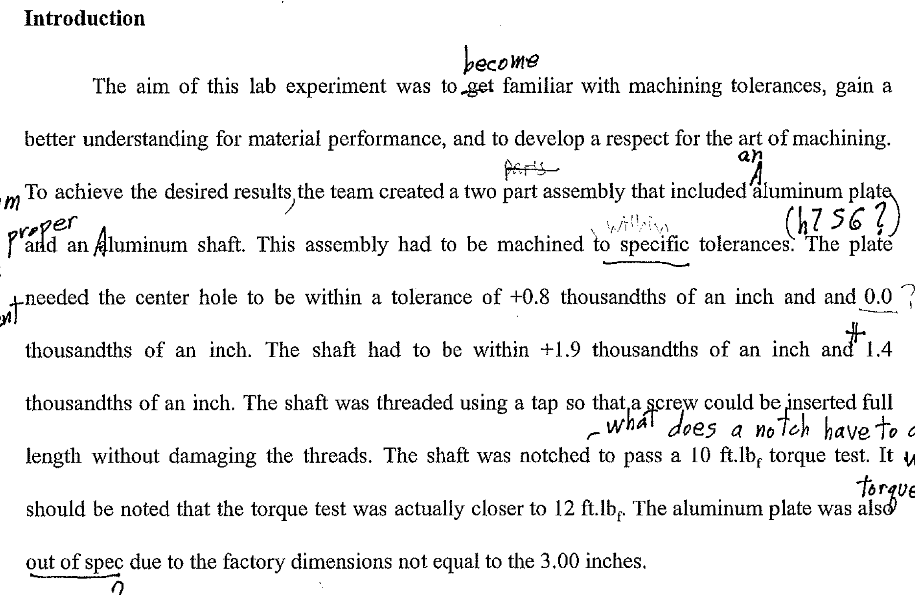
Why are we here? Introduction 1
Notes:
This explains some of the learning objectives of the lab, but does not introduce the essential problem that needed to be solved in the lab. The lab report should be focused on those problems (What was the experiment and why it needs to be done in an engineering context?)
It then launches into details about specifications (these would be more appropriate in the theory or another section) and details about the process and results (which belong in both the abstract and even more so in the discussion/conclusion sections of the report.

Slide 14
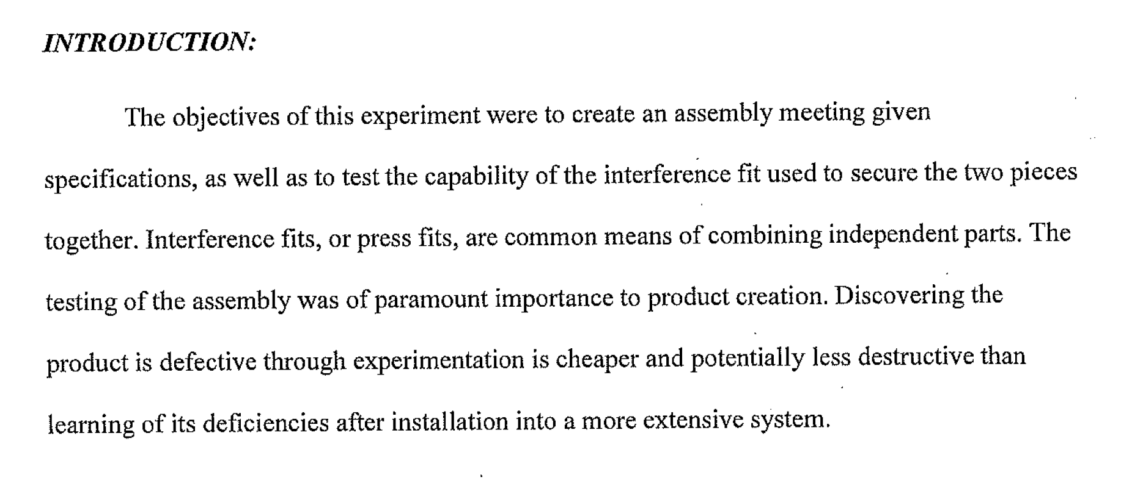
Why are we here? Introduction 2
Notes:
This begins with the experiment, explains the relevance of the problem (why the heck the audience should care about this), and describes implications of the process.

Slide 15
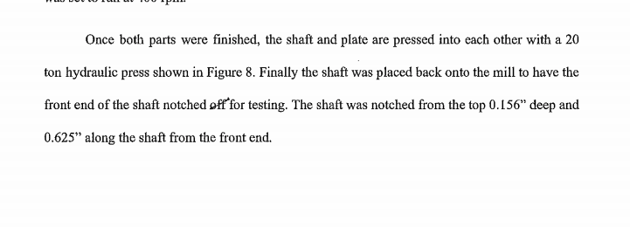
What are our expectations for procedures?

Slide 16
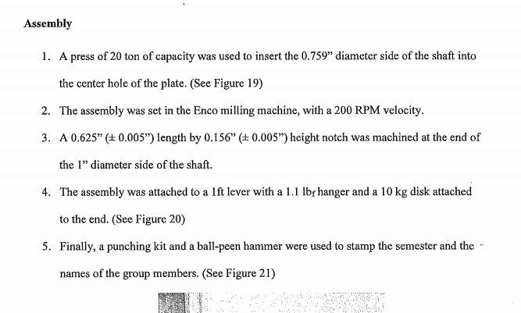
What are our expectations for procedures?

Slide 17
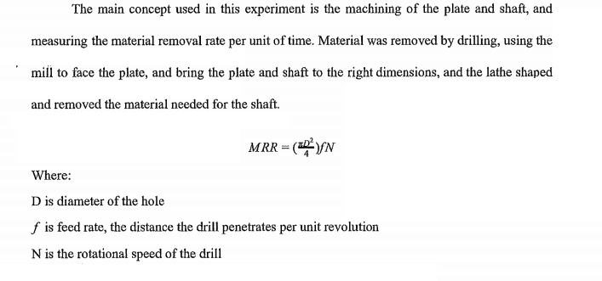
Label everything & Explain visuals

Slide 18
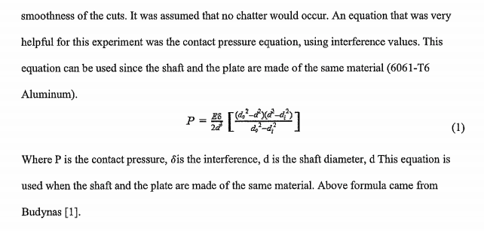
Label everything & Explain visuals

Slide 19
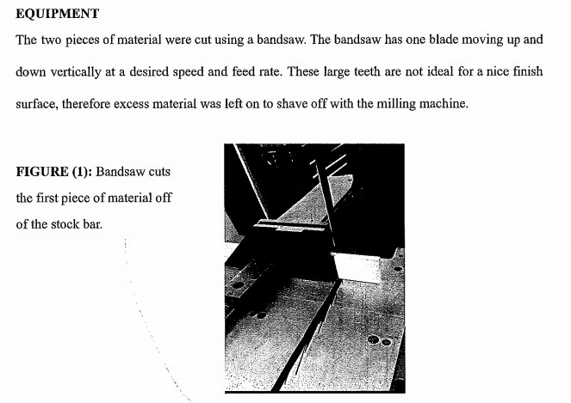
Label everything & Explain visuals

Slide 20

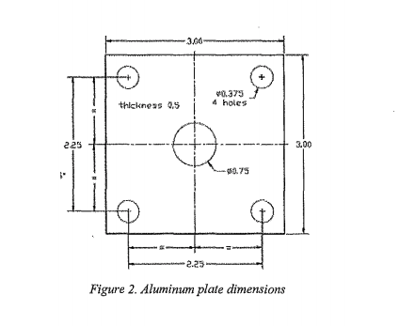
Label everything & Explain visuals

Slide 21
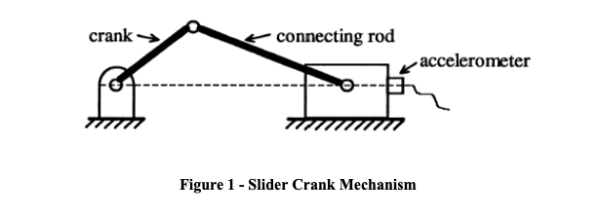
Label everything & Explain visuals

Slide 22
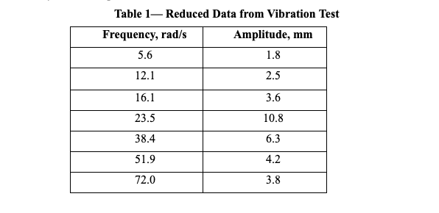
Label everything & Explain visuals

Slide 23
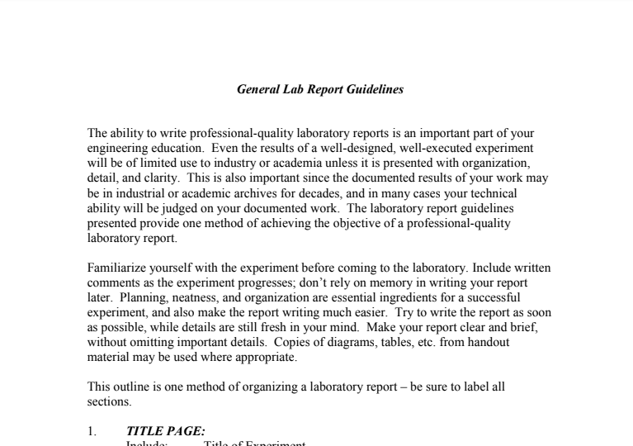
Read and follow your specs.
Notes:
If your instructor provides you with guidelines or specifications for the assignment, read them carefully and follow the directions. Ask for examples of good lab reports if they have them.
Finally, remember that writing is a process of multiple drafts and focusing on different revisions at different steps in the process. Don’t worry, for example, about third person and personal pronouns on the first draft—just get the thing written. You can revise for personal pronouns or past tense issues later.
And *read* the technical literature with an attention to *how* authors get ideas across. How do they introduce problems? How technical is their language? How direct are their sentences? Reading like an engineer (and thinking about how or why engineers read) will help you to write like one, too.

Slide 24
Writing is a process
Draft
Review
Edit

Slide 25
For more information:
Writing as an Engineer or Scientist
www.craftofscientificwriting.com
Online Technical Writing
https://www.prismnet.com/~hcexres/textbook/
Notes:
Sentence style, revision strategies, examples, videos, and more content

Slide 26
Remember: Writing improvement takes practice and feedback! Get as much of both as you can.

