Slide 1



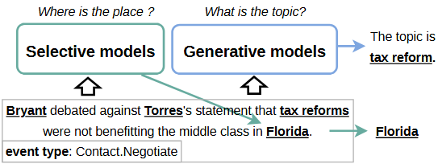
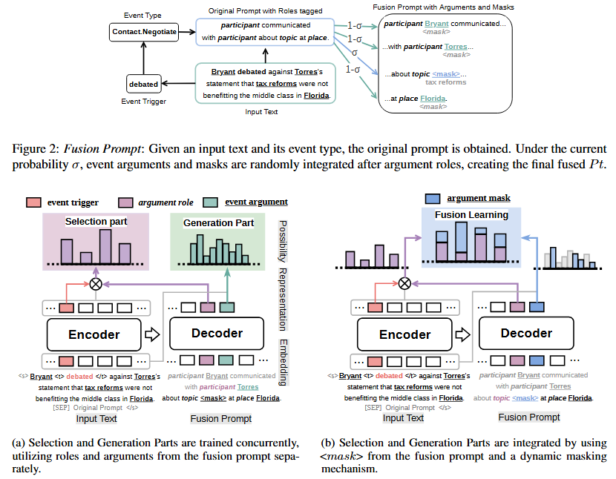
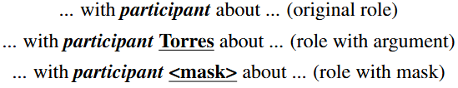



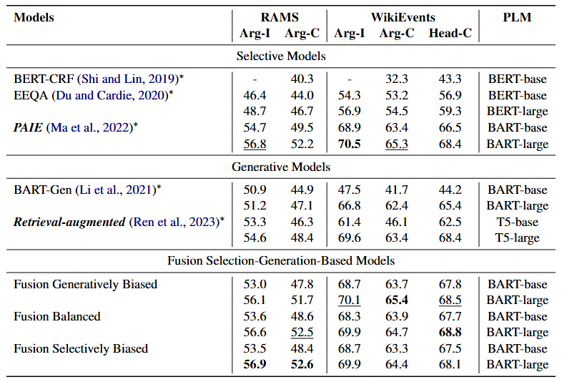
Fusion meets Function: The Adaptive Selection-Generation Approach in Event Argument Extraction
Guoxuan Ding, Xiaobo Guo, Xin Wang, Lei Wang, Tianshu Fu, Nan Mu, Daren Zha
dingguoxuan@iie.ac.cn
Abstract
Difference Between Selective and Generative Methods in EAE
Event Argument Extraction is a critical task of Event Extraction, focused on identifying event arguments within text. This paper presents a novel Fusion Selection-Generation-Based Approach, by combining the precision of selective methods with the semantic generation capability of generative methods to enhance argument extraction accuracy. This synergistic integration, achieved through fusion prompt, element-based extraction, and fusion learning, addresses the challenges of input, process, and output fusion, effectively blending the unique characteristics of both methods into a cohesive model. Comprehensive evaluations on the RAMS and WikiEvents demonstrate the model's competitive performance and efficiency.
Selective methods identify tokens in text for answer selection, while generative methods employ natural language generation to produce exhaustive answer sequences.
Model Overview
Model Formulation
fusion prompt
element-based extraction
In Selection Part, through the vector representation of roles, they encapsulate the starting and ending positions of arguments.
In Generation Part, through the vector representation of arguments, they generate a vocabulary-sized probability distribution.
fusion learning
Performance (%) in Event Argument Extraction
In the Fusion Part, the vector representation of masks is combined with the selective probability distribution.
Conclusion
In conclusion, our research presents a Fusion Selection-Generation-Based Approach for Event Argument Extraction, merging selective and generative methods. Empirical evaluations on the RAMS and WikiEvents indicate improved performance and efficiency. This study contributes to the EAE field by demonstrating the practicality of integrating different approaches. In future work, we plan to design a more suitable fusion method and adapt our fusion model to other domains, thereby exploring broader applications and achieving deeper integrations in information extraction.

