Slide 1
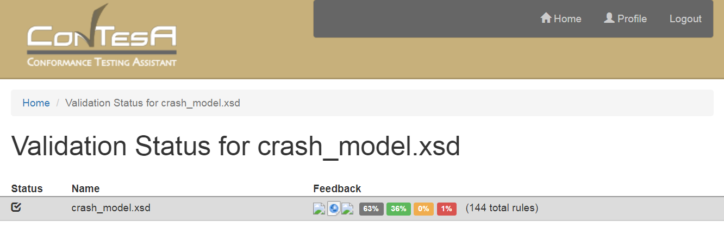
Conformance Reports
Rules N/A
Rules Passed
Rule Warnings
Rules Failed

