Slide 1
NIEM Metamodel
Integrating a NIEM tools strategy Webb Roberts webb.roberts@gtri.gatech.edu

Slide 2
How we got here
NIEM focused on interoperability of data across communities
Multiple levels of governance: core, domains, exchange
Everything extensible and reusable
NIEM focused on interoperability of data across systems
System-independent data & data definitions
Supported by free & open standards and tools
NIEM data definitions were exclusively represented as XML Schema
NIEM data was exchanged as XML
NIEM data definitions were used with other technologies as applications of XML

Slide 3
Where we are now
NIEM extended support to other uses of NIEM Support for UML via the NIEM UML Profile Support for JSON via the NIEM JSON Specification Shortcomings UML profile is limited to NIEM 3, few tools, and IEPD creation There is no tool support for NIEM for JSON Non-XML adopters of NIEM are required to build XML Schema for exchange definitions, hindering non-XML adopters

Slide 4
Next requirement
Expand beyond interoperability across communities and systems Add a focus on interoperability of data across technologies Initial focus is on JSON and UML support Provide interoperability between NIEM data definitions and other formats NIEM data definitions ↔︎ UML models NIEM data definitions ↔︎ JSON Schema Represent NIEM data definitions in other formats Represent other formats as NIEM data definitions Candidate Data Standards and Tools Spreadsheets to support governance XML, XML Schema JSON, JSON Schema RDF Schema & Web Ontology Language Linked Open Data via JSON-LD and RDF Unified Modeling Language (UML) Schema for relational databases Apache Avro Protocol Buffers GraphQL Human consumption: diagrams & documentation Support for a NIEM tool architecture The NTAC has put forward a NIEM tool architecture that provides for generation of different representations of NIEM data definitions including JSON, UML, and documentation A piece of this is a representation of NIEM data models A "model description" that can be a basis for generating representations of NIEM for different technologies Serves the function of a wantlist and extension schemas The "model description" contains what we think of as NIEM data definitions Current work: a data model for NIEM data definitions AKA a NIEM metamodel It defines a class of data objects that describe a NIEM data models (a "model description" data object) Represents the aspects of NIEM model that we care about, without a focus on XML Schema-specific features It describes what the NIEM model is: Namespaces: collect and label data components so that they can be governed and distinguished Data components have names, namespaces, and human-readable definitions Types: represent things and values Classes that define categories of objects Datatypes that define categories of text: strings, dates, enumerations Properties: represent relationships and characteristics Object properties: represent relationships to objects Map to XML Schema elements Data properties: represent relationships to simple data values Map to XML Schema attributes What we have done so far The NTAC is drafting a metamodel represents a NIEM model (NIEM data definitions) as a data object We can represent NIEM reference schemas as a "model description" data object Most features are supported, but not necessarily all; it's a draft This could be handled as XML, JSON, or other formats We can convert NIEM data descriptions into conformant XML Schema We have the metamodel represented as data Next steps Ensure the metamodel covers all needed NIEM features: externals, augmentations, "wantlist" functionality Map the metamodel to needed technologies RDF, JSON Schema, UML Make it part of a tool architecture Use it to provide tool support for other NIEM representations END Phase 1: Modularize Core Services Phase 2: Improved Function via Additional Services

Slide 5
This is a slide
This is some text on a slide.

Slide 6
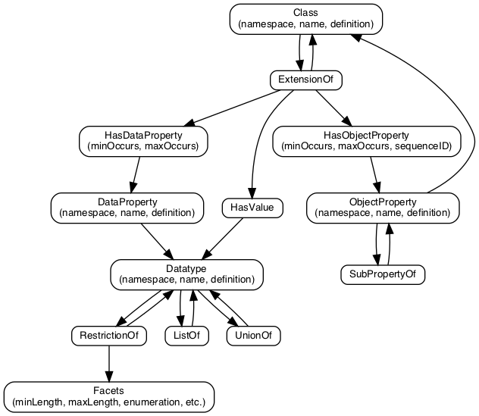
another title
alt text

