Slide 1
context
abstract
producer
Information requirement
(the facts that must be conveyed
abstract
consumer
defines
defines
Business
Analyst
Subject
Matter
Expert
Message
Designer
creates
Message
Developers
Message
format
understand
understand
Message
Developers
specifies
implement
System /
Application
interface
System /
Application
System /
Application
System /
Application
System /
Application
Message
(XML,
JSON, etc.)
System /
Application
Producers
Consumers

Slide 2
context
abstract
producer
Information requirement
(the facts that must be conveyed
abstract
consumer
defines
defines
Business
Analyst
Message
Designer
Subject
Matter
Expert
creates
Message
Developers
Message
format
understand
understand
Message
Developers
specifies
implement
System /
Application
interface
System /
Application
System /
Application
Message
(XML,
JSON, etc.)
System /
Application
System /
Application
System /
Application
Producers
Consumers

Slide 3
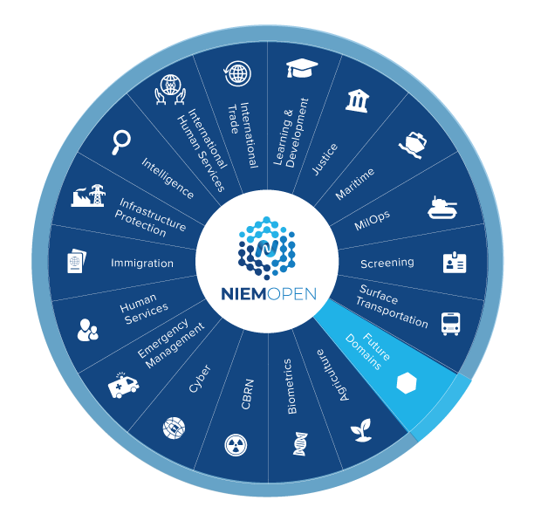
community
Domain models
NIEM
Core
Domain communities: analysts, SMEs, developers with shared subject interests
Business architecture committee (NBAC): representatives from all communities, creating a common core
NIEM data model
design
design

Slide 4
community
Domain models
NIEM
Core
Domain communities: analysts, SMEs, developers with shared subject interests
Business architecture committee (NBAC): representatives from all communities, creating a common core
NIEM data model
design
design

Slide 5
messageSpec
message specification
messages
message type
defines content of
message format
defines syntax of
<my:Request
xmlns:my="http://example.com/M
xmlns:nc="https://docs.oasis-op
<my:Parameter>
<my:SomethingOrOther>
Request
Request.XML
same information
message format
defines syntax of
{
"@context": "http://example.com
"my:Request": {
"my:Parameter": {
"my:SomethingOrOther": {
Request.JSON
message type
defines content of
message format
defines syntax of
<my:Response
xmlns:my="http://example.com/M
xmlns:nc="https://docs.oasis-op
<my:Result>
<my:SomethingOrOther>
Response
Response.XML
same information
message format
defines syntax of
{
"@context": "http://example.com
"my:Response": {
"my:Result": {
"my:SomethingOrOther": {
Response.JSON

Slide 6
msg+meta
specified-by
instance-of
Message (runtime instance data)
NIEM data model
Metamodel
person object
is-a
nc:PersonType
is-a
Class
has-a
has-a
nc:PersonName
nc:PersonName
is-a
Object Property
is-a
name object
is-a
nc:PersonNameType
is-a
Class
has-a
has-a
nc:PersonFullName
is-a
Data Property
nc:PersonFullName
is-a
literal
Clark Kent
is-a
xs:string
is-a
Datatype

Slide 7
xml-meaning
nc:PersonType
nc:PersonNameType
rdf:type
rdf:type
_:n0
nc:Person
_:n1
nc:PersonName
_:n2
nc:PersonFullName
“Clark Kent”

