Slide 1
abstract
producer
Information requirement
(the facts that must be conveyed
abstract
consumer
defines
defines
Business
Analyst
Subject
Matter
Expert
Message
Designer
creates
Message
Developers
Message
format
understand
understand
Message
Developers
specifies
implement
System /
Application
interface
System /
Application
System /
Application
System /
Application
System /
Application
Message
(XML,
JSON, etc.)
System /
Application
Producers
Consumers

Slide 2
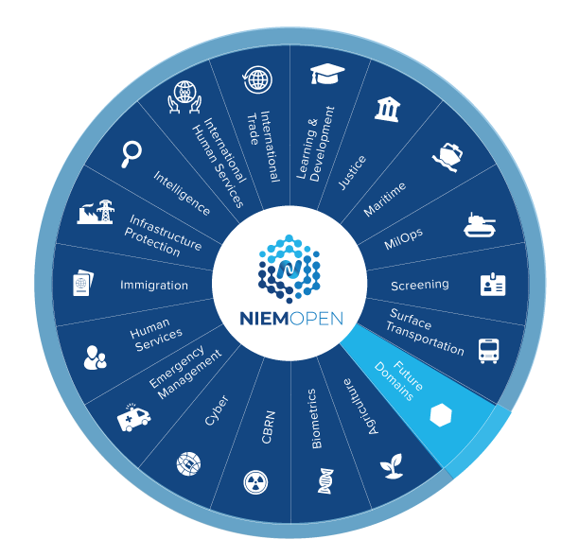
Domain models
NIEM
Core
Domain communities: analysts, SMEs, developers with shared subject interests
Business architecture committee (NBAC): representatives from all communities, looking for commonalities
NIEM data model
design
design

Slide 3
fig 3-2
Message
Metamodel
class
object
is-a
nc:PersonType
has-a
nc:PersonName
nc:PersonName
object property
class
nc:PersonNameType
is-a
object
is-a
has-a
nc:PersonFullName
nc:PersonFullName
data property
datatype
literal
Clark Kent
xs:string
is-a
is-a

