Slide 1
Tool Strategy
ToolStrategy_V19_5 December 2019 (K Escobar review)

Slide 2
Agenda
Vision
Tool Strategy Today
Current Toolset Gaps
Assumptions
Potential Courses of Action
Recommendation

Slide 3
Tool strategy Vision
Provide a comprehensive, end-to-end, automated NIEM toolset enabling our customers with the ability create all associated artifacts within the IEPD lifecycle

Slide 4
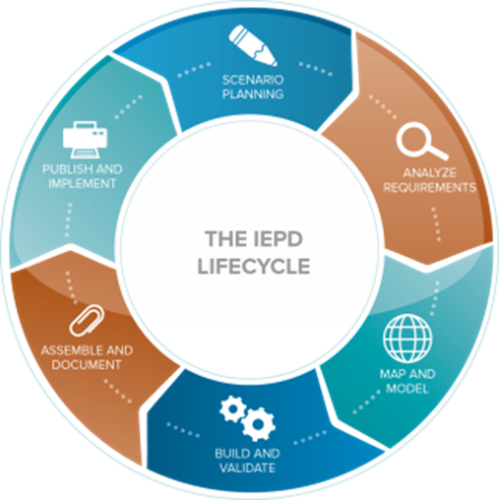
Tool strategy Where we are today Non-integrated, Partial Solution Toolset
Publish & Implement
XML
UML
JSON
ZIP File
Scenario Planning
UML Modeling Tools
Visio
MS Office
Assemble & Document
UML
Visio
MS Office
ZIP Tools
Analyze Requirements
UML Modeling Tools
Visio
MS Office
ReQtest, Qualtrics Core, Confluence …
Build & Validate
SSGT
Code List Generation Tool
NIEM Conformance Tool (ConTesA)
Migration Tool
Map & Model
Mapping Spreadsheet
Schema Subset Generation Tool (SSGT)
Movement
Legend
● Automated tools
● Manual tools

Slide 5
Tool strategy current gaps
Limited ability to browse NIEM elements
Limited automated mapping
IEPD validation requires third party-purchased tool
Limited ability to output alternate data formats (e.g., JSON, XML, UML, etc.)
Inadequate code documentation
Requires redesign of IEPD data output
Limited ability to reuse
Most source code proprietary

Slide 6
Tool strategy assumptions
Work efforts fit into existing resources
NIEM Management Office (NMO) will provide oversight, by leveraging
Executive Steering Committee guidance
NIEM Business Architecture Committee (NBAC) direction & input
NIEM Technical Architecture Committee (NTAC) direction & input
Lead developer
User community
Individual tool vendor’s non-proprietary code available for download, use, and modification

Slide 7
Tool strategy possible Courses of Action
Course of Action (COA) and Related Activities
COA 1 Status Quo Current tools sustained to follow NIEM model releases only
COA 2 Limited Upgrade of Current Tools Upgraded to address gaps Increased ability to browse NIEM elements, all code identified/documented
COA 3 Build New, Maintain Existing Current tools sustained - NIEM model releases only (time limited) Cloud-enabled environment - complete tool redesign, non-proprietary source code
COA 4 Build New, Modernize Existing Current tools upgraded to address gaps Cloud-enabled environment - complete tool redesign, non-proprietary source code

Slide 8
Tool strategy
COA 1 Status Quo Current tools sustained to follow NIEM model releases only
Advantages + No additional resource reallocation required + Maintain existing capabilities | Disadvantages - Domains develop tools independently - Limited ability to browse all NIEM elements - Proprietary software, outdated code
Level of Effort: NMO ‒ Low / Domain ‒ High
Timeline: Follows NIEM model release schedule
Risk: Does not address gaps; does not provide a comprehensive, end-to-end NIEM toolset to efficiently create IEPDs and artifacts

Slide 9
Tool strategy
COA 2 Limited Upgrade of Current Tools Current tools upgraded to address gaps Increased ability to browse NIEM elements, all code identified/documented
Advantages + Increased ability to browse all NIEM elements + Identify and document all code | Disadvantages - Requires resource reallocation - Requires training for designers, developers, and implementers - Proprietary software not government-owned
Level of Effort: NMO and Domain ‒ Medium
Timeline: 12-18 months
Risk: Addresses browsing gaps only; does not provide a comprehensive, end-to-end NIEM toolset to efficiently create IEPDs and artifacts

Slide 10
Tool strategy
COA 3 Build New, Maintain Existing Current tools sustained - NIEM model releases only (time limited) Complete tool redesign, non-proprietary source code
Advantages + Provides artifacts that support JSON and UML in near-term + New tool architecture: Deployable to multiple environments; non-proprietary source code; modular + Improved functionality and user experience + Can be scaled up with increased resources | Disadvantages - Requires resource reallocation - Two environments must be maintained for period of time - Requires training for designers, developers, and implementers
Level of Effort: NMO and Domain ‒ Medium
Timeline: Three-phased approach over five years
Risk: Resource allocation could delay future releases

Slide 11
Tool strategy
COA 4 Build New, Modernize Existing Current tools upgraded to address gaps Cloud-enabled - complete tool redesign, non-proprietary source code
Advantages + Complete redesign + Automated IEPD lifecycle + Non-proprietary source code | Disadvantages - Requires addition resource allocation - Two environments must be maintained for period of time - Requires training for designers, developers, and implementers
Level of Effort: NMO ‒ High / Domain ‒ Low
Timeline: Three-phased approach over five years
Risk: Without additional funding, work will exceed five years

Slide 12
NMO Recommends tool strategy COA 3 Build New tools, Maintain Existing
Next Steps Stand-up tiger team (domain SMEs) Codify three-phased tool strategy Establish actions with milestones Establish deliverables to address tool gaps Report milestone status to ESC
Level of Effort: Balanced “Medium” LOE for NMO and Domains
Timeline: Three-phased approach over five years ESC Decision: ___Approve ___Disapprove

Slide 13
Back-up

Slide 14
Niem TOOLS
Conformance Testing Assistant – ConTesA
Assists developers by automatically identifying potential locations of non-conformance within IEPD artifact using the NIEM NDR and IEPD specifications. (Proprietary)
Enterprise Information Management (EIM) v1.0 Tool – EeS
Allows users to browse the NIEM model and enable functions to support NIEM IEPD life-cycle. The tool has features for model discovery and expansion, along with the ability to generate schema subsets and validate the schema subset against NIEM conformance targets. (Proprietary)
Migration Assistance
Provides assistance for want-list migration. (Proprietary)
Movement
For those users who would like to leverage only the NIEM terms and definitions when building custom JSON objects for a lightweight exchange. (Open Source)
NIEM Java Binding Tool
Generates consistent bindings to Java objects for NIEM schema subsets and extension schema documents. (Open Source)
Schema Subset Generation Tool – SSGT
Enables users to search through the NIEM data model and build a NIEM subset. (Proprietary)
Sparx Systems Enterprise Architect
Enterprise Architect is a UML Modeling tool. Users build their IEPDs to generate the subset schemas from the model to produce exchange files, static artifacts, metadata and catalog files. (Proprietary)
Visual NIEM
Displays NIEM elements in a graphical format, as a large wheel.

Slide 15
Niem TOOLS supported UP TO NIEM 3.0
MagicDraw – Cameo NIEM Plugin
Reads existing NIEM artifacts and helps produce a UML model ready for reuse. The plugin makes it easy to find, reuse, and subset elements from reference namespaces and existing NIEM IEPD. (Proprietary)
NIEM Wayfarer
Provides search and discovery for the NIEM data model with detailed information for each element and type.
(Limited usage; code available on request, but not publicly available)
CAM Editor Toolkit
Helps with building and deploying information exchanges and Open Data APIs using NIEM and XML or JSON with SQL. (Open Source)
Crossflo CDX ExchangeBuilder
Automates the processes and reduces the time associated with creating NIEM MPDs, IEPD’s and LEXS Digest messages. It provides full lifecycle management of all exchange artifacts, built upon a pure XML semantic metadata registry. (Proprietary)

