Slide 1
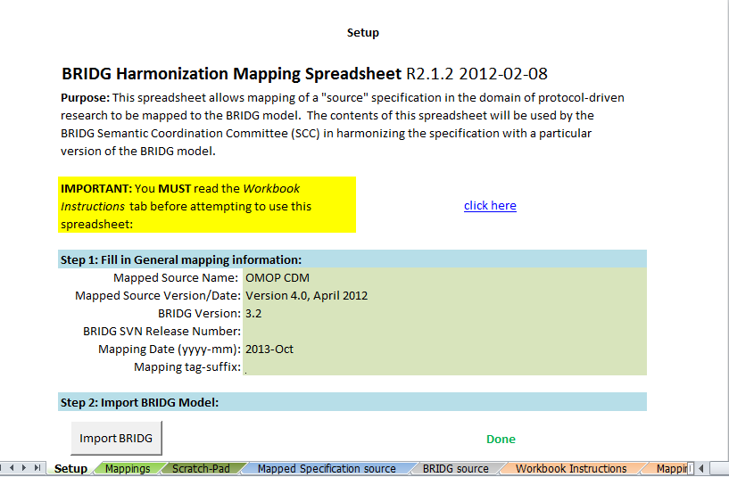
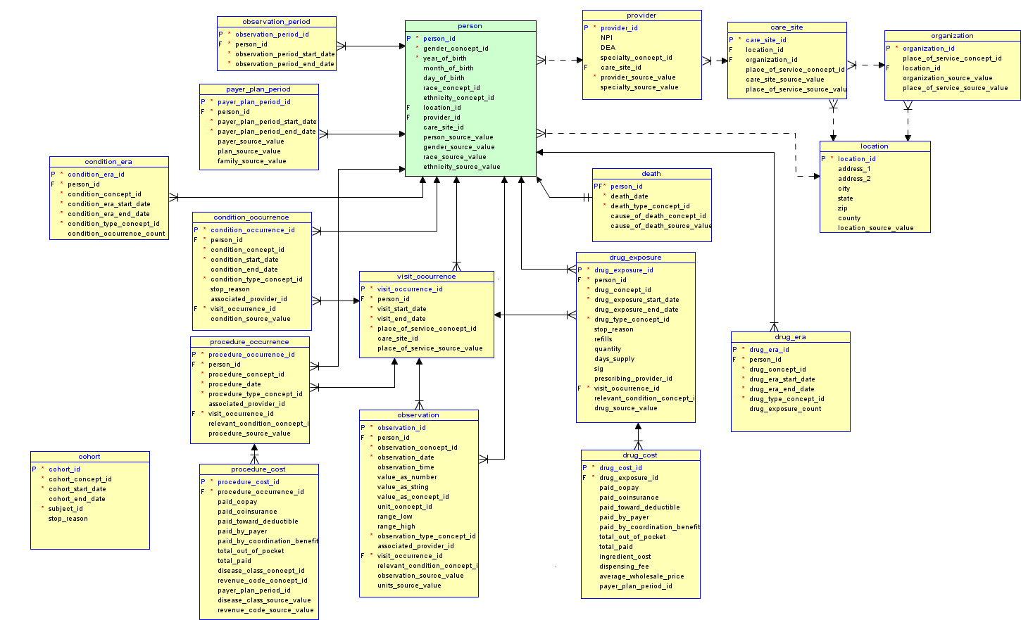
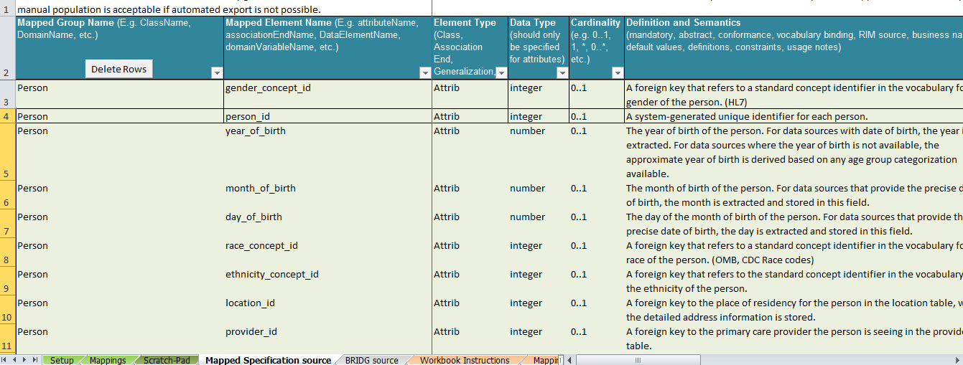
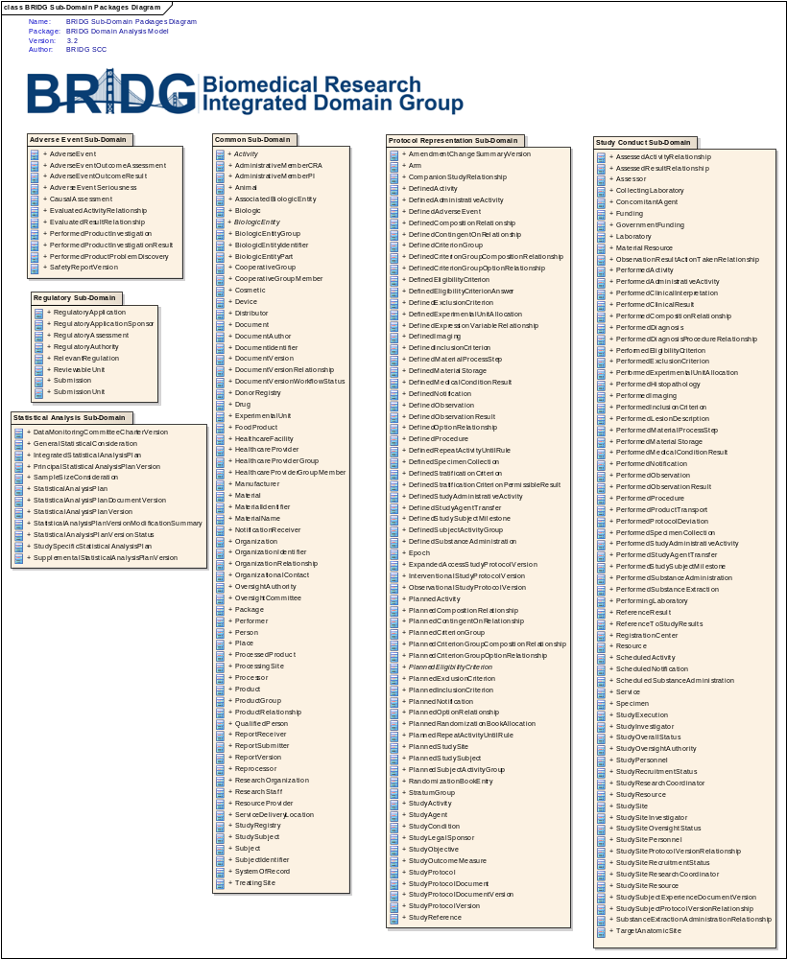
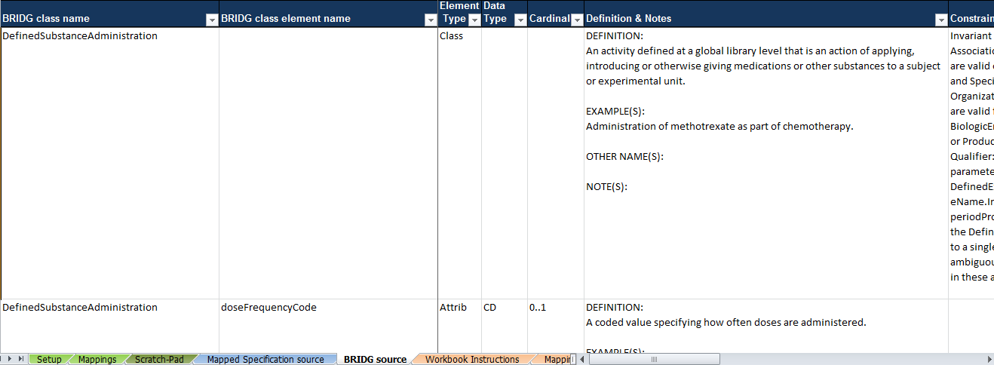
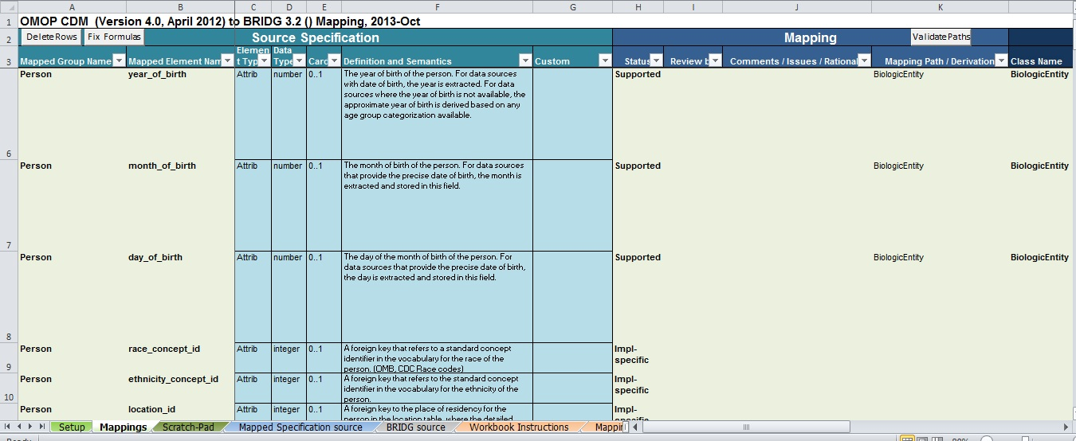
Harmonization of the OMOP Common Data Model with the BRIDG Model
Mitra A. Rocca, Dipl. Inform. Med ¹, Wayne Kubick ², Rebecca Kush, Ph.D. ², Syed Haider ¹, Patrick Ryan ³
¹ Food and Drug Administration, Center for Drug Evaluation and Research, Office of Translational Sciences
² Clinical Data Interchange Standards Consortium
³ Janssen Research and Development
1. INTRODUCTION
2. METHODS
Figure 3 illustrates the mapping process of the OMOP CDM version 4.0 to BRIDG model release 3.2.
3. RESULTS
The Observational Medical Outcomes Partnership (OMOP, http://omop.org) is a public-private partnership designed to protect human health by improving the monitoring of medical, such as drugs or other regulated medical products, for safety and effectiveness. OMOP draws on the expertise and resources of a large community from the pharmaceutical industry, academic institutions, non-profit organizations, the Food and Drug Administration (FDA), and other federal government agencies¹. The OMOP initiative has focused on conducting research to determine the contribution and utility of using existing healthcare databases (administrative claims and Electronic Health Record (EHR) data) to identify and evaluate the effects of medical products. To achieve the research objective, OMOP created a suite of tools, such as a data model, experimental protocols, and database evaluation tools.
As part of the tool set, OMOP initially developed², and now improved and enhanced, a common structure and framework for organizing and standardizing observational data. The updated OMOP Common Data Model (CDM) can accommodate use cases to perform research related to medical treatment outcome studies, including medical device safety, comparative effectiveness, and healthcare quality. This document describes the design and technical specifications of the OMOP Common Data Model (version 4). ¹
The Biomedical Research Integrated Domain Group (BRIDG) Model is a collaborative effort engaging stakeholders from the Clinical Data Interchange Standards Consortium (CDISC), the HL7 Regulated Clinical Research Information Management (RCRIM) Work Group, the US National Cancer Institute (NCI), and the US Food and Drug Administration (FDA). The goal of the BRIDG Model is to produce a shared view of the dynamic and static semantics for the domain of protocol-driven research and its associated regulatory artifacts. This domain of interest is further defined as:
Protocol-driven research and its associated regulatory artifacts: i.e. the data, organization, resources, rules, and processes involved in the formal assessment of the utility, impact, or other pharmacological, physiological, or psychological effects of a drug, procedure, process, or device on a human, animal, or other subject or substance plus all associated regulatory artifacts required for or derived from this effort, including data specifically associated with post-marketing adverse event reporting. ³
This poster will describe the this study is to conduct a mapping between OMOP’s Common Data Model and the BRIDG model.
Various Adverse event models have already been harmonized with the BRIDG model such as ISO/HL7 Individual Case Safety Report (ICSR)/ICH E2BM R3, NIH Basal Adverse Event Reporting System (BAER), Clinical Data Interchange Standards Consortium (CDISC) Study Data Tabulation Model (SDTM) Adverse Event (AE) domain, NCI’s Cancer Adverse Event Reporting System (caAERS). The harmonization between OMOP’s Common Data Model and the BRIDG model will establish the link between prospective clinical research and life sciences studies and retrospective active surveillance studies utilizing observational data such as those carried out by the OMOP investigators. OMOP’s CDM Version 4 standardizes the format and vocabularies used across disparate observational data sources, enabling the application of standardized analytical methods across various data sources.
In order to carry out this study the OMOP CDM Version 4.0 tables and fields were imported into the BRIDG harmonization/mapping spreadsheet and each field in the OMOP CDM Version 4.0 was mapped to classes and elements in the BRIDG model Release 3.2.
Figure 1 illustrates the Entity-Relationship diagram of the CDM data tables and relationships between them.
OMOP CDM Version 4.0 and BRIDG model Release 3.2 were examined and concepts from the OMOP CDM tables and fields were mapped to the BRIDG classes and elements. Some of the fields in the OMOP CDM version 4.0 were not present in the BRIDG model and need to become available in a forthcoming release of the BRIDG model. The BRIDG release 3.2 encompasses various adverse event reporting concepts however the focus has been on spontaneous adverse event reporting concepts and not active drug surveillance leveraging observational data.
4. DISCUSSIONS
We found that the OMOP Common Data Model can be mapped to the BRIDG model. .
The concepts missing in the BRIDG model release 3.2 will become available in a forthcoming release of the BRIDG model.
Harmonizing the BRIDG model with the OMOP CDM will enable linking the protocol driven clinical research artifacts to the post market active surveillance studies.
Figure 1: OMOP CDM Version 4.0 Data Tables and Relationships
Figure 2 illustrates the BRIDG logical model ⁴.
5. REFERENCES
OMOP Common Data Model Version 4.0 Specification, April 2012, http://omop.org/CDM
Overhage JM, Ryan PB, Reich CG et al. Validation of a common data model for active safety surveillance research. J Am Med Inform Assoc. 2012;19:54-60.
3. BRIDG Model Repository. http://www.bridgmodel.org/
4. BRIDG 3.2 Comprehensive Domain Analysis Model, Static Elements Report, Sept. 2012
Figure 2: BRIDG Sub-Domain Packages Diagram
Figure 3: OMOP/BRIDG Harmonization Process

