Slide 1
Unifying Metadata for Stream and Batch Queries in a Cloud Service
Florian Fröse¹, Daniel Bauer, Daniel Pittner, Sean Rooney
IBM Research
¹ now Adobe Research

Slide 2
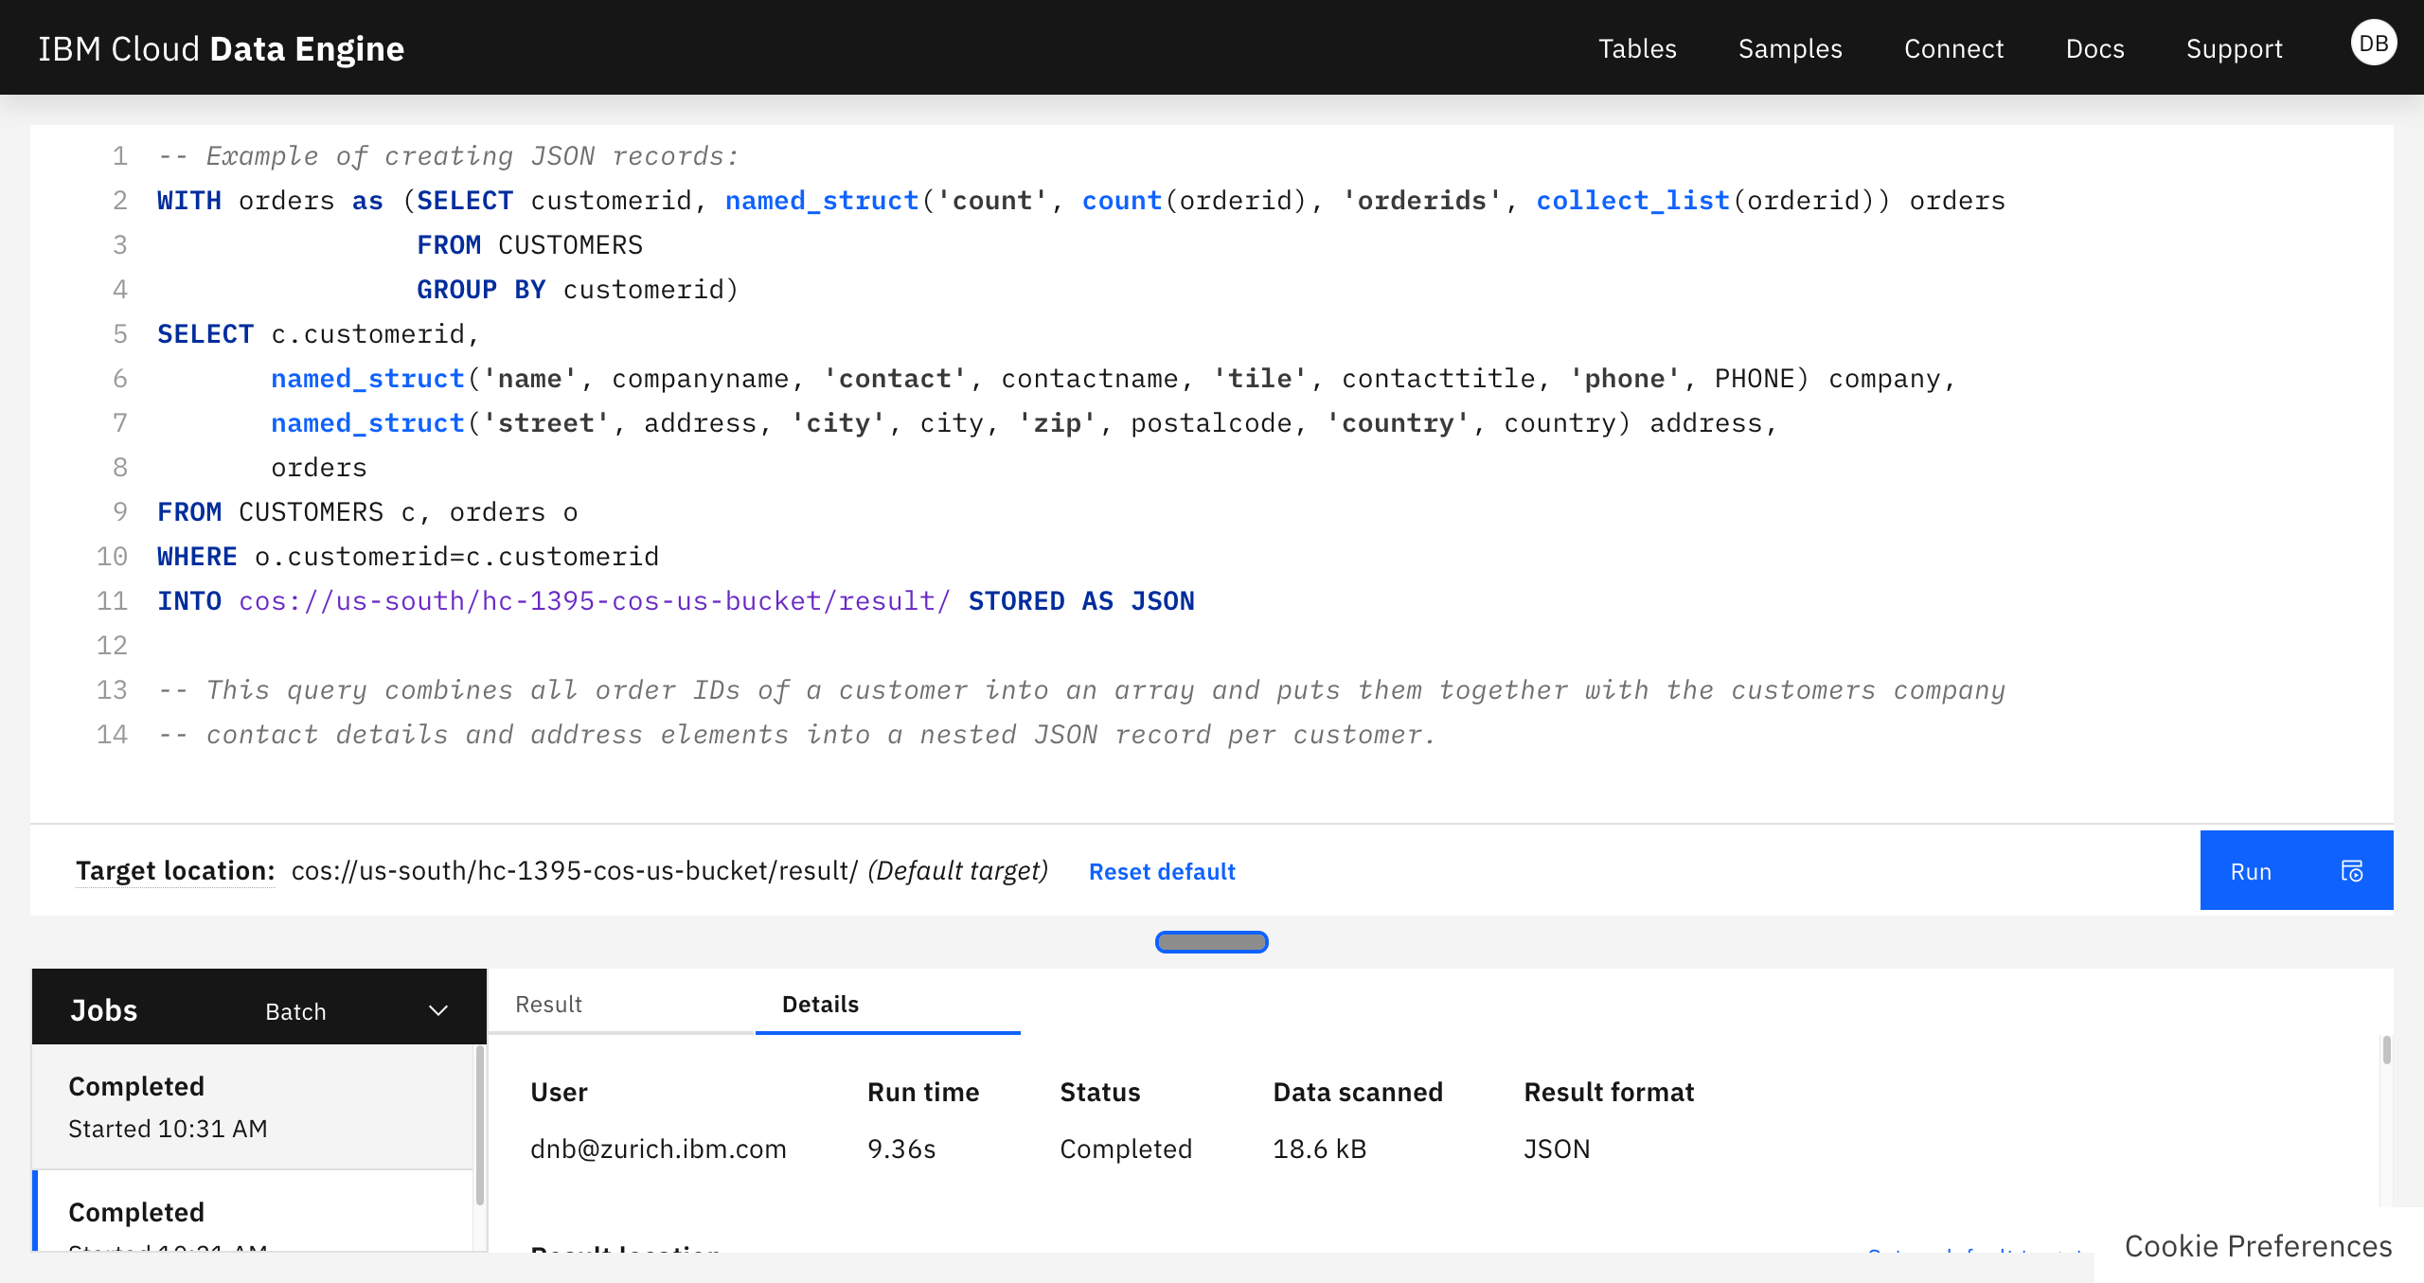

Slide 3
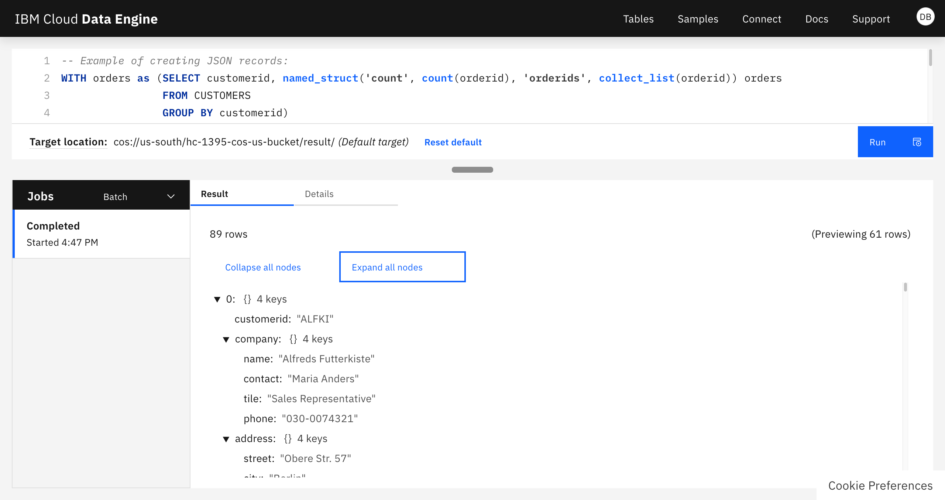
{
"customerid": "ALFKI",
"company": {
"name": "Alfreds Futterkiste",
"contact": "Maria Anders",
"tile": "Sales Representative",
"phone": "030-0074321"
},
"address": {
"street": "Obere Str. 57",
"city": "Berlin",
"zip": "12209",
"country": "Germany"
},
"orders": {
"count": 6,
"orderids": [
10643, 10692, 10702, 10835, 10952, 11011
]
…

Slide 4



Goal: Stream Queries in Data Engine
Change Data Capture (CDC)
Schema Registry
Relational Database
CDC System
e.g. Debezium
Transaction Log
Cloud Data Engine
Cloud Object Store Output Data

Slide 5

Goal: Stream Queries in Data Engine
IoT / Edge Scenario
Schema Registry
Edge System e.g. MQTT Broker
Sensor
Cloud Data Engine
Cloud Object Store Output Data
Cloud Object Store Input Data

Slide 6
Batch Query / Stream Query Differences
Batch Query
Stream Query
Operates on finite data sets
Table schema doesn’t change during query execution
Well defined semantic for aggregation, grouping and joining
Streams are nominally infinite
Schema may change while query is running
Aggregation, grouping and joining defined on “data windows”

Slide 7
Data Engine Architecture for Batch Queries
Web SQL Console
or Application
Hive Metastore Table Definitions
Service API
Job Handler
SQL Query Execution on Apache Spark
Cloud Object Store
Input Data
Cloud Object Store
Output Data

Slide 8

Kafka Control- and Data Flow
Record Schema
Schema Registry
Structure of the Kafka Stream
Record Schema
Kafka Stream
Producer
Kafka Stream Consumer
Publishes Stream of Records
Consumes Stream of Records
Each Kafka message contains the binary encoded record (e.g., Apache Avro) and a reference to the record’s schema

Slide 9
Extension for Stream Queries
Schema Registry
Structure of the Kafka Stream
Web SQL Console
or Application
Registry Proxy
Hive Metastore Table Definitions
Service API
Job Handler
Kafka I/O extensions
SQL extensions Stream job handler
Kafka Stream
Producer
SQL Query Execution on Apache Spark
Kafka I/O extensions
Kafka Topic Stream of Records
Cloud Object Store
Output Data

Slide 10
Handling Schema Evolution
Hive Metastore
Reader’s schema
Writer’s schema
name: string addr: string
Executor detects schema change
For compatible changes, records are mapped to the existing reader’s schema
For incompatible changes, query execution is aborted with an error
name: string addr: string age: integer
Kafka Stream
Producer
SQL Query Execution on Apache Spark
Cloud Object Store
Output Data
Kafka Topic Stream of Records

Slide 11
Summary and Conclusion
Extended Data Engine, a cloud data analytics service, with support for Kafka based data streams
Use Hive Metastore as common repository to describe batch- and stream data sources
Integrate Kafka producers using a transparent schema registry proxy
Support forward-compatible schema evolution without interrupting running stream queries
Leverage Apache Spark as a versatile data processing engine

