Slide 1
From parsing, to query processing, to resiliency: Deriving unexpected value from database technology through componentization
Speaker: Jonathan Goldstein
Many drivers and contributors to all the projects mentioned here
Microsoft Research

Slide 2
Why componentize DBMS technology/components?
The expected: Agility – In a fast-changing world, we need to evolve our systems quickly to try them in the marketplace
Capabilities can be exploited and optimized while minimizing assumptions about the surrounding system
Stacks can be evolved more easily
SQL Server was once Sybase, but because of excellent internal componentization, it incrementally evolved into an entirely new database product
The unexpected: Code Reuse Across multiple projects/products:
Functionality can be added to multiple larger user-facing systems
Optimizing one component has positive performance consequences for many projects
Used in situations where a DBMS would never be used

Slide 3
What I’ll cover in this talk
Identify a number of components inside a DB server which we’ve componentized
Cover the independent value proposition of each component
Talk a bit about our technology
Reflect on use cases
Wrap up the talk with lessons learned

Slide 4
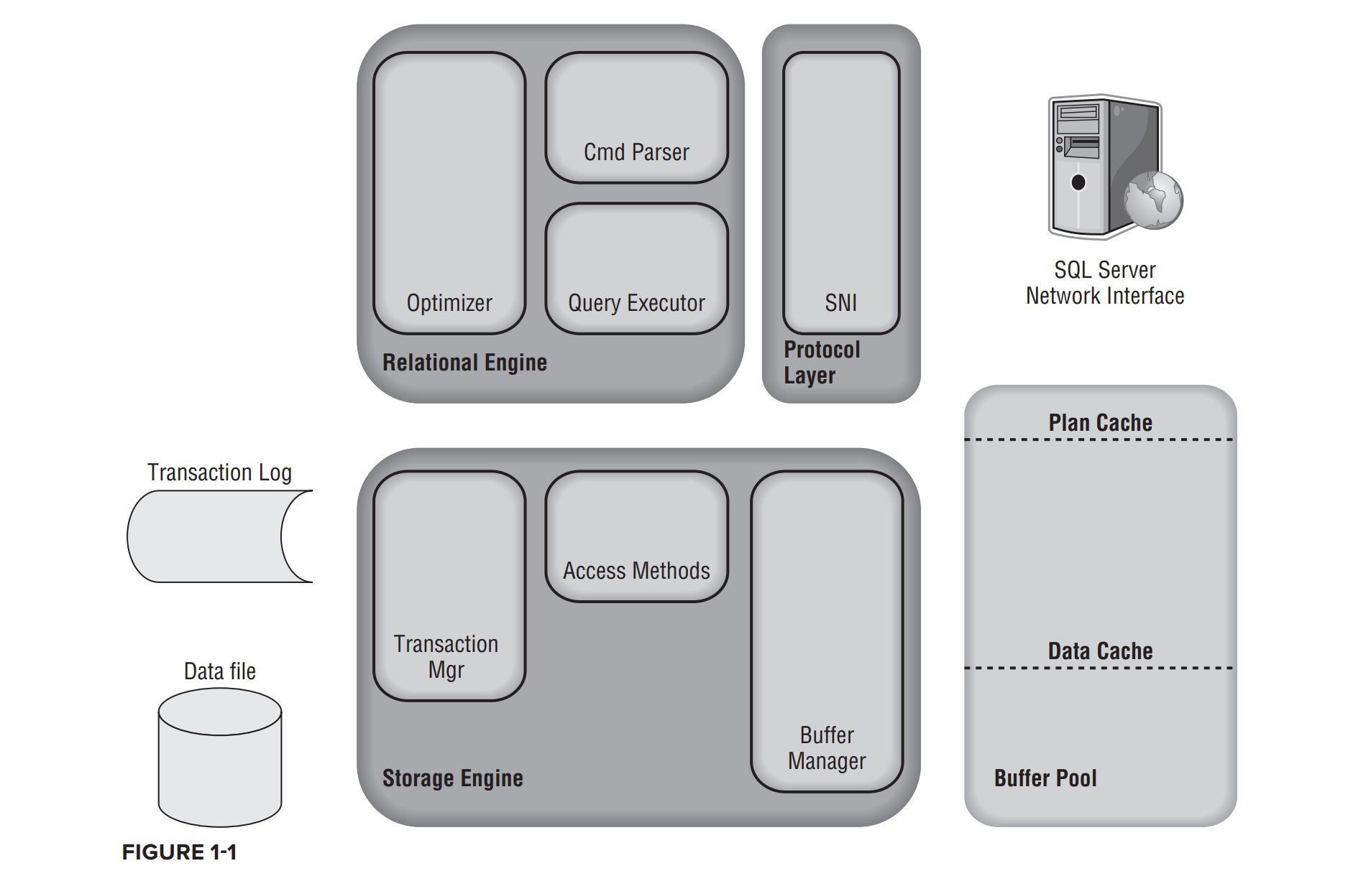
DB Server Architecture
Mison
Trill
Ambrosia
From “SQL Server Internals” excerpts:
https://catalogimages.wiley.com/images/db/pdf/9780470484289.excerpt.pdf

Slide 5
Mison (Data Parser)

Slide 6
Why is efficient parsing important?
Proliferation of text data born from non-DB applications and logs
Not reliably schematized
Popular formats include JSON and CSV (both supported by Mison)
A wealth of products used to process text data
Map-Reduce based tools like Hadoop and Spark
Data warehousing tools like Azure Synapse Analytics, AWS Athena, and Big Query
Data visualization tools and notebooks like Power BI and Jupiter
Input data used in many Python ML pipelines

Slide 7
Why is efficient parsing important (in Spark SQL)?
>90% time is on parsing!

Slide 8
Mison Technology
Filter and projection push-down
Especially designed for data analytics applications
Build structural index on-the-fly (like metadata in binary formats)
Quickly jump to requested fields
Exploit data parallelism
Char size: 1 byte, CPU word size: 8 bytes or 32 bytes (SIMD)
Process a vector of chars in each instruction
SIMD vectorization (for data-independent operators)
Bitwise parallelism (for data-dependent operators)

Slide 9
Filter and Projection Push-down
Observation: Applications typically only make use of certain fields, rather than all fields.
Example: select a1,a4 from R where a1.StartWith(‘1’)
a1 | a2 | a3 | a4 | a5 | a6
a1 | a2 | a3 | a4 | a5 | a6
a1 | a2 | a3 | a4 | a5 | a6
row1 row2
.
.
.
.
.
.
rowN
row1 row2
.
.
.
.
.
.
rowN
row1 row2
.
.
.
.
.
.
rowN
Ideal
FSM parser
Mison
Heavy CPU work
Light CPU work
No CPU work

Slide 10
Case Study: Query Raw Data Using Spark SQL
Mison
Spark SQL (with Jackson Parser)
~10X faster in parsing
5-10X faster in overall performance
Parsing is not the dominant operation anymore

Slide 11
Mison Impact
Azure Synapse Analytics
Azure Storage
Cosmos
10+ parsers based on Mison techniques on GitHub:
simdjson: open source JSON parser
incorporates Mison’s techniques
#2 monthly trending project on GitHub (Feb 2019)
>15K stars on GitHub

Slide 12
Trill (Query Processor)

Slide 13
QP as a technology value proposition: What QP is for
Traditional DB workloads: (OLTP/HTAP/OLAP)
Potentially complex relational queries over static data
Require high performance
Real-time relational streaming workloads:
Potentially complex relational standing queries over changing temporal data
Requires the integration of temporality into query semantics:
Time windows over time stamped data
Semantic and algorithmic integration with tradition signal processing like FFT
Off-line temporal workloads:
One shot queries over static temporal data
Requires high performance
Requires the same integration of temporality into query semantics as real-time
Off-line approximate query answering with revisions
Easily done with the right kind of temporal integration
Requires high performance
Frequently desirable to integrate this functionality into non-DB products:
Data visualization tools
Moving computation around in IOT scenarios
Computing KPIs within applications

Slide 14
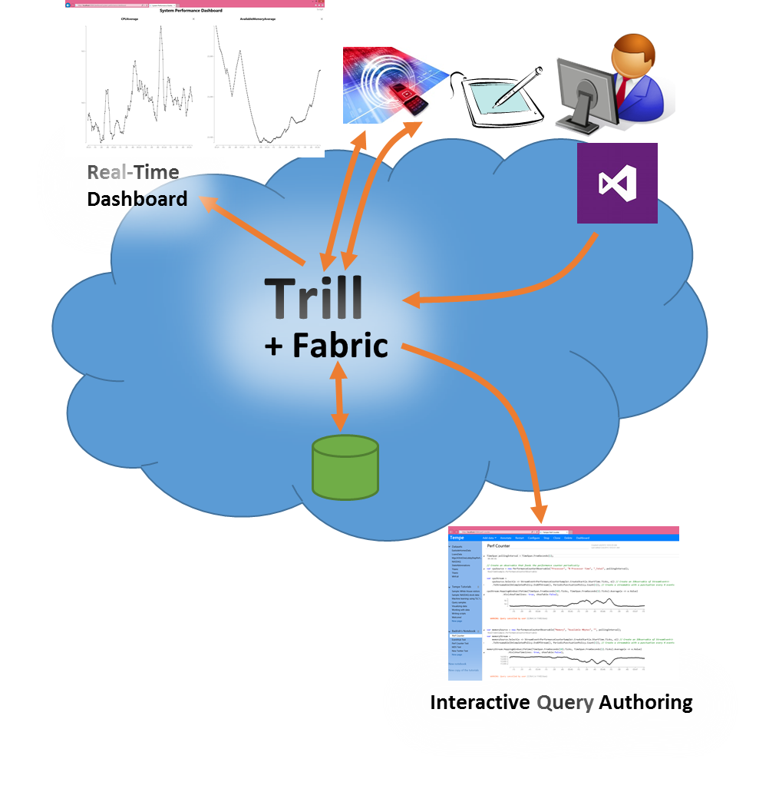
Trill: Fast Streaming Analytics Library
Query model
Expressiveness > SQL, based on CEDR model
Supports patterns and augmented automata
Supports digital signal processing (not in official release)
Performance
2-4 orders of magnitude faster than first wave SPEs
For relational, comparable to columnar DBMS
Easy integration with FASTER for larger than memory query state
Fabric & language integration
Built as high-level language (HLL) library component
Extended LINQ syntax
Works with arbitrary HLL data-types & libraries
MS supported open-source project at: https://github.com/Microsoft/Trill

Slide 15
On Trill’s Query Semantics
A Key insight:
Windowing logic composes much more cleanly if windowing is a property of the data rather than a query context
Example: Calculate a 10 minute moving count of the number of rows produced by joining streams A, and B, where each row from A can join with any row from B which occurs within 10 seconds after A occurs
var joinResult = A.AlterEventDuration(TwentySeconds).Join(
B.AlterEventDuration(OneTick), (e1, e2) => ...);
var windowedCountResult =
joinResult.AlterEventDuration(TenMinutes).Count();

Slide 16
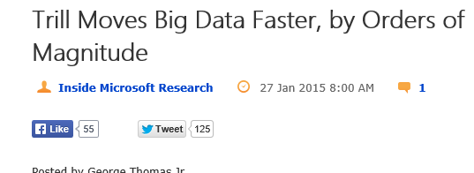
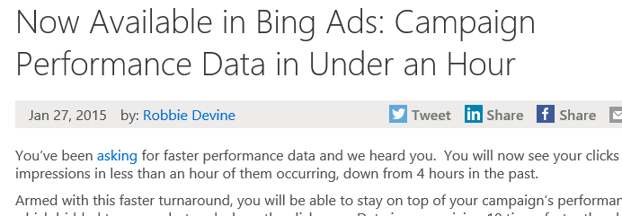
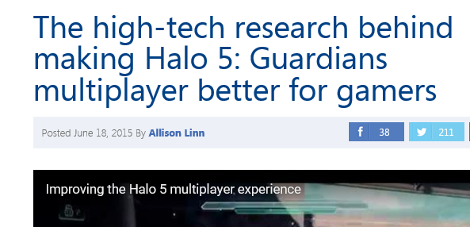

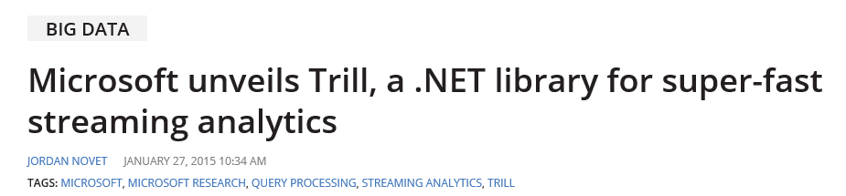
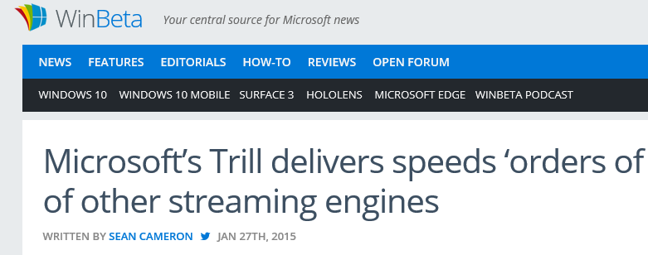

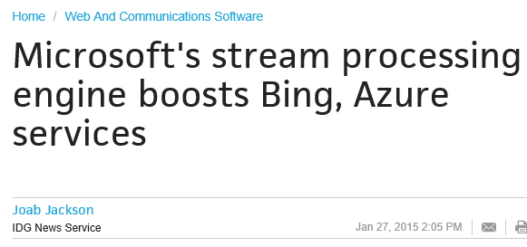
Used Across Microsoft
Azure Stream Analytics service
Bing Ads
Office, Exchange, Windows
Halo game monitoring & debugging
Key enabler: performance + fabric & language integration + query model

Slide 17
Ambrosia (Resiliency Framework)

Slide 18
Resiliency as a value proposition
Resiliency is the ability for a, possibly distributed, computation to survive failure and/or migration according to some notion of correctness
DBs define failure semantics relative to transaction commit notification, and use log-based recovery to enforce them
Given the variety of devices employed at the edge, migration is an assumed capability of today’s applications
Stateless – Banking applications
Need to avoid leaking non-durable side effects to users (i.e. commits must be durable on notification)
Stateful – Migratable multiplayer role-playing games which speculate and compensate
Almost all applications, in addition to partially running on a device, also span multiple machines in the cloud, all of which can fail or become stranded. Programming against this is extremely painful. Components include:
Messaging components like Kafka and Service Bus
Compute components like Azure Functions
Cloud DB components like SQL Azure and Cosmos DB

Slide 19
Core idea
Make all local (to a VM) computation deterministically recoverable through logging and replay (a.k.a. command logging)
Wrap all communication in libraries which exploit the deterministic recoverability of computation to completely mask failover and migration
Use a virtually resilient object-oriented programming model where the commands which are logged are RPC calls on the methods (.NET programming framework and runtime)
Ambrosia Runtime
In Message
Out Message

Slide 20
Ambrosia To The Rescue!
Having a log is great! Look at all the cool toys!
Recover from checkpoints + interaction log – like DBs
Can use active standbys to guarantee high availability – like log shipping DBs
Free time travel debugging – because we are command logging
Historical What-if testing – because we are command logging
Problems which we solved along the way using DBMS tech/components
Non-determinism
Like DBMSs, Ambrosia immortals can be non-deterministic, but must be deterministically recoverable
Performance
We incorporate high performance logging technology from modern DBMSs
Like streaming systems (e.g. Trill) and DB logging, batching is used extensively to effectively navigate the throughput/latency tradeoff throughout

Slide 21
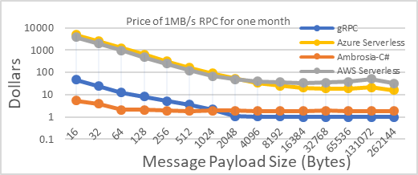
Ambrosia results
We have about an order of magnitude higher throughput than gRPC (C++). Both latency and cost are dramatically lower than cloud function solutions
We have applications that can be transparently migrated, in real time, across clients, servers, and even operating systems and architectures

Slide 22
Ambrosia Impact & Reflection
Internal services
Influenced Azure Durable Functions
Open source release
https://github.com/Microsoft/AMBROSIA
Ambrosia is a different kind of componentization than Mison and Trill, as it refactored parts of the DBMS:
Server logging and recovery component
Parts of the server management component and distributed runtime which includes failover and log shipping

Slide 23
Lessons Learned

Slide 24
What were our biggest challenges?
Ruthlessly eliminating the impulse to be “extra helpful”
Jonathan’s Minimalist Observation ☺: Every choice to solve a problem in a particular way makes your component useless to those that don’t want it solved that way. Note that this effect is exponential
Jonathan’s Minimalist Rule: Solution = opinion. Only solve problems which are part of the core value of your component. Don’t be unnecessarily opinionated:
Unlike StreamInsight, Trill was a passive library, not a server
Mison only incorporates the portion of query processing which is advantageous to include in the parser (filters)
Ambrosia is opinionated about how logic is structured/expressed (hmmm ☺)

Slide 25
What were our biggest challenges?
APIs matter – The complexity of explaining how to use a component must be commensurate with the value of the component:
Mison has a narrow API, narrow functionality, and broad utility
Trill has a broad API (bigger than traditional SQL queries!), but is useful for solving many very complex problems. The breadth of problems solved makes it worth learning, like SQL
Ambrosia has a narrow API, but a subtle contract with the application writer. In particular, non-deterministic application logic must be handled in a particular, careful, way. However, it solves difficult and important problems

Slide 26
What were our biggest challenges?
The pathway to successful componentization isn’t always clear at first:
CEDR -> StreamInsight -> Trill (took 10 years total)
Ambrosia -> <coming soon>
When we failed to attract internal customers, the culprit was usually some combination of needing to better employ Jonathan’s Minimalist Rule and creating an API which is hard to explain
We never had to make a business case for componentizing, just an engineering one. Others in the workshop with the necessary experience will hopefully comment on the business model challenges

Slide 27
A big thank you to my many collaborators ☺

