Slide 1
Velox: Meta’s Unified Execution Engine
CMDS 2022
Pedro Pedreira - pedroerp@fb.com
Software Engineer
8/19/22

Slide 2
Agenda
Motivation
Overview
Use Cases
Library Components

Slide 3
Motivation

Slide 4








User Workload Variety
Analytics
Realtime
Graph
Monitoring
Transactional
ML
…?
Notes:
We’re coming from a place where we have a large variety of user workloads to serve. We have …
… and more recently a set of ML workloads that
are quickly becoming the largest consumer of data
are make us re-thinking how we build data systems.
and user needs are likely to evolve in the future

Slide 5
Engine Specialization
“One size does not fit all”
Analytics
Realtime Infra
Graph
Monitoring
Transactional
ML
Presto
Spark
Saber
Cubrick
XStream
Scribe
FBETL
DIGraph
Scuba
ODS
Logarithm
MySQL
RocksDB
XSQL
TorchArrow/PyTorch
F3
Koski
Notes:
The traditional way of address this issue is by focusing on engine specialization, which means …
This is just a subset of the engines available, just to illustrate … but there are many many more

Slide 6
Engine Specialization
The flipside
Very limited reusability.
Duplicates efforts and forces engineers to reinvent the wheel.
Hard to maintain and enhance.
Where do we optimize?
Exposes inconsistencies to end-users.
Hurts our capacity to move fast and innovate.
Analytics
Realtime Infra
Graph
Monitoring
Transactional
ML
Presto
Spark
Saber
Cubrick
XStream
Scribe
FBETL
DIGraph
Scuba
ODS
Logarithm
MySQL
RocksDB
XSQLm
TorchArrow/PyTorch
F3
Koski
Notes:
Even though there’s similarity between these engines, reusability is still very limited.
It forces us to duplicate …

Slide 7

Through the Looking Glass
Different, but not really…
 | Presto | Spark | XStream | Scuba | Cubrick | Koski | F3
Language Frontend | Presto SQL | HQL / DataSet API | UPM | Scuba SQL | Cubrick SQL | Koski DataFrame | F3 DSL
IR | Presto IR | Spark IR | UPM IR | Scuba IR | Cubrick IR | Koski IR | F3 IR
Optimizer | Presto Optimizer | Catalyst | XStream Optimizer | Scuba Optimizer | Cubrick Optimizer | Koski Optimizer | F3 Optimizer
Execution Runtime | Presto Runtime | Spark Runtime | XStream Runtime | Scuba Runtime | Cubrick Runtime | DPP | -
Execution Engine | Presto | Spark | XStream Codegen | Scuba | Cubrick | Koski | F3 DAG
Notes:
So Velox is an effort at unifying these execution engines into a single consistent and shared library

Slide 8
Through the Looking Glass
Different, but not really…
 | Presto | Spark | XStream | Scuba | Cubrick | Koski | F3
Language Frontend | Presto SQL | HQL / DataSet API | UPM | Scuba SQL | Cubrick SQL | Koski DataFrame | F3 DSL
IR | Presto IR | Spark IR | UPM IR | Scuba IR | Cubrick IR | Koski IR | F3 IR
Optimizer | Presto Optimizer | Catalyst | XStream Optimizer | Scuba Optimizer | Cubrick Optimizer | Koski Optimizer | F3 Optimizer
Execution Runtime | Presto Runtime | Spark Runtime | XStream Runtime | Scuba Runtime | Cubrick Runtime | DPP | -
Execution Engine | Presto | Spark | XStream Codegen | Scuba | Cubrick | Koski | F3 DAG
All very similar!
Notes:
So Velox is an effort at unifying these execution engines into a single consistent and shared library

Slide 9


Through the Looking Glass
Different, but not really…
 | Presto | Spark | XStream | Scuba | Cubrick | Koski | F3
Language Frontend | Presto SQL | HQL / DataSet API | UPM | Scuba SQL | Cubrick SQL | Koski DataFrame | F3 DSL
IR | Presto IR | Spark IR | UPM IR | Scuba IR | Cubrick IR | Koski IR | F3 IR
Optimizer | Presto Optimizer | Catalyst | XStream Optimizer | Scuba Optimizer | Cubrick Optimizer | Koski Optimizer | F3 Optimizer
Execution Runtime | Presto Runtime | Spark Runtime | XStream Runtime | Scuba Runtime | Cubrick Runtime | DPP | -
Execution Engine | Presto | Spark | XStream Codegen | Scuba | Cubrick | Koski | F3 DAG
All very similar!
Notes:
So Velox is an effort at unifying these execution engines into a single consistent and shared library

Slide 10


Slide 11
Velox Mission
Converge, Accelerate, and Unify execution engines across Meta and beyond
Notes:
With that said, Velox’s mission is to…

Slide 12
How?
#1 - Develop a shared library
#2 - Define common data processing APIs
#3 - Integrate with data management systems
Notes:
We’re doing that by …

Slide 13
Velox Library Overview
A generic C++ database acceleration library.
Generic APIs: from batch to interactive, to stream processing, to AI/ML workloads.
Key Concepts: Modularity and Extensibility.
C++: native code for maximum efficiency
10x cpp vs. java win (TPC-H Q1 and Q6 microbenchmarks).
Vectorized: leverage data and instruction-level parallelism
State-of-art
Centralize all optimizations implemented in current engines.

Slide 14
Velox Library Overview (2)
Database acceleration library vs. DBMS.
Velox takes a fully optimized physical plan as input.
No frontend (SQL parser or dataframe layer)
No global optimizer.
Though there’s tons of adaptivity.
Velox sits on the data-path
Everything that runs on a single server.
No control plane.

Slide 15
Velox - Value Proposition
01
Efficiency and Latency
02
Consistency and Consolidation
03
Reusability

Slide 16
Use Cases

Slide 17
Velox - Use Cases
Analytics:
Presto/Prestissimo - interactive
Spark/Spruce/Gluten - batch
Saber - external analytics
Realtime Infrastructure:
XStream - stream processing
FBETL/Morse - data warehouse and database ingestion
Scribe - log messaging system
Transactional:
XSQL - distributed transaction processing
Machine Learning:
TorchArrow/PyTorch - data preprocessing
F3 - feature engineering
XLDB/Koski - training

Slide 18

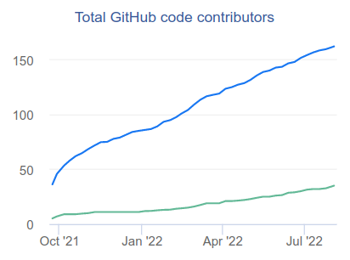
Velox - Open Source
Publicly announced last week!
https://engineering.fb.com/2022/08/31/open-source/velox/
Available in github:
https://github.com/facebookincubator/velox
Fast growing open source community
+150 developers
Meta, Ahana, Intel, Voltron Data, …
# of contributors

Slide 19
Velox Library
Under the hood
Notes:
now that we talked about what are the motivations and what Velox is, let’s dive into specifics

Slide 20
Velox Library - Components Outline
Types:
Scalar and nested data types, including structs, maps, arrays, tensors, and more.
Vectors:
An “Arrow-compatible” columnar memory layout module.
Expression Eval:
Fully vectorized expression evaluation engine built based on Vector-encoded data.
Functions:
APIs for custom scalar (row-by-row and batch-by-batch) and aggregate functions.
Operators:
Common data processing SQL operators (OrderBy, GroupBy, HashJoin, etc).
I/O:
Pluggable file format encode/decoder, storage adapter, and network serializers.
Resource Management:
Memory pools, arenas, thread/tasks, spilling, SSD and memory caching.

Slide 21
Vectors

Slide 22
Velox Library - Vectors
Memory layout similar to Arrow, but 3 main differences:
More encodings (Constant and RLE).
Custom fixed-width string encoding – StringView
Support for out-of-order writes:
Speed up execution of conditionals
Modified encoding for complex types.
“Arrow++”
Arrow C ABI interoperability layer.
Extensions proposed to the Arrow community:
https://lists.apache.org/thread/49qzofswg1r5z7zh39pjvd1m2ggz2kdq

Slide 23
Vectors - Flat Vector
(optional) Nulls buffer - 1 bit per value: 0 = null, 1 = not null
Values buffer – type-specific fixed number of bytes per value
BIGINT – 8 bytes
INTEGER – 4 bytes
SMALLINT – 2 bytes
TINYINT – 1 byte
BOOLEAN – 1 bit per value
DOUBLE – 8 bytes
FLOAT – 4 bytes
VARCHAR, VARBINARY – 16 bytes
Vectors and Buffers own memory and can be shared and reused safely
nulls
values

Slide 24
Vectors - Flat String Vectors
Based on Umbra: A Disk-Based System with In-Memory Performance paper
16 bytes per string.
4-byte size + 4-byte prefix + 8-byte pointer to external buffer
Variable-width vector effectively becomes fixed-width (16 bytes each)
Can now be written out-of-order
Short strings (up to 12 bytes) are inlined
Short-circuit comparisons based on prefix
More flexibility for string manipulation functions
trim, substr, …
nulls
values
stringBuffers
struct StringView {
uint32_t size_; char prefix_[4]; union { char inlined[8]; const char* data; } value_;
}

Slide 25
Vectors - Array and Map Vectors
Include both offsets and sizes
32-bit integers
Support out-of-order writes
if (a % 2 = 0, arrayColA, arrayColB)
#1. Condition is evaluated
Generates a bitmask.
#2. Then clause is evaluated
Results from arrayColA are written to the output vector.
#3. Else clause is evaluated
Results from arrayColB are written to the output vector.
nulls
offsets
sizes
elements vector
nulls
offsets
sizes
keys and values vectors

Slide 26
Vectors - Dictionary Vector
nulls
indices
Dictionary
values vector
(optional) Nulls buffer
Indices buffer
32-bit integers
Dictionary values vector (base vector)
Dual use
Compact representation of repeated values
Zero-copy representation of:
cardinality reducing (filter, selective join)
cardinality increasing operation (unnest, join)
Produced by the ORC/Parquet reader for columns that are dictionary encoded on disk

Slide 27
Vectors - Lazy Vector
Vectors that only get populated upon first use.
Useful in cardinality reduction operations
Depending on the operation’s selectivity, can entirely avoid materialization.

Slide 28
Expression Evaluation

Slide 29
Velox Library - Expression evaluation
Evaluate expressions in a vectorized manner.
Takes an expr tree as input.
Use cases:
FilterProject operator.
TableScan (predicate pushdown).
Standalone component depending on engine needs.

Slide 30
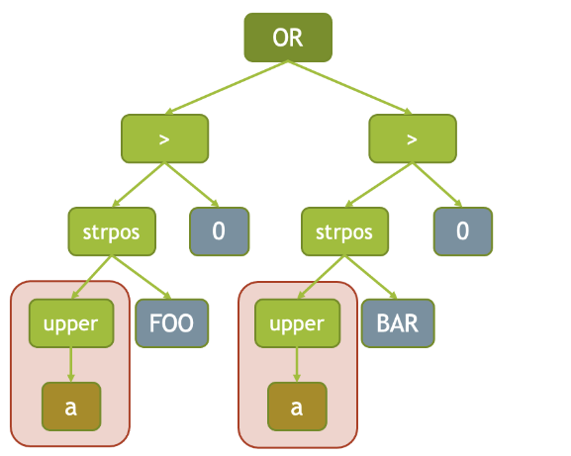
Velox Library - Expression evaluation
Compilation:
Constant folding:
upper(a) = upper(‘Foo’) => upper(a) = ‘FOO’
Conjunct flattening (for Adaptive Conjunct Reordering):
AND(AND(AND(a, b), c), AND(d, e)) => AND(a, b, c, d, e)
Common subexpression elimination
strpos(upper(a), ‘FOO’) > 0 OR strpos(upper(a), ‘BAR’) > 0

Slide 31
Velox Library - Expression evaluation
Execution:
Recursive descent of the expression tree, passing down a row mask identifying the active rows
On each step, evaluation is avoided if:
if the current node is a common subexpression
any of the inputs are null (and node propagates null)
a
b
a
b
a
b
0
0
0
0
0
0
rows:
0…5
rows:
1,3,4
6
1
6
1
6
1
AND(GT(a, 5), LE(b, 3))
a > 5
b <= 3
1
2
1
2
1
2
7
3
7
3
7
3
8
4
8
4
8
4
3
5
3
3

Slide 32
Velox Library - Expression evaluation
Execution:
Recursive descent of the expression tree, passing down a row mask identifying the active rows
On each step, evaluation is avoided if:
if the current node is a common subexpression
any of the inputs are null (and node propagates null)
Encoding peeling:
If inputs are dictionary-encoded, compute only considering distinct values.
And memoization:
Reuse results if dictionary wrapping are the same.

Slide 33
Experimental
Results

Slide 34
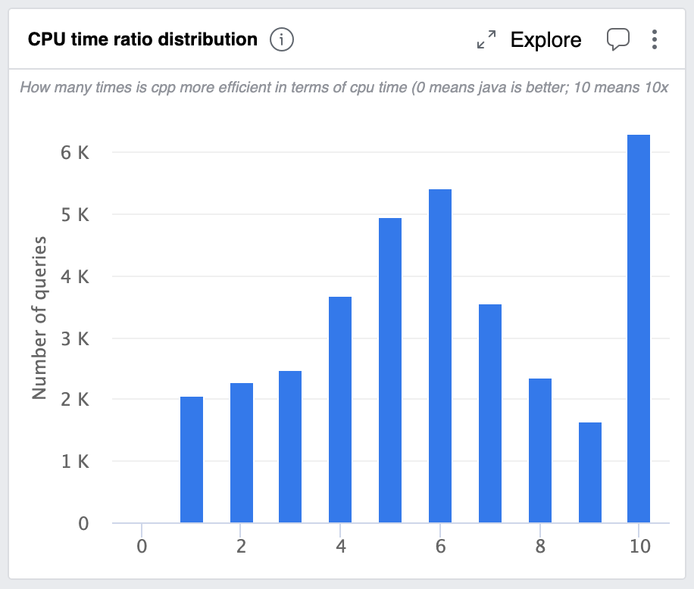
Presto/Prestissimo Results
Prestissimo is 10+x
more efficient
Prestissimo is 6-7x
more efficient

Slide 35
Conclusion

Slide 36
Conclusion
It is possible to converge execution across different specialized engines.
Doing so in open-source can benefit the entire industry.
Future work:
Continue blurring the boundaries between Analytics and ML.
Software and hardware co-evolution.
Further componentization of the stack.
More collaboration with academia.

Slide 37
Thank you!

Slide 38
Q/A

