Slide 1
The Gluten Open-Source Software Project: Modernizing Java-based Query Engines for the Lakehouse Era
Presenter: Akash Shankaran
Authors: Akash Shankaran, George Gu, Weiting Chen, Binwei Yang, Chidamber Kulkarni, Mark Rambacher, Nesime Tatbul, David E. Cohen
Intel Corporation
Notes:
Intel led OSS effort with community partners such as Velox/Meta, Substrait and Arrow.
Gluten optimizes performance of Java based query engines, such as Spark

Slide 2
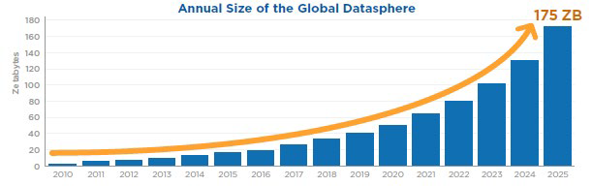
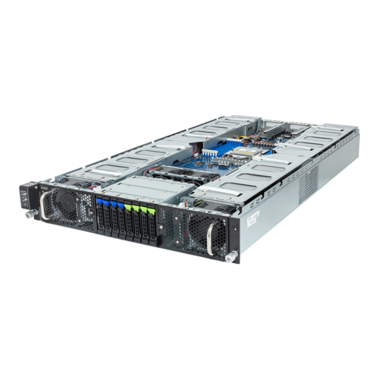
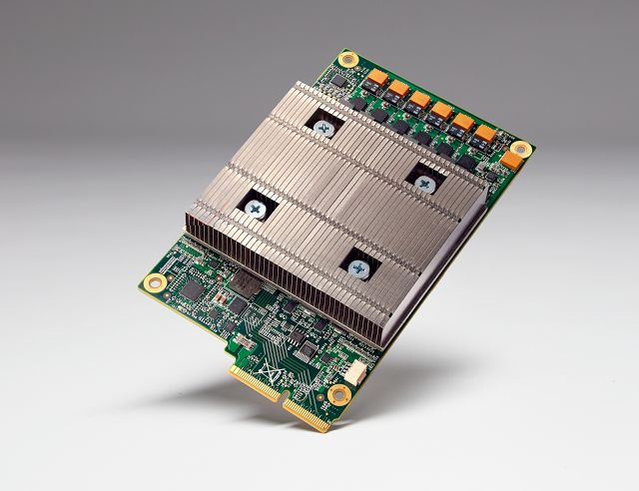
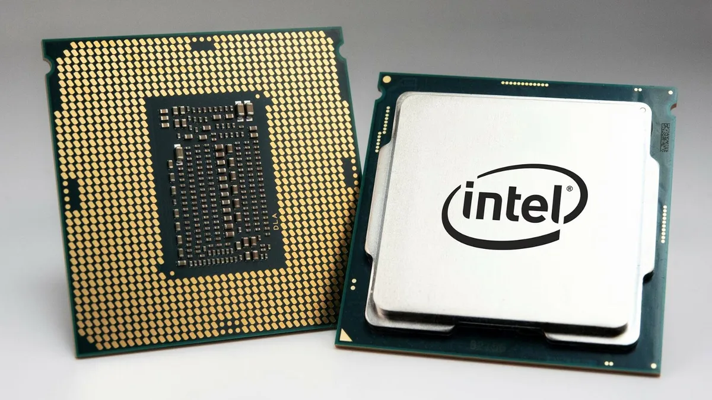
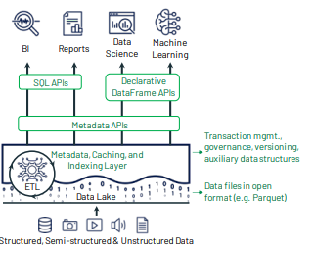
Background – Disruptive Trends
Exponential growth in compute demand, largely driven by data supporting machine learning (ML), training models.
Such data is increasingly processed over custom, heterogeneous hardware: CPUs, GPUs, TPUs, FPGAs, etc.
Data lakehouses: Rise of open table formats, decouple query engine from storage, ability to perform mutable transactions on tables.
https://www.i-scoop.eu/big-data-action-value-context/data-age-2025-datasphere/
https://www.cidrdb.org/cidr2021/papers/cidr2021_paper17.pdf
Notes:
Data mostly in support of machine learning (ML), training models and eventually serving these to personalize digital content.
Motivation of why GPUs, TPUs, FPGAs etc. – there is a motivation to reduce costs in dc, drive avg utilization higher, pressure to move adjacent workloads to GPUs.
GROWTH IN DATA
GROWTH IN HARDWARE PROCESSING POWER
INNOVATION IN DATA MANAGEMENT ARCHITECTURE
Data lakes – stores raw, unstructured data on disaggregated storage.
Data warehouse – stores structured, filtered data for specific purpose.
Lakehouse Data management capabilities – disaggregation of log-structured storage from compute servers, independent scaling of storage from compute, ingest data using supported serialization format e.g. Parquet.
What are the data management capabilities of a Lakehouse deployment?
1. Disaggregation of log-structured storage from the compute servers. This allows independent scaling of the storage and compute resources.
2. Ingestion of any type of data into the Lakehouse using a supported serialization format (Apache Parquet)
3, Mutable tables - allowing for transactional updates, schema modifications, etc.
4. Projected data from lakehouse into downstream services (analytic services such as SQL query engines, search systems, stream processors, query editors, notebooks, and machine learning (ML) models through direct access, real-time, and batch workflows).

Slide 3

Motivation – SparkSQL as a Service
SparkSQL has been an engine of innovation in this market.
The shift towards lakehouses has created opportunities for SparkSQL-as-a-Service providers.
Motivation for an open-source initiative (Gluten):
The Photon solution is not available to the Spark community.
Due to scale/TCO for above customers, the Delta Lake approach is not feasible.
For external customers: Hyperscalers: Amazon EMR, Azure Synapse, Google Dataproc, Alibaba EMR, etc. Databricks (available on all public clouds) | For internal constituents: Pinterest, Meituan, Netflix, Stripe, etc. Operates at a scale that rivals the hyperscalers.
Notes:
Motivation for gluten:
1. Delta lake approach is not feasible for such customers given scale/TCO, and that forces innovation/alternatives.
2. DBR takes photon private. => Opensource counterpart for Photon needed.
Databricks bringing the lakehouse architecture provides performance and efficiency advantages, and at the same time changes dynamics of the Spark community.
Why Gluten?
Transform Spark into a vectorized SQL engine to break through row-based data processing and JVM limitations.
Current solutions:
Databricks (proprietary photon acceleration library)
Nvidia (spark-rapids targeted for NVidia hardware)
Intel (Gluten – open-source initiative, *targeted for heterogeneous hardware)
relies on other Apache licensed OSS projects – Velox, Arrow, Substrait.io etc.

Slide 4
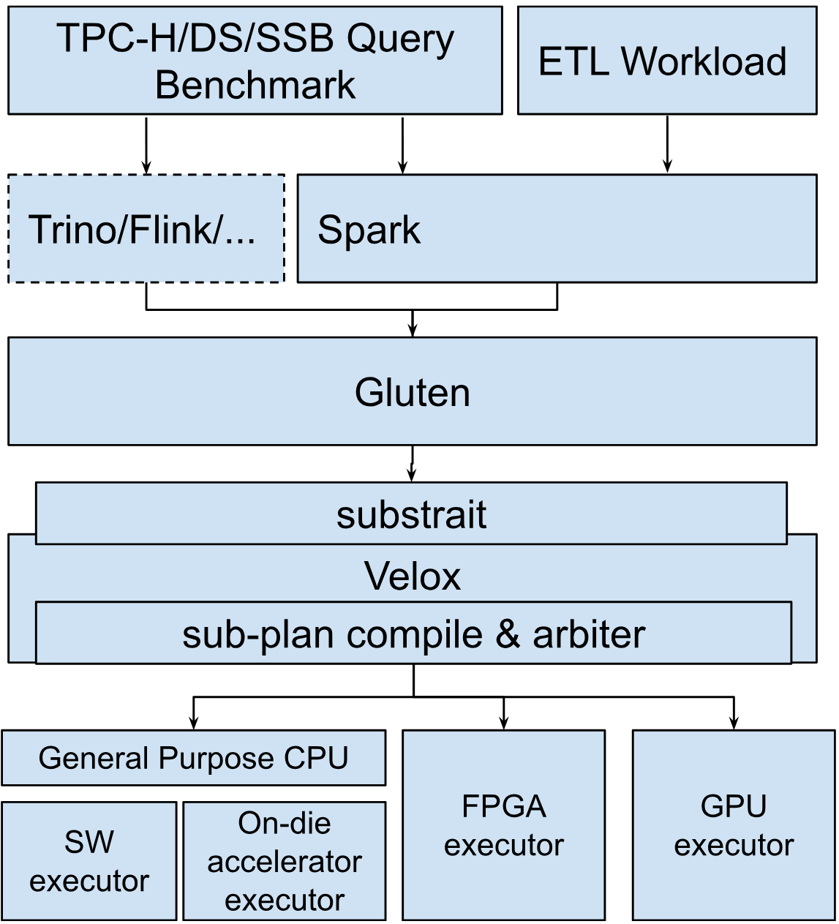
The Gluten Open-Source Software Project
We envision Gluten to:
support a variety of workloads & execution frameworks
generalize across query engines (e.g., Velox, Clickhouse, Arrow)
run on heterogeneous hardware (e.g., CPUs, GPUs, FPGAs)
Notes:
Why Gluten?
Transform Spark into a vectorized SQL engine to break through row-based data processing and JVM limitations.
Redesigned architecture allows pluggable engines (Velox, Clickhouse, Arrow)
Gluten+Velox vectorized execution performed better than Gazelle
Backends can be language agnostic (Velox uses C++, ClickHouse uses LLVM)
Opened Gluten to a larger, vibrant Velox community.
Initially started as Project Gazelle – focused on enabling Spark to exploit SIMD, using Intel’s Advanced Vector Extensions (AVX) technology.
Due limited community participation, development burden fell to Intel.
At the same time, other vectorized SQL engines emerged including Meta-led Velox.
Initiated by Intel and Kyligence, focus pivoted towards integrating Velox as the engine, with Gazelle JNI leading to Project Gluten.

Slide 5
Performance Characterization Spark vs. Spark+Gluten+Velox
2.71X
2.29X
Notes:
axis – relative query run times

Slide 6
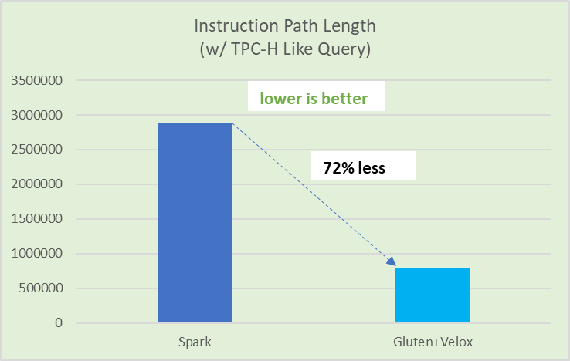
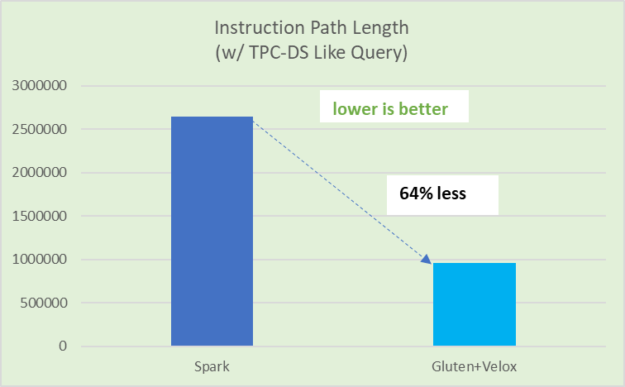
Performance Characterization Microarchitectural Analysis
Instruction Path Length with and without Gluten+Velox
Reduction in Path Length leads to huge performance savings.
fewer instructions required to produce the same output
Notes:
Axis – path length value.
Huge performance savings in path lengths.
Efficiency – takes less work to produce output. If goal is to binpack, then this is useful.
Velox – does not support AVX2.

Slide 7
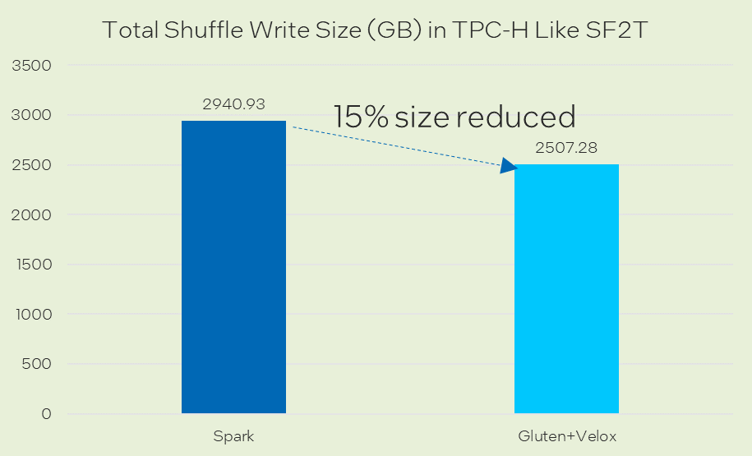
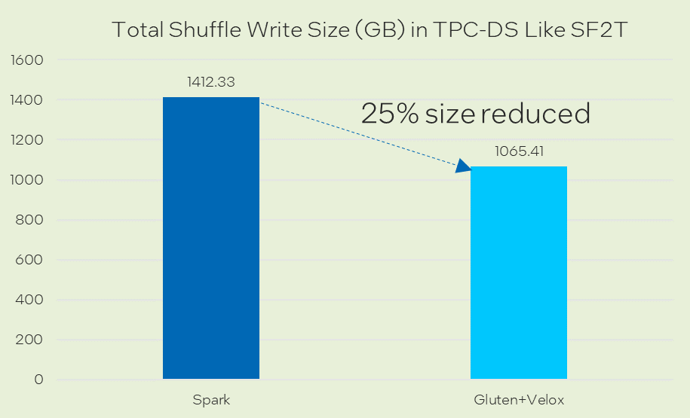
Performance Characterization Shuffle Write Reduction
Shuffle Write Sizes with and without Gluten+Velox (compression: lz4)
Columnar-based shuffle can take advantage of compression codecs (e.g., lz4, zlib, zstd).
Users can choose codec based on columnar data type to get higher compression ratio for better performance.

Slide 8


Gluten Community Participation and Adoption
Active Community Participation:
10+ companies across the globe have made contributions to the Gluten Project.
Increasing Adoption:
Strong interest from various hyperscalers and large Spark customers in trying Gluten for their offerings.
https://github.com/oap-project/gluten

Slide 9
Future Directions
Develop an Application Binary Interface (ABI)
Extend Gluten as a JNI bridge to other query engines
Target heterogeneous hardware
Offload Spark shuffle to hardware accelerators (e.g., Intel-QAT) for additional performance improvements
With Velox and Substrait, extend composability to the
underlying heterogeneous hardware, supporting the vision of
Composable Data Management Systems.
https://ceur-ws.org/Vol-3462/CDMS8.pdf
Notes:
Design of an application binary interface (ABI) -> which can be supported by native acceleration libraries.
Gluten as a JNI bridge to other query engines (Trino, Flink etc.)
Enabling gluten-based query engines to target heterogeneous hardware
Partner ecosystems extending composability.

Slide 11
BACKUP

Slide 12
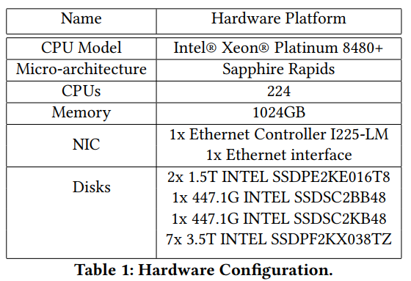
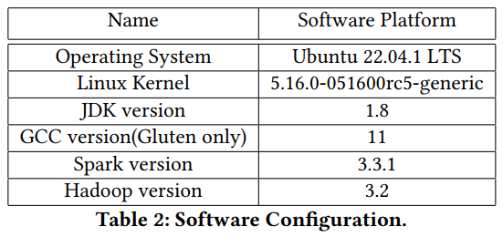
Configurations

Slide 13
Gluten working model
Worker Node
Task Thread
Executor
Executor
Task
Task
Operator 1
Operator 2
Block manager
Task
Block manager
Task
Operator 3
Driver Node
Fallback
No
Op. is native?
Yes
Worker Node
Executor
JVM SQL Engine
Executor
Gluten Plugin
Task
Task
JNI Bindings
Block manager
Task
Operators
Block manager
Task
Native Library
Expression
JIT
Clickhouse
Velox
Whole Stage Code Gen
3rd Party Engine
Apache Arrow Computer Engine
13

Slide 14
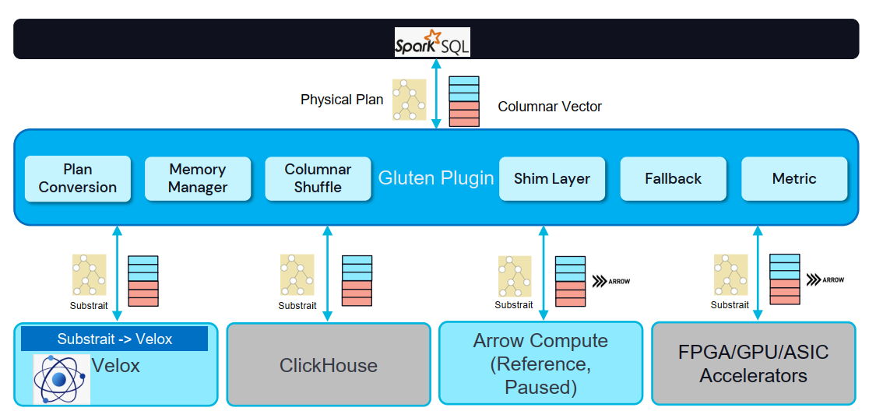
Gluten - architecture

Slide 15
Offloading Spark to a native vectorized engine
Problem: Spark workloads becoming increasingly CPU-bound.
Solution: Transform Spark into a vectorized SQL engine to break through row-based data processing and JVM limitations.
Current solutions:
Databricks (proprietary photon acceleration library)
Nvidia (spark-rapids targeted for NVidia hardware)
Intel (Gluten – open-source initiative, *targeted for heterogeneous hardware)
relies on other Apache licensed OSS projects – Velox, Arrow, Substrait.io etc.
re
Notes:
Needs more work***

