Slide 1
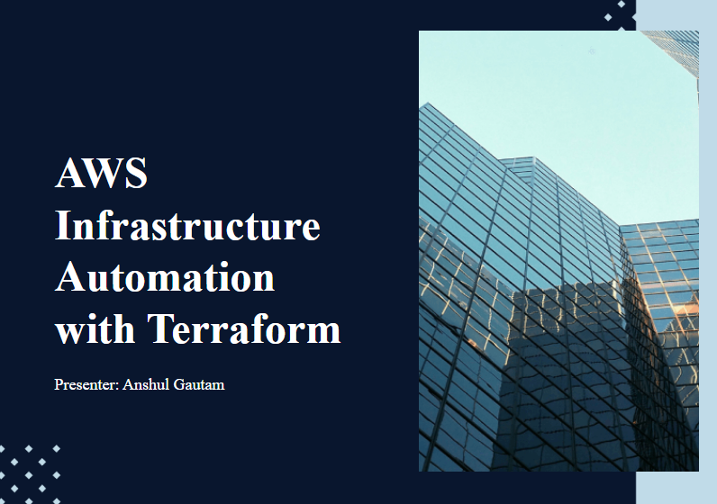

Slide 2
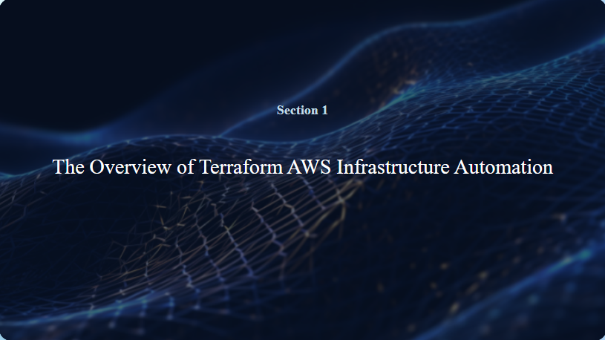

Slide 3
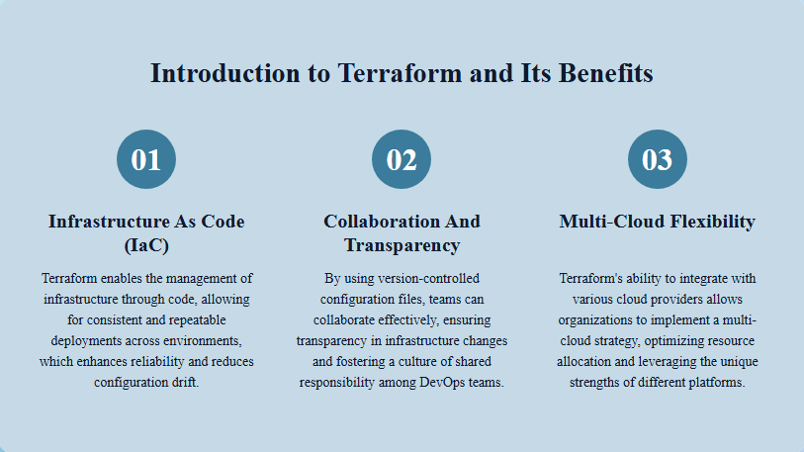
Terraform: Terraform is a tool that helps you manage infrastructure (like servers and networks) using code instead of manually configuring them. You write simple, readable configuration files to define what your infrastructure should look like. With Terraform, you can automate changes to your infrastructure across different cloud providers, making the process consistent and reducing the chances of mistakes that can happen with manual setup.

Slide 4
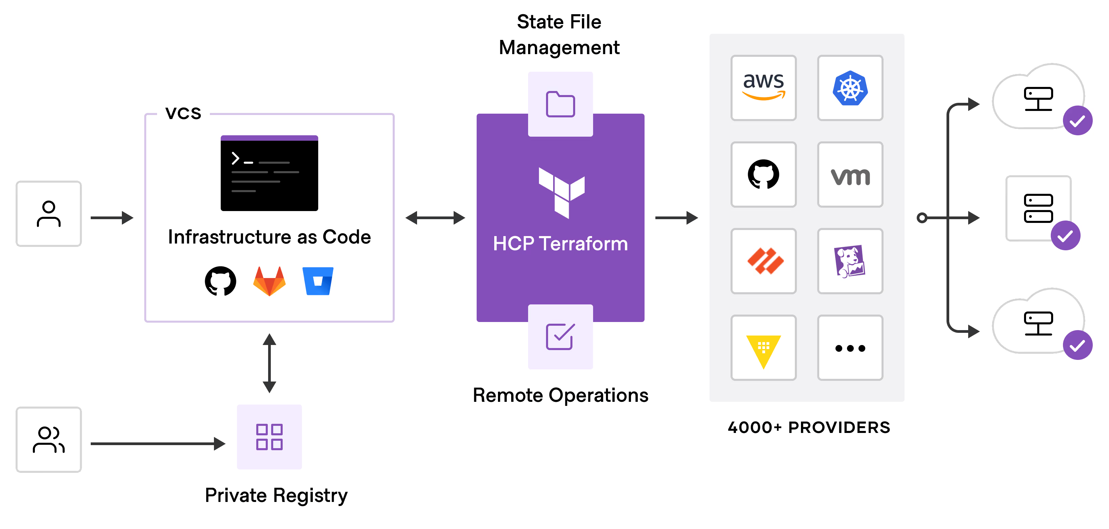
Why Use Terraform? Infrastructure as Code (IaC): Terraform allows you to define your infrastructure in code, making it easier to manage, version, and automate. Provider Agnostic: While used with AWS, Terraform can manage infrastructure across multiple providers (Azure, GCP, etc.). State Management: Terraform maintains a state file which helps in tracking the resources and their configurations.

Slide 5
What is AWS? Amazon Web Services (AWS) is a comprehensive cloud computing platform provided by Amazon. It offers a wide range of services, including infrastructure as a service (IaaS), platform as a service (PaaS), and software as a service (SaaS). AWS allows users to access computing resources, storage, databases, networking, analytics, machine learning, and other services over the internet on a pay-as-you-go basis.
Flexibility & Scalability: Scale resources on demand to handle unpredictable or high loads, reducing over provisioning and costs.
Cost-Effectiveness: Pay-as-you-go model eliminates large upfront investments, suitable for startups and enterprises.
Global Infrastructure: Low-latency access via a vast global network of data centers and availability zones.
Security & Compliance: Robust security features and certifications ensure data protection and regulatory compliance.
Innovation & Support: Frequent new services, extensive community, and partner ecosystem.
Ease of Management: User-friendly console and APIs simplify configuration, management, and monitoring.
Wide Range of Services: Over 200 services across compute, storage, databases, networking, ML, and more.

Slide 6
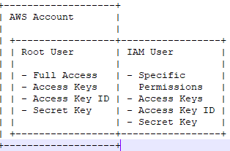
Getting started with setup
Prerequisites:
For local machine: Git, Terraform, aws cli, VS Code.
Online: Amazon Account, Github Account.
AWS Account
Root User
Access Keys: Access Key ID and Secret Access Key
IAM User
Access Keys: Access Key ID and Secret Access Key

Slide 7
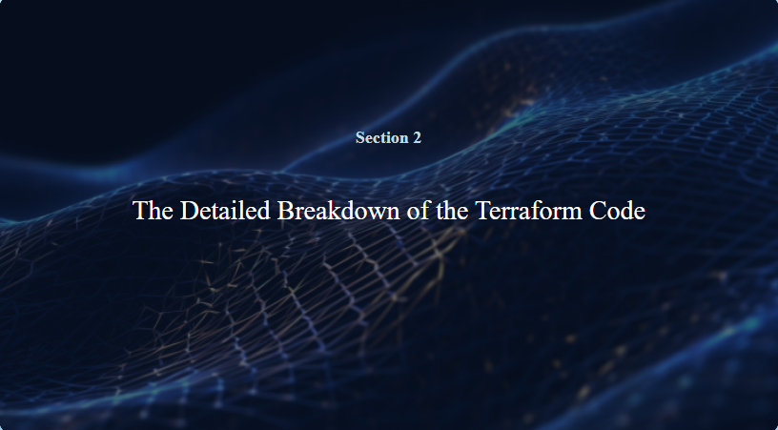

Slide 8
1. Introduction
This Terraform script sets up a basic AWS infrastructure, including:
A Virtual Private Cloud (VPC)
Public and private subnets
EC2 instances with attached EBS volumes
Security groups, IAM roles, and policies for CloudWatch and S3 access
DynamoDB table

Slide 9
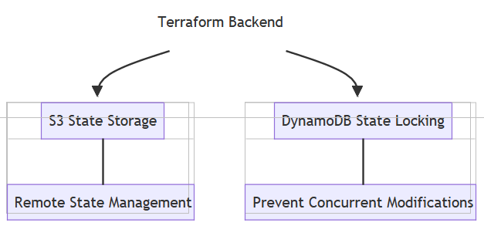
2.Backend Configuration
Implementing a robust backend configuration with AWS S3 and DynamoDB not only enhances collaboration and security but also ensures efficient state management, allowing for seamless infrastructure updates and minimizing the risk of state file corruption.
Flowchart:
- S3: Stores Terraform state files.
- DynamoDB: Manages state locking to avoid conflicts.

Slide 10
hcl
terraform { backend "s3" { bucket = "github-actions-demo-33" key = "github-actions-demo.tfstate" region = "ap-northeast-1" dynamodb_table = "terraform-state-lock" encrypt = true } }

Slide 11
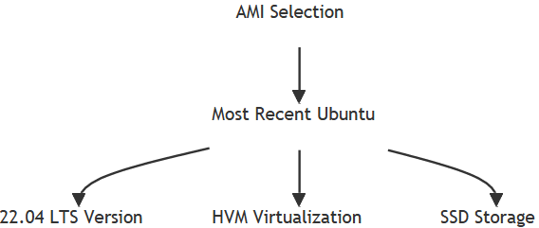
3. AMI Selection Strategy
AWS AMI Icon with Filters Applied for Ubuntu Images.
In the AWS Management Console, you can filter for AMIs by using the search feature:
Owner: "099720109477" (Canonical, the owner of the official Ubuntu AMIs)
Platform: Ubuntu
Example Ubuntu AMI: "Ubuntu Server 20.04 LTS"

Slide 12
hcl
data "aws_ami" "ubuntu" { most_recent = true filter { name = "name" values = ["ubuntu/images/hvm-ssd/ubuntu-jammy-22.04-amd64-server-*"] } filter { name = "virtualization-type" values = ["hvm"] } owners = ["099720109477"] }

Slide 13
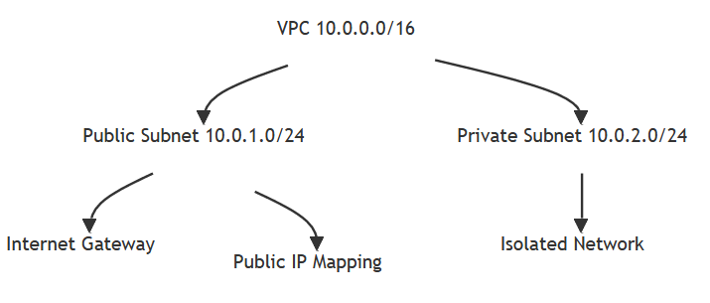
4.Networking - VPC and Subnets
VPC with Public and Private Subnets
Public Subnet: Contains resources that need direct access to the internet (e.g., load balancers).
Private Subnet: Contains resources that don’t require direct internet access (e.g., databases).
VPC: 10.0.0.0/16
Public Subnet: 10.0.1.0/24 (e.g., web servers) Private Subnet: 10.0.2.0/24 (e.g., databases)

Slide 14
Hcl VPC:
resource "aws_vpc" "ccVPC" { cidr_block = var.vpc_cidr instance_tenancy = "default" tags = { Name = "ccVPC" } }
Public and Private Subnet:
resource "aws_subnet" "public_subnet" { vpc_id = aws_vpc.ccVPC.id cidr_block = "10.0.1.0/24" availability_zone = "ap-northeast-1a" map_public_ip_on_launch = true tags = { Name = "PublicSubnet" }} resource "aws_subnet" "private_subnet" { vpc_id = aws_vpc.ccVPC.id cidr_block = "10.0.2.0/24" availability_zone = "ap-northeast-1a" tags = { Name = "PrivateSubnet" }}

Slide 15
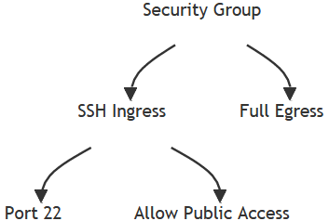
5: Security Groups
Security groups act as virtual firewalls for AWS resources, controlling inbound and outbound traffic through defined rules. They enhance security by allowing only necessary traffic, thus minimizing exposure to potential threats while ensuring that applications function correctly within the AWS environment.
In Terraform, security groups are defined using the `aws_security_group` resource, enabling automated and consistent configuration. This approach allows for easy updates and modifications, ensuring that security policies are applied uniformly across all instances, thereby improving overall infrastructure security and compliance.
| Security Group |
| Name: WebSG
| Ingress Rules: |
| - Type: SSH |
| Protocol: TCP |
| Port: 22 |
| Source: 203.0.113.0/24 (Your Public IP) |

Slide 16
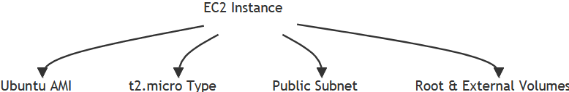
6: EC2 Instance
Instance Configuration Essentials: Properly defining the EC2 instance parameters in Terraform, such as AMI, instance type, and security groups, is crucial for ensuring optimal performance and security tailored to specific application needs.
EBS Volume Integration: Configuring an external EBS volume alongside the EC2 instance enhances storage capabilities, allowing for scalable data management and improved performance for applications requiring additional disk space.
EC2 instance launched in a public subnet.
- AMI: Ubuntu.
- Instance Type: t2.micro.
- Attached EBS volume: External disk (/dev/xvdh).

Slide 17
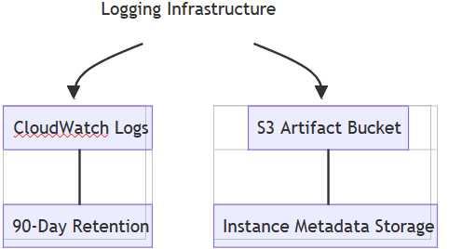
7. Logging and Artifact Storage
Enhanced Monitoring Capabilities: Implementing AWS CloudWatch for logging and Amazon S3 for artifact storage provides a comprehensive solution for tracking infrastructure changes and maintaining a historical record, thereby facilitating effective monitoring, compliance, and operational analysis.
CloudWatch Log Group for storing audit trails. Tracks audit logs such as instance creation events.
S3 Bucket for storing artifact history. Stores artifact history (JSON files) for each resource.

Slide 18
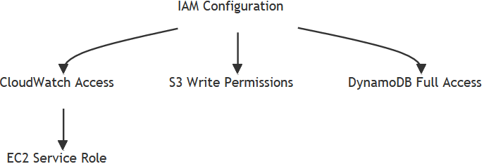
8. IAM Roles and Policies
Role-Based Access Control: IAM roles facilitate secure, temporary access to AWS resources, allowing services like EC2 to assume roles with defined permissions, thus enhancing security by minimizing the risk of credential exposure.
CloudWatch S3 Access Role (cloudwatch_s3_role):
Allows EC2 instances to assume this role
Creating CloudWatch log groups .Putting log events in the /aws/ec2/audit_trail log group
Writing objects to the specific S3 bucket created for artifact history
DynamoDB Access Role (dynamo_role):
Provides full access to DynamoDB resources, including: All DynamoDB actions (create, read, update, delete, etc.)

Slide 19
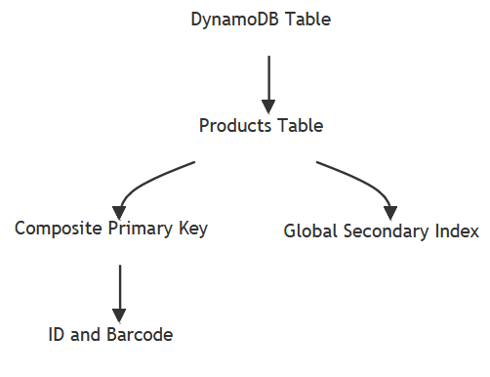
9. DynamoDB Table Setup
Used for storing structured data with high availability and scalability.
Attributes include id (hash key), barcode (range key), name, and description.
Supports a Global Secondary Index for optimized queries.
Pay-per-request billing model ensures cost efficiency.
Configured as part of backend state locking for Terraform.

Slide 20
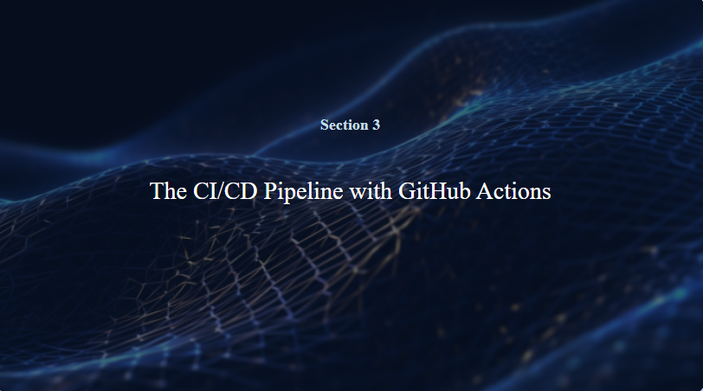

Slide 21
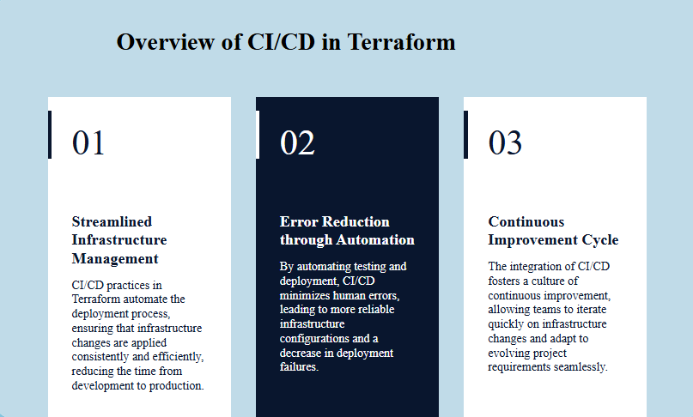
10. GitHub Actions: Automate deployment of Terraform configurations.

Slide 22
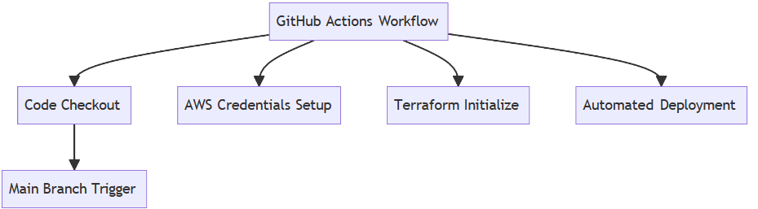
Workflow Example:
Automates Terraform deployment using GitHub Actions workflow.
Includes steps for code checkout, AWS credential configuration, and Terraform commands.
terraform init initializes backend and modules.
terraform plan previews changes and ensures accurate deployment.
terraform apply provisions resources automatically.
Improves collaboration, reduces manual errors, and supports continuous delivery.

Slide 23


