Slide 1


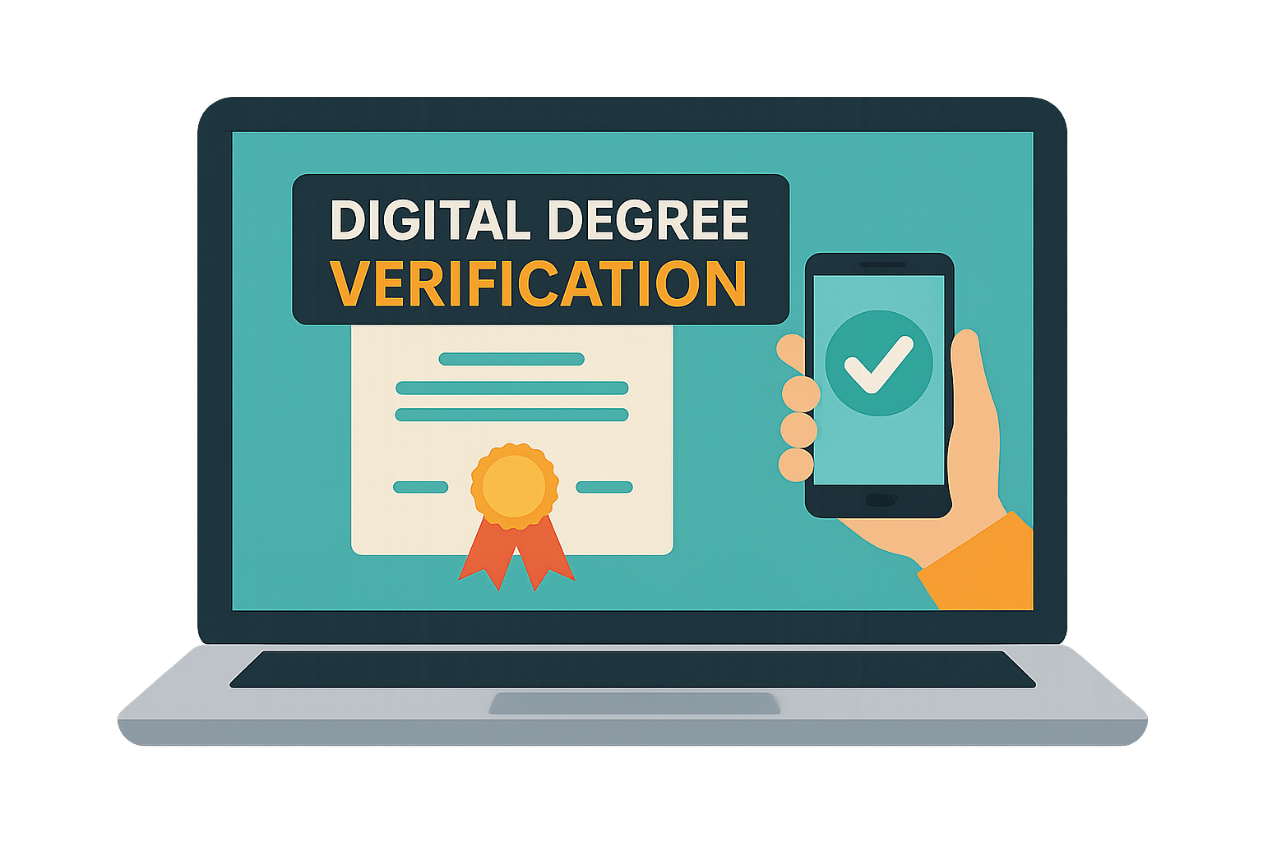






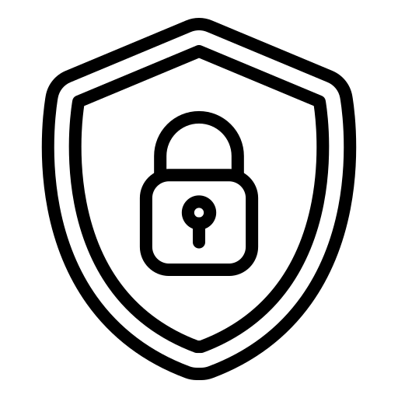




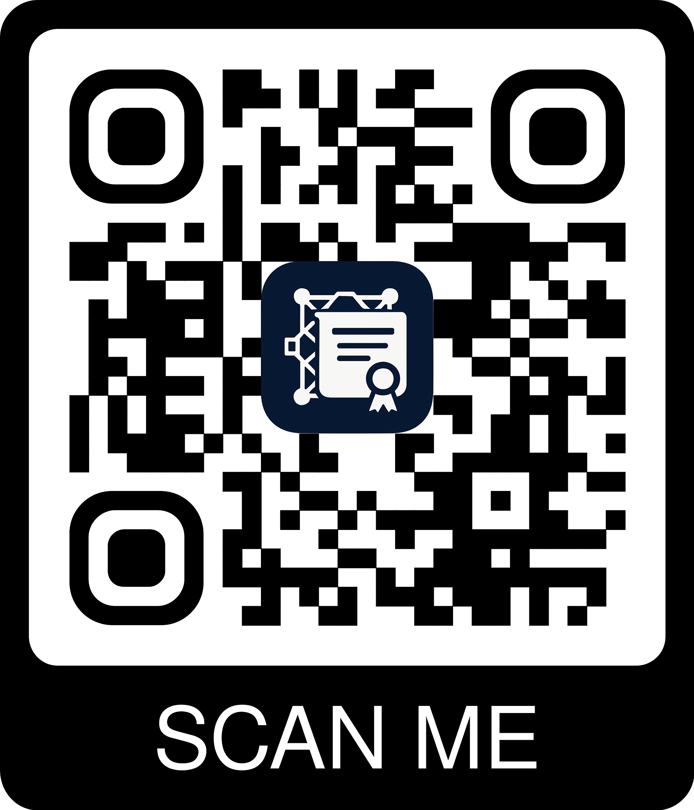
School of Computing
Student: Christopher Dobey & Padraig Mann BSc. In Computer Science Supervisor: Dr. Sahraoui Dhelim
Secure Credential Verification Using Blockchain
Issue Credentials
Request Access
Verify Documents
Issuers can securely issue digital credentials that are tamper-proof and easily verifiable on the blockchain, eliminating the risk of fraud.
Graduates securely access and share their digital credentials with potential verifiers on our platform, maintaining full control over their credentials.
Verifiers can instantly verify credentials with our secure platform, ensuring that candidates' credentials are legitimate and trustworthy.
Key Benefits
Secure & Tamper-Proof: Credentials are securely stored on the blockchain, making them impossible to forge or tamper with, ensuring lifelong validity.
Instant Verification: Verifiers can verify credentials in seconds, not days or weeks, streamlining the hiring process and reducing administrative overhead.
User Control: Graduates maintain full control over who can access their credentials, with detailed permissions and revocation capabilities.
Trusted Network: Our platform connects legitimate educational institutions, graduates, and verifiers in a secure, transparent ecosystem.
Issuer
Blockchain
Graduate
Technology Stack
Frontend: | React, Vite, Vitest, MantineUI
Backend: | ExpressJS, NodeJS, Prisma
Blockchain: | Hyperledger Fabric, AWS
Database: | PostgreSQL, Supabase
We're Live! 🚀
See how Legitify simplifies digital verification!
Scan to check it out now!
www.legitifyapp.com

