Slide 1
C++ Program & Obtaining Substrings
C++ Program implements a number guessing game, executables stored in “Executables” folder
To get the longest substrings between files, we began with an approach that would analyze two files for substrings
We used the dynamic programming (DP) approach detailed here:
https://en.wikipedia.org/wiki/Longest_common_substring_problem
We wrote the program first in Python: lcs.py
Python was too slow, so we converted it to C++: lcs.cpp
We then tried adapting the DP approach to work with 3 files
However, this does not work because with an average file size of 17,000 bytes, the 3D DP array would be 17000x17000x17000 bytes large, or 4913gb

Slide 2
Optimizations and Solutions
Issue: Too much data required by DP array (4,913gb)
SOLUTION 1 - Working:
Convert two file solution to used optimized version of DP algorithm where only most recent row is stored: lcs_opt1.cpp
However, not able to get this working for more than two files
SOLUTION 2 - Not working:
Convert program to use generalized suffix trees, although we are still having trouble with this: lcs_suffix.cpp
http://www.geeksforgeeks.org/suffix-tree-application-5-longest-common-substring-2/

Slide 3
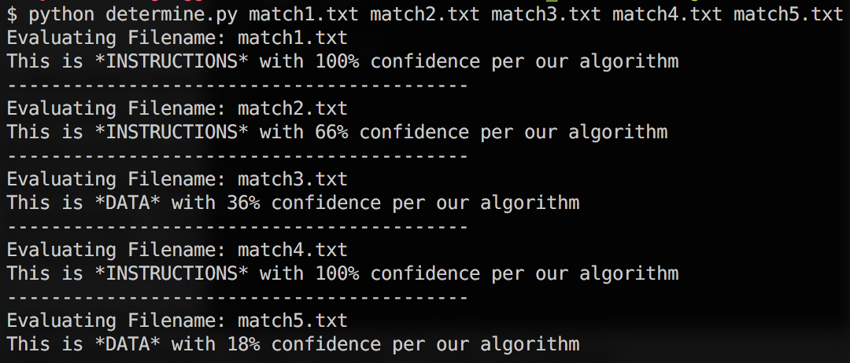
Disassembly Problem
Approach: use multiple heuristics to score and categorize a hex string as instructions or data (Python)
Number of common opcodes present
Amount of padding present
Unlikely opcode combinations
Positive score indicates Instructions
Negative score indicates Data
Gives percent (%) confidence of decision

